Slide 1

Basic Information Governance Training

Slide 2
Learning Objectives
By the end of this session you will understand:
The principles and terminology of information governance (IG).
Basic data security / cyber security terminology.
The importance of data security to patient/service user care.
That law and national guidance requires personal information to be protected.
And be able to:
Explain your responsibilities when using personal information.
Identify some of the most common data security risks and their impact.
Identify near misses and incidents and know what to report.
Distinguish between good and poor practice when using personal information.
Apply good practice in the workplace.

Slide 3
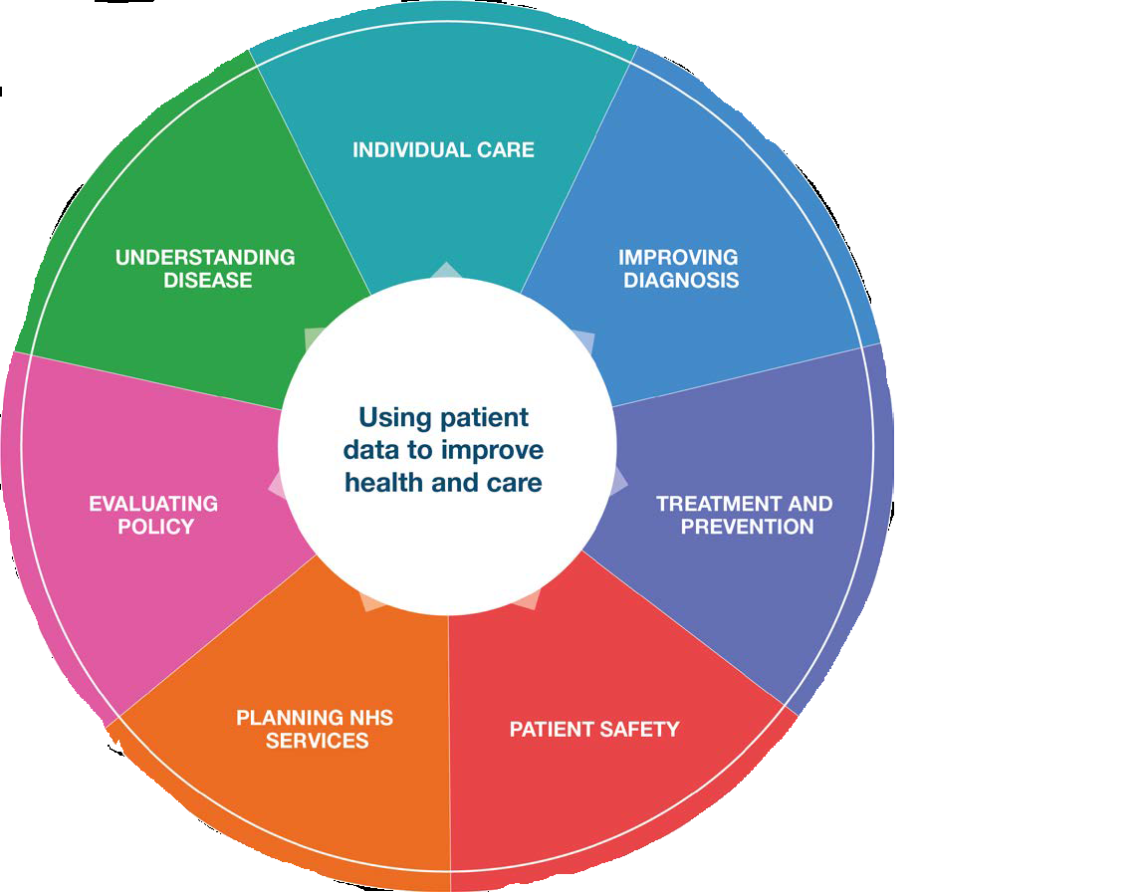
Why is IG important in Health and Care?
Data Security has always been important.
More complex now technology is so central to delivery of health and care.
Use technology so does not pose unacceptable risk to organisation or patients / service users.
We all have a duty to protect people’s information in a safe and secure manner.

Slide 4
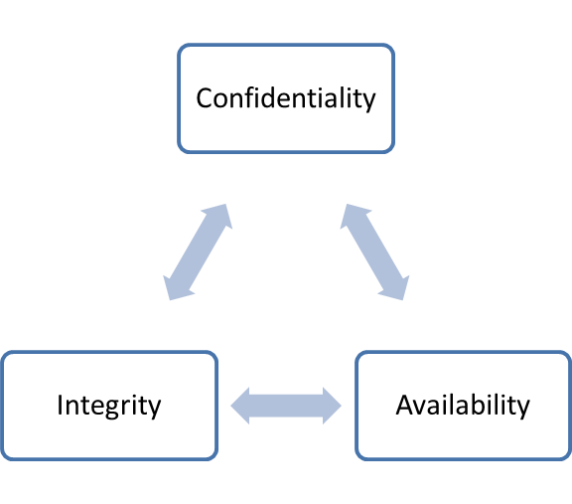
Comprehensive good practice
Confidentiality is ensuring information given in confidence is only accessible to those with a proven need to see it.
Integrity is about information stored in a database being consistent and un-modified.
Availability is about information being there when it’s needed to support care.

Slide 5
Scenario
Jane falls badly and hurts her leg.
The paramedics ask Jane for her details and whether she is allergic to any medications but Jane isn’t sure.
The paramedics attempt to access Jane’s Summary Care Record, [Confidentiality – the Paramedics have a proven need to see the record.] But there is a telephone network outage preventing access.
The paramedics administer morphine, but Jane is allergic – a fact held on her record – and goes into anaphylactic shock. [Integrity – the record is correct and unmodified but was not available.]
In hospital she is kept in intensive care.
In this case, the lack of information Availability has had a direct impact on patient care.

Slide 6
Types of information
In health and care settings, you might see:
Personal information: Information about someone is 'personal' when it identifies an individual. It may be about living or deceased people.
Sensitive or special category information: patients and service users may consider particular types of information to be highly sensitive, for example, information relating to their mental or sexual health.
Confidential information: is disclosed in confidence to staff – patients and service users expect that information to be treated confidentially.
Pseudonymised information: In which an individual’s identity is disguised by using a unique identifier (that is, a pseudonym). This does not reveal their ‘real world’ identity, but allows the linking of different data sets for the individual concerned.
Anonymised information. Anonymisation requires the removal of name, address, full post code and any other detail or combination of details that might support identification, either by itself or when used with other available information. Anonymised information does not identify a person, so it cannot be personal or confidential.

Slide 7
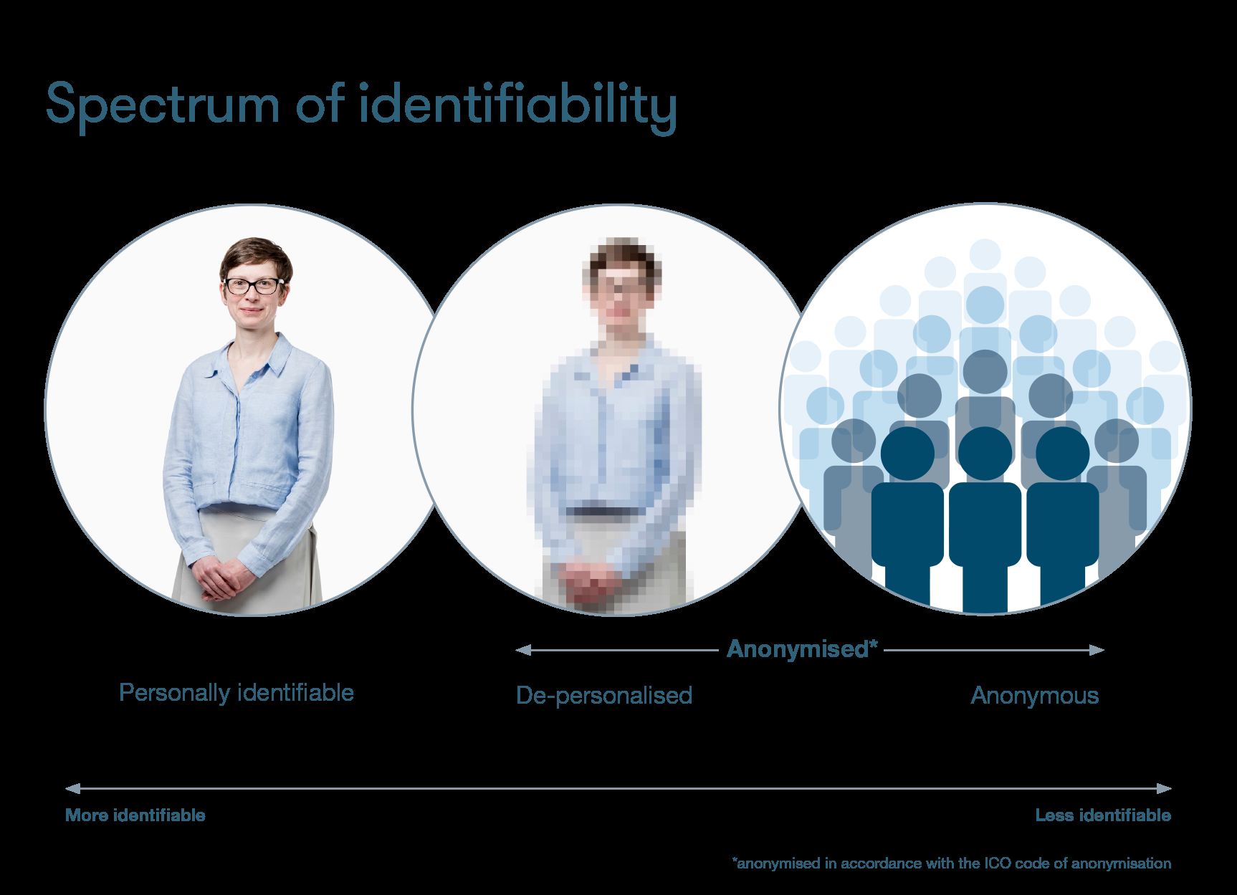

Slide 8
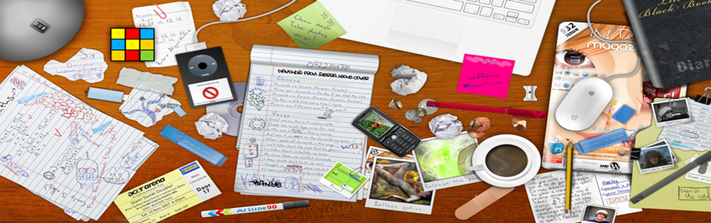
The Value of Information
Health and care information is valuable.
Poor security can cause personal, social and reputational damage.
Some of the common ways that information is lost:
Losing information, including paper records, over the phone, via faxes, loss of computers or mobiles phones
Theft of information, such as by clicking on links to fake websites (phishing)
Insecure storage and disposal of information leading to loss or theft

Slide 9
Lawful reasons for processing
Article 6(1)(e) “…processing of personal data that is necessary for the performance of a task carried out in the public interest…”
(a)the administration of justice,
(b)the exercise of a function of either House of Parliament,
(c)the exercise of a function conferred on a person by an enactment or rule of law*
(d)the exercise of a function of the Crown, a Minister of the Crown or a government department, or
(e)an activity that supports or promotes democratic engagement
*The Health and Social Care Act (2015)

Slide 10
Research
Personal data
Non-public authorities – legitimate interest
Public authorities – support task in the public interest
Explicit consent – if other basis not available
Sensitive personal data (‘special category’ data)
‘Processing is necessary for archiving purposes in the public interest, or scientific and historical research purposes or statistical purposes’ subject to safeguards
Explicit consent – if other basis not available

Slide 11
Common law duty of confidentiality
This applies to information where another lawful basis has not been established. Information that individuals disclose in confidence should not be used or shared further without a lawful reason; the reasons are:
consent of the individual
Where there is a legal reason to disclose information
Where there is a public interest justification
A decision to disclose without consent should be made by senior staff.

Slide 12
Data Protection Act Principles
The GDPR sets out seven key principles:
Lawfulness, fairness and transparency
Purpose limitation
Data minimisation
Accuracy
Storage limitation
Integrity and confidentiality (security)
Accountability
These principles should lie at the heart of your approach to processing personal data.

Slide 13
Using the Caldicott Principles to inform your approach…
Principle 1: Do you have a justified purpose for using confidential information?
Principle 2: Is it absolutely necessary to do so?
Principle 3: Are you using the minimum information required?
Principle 4: Are you allowing access to this information on a strict need-to-know basis only?
Principle 5: Do you understand your responsibility and duty to the subject with regards to keeping their information secure and confidential?
Principle 6: Do you understand the law and are you complying with the law before handling the confidential information?
Principle 7: Do you understand that the duty to share information can be as important as the duty to protect confidentiality?

Slide 14

Confidentiality – Good practice
We all have a legal duty to respect the privacy and to use personal information appropriately.
The main aspects of confidentiality good practice are:
Informing people.
Sharing information for care.
Sharing information for non-care.

Slide 15
Confidentiality - Informing People
You should inform patients and service users that you are accessing and using their information.
Explain
Clearly explain to people how you will use their personal information and point them to additional information about this – for example, on your organisation’s website, in a leaflet or on a poster.
Informed choice
Tell them whether that choice (where applicable) will affect the services offered to them.
Meet expectations
Only use personal information in ways that people would reasonably expect.
You must not use consent as the legal basis for using someone’s information –you have previously informed the individual what you will do with their information.

Slide 16
Your Access to network and data is monitored
The Trust can verify your activities by checking the network/IT systems and consent is not necessary. This is to ensure that any concern about access which is not appropriate is readily investigated.
Many IT systems, RiO for example, will be monitored and access activity is recorded for security purposes. Therefore an audit trail exists showing who accessed a particular service user’s records.
Patient Users have the right to ask for this audit trail to know who accessed their records.
If you are a system administrator you are accountable for that system and must not use your privileges to access information without a valid business reason.

Slide 17
Confidentiality - Sharing information for care
Sharing information with the right people can be just as important as not disclosing to the wrong person.
Note the duty to share for care where the right conditions are met.
Check
Check that the individual understands what information will be shared and has no concerns.
Best practices
Ensure that the data protection, record keeping and security best practices covered later in this presentation are met.
Respect objections
Normally, if the individual objects to any proposed information sharing, you must respect their objection even if it undermines or prevents care provision –this does not apply if third parties would be put at risk. Your Caldicott Guardian or Information Governance Manager will be able to advise on what to do in these circumstances.

Slide 18
Confidentiality - Sharing information for non-care
In many cases –explain and acquire permission
If there is a risk of immediate harm:
Share first.
Then inform the IG manager as soon as possible.
Ask
Find out who is responsible for managing information sharing requests in your organisation.
Advice
Discuss the request with this person.
Action
Provide the information only when authorised to do so.

Slide 19

Data Protection
Rights under the Act include:
To be told what personal information is being used for.
To see and have a copy of your personal information.
To have objections to processing considered in some circumstances.
Other rights exist and the following ones may be relevant, depending on your organisation’s activities:
To prevent processing for direct marketing.
Privacy must be considered at the beginning of any new project and a Data Protection Impact Assessment needs to be carried out (there is a template on the intranet).

Slide 20
Rights of Individuals
Individuals have rights in relation to their information including:
Make subject access requests.
Have inaccuracies corrected.
Have information erased (where it has not been relied upon to provide health or care).
Object to direct marketing.
Restrict the processing of their information.
Patient / service users might be able to view their record online – online access should not reveal information that they do not already know relating to 3rd parties.

Slide 21
Agreeing to participate and the ethos of co-production
Consent for treatment
Lawful basis for processing
Transparency or
Patient engagement

Slide 22
Data Protection - Good Practice 1
Follow Trust procedures and policies (All Information Governance policies are on Trustnet under Information Governance tab)
No surprises - handle people’s information as you would expect others to handle your personal information.
Be open, honest and clear about:
Why you need personal information.
What you intend to do with it.
Who you may share it with.
How the individual can obtain a copy.

Slide 23
Data Protection - Good Practice 2
Remember - patients and service users have a right to see information recorded about them. So make sure you:
Record clearly so that others can rely on your entries.
Be accurate and keep information up-to-date.
Call IT Helpdesk to arrange disposal of computer equipment used to process personal information.

Slide 24
The Freedom of Information Act 2000
The Act allows anyone from anywhere in the world to make a written request for information held by a public body.
The Act only applies to information that already exists in a recorded form.

Slide 25
Handling FOI requests
FOI requests should be handled by trained staff.
Normally, you should not try to handle a request yourself.
If you are not sure whether a request is ‘business as usual’ (BAU) or FOI, ask.
Send any FOI requests immediately to elft.foi@nhs.net
Comply with the 20 working day turnaround –if you are asked to supply data for and FOI request, you only have a few days to respond.

Slide 26
Can you recognise a valid FOI request?
Identify which ones you think are valid FOI requests and which you think are not valid FOI requests |  | Valid | Not valid
A. | Please send me a copy of my social care record
B. | How many GPs work in the practice?
C. | When’s my daughter’s next appointment?
D. | How much did the Trust spend on rail travel last year?
E. | How many staff have passed their IG training?
F. | What services are being considered for closure in the next year?

Slide 27

Record keeping - Good practice
Poor quality information presents a risk to patients, service users, staff members and the organisation. It is vital that records are:
Accurate and up to date.
Know ‘what and why’ needs recording in the correct system/record.
Check the information.
Report errors.
Recorded and complete.
At the time events occur.
Include NHS number.
Don't create duplicate records.
Quick and easy to locate.
Save records in a secure place that is easy to find.
Seek help if you are uncertain.

Slide 28
Scenario
Bill is seeking treatment for depression and has not told his work colleagues.
Due to a data entry error, the clinic contacts him at work rather than on his personal number.
His colleague answers, and is mistaken for Bill.
The colleague discovers Bill’s condition and proceeds to tell other colleagues.
Embarrassed, Bill resigns and makes a formal complaint to the clinic.
This scenario shows the importance of:
Entering information accurately into the correct systems.
Verifying identity before disclosing confidential information.

Slide 29
Summary
We all have a responsibility to use information lawfully.
Sharing information can improve speed and quality of service.
Make sure it is shared in a secure way.
Gain consent if necessary.
Allow individuals to check the accuracy of information held about them.
If you are unsure - seek advice from Information Governance: elft.information.governance@nhs.net.
020 7655 4018.

Slide 30
Avoiding threats to data security
This section looks in more detail at potential threats to the security of information in the workplace.
You will learn about:
Social engineering.
Email phishing and malware.
Good practice for protecting information.

Slide 31
Social engineering
Those who want to steal data may use tricks to manipulate people to give access to valuable information. This is called social engineering.
On the phone: A social engineer might call and pretend to be a fellow employee or a trusted outside authority (such as law enforcement or an auditor).
In the office: "Can you hold the door for me? I don't have my key/access card on me." How often have you heard that in your building? While the person asking may not seem suspicious, this is a very common tactic used by social engineers.
Online: Social networking sites have opened a whole new door for social engineering scams. One of the latest involves the criminal posing as a Facebook "friend”. But you can never be certain the person you are talking to on Facebook is actually the real person. Criminals are stealing passwords, hacking accounts and posing as friends for financial gain.

Slide 32
The fake ICT Department
Criminals have set up call centres that make calls to health organisations or social care providers.
They ask for your username, password, email address or other details about where you work.
They may ask you to click on a malicious web or email link.
The ICT department or provider will not need to ask these types of questions.

Slide 33
Social Engineering - what you can do
Always be vigilant:
When using the phone,
Receiving unsolicited emails,
Using social media, or
Walking around your place of work.
If it’s safe to do so:
Challenge suspicious behaviour, and
Request proof of identification.
Stay Vigilant

Slide 34

Email phishing and malware
Email though efficient has risks:
Criminals use email attachments and links to trick people into providing information.
Email attachments may be executable files that contain malicious software (malware).
This is known as phishing and the emails aim to force you to make a mistake.
Never give your login details to anyone.
If you receive an email requesting sensitive information that looks as though its from a colleague - double check by phoning the colleague.
Do not open links or attachments in unsolicited emails.
Report suspicious emails to: it.servicedesk@elft.nhs.uk.
020 7655 4004.

Slide 35
Phishing - what to do
Be vigilant:
Do not install any new software unless authorised.
Think - Is someone trying to extract or extort information?
Discuss issues with your manager and ICT department/provider.
If you do identify a phishing email, take these steps:
Do not reply.
Select the email, right-click it and mark it as junk.
Block suspicious email domains.
Inform IT department: it.servicedesk@elft.nhs.uk. 020 7655 4004.
Stay Vigilant

Slide 36
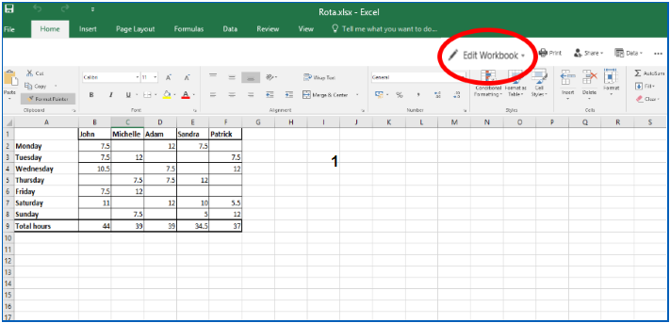
Macros
Macros are a series of actions that a program such as Microsoft Excel may perform to work out some formulas.
Always be vigilant - do you trust the source of the document?

Slide 37
Malware
Malicious software (malware) can:
Be on your computer and evade detection.
Make your computer run slowly or perform in unusual ways.
ICT will:
Ensure that you have up-to-date antivirus software installed.
Assist if you suspect your computer is not performing as it normally does.

Slide 38
Good Practice - Locking Devices
Lock your device as soon as you stop using it.
Set passcodes on mobile phones, laptops, PCs and tablets.
If you see a colleague's device open and unlocked, lock it for them and gently remind them to do so in future.
On corporate mobile devices - activate the lock function.
Tip: select the Windows Key + L on your keyboard to quickly lock your laptop or PC.

Slide 39
Good practice - Untrusted websites
Be vigilant when you visit a website that is declared "untrusted".
If a web browser states that you are about to enter an untrusted site, be very careful – it could be a fake phishing website that has been made to look genuine.
A browser may display a red padlock or a warning message stating “Your connection is not private”.

Slide 40

Good practice - Mobile devices
Digital Dos
Read, understand and comply with Trust procedures.
Seek advice from your line manager if any aspects of the procedures are unclear.
Store your digital assets securely when not in use.
Update antivirus software if your digital asset prompts you to do so.
Keep regular backups of the data stored on digital assets – store appropriately, according to Trust procedures.
Report any lost or stolen digital asset to the police immediately.
Report incidents on Datix.
Ensure that digital assets and passes are handed back if you are leaving the organisation.

Slide 41
Good practice - Mobile devices
Digital Don’ts
Don’t use your own device for business purposes unless authorised.
Don’t use work-provided digital assets for personal use unless authorised.
Don’t connect your work-provided digital asset to unknown or untrusted networks – for example, public Wi-Fi hotspots.
Don’t allow unauthorised personnel, friends or relatives to use your work-provided digital assets.
Don’t attach unauthorised equipment of any kind to your work-provided digital asset, computer or network.
Don’t remove or copy personal information, including digital information (such as by email, on a USB stick), off site without authorisation.
Don’t leave digital assets where a thief can easily steal.
Don’t install unauthorised software or download software or data from the internet.
Don’t disable the antivirus protection software.

Slide 42
Good practice - Disposal of confidential information
Much of the data that health and care organisations create and use is classed as Official in the eyes of the government.
OFFICIAL - Government Definition: The majority of information that is created or processed by the public sector: This includes routine business operations and services, some of which could have damaging consequences if lost, stolen or published in the media.
Follow your Trust processes for secure disposal.
Take special care to securely dispose of:
Paper records that contain confidential information
Desktop computers
Servers
Multifunction devices (e.g. printers/photocopiers)
Laptops, tablet computers and electronic notebooks
Mobile telephones
Digital recorders
Cameras
USB devices
DVDs, CDs and other portable devices and removable media.

Slide 43
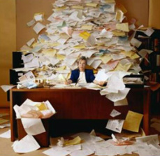
Good practice - Clear desks
Do not leave information in unsecure locations.
Having a clear desk means reduced potential for leaving sensitive information unattended, reducing the risk of a breach.

Slide 44
Breaches and incidents
Covers two categories:
A breach of one of the principles of the Data Protection Act 2018 and/or confidentiality law.
Technology-related incidents.
A breach can be caused by a security incident (for example, disclosure of patient details using social media). However, some incidents (for example, defacing a website) may not involve a breach of information.

Slide 45
Different types of incident
Breaches | Cyber incidents
Identifiable data lost in transit | Phishing email
Lost or stolen hardware | Denial of service attack
Lost or stolen paperwork | Social media disclosure
Data disclosed in error | Website defacement
Data uploaded to website in error | Malicious damage to systems
Non-secure disposal – hardware | Cyber bullying
Non-secure disposal – paperwork
Technical security failing
Corruption or inability to recover data
Unauthorised access or disclosure

Slide 46
Most reported breaches in health and care
Common breaches and incidents include:
Letters sent to wrong place because the designated template was not used
Faxes that are sent to the wrong number or misplaced.
Lost or stolen paperwork.
Discuss learning from incidents at your team meeting.

Slide 47
Incidents using technology
Website defacement This term is used to describe an attack on a website that changes the content of the site or a webpage. It may also involve creating a website with the intention of misleading users into thinking that it has been created by a different person or organisation.
Social media disclosure This term is used to describe the disclosure of confidential or sensitive information by an organisation’s employees through a social media site.
Denial of service attack This term is used to describe an attempt to make a machine or network resource unavailable to its intended users.
Malicious damage to systems This term is used to describe what happens when a person intentionally sets out to corrupt or delete electronic files, information or software programs.

Slide 48
Consequences of breaches and incidents
How can an important decision about a person’s care be made if:
Their record was no longer available, was wrong or incomplete; or
Someone had tampered with it.
By now you should understand why security measures are in place.
We all need to help ensure that information is protected in the best way possible.

Slide 49
Postal breach
The situation - Miss Broom is waiting to receive information from her social worker. She opens her post one morning and finds that, as well as her own letter, the envelope contains two further letters addressed to other people. Miss Broom contacts the organisation and tells an administrative officer about the additional letters. She receives an apology and the promise of a call back.
The organisation’s reaction - The organisation's information governance lead telephones Miss Broom to apologise for the error and asks her to keep the letters safe whilst arrangements are made for someone to collect them.
Consequences - The organisation wrote a formal apology to Miss Broom and to the two individuals that she received letters about. Both individuals were deeply concerned that Miss Broom (who they did not know) now knew important information about them. One of them wrote to their local paper about the breach. Senior staff in the local authority spent the next two weeks responding to media queries about the number of breaches the organisation had experienced. The other individual, who had suffered from a similar breach the previous year, instructed his solicitor to bring legal proceedings against the local authority.

Slide 50
Postal checklist
Address personal information to a named person.
Consider using tracked or recorded delivery for personal information.
Case notes should only be sent in robust packaging.

Slide 51
Email breach
The situation - Mr. Foster has recently been diagnosed with depression and has joined a support group to help him through his care. The organisation emails information to support group members each month. Recently, they have started to receive emails and phone calls from individuals who are upset about the disclosure of their names and email addresses to more than 500 people.
The organisation’s reaction - The organisation undertakes an investigation and finds that a new member of staff had sent out the email. They had mistakenly put the list of all the support group members’ email addresses in the ‘CC’ field – rather than the ‘BCC’ field – of all the individual emails.
Consequences - Everyone who received the email could identify who was a member of the depression support group. The investigation also finds that all existing staff members involved in sending out emails knew what to do, but had not supervised the new member of staff.

Slide 52
Email checklist
Before emailing any external parties:
Check whether it is acceptable to send personal information.
Confirm the accuracy of the email addresses.
Check that everyone on the copy list has a genuine ‘need to know’.
Use the minimum identifiable information (e.g. NHS number).
Check encryption requirements.
Where email needs to be sent to an unsecure recipient:
Check they understand and accept the risks, or
If you can encrypt the email.

Slide 53
Phone breach
The situation - Joe, a practice manager, receives a call from a local hospital requesting information about Mrs Smith, one of the practice patients. He knows she has been referred to that hospital for cancer investigation so he gives the information to the caller.
The result - The next morning, Mrs Smith phones the practice and tells Joe that her brother-in-law has information about her health that he can only have obtained from the practice. At that point, Joe realises he had no proof that the previous day's call was from the local hospital.

Slide 54
Phone checklist
Where possible:
Confirm the enquirer’s name, job title and organisation.
Confirm the reason is appropriate.
Take a contact phone number, e.g. main switchboard number.
Check whether the information can be provided - if in doubt, tell the enquirer you will call them back.
Provide the information only to the enquirer.
Record your name and details about disclosure, along with the recipient’s details.

Slide 55

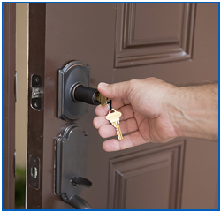

Data security risks 1
Last week, someone in a high visibility vest visited a Social Care office as well as a GP practice. He followed a member of staff into the building and told the receptionist that he needed everyone's details for a 'software update'. He then sold these details to other criminals. Let’s find out what else he found.

Slide 56
Data security risks 2
Doors: Nearly every door was open; even “restricted access” doors had been propped open to allow for a delivery.
Visitors: The receptionist was happy to direct him to the server room…he wasn’t even asked to sign in or show a visitor’s badge.
Desks: There was so much information in unoccupied office areas. He randomly dispersed memory sticks on the desks; hopefully someone will plug one into their machine and it can start installing malware.
Other areas: The server room door was unlocked, meaning he could disrupt the server causing connectivity problems.
As there is so little physical security, he can potentially come and go as he pleases…perhaps next week.

Slide 57
Module summary
Having completed this session, you should understand:
The principles and terminology of information governance (IG).
Basic data security / cyber security terminology.
The importance of data security to patient/service user care.
That law and national guidance requires personal information to be protected.
And be able to:
Explain your responsibilities when using personal information.
Identify some of the most common data security risks and their impact.
Identify near misses and incidents and know what to report.
Distinguish between good and poor practice when using personal information.
Apply good practice in the workplace.
IG covers the ‘can I?’ question…

Slide 58
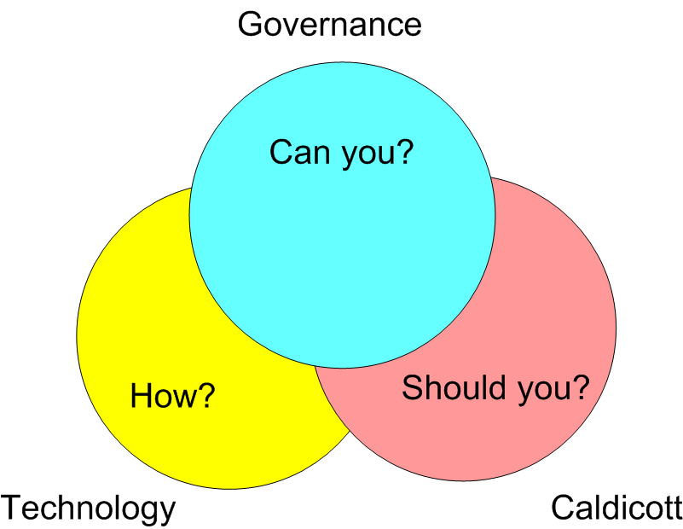

Slide 59
Further information
Chris Kitchener, Data Protection Officer 020 7655 4110
Dr Paul Gilluley, Caldicott Guardian
020 7655 2177
Elft.foi@nhs.net
Elft.information.governance@nhs.net
IT helpdesk: it.servicedesk@elft.nhs.uk.
020 7655 4004

