Slide 1
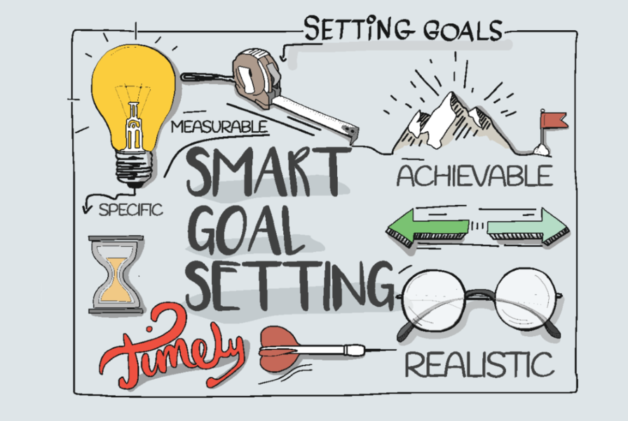
Developing Aim Statements for QI Projects
Dr Liz Dawson, Primary Care Medical Director recently reflected that, “We often set off on the road of wanting to make things better, but without a really clear idea of where we want to go. We can lose our way when we reach a fork in the road." She goes on to suggest that, “clear aims help us travel the road to really making things better and help us to know which turns to take.“
Aim statements for Quality Improvement (QI) projects answer the first question in the Model for Improvement (IHI), “What are we trying to accomplish?” They turn the team’s shared purpose into a clear plan. Making an aim Specific, Measurable, Achievable, Realistic and Timely (SMART) means that the team is clear on the second question in the Model for Improvement (IHI), “How will we know that change is an improvement?”.
The Institute of Medicine (1999) outlines six aims for improvement in healthcare that would be a great foundation for a QI project. These are for healthcare to be safe, effective, patient-centred, timeline, efficient and equitable.
The team at Leighton Road Surgery decided they want to provide more personalised care to suit the needs of their large patient population by using a new assessment tool called Dialog. This seemed like an overwhelming task, and the team were unsure how to go about it. So they developed a SMART aim setting to narrow down their aspirations.
.
In order to make their goal more specific the team decided to “improve the care people receive Leighton Road Surgery.”
They wanted to make this measurable so it became “improve service users satisfaction with the care they receive at Leighton Road Surgery.”
To make this achievable they decided to start testing their ideas with a small subgroup: ‘improve people attending childhood immunisations clinic’s satisfaction with the care they receive at Leighton Road Surgery.’
Once they had baseline data, they were able to set a realistic target: “improve service users’ satisfaction with the care they receive at Leighton Road Surgery from 75% - 95%.
Finally, they held themselves to account by making their aim timely. So their final aim was, “improve service users’ satisfaction with the care they receive at Leighton Road Surgery from 75% - 95% in 3months.”
Developing this together has united the staff and service user representatives. It has drawn boundaries around the project so it is manageable and motivating. If they are successful after three months, the team plan to scale up by repeating this process for a different group of service users.
Tsungai Muchegwa (People Participation Group member) reflected, “I am pleased with ‘Dialog’ and the progress made to date. The way Dialog has been developed for our surgery is that it is person-centrered, inclusive and gives us patients a voice to determine how our health services are shaped for us.”

