Slide 1

Integrated Practice Report – x practice
A look back on x 2021

Slide 2
Contents Page
Executive Summary
Special projects to note / highlight
DMT
  Performance and trends – QOF
  Performance and trends – KPIs
  Performance and trends – Enhanced services
  Performance and trends - Vaccinations
  Performance and trends – Screening programmes
  Performance and trends – LD & SMI
  Performance and trends – Cervical smears
  Primary Care Network – Usage of ARRS
  Practice – Number of appointments
  Practice – List size
  Practice – Patient online
  Workforce compliance – Sickness absence
  Workforce compliance – Supervision
  Workforce compliance – Appraisals
  Finance
  Bank and Agency ad hoc staffing trends
  Common times / days of ad hoc staffing
QAG
  PREM
  Workforce compliance – Mandatory and statutory training
Risk Register

Slide 3
Executive Summary
What this report tells us and our plans for improvement next month
What this report tells us / projects of interest
Areas we plan to deliver improvement in for next month

Slide 4
Primary Care Indicators

Slide 5
Performance and trends – QOF
 | More than 15% to go
 | 15% or less to go
 | Target met

Slide 6
Performance and trends – KPIs
Indicator | Indicator description | Target | Performance
New Patient health checks | Number of patients to receive a New Patient Health Check within one week of registering
NHS Health checks | Patients between the age group of 40-74 years having care plan recorded
Register of carers | Number of carers on the register
Ethnicity recording
Employment status | % of patients for which employment status was recorded
Accommodation status | % of patients for which accommodation status was recorded

Slide 7
Performance and trends – Enhanced Services
Enhanced Service signed up to | Activity

Slide 8
Performance and trends – Covid-19
Notes

Slide 9
Performance and trends – Vaccinations
Childhood imms
Notes

Slide 10
Performance and trends – Screening
Screening area | National Target | 19/20 year end | Q1 20/21 | Q2 20/21 | Q3 20/21 | Q4 20/21 | Q1 21/22 | Q2 21/22 (July) | Narrative
Cervical screening (25-49)
Cervical Screening (50-64)
Breast Screening
Chlamydia Screening
Bowel Screening
Childhood imms and preschool boosters

Slide 11
Performance and trends – Screening
LD & SMI
SMI patients registered | SMI patients had Health Check | %SMI had Health Check | Narration
LD Patients Registered | LD patients had Health Check | % LD Patients had Health Check | Narration

Slide 12
Performance and trends – Screening
Cervical smears

Slide 13
Primary Care Network – Usage of ARRS
Role | Number of appointments available to the practice | Number of appointments used by the practice | Difference
Notes

Slide 14
Practice - Number of appointments
Notes

Slide 15
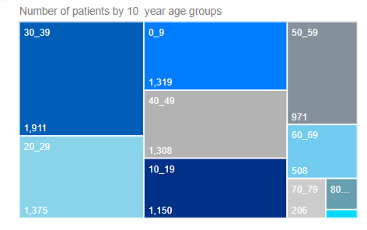
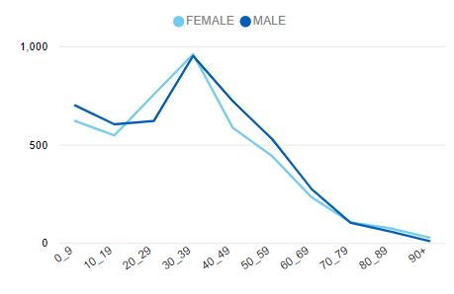
Practice List Size (Weighted and Raw)
Q1 19/20 | Q2 19/20 | Q3 19/20 | Q4 19/20 | Q1 20/21 | Q2 20/21 | Q3 20/21 | Q4 20/21 | Q1 21/22 | Q2 20/21 (July) | Basis
 |  |  |  |  |  |  |  |  |  | Raw
 |  |  |  |  |  |  |  |  |  | Weighted
Number of new joiners | Number of leavers | % Turnover

Slide 16
Patient online
(June 2021 – latest data available)
Notes

Slide 17
Workforce Compliance – Sickness absence
Notes

Slide 18
Workforce Compliance – Supervision audit
Workforce group | Number of staff in the group | Number of staff who have had supervision this month | %
Admin
Nursing
Medical
Notes

Slide 19
Workforce Compliance – Appraisals
Assignment Count | Reviews Completed | Reviews Completed %
Notes

Slide 20
Cauldwell Medical Centre
Position - £563k Overspend
This represents an adverse movement of £304k in month.
The income assumption was originally based on the P&L income position for FY19-20 as was originally reported in the June 20 accounts as £1.3m. This has now changed to reflect a more accurate position based on the actual income received to date and the income as reported from the Open Exeter Statements.
The real forecast year end position looks set to be in the region of £1.0m but according to last year NHSE the actual income received for FY19-20 was £1.5m.
This reduction in income assumption has resulted in an adverse movement of £259k in month.
Vacancy savings of £422k is being used to cover both agency and bank staff which total £810k year to date. Pressure on pay therefore is £388k.
The new proposals for the substantive nursing staff has now been approved so agency spend for nursing is expected to end going forward. Recruitment is currently taking place for salaried GP’s, so agency spend is expected to reduce as the year progresses.
Non-pay is currently reporting an underspend of £83k year to date which is being absorbed by the pay overspends.
Action
Set up a meeting with the CCG to discuss the income versus last year’s outturn.
Work with the CCG to reconcile the income position.
Cauldwell Medical Centre
Position - £563k Overspend
This represents an adverse movement of £304k in month.
The income assumption was originally based on the P&L income position for FY19-20 as was originally reported in the June 20 accounts as £1.3m. This has now changed to reflect a more accurate position based on the actual income received to date and the income as reported from the Open Exeter Statements.
The real forecast year end position looks set to be in the region of £1.0m but according to last year NHSE the actual income received for FY19-20 was £1.5m.
This reduction in income assumption has resulted in an adverse movement of £259k in month.
Vacancy savings of £422k is being used to cover both agency and bank staff which total £810k year to date. Pressure on pay therefore is £388k.
The new proposals for the substantive nursing staff has now been approved so agency spend for nursing is expected to end going forward. Recruitment is currently taking place for salaried GP’s, so agency spend is expected to reduce as the year progresses.
Non-pay is currently reporting an underspend of £83k year to date which is being absorbed by the pay overspends.
Action
Set up a meeting with the CCG to discuss the income versus last year’s outturn.
Work with the CCG to reconcile the income position.
Finance (Overview)
Notes

Slide 21
Finances (Budgets)
Notes

Slide 22
Finances (Financial position)
Notes

Slide 23
Finances
(Establishment Report and
Bank and Agency usage)
Notes

Slide 24
Finances (Bank and Agency Usage Analysis)
Notes

Slide 25
Bank and Agency ad hoc staffing trends – common times / days
Notes

Slide 26
Patient Reported Experience Measure
PREM results

Slide 27
Patient Reported Experience Measure
PREM results

Slide 28
Patient Reported Experience Measure
PREM results
What Went Well?
Very good | Good | Neither good nor poor | Poor | Very poor | Grand Total
Patient Comments
Practice | Number of Positive Comments

Slide 29
Workforce Compliance – M&S Training

Slide 30
Risk Register

