Slide 1
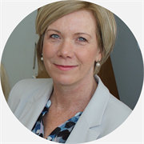
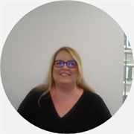
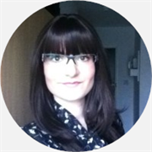
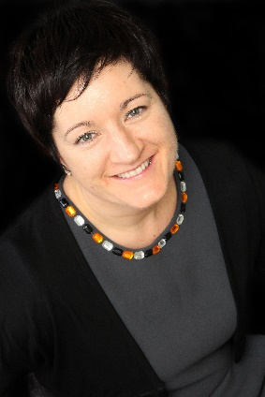
Organisation Development Team

Slide 2
Our aim is to develop a culture within ELFT where all people flourish and deliver high quality, continually improving, compassionate, inclusive and safe care.
Our work helps to improve leadership, team working, culture and change. This might be done via a planned change project, a team away day, a leadership diagnostic or an investigation into culture within a service or department.
We create bespoke tailored events for teams and we operate a structured consulting, diagnostics, delivery and evaluation process to ensure meaningful impact.
We use a variety of psychometric instruments, diagnostic techniques and OD interventions and apply behavioural science approach to our work.

Slide 3
What we offer
Our main areas of work are:
Personal and Career development Support
Coaching and Mentoring
Leadership and Management Development
Team Development – including tailored support to mange conflict or specific difficulties within your team
Tailored support to bespoke your recruitment and onboarding practices
Wellbeing – in association with our Wellbeing team

Slide 4
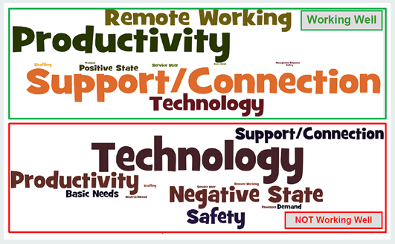
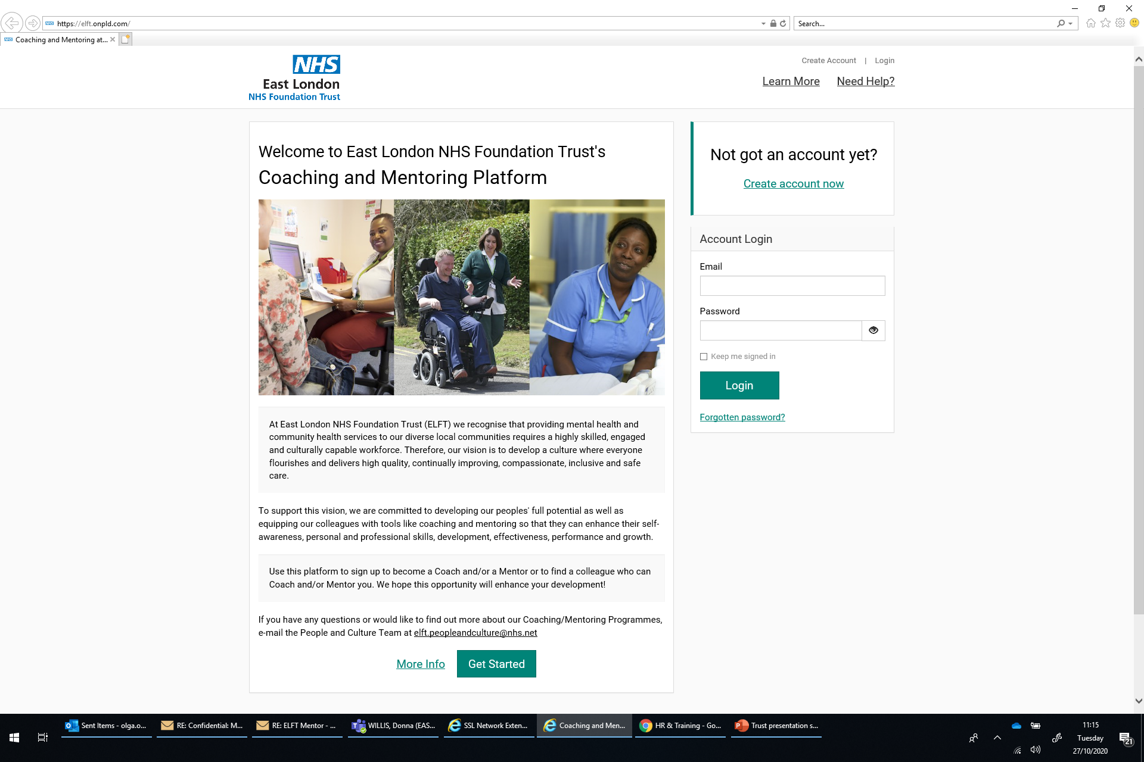
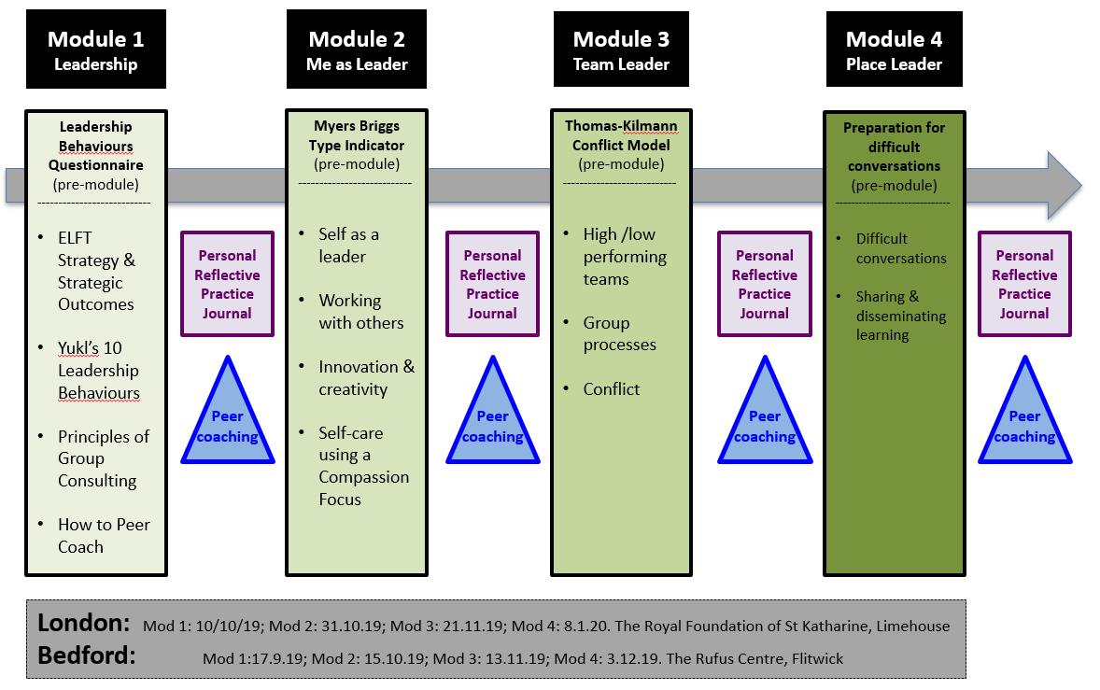

Slide 5
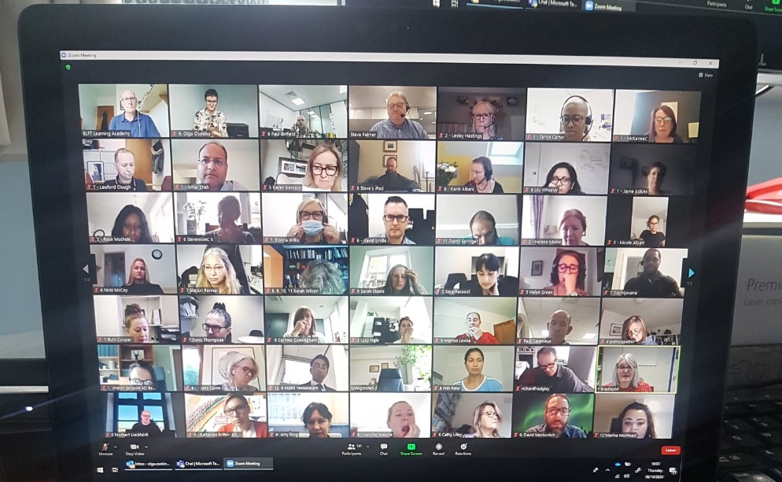
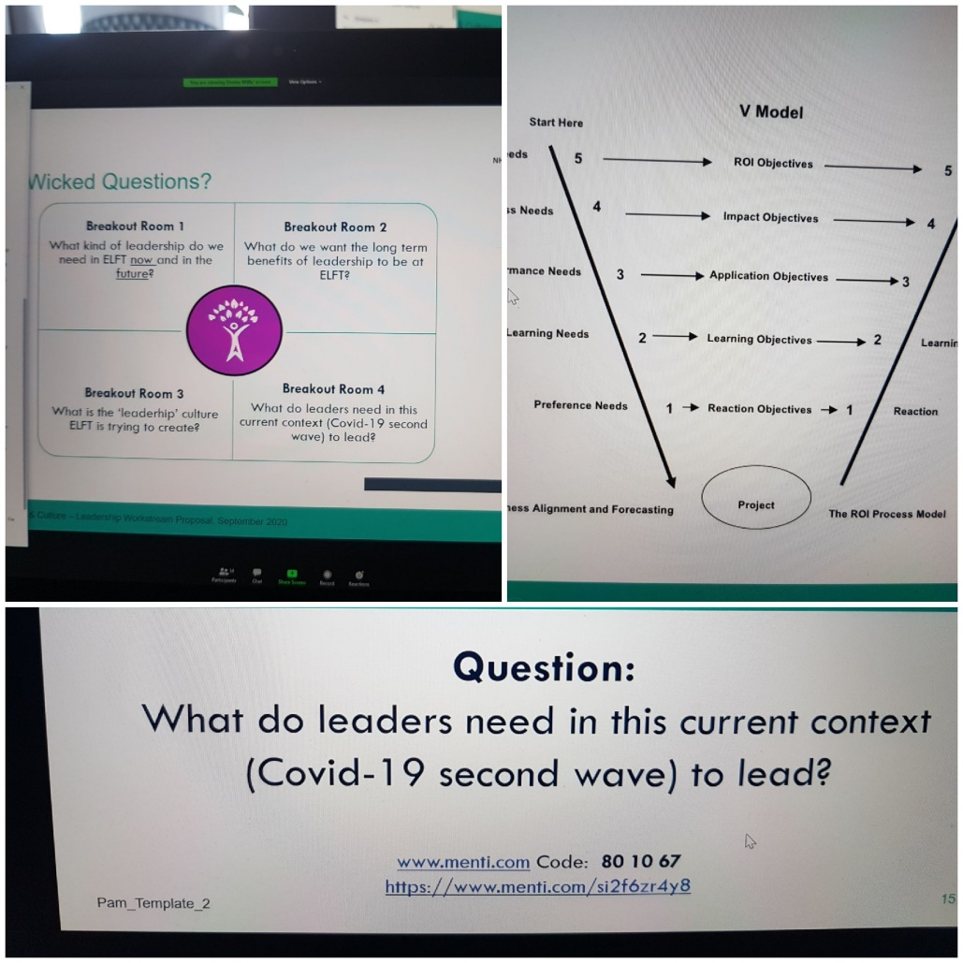
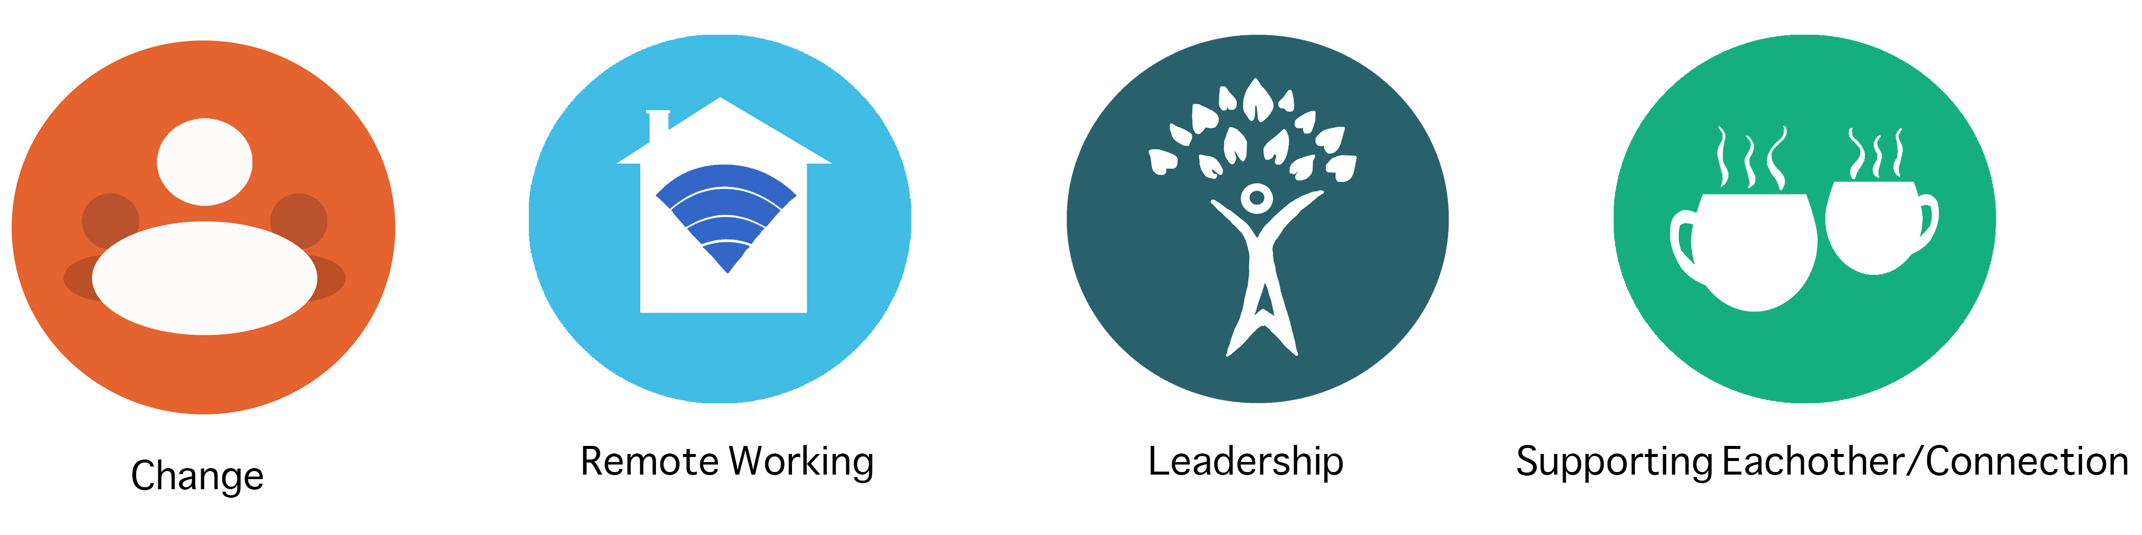
DMT Away Days
Leadership Workstream
Re-connecting Teams

Slide 6
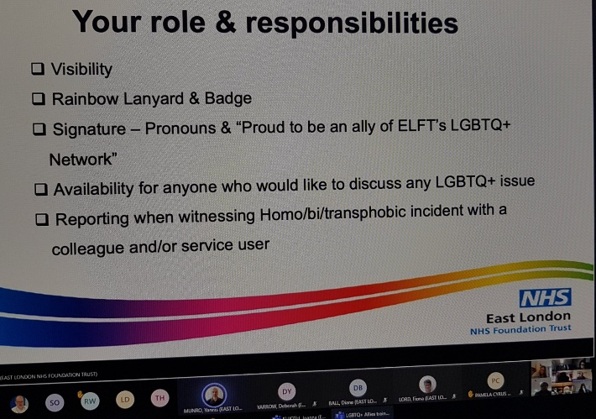
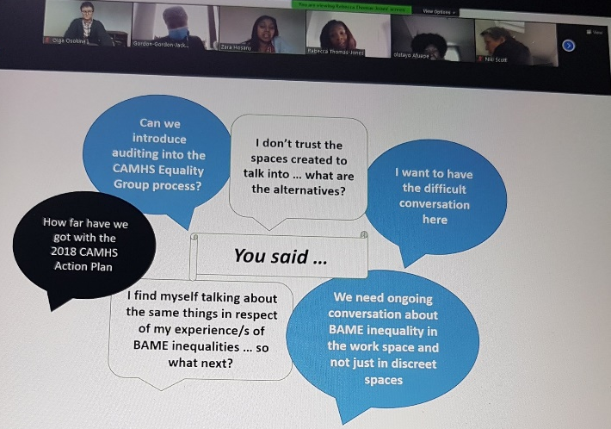
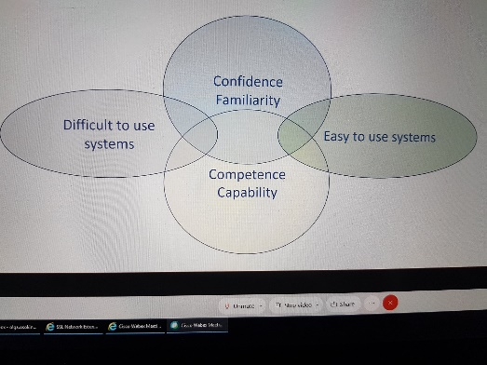

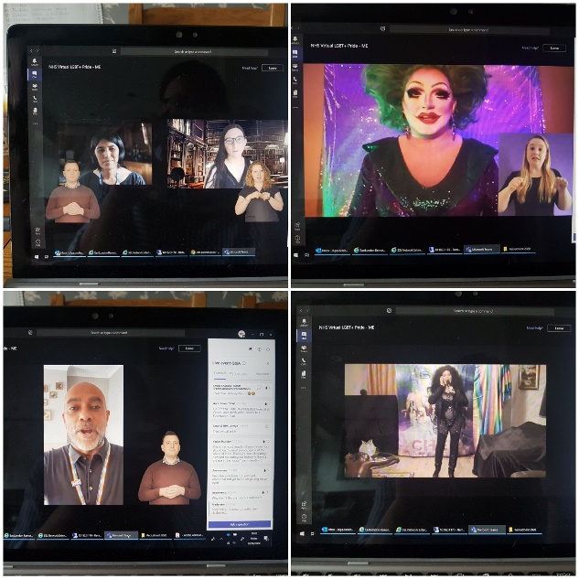
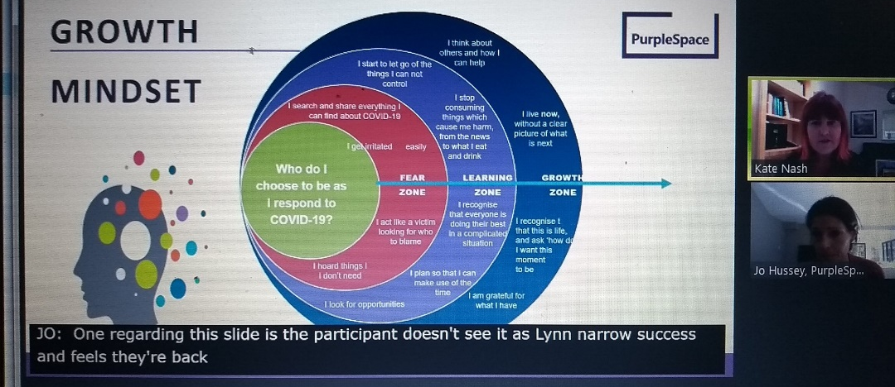
Supporting Staff Networks

Slide 7
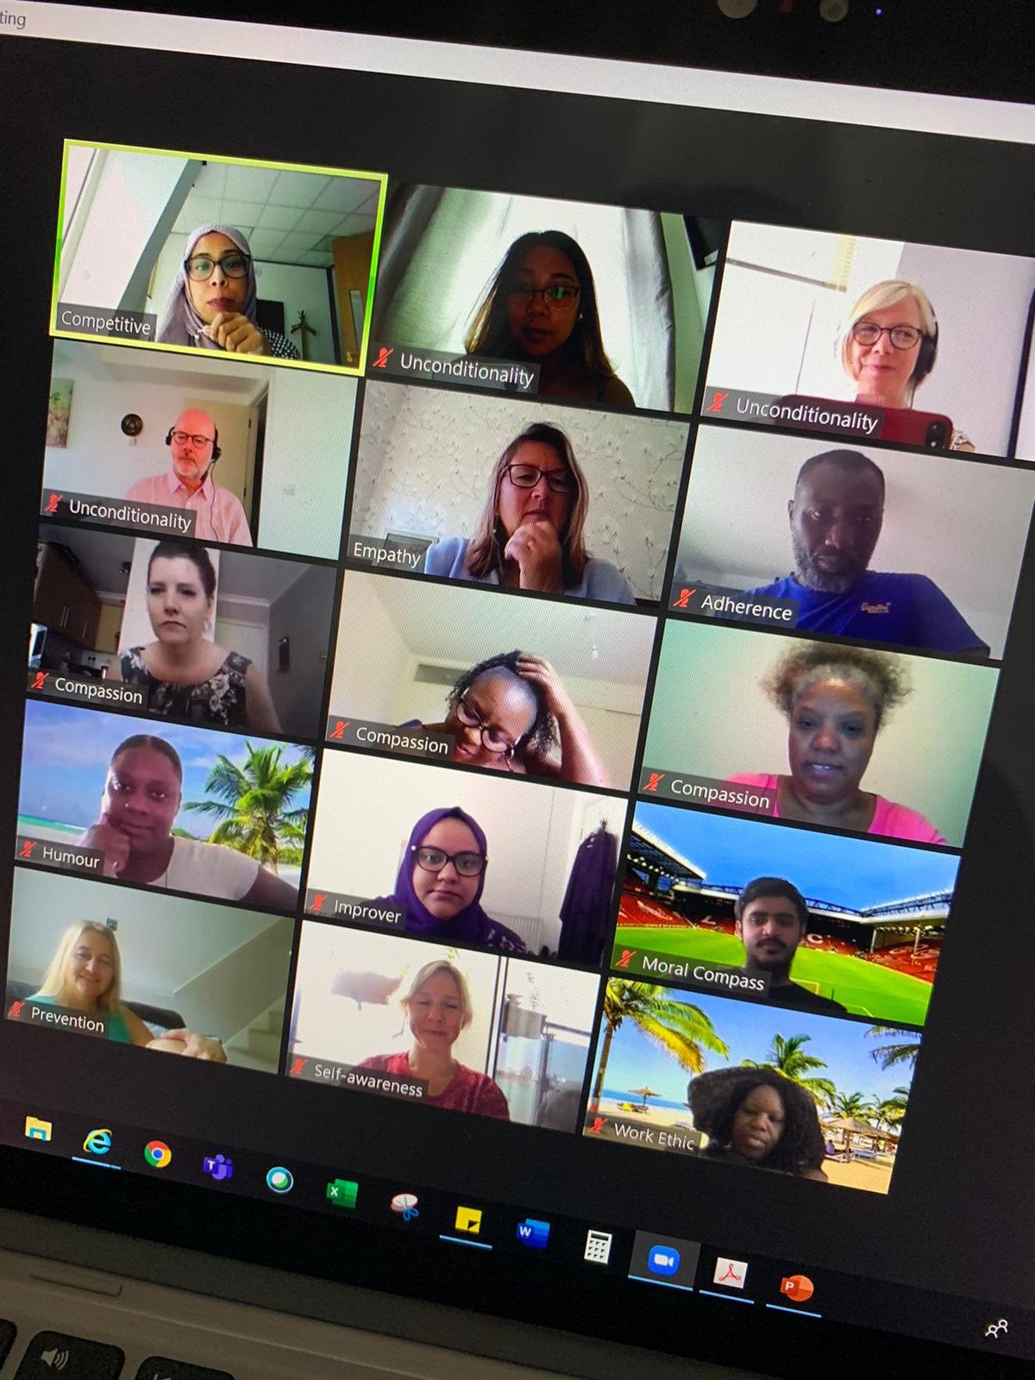
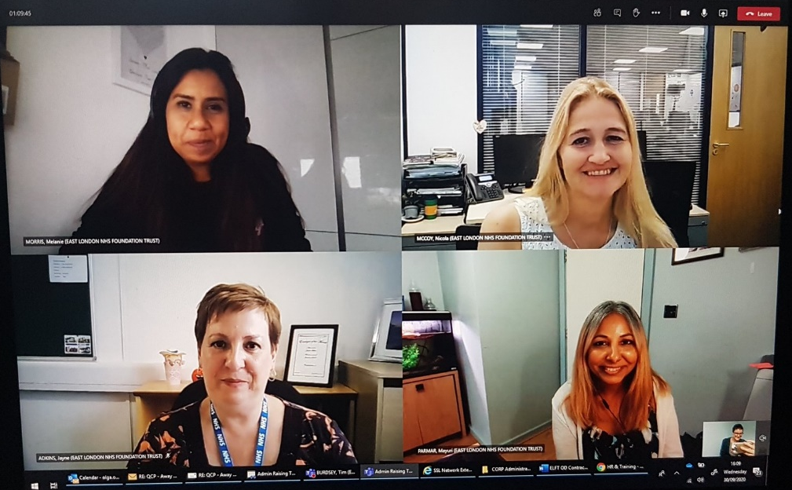
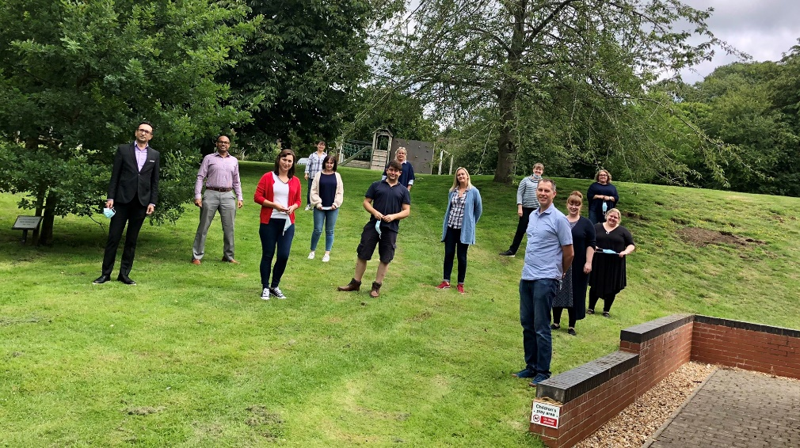
Bespoke Team Away Days

Slide 8
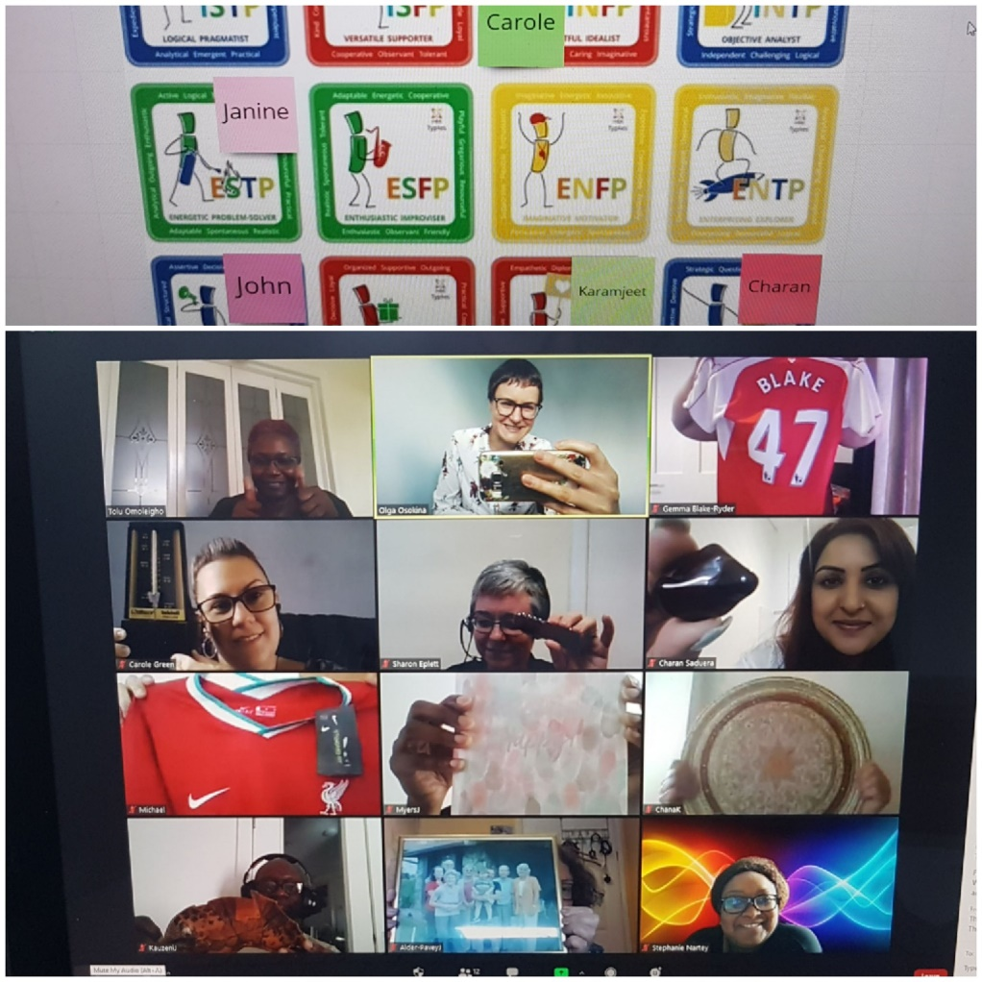
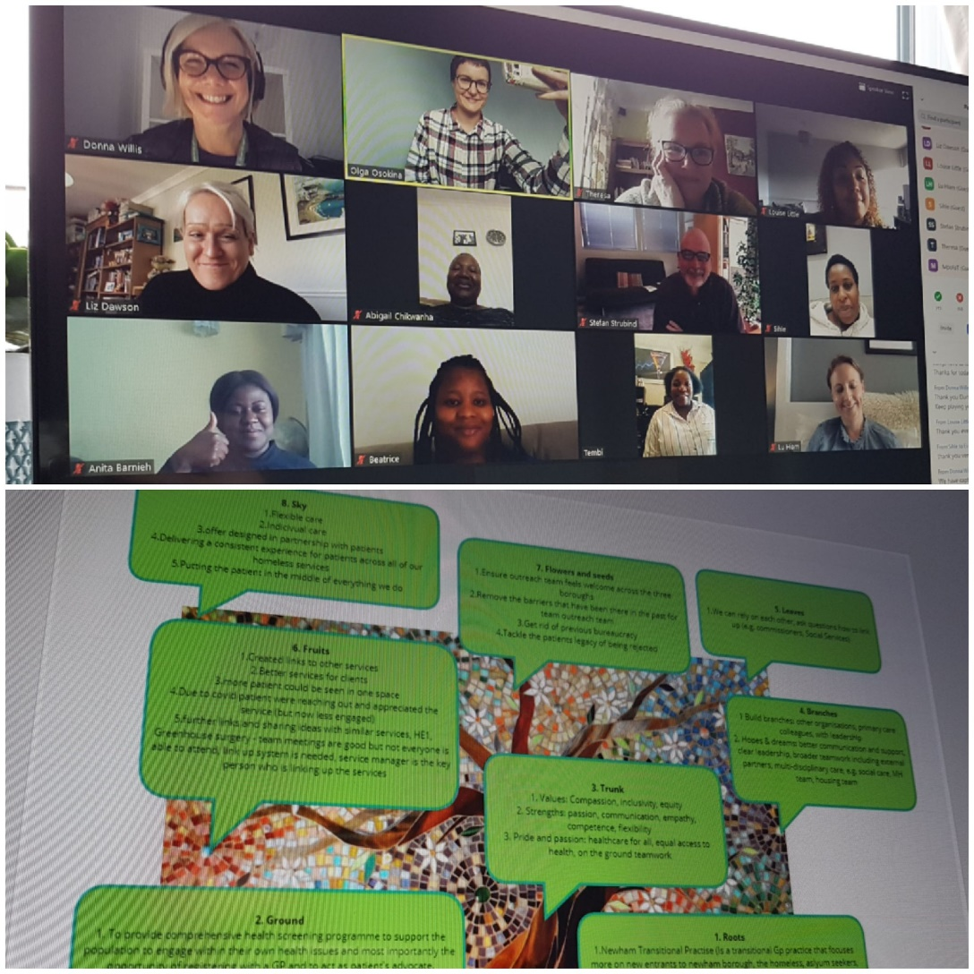
Bespoke Team Away Days

