Slide 1
Reducing Health Inequalities in Primary Care at East London NHS Foundation Trust
11 August 2021

Slide 2
Agenda
Aims for today
Get your feedback to refine our proposed approach
Prioritise what we most need to do within the broad framework of a QI project
Identify who should be involved in the next steps
Agenda
3.30 Introductions (Emily)
3.40 Confirming overall approach (Emily)
3.50 Specific area of focus: cervical screening (Emily)
4.15 Project governance and role of project team (Sultan)
4.25 Project planning approach (Toitei)
4.40 Progress to date and next steps – cervical screening track
  Data review (Sultan / Emily)
  Next steps - process mapping, engagement and defining our aim (Toitei)

Slide 3
1. Introductions

Slide 4
2. Confirming overall approach

Slide 5
Background
Aims:
To measurably reduce a health inequality in primary care
To increase capacity for inequalities projects in the primary care directorate
To establish a model for the public health team to work with other directorates
Progress so far:
DMT agreement to address a single issue across all five practices
DMT longlisting of potential populations and outcomes
Lunch & Learn discussion on wider determinants of health (& amazing existing work!)
Review of annual Directorate plan
Initial investigations into data availability/quality
Discussions/advice from some practice managers & QI team
Decision to start small, utilising existing plans

Slide 6
Overall approach – two tracks
Develop long-term health inequalities agenda for the primary care directorate
Output: High-level Triple Aim Programme plan for 2022 (& beyond)
Understanding our practice populations through engagement, data analysis and asset mapping
Establishing inclusive, ongoing participation and engagement mechanisms
Establishing a Triple Aim portfolio focused on reducing inequalities
Identify a quick win and demonstrate early impact
Output: Specific QI-informed project to reduce a specified health inequality (cervical screening uptake) in 2021-22
Measuring differences in uptake within and between our different practice populations
Consultation, process mapping and asset mapping to understand barriers, develop driver diagram
Applying and testing changes in practice

Slide 7
3. Potential quick win: cervical screening (Emily)

Slide 8
Longlist of project options
Identified at Primary Care DMT, 23 June 2021
Service access for trans and non-binary patients
Service access for people with English as a second or other language
Service access for migrants
Service access for homeless people
Service access for people with substance misuse problems
Service access for people with learning disabilities
Service access for older people
Uptake of screening and immunisations among Gypsy, Roma and Traveller communities
Children’s mental health
Physical healthcare for people with a mental health diagnosis
Late presentation for cancer

Slide 9
Proposed outcome focus: (cervical) cancer screening
How large a population is affected? | Every person with a cervix aged 25-64 is eligible for screening. There are 9,577 female patients in this age group at ELFT practices, 26% of the registered population (source: GP Practice Profiles)
What aspect(s) of inequality are we focusing on? | Geography/deprivation There is lower screening uptake and higher cervical cancer incidence & mortality in deprived areas (source: PHE). Individual characteristics: There is lower uptake among: lesbian and bisexual women (& barriers for trans men) (Source: PHE) Those with learning disabilities (source: PHE) People of South Asian, Black, or Other White; or Mixed ethnicity (compared to White British) Those with first language other than English
How substantial is the impact on health outcomes for this population? | Cervical screening participation is associated with a 60% reduction in cervical cancer among women aged 40 and is particularly effective in reducing advanced cancers.
How important is this issue to service users? | Consultation with PPGs still to be undertaken.
To what extent does this issue affect all ELFT practices? | There is lower uptake than the CCG average in 4/5 ELFT practices. The extent of inequalities in uptake within practices not yet known.
How important is this issue to staff? | To be discussed in this meeting.
How well does this align with existing strategy and plans? | ELFT: Primary Care Directorate plans include communications activity to increase screening BLMK: “Earlier diagnosis of cancer by increasing uptake in screening and introduction of Faster Diagnosis Standard.” NEL: “Use a range of approaches to increase the awareness and uptake of screening programmes by local people” HLP: https://public.tableau.com/app/profile/transforming.cancer.services.for.london/viz/Cervicalscreeningdashboard/Cervical
Can we make a difference to this issue? | Yes. LRS has previously successfully increased uptake through direct patient contact by phone and there is a wider evidence base for screening uptake interventions in primary care, including to reduce inequalities.
Do we have the resources to make a difference to this? | Initial intention is to deliver change within existing resources; further resources can be sought if ambition grows.

Slide 10
Discussion
What are the opportunities of the two-track approach?
What are the risks of the two-track approach?
How can we engage primary care directorate staff in an overall ambition to reduce health inequalities?
How can we engage primary care directorate staff in work to reduce inequalities in cervical screening uptake?

Slide 11
4. Project governance (Sultan)

Slide 12
Possible governance model (for discussion)
Role | Name | Remit
Sponsor | Marina Muirhead | Oversight; approval; secure resources; ensure accountability through other appropriate groups
Clinical lead | Liz Dawson | Clinical decision making; review & approve any changes to protocols; approve any patient-facing health advice
Project leads | Toitei Kurima Sultan Ahmed | Project planning and delivery
Public Health Advisor | Emily Humphreys | Support for project planning and delivery, data definitions, evidence review, recommend public health tools and approaches and advise on their application
QI Advisor | Nicola Ballingall | Recommend QI tools and approaches and advise on their application, support project group at QI forums
Project group | Louise Cole, Louise Little, Joanne Alder-Pavey, Nicola Hoad, Angela Bartley, representative from CMC (Victoria Condon?) | Meet 4-weekly (TBC), support development of project plans, contribute to specific outputs as needed (eg datasets, process maps, project plans, driver diagrams, communications resources). Delivery and advisory role.
DMT/ formal oversight | DMT members | Formal accountability – sign-off role.

Slide 13
5. Project planning approach (Toitei)

Slide 14
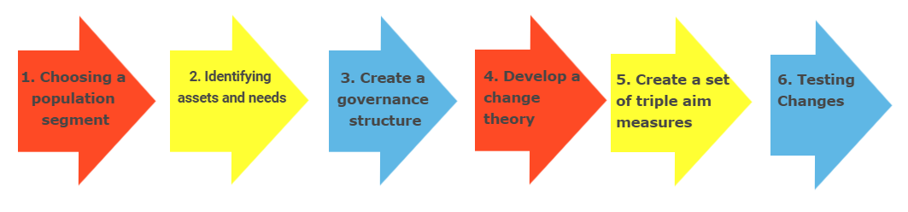
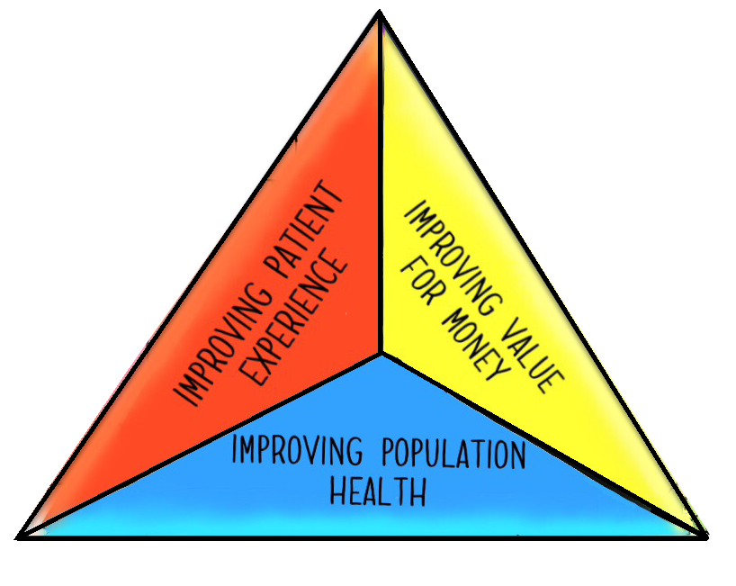

Slide 15
Components for a Triple Aim/QI project
Potential tasks & functions at each stage
High-level data review High-level evidence review High level consultation Review plans/strategies for alignment Assessment against a prioritisation framework Identify project lead | Need/ asset mapping Three part data review: Quantitative Staff Service users Literature review Identify QI/ public health /people participation leads | Business case Accountability structure Project management plan Evaluation planning | Driver diagram | SMART objectives Triple aim: Population outcomes Patient experience Value for money | PDSA cycle Review Implementation planning Wider dissemination (stories, publications)
Discussion:
Which of these components will we need to establish a Triple Aim programme for the directorate?
Which of these components will we need to establish a cervical screening inequalities project?
What other components will we need?

Slide 16
6. Progress so far – cervical screening track

Slide 17
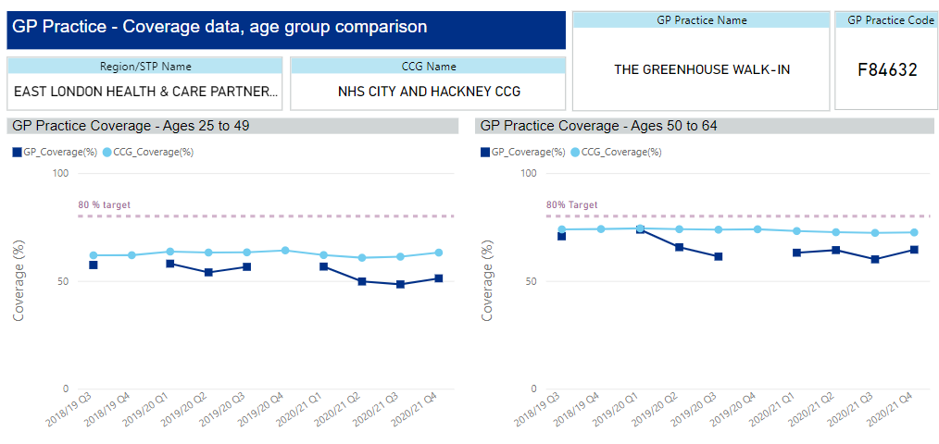
Overall practice data: Greenhouse

Slide 18
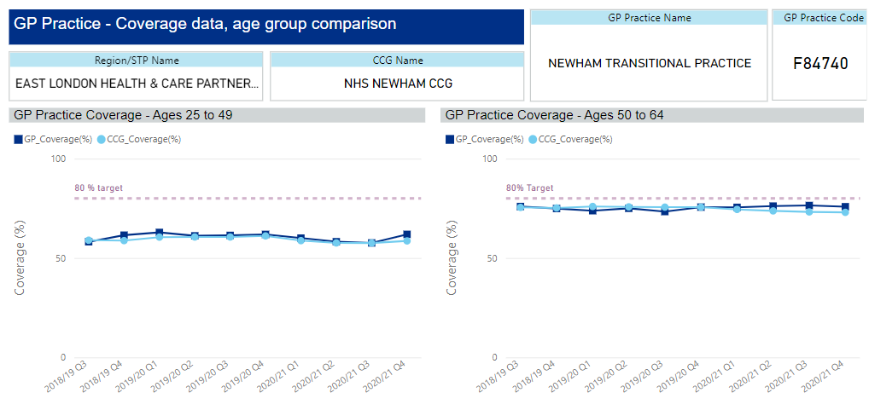
Overall practice data: Newham Transitional Practice
Notes:
There is a buddy system in Newham pairing a clinician with an administrator, and they jointly agree an approach

Slide 19
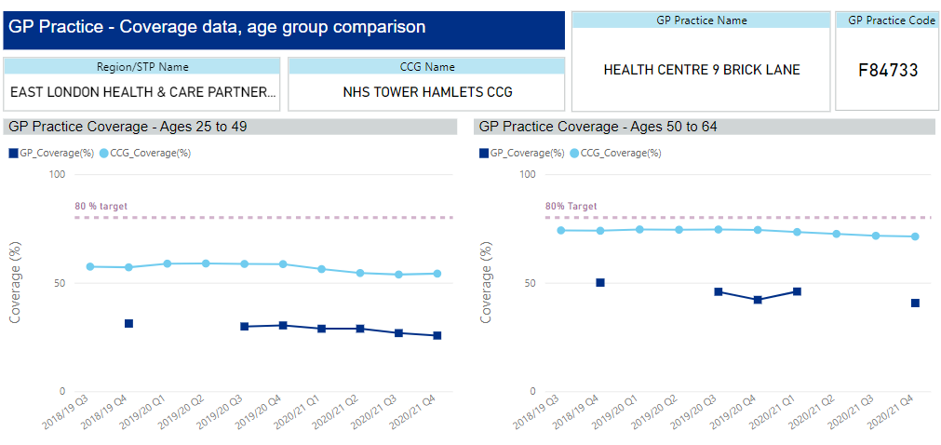
Overall practice data: Health E1

Slide 20
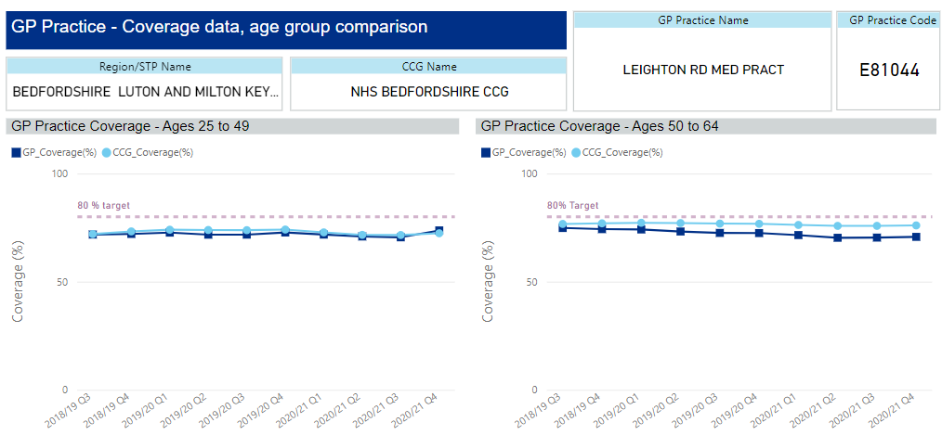
Overall practice data: Leighton Road Surgery
Notes:
There is an intervention – calling patients directly to book them in

Slide 21
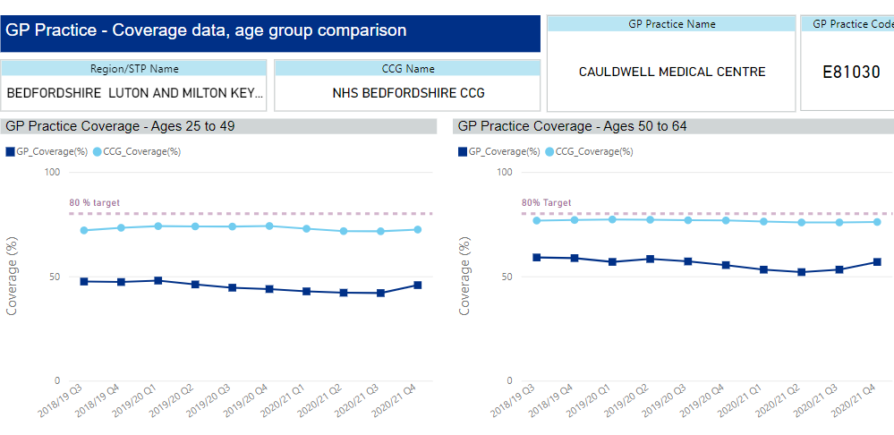
Overall practice data: Cauldwell Medical Centre

Slide 22
Are there inequalities within our practices?
Data searches and populations are currently being defined. Initial analysis of Greenhouse practice data on differences in uptake between those with English as a first and second language found no statistically significant differences within the practice.
Among 25-49 year olds
45/110 (40.9%) unscreened overall
14/31 (45.1%) unscreened among those with English as second language
41/104 (39.4%) unscreened among those with English as first language
Difference is not statistically significant
Among 50-64 year olds
14/73 (19.1%) unscreened overall
Subgroup data suppressed (n<5 in one group)
Difference not statistically significant
Notes:
Possible explanations:
Chance – number too small to reveal a difference
Bias/confounding
True finding – there is no difference within the practice (which means that people are equally well engaged in screening at this practice whether English is their first language or not). The inequality we see between this practice and the wider local population is driven by the other challenges faced by this practice population and we should focus there.

Slide 23
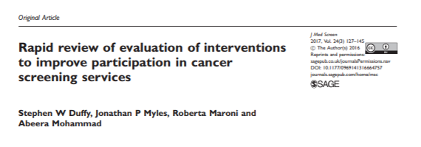
Background: what works?
Interventions which increase uptake:
Pre-screening reminders
GP endorsement (also reported to reduce inequalities in one study)
Personalised reminders for non-participants
More acceptable screening tests ie self-sampling (similar effects in different subgroups in most studies – does not increase inequalities)

Slide 24
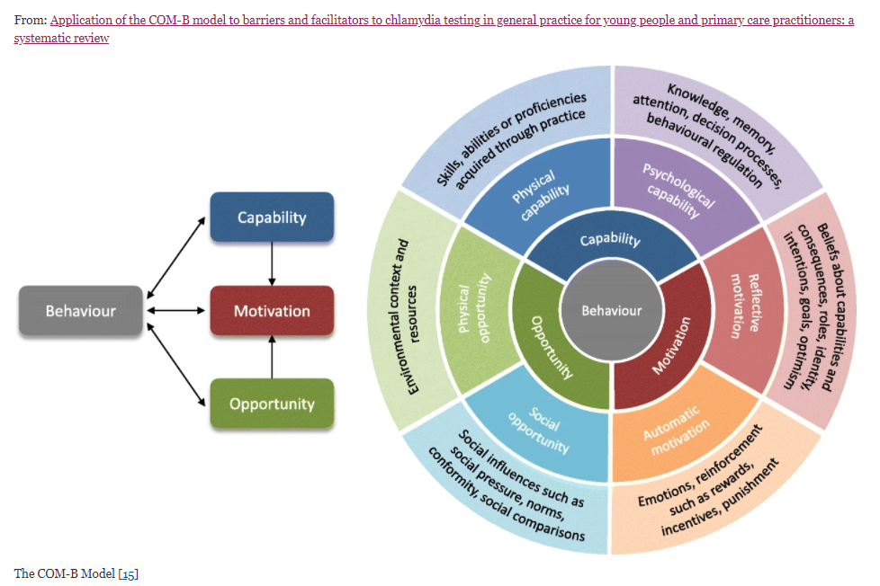
Background: the COM-B model

Slide 25
Next steps
Defining project plan and seeking approval at QI lunch
Process mapping
Engagement of staff and patients
Refining our aim:
“To increase the uptake of cervical screening within our practice populations by X% and to reduce inequalities in uptake between XXXX and XXXX within our practices by March 2022“
Developing our approach for the Triple Aim track

