Slide 1
Primary care and health inequalities
16 July 2021

Slide 2
Learning objectives
To understand what is meant by the term ‘health inequalities’
To understand some of the causes of health inequalities
To reflect on the role of primary care in reducing health inequalities

Slide 3
Session plan
Presentation:
What are health inequalities?
Frameworks for understanding and addressing the causes of health inequalities
The role of healthcare in reducing health inequalities
Discussions:
What is the role of primary care in reducing inequalities?
Addressing health inequalities at ELFT
What do we know about ELFT practice populations?

Slide 4
What are health inequalities?
“Health inequalities are avoidable, unfair and systematic differences in health between different groups of people” (King’s Fund)
Inequalities in which outcomes?
health outcomes - such as mortality rates, life expectancy or disease prevalence
healthcare quality and access - such as availability of specific treatments
immediate health risk factors - such as smoking, diet or alcohol use
wider social and environmental factors - such as deprivation or air pollution
Health and care costs
Inequalities in which characteristics?
Individual circumstances such as income, profession, or education
Geography, such as the amount of green space, or the jobs available in a local area
Specific characteristics protected under the Equalities Act, such as ethnicity or sex
Potential sources of vulnerability – such as recent migration, or severe mental illness
Intersectionality of different characteristics can also lead to poorer health outcomes for some populations.
Source: King’s Fund (2020), What are health inequalities?

Slide 5
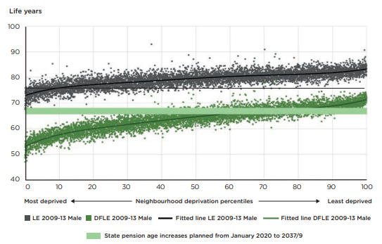
There is a gradient in health outcomes
Male life expectancy, and disability-free life expectancy at birth, by deprivation
Source: Institute of Health Equity (2020) Marmot Review 10 Years On (https://www.instituteofhealthequity.org/resources-reports/marmot-review-10-years-on)
Notes:
Both life expectancy and disability-free life expectancy (DFLE) show a gradient – meaning all experience health inequalities
The difference is wider for DFLE, than LE so higher deprivation means a shorter life with a greater proportion spent in ill-health

Slide 6
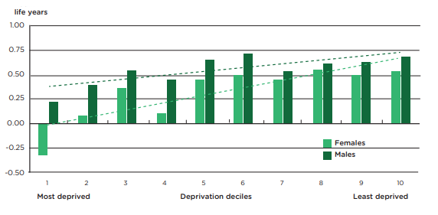
Some health inequalities are increasing
Gain in life expectancy by sex, 2010-12 to 2016-18
Source: Institute of Health Equity (2020) Marmot Review 10 Years On (https://www.instituteofhealthequity.org/resources-reports/marmot-review-10-years-on)
Notes:
Increases in life expectancy have stalled overall
Greater gains in the least deprived deciles mean that the gap is widening
Life expectancy declined among females in the most deprived decile

Slide 7
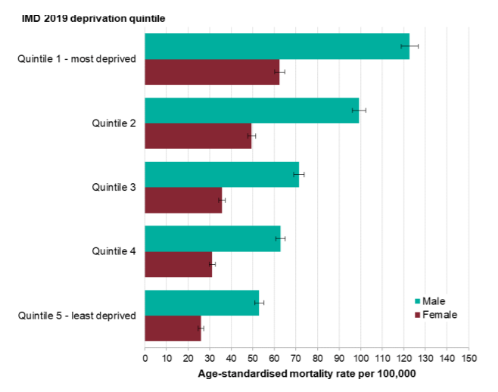
COVID-19 has highlighted health inequalities (and may have worsened some)
Age standardised death rates in laboratory confirmed COVID-19 cases by deprivation quintile and sex, as of 13 May 2020, England.
Higher risk for COVID-19 death (1):
Older age, male sex, deprivation, comorbidities (including diabetes, severe asthma), Black or South Asian ethnicity
Evidence of indirect impacts from the pandemic in London (2):
BAME communities, women, young people, shielded populations, vulnerable adults, low income households, people with disabilities
Williamson EJ, Walker AJ, Bhaskaran K, et al. Factors associated with COVID-19-related death using OpenSAFELY. Nature 2020;584:430–6. doi:10.1038/s41586-020-2521-4
Hobart V, Zeuner D, Whiteman S, et al. Wider impacts of the COVID-19 pandemic and recovery of population health outcomes for London - London Datastore. 2020.https://data.london.gov.uk/dataset/wider-impacts-covid-19-recovery-of-health-outcomes (accessed 25 May 2021).
Source: Public Health England, Disparities in the risks and outcomes of COVID-19 (2020)
Notes:
Differences in COVID-19 outcomes also highlight the importance of intersectionality as multiple factors coincide to increase health risks. A review of deaths of London bus drivers (https://www.instituteofhealthequity.org/resources-reports/london-bus-drivers-review)
found that they were 3.5 times as likely to die between March and May 2020 as men of the same age across all occupations in England and Wales.
There are a lot of inequalities here:
- Ethnicity (a high proportion of those who died were from BAME backgrounds)
- Geography (the pandemic spread earlier in London than elsewhere; many bus drivers were living in deprived areas)
Occupation (London bus drivers have a sedentary job and have been known to be at higher risk of cardiovascular disease since the 1950s which increases their underlying risk; bus drivers had high exposure to COVID-19 because they are in a frontline role coming into contact with more people)

Slide 8
Understanding and addressing the causes of health inequalities

Slide 9
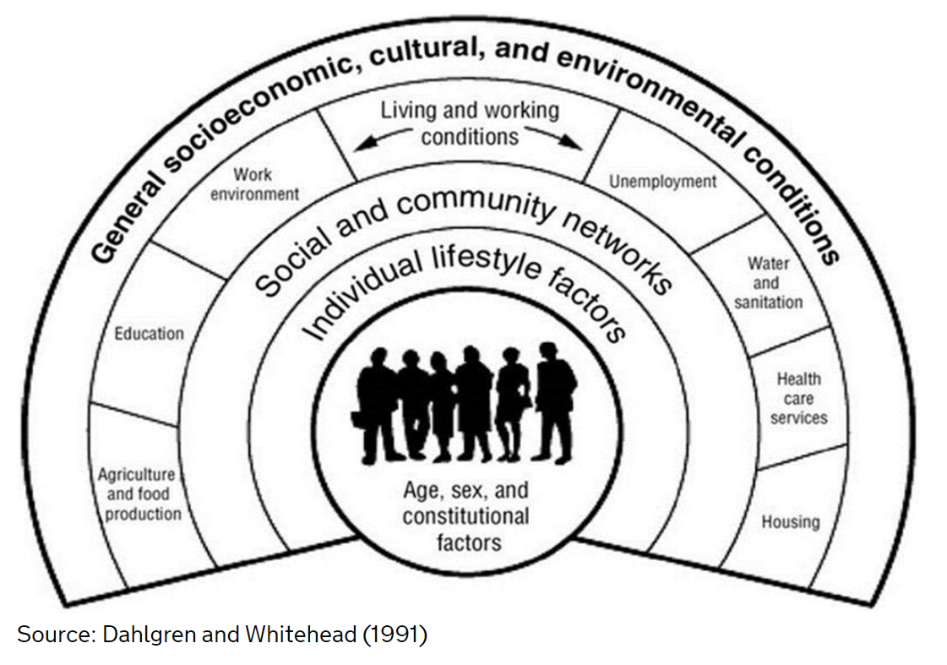
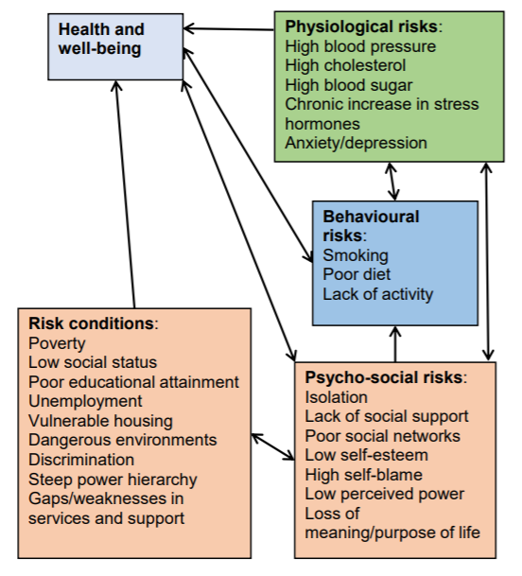
What causes health inequalities?
Source: NHS Right Care (2018)

Slide 10
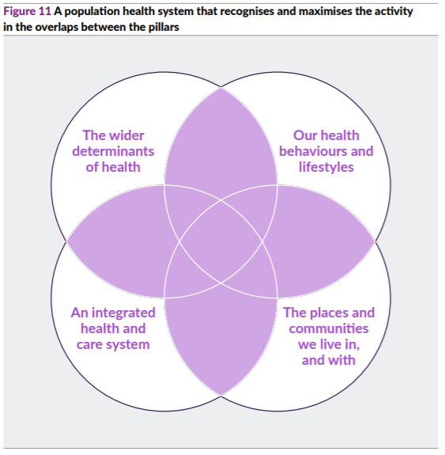
A population health approach to reducing inequalities
Source: King’s Fund, Pillars of a Population Health System, 2018
Notes:
Population health approaches are often thought of as part of the solution to health inequalities because thinking in population terms enables us to focus on how to promote the health of groups of people who might have experienced systematic disadvantages.
This framework is one of many, but what it is referring to
Wider determinants of health, such as:
Income
Housing
Environment
Education
Transport
Work
Health behaviours, such as:
Smoking
Alcohol
Physical activity
Diet
Integrated health and care system
Recognition of multimorbidity and complexity (more common in deprived areas)
Social (as well as medical) models of health
Places and communities (PHE 2015)
Community development (asset based)
Volunteer and peer roles
Collaborations and partnerships
Access to local community resources
All parts of this framework are important. Unless work on healthy behaviours and health care is contextualised in wider work on communities, inequalities and wider determinants, there are risks that inequalities will be widened rather than reduced, because those who already have more resources (money, time, education, transport, social status) will find it easier to access services.

Slide 11
The role of healthcare in reducing health inequalities

Slide 12
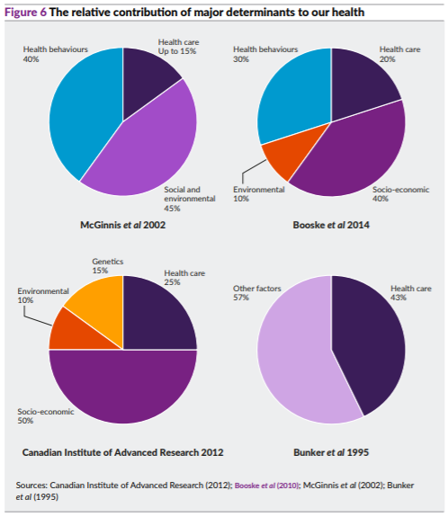
What is the role of healthcare in health inequalities?
Source: King’s Fund, Pillars of a Population Health System, 2018
Notes:
Lifecourse models suggest that health outcomes are affected by different risks from pre-conception throughout our lives
Healthcare plays an important direct role, but is only responsible for a minority of inequalities in overall health outcomes
Healthcare providers can also influence the other determinants of health

Slide 13
Inequalities in healthcare services
Socio-economic inequalities in healthcare services (1)
Other inequalities in healthcare services (examples)
Wealthier people tend to:
Use services less overall
Present earlier
Make greater use of preventative services (such as screening and vaccination)
Have shorter waiting times for some procedures
Receive better quality care in some areas (including primary care)
Report better experiences.
Ethnicity: no evidence of ethnic inequalities in use of GP services, but there are inequalities in use of hospital services (2) and in patient experience in many services (3)
Mental illness: People with severe mental illness may be less likely to receive preventative care (4)
Inclusion health groups: some are less likely to access preventive and primary care services, relying on emergency services when their health needs become acute (5)
Cookson R, Propper C, Asaria M, et al. Socio-Economic Inequalities in Health Care in England. Fisc Stud 2016;37:371–403. doi:10.1111/j.1475-5890.2016.12109
Nazroo JY, Falaschetti E, Pierce M, et al. Ethnic inequalities in access to and outcomes of healthcare: Analysis of the Health Survey for England. J Epidemiol Community Health 2009;63:1022–7. doi:10.1136/jech.2009.089409
Raleigh V, Holmes J. The health of people from ethnic minority groups in England | The King’s Fund. 2021. https://www.kingsfund.org.uk/publications/health-people-ethnic-minority-groups-england (accessed 25 May 2021).
Health matters: reducing health inequalities in mental illness - GOV.UK. 2018. https://www.gov.uk/government/publications/health-matters-reducing-health-inequalities-in-mental-illness/health-matters-reducing-health-inequalities-in-mental-illness (accessed 25 May 2021).
Inclusion Health: applying All Our Health. 2021. https://www.gov.uk/government/publications/inclusion-health-applying-all-our-health/inclusion-health-applying-all-our-health (accessed 11 May 2021).

Slide 14
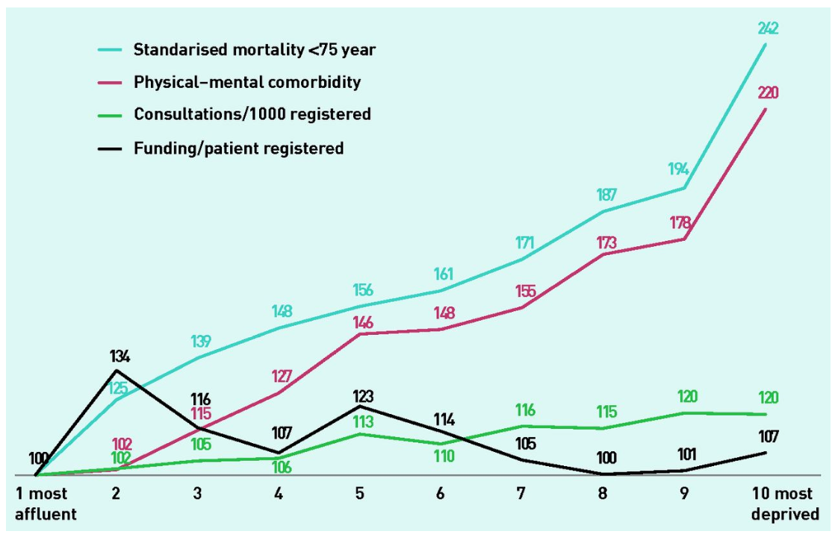
Inequalities in primary care
Differences from least deprived decile for mortality, comorbidity, consultations, and funding. Least deprived decile = 100
McLean et al (2015), General practice funding underpins the persistence of the inverse care law: cross-sectional study in Scotland, BJGP
Notes:
Cross-sectional study based on routine data from 956 practices in Scotland
Consultation rates are higher in more deprived areas, but not in proportion to higher levels of need
No association found between practice funding and deprivation, or between practice funding and consultation rates

Slide 15
Why is primary care important for health inequalities?
Population coverage
Breadth of expertise
Frequency of contact
Delivery of preventative services
Gatekeeper for other health services
Responsible for whole person rather than a single disease
Based in local communities

Slide 16
How might primary care providers reduce health inequalities?

Slide 17
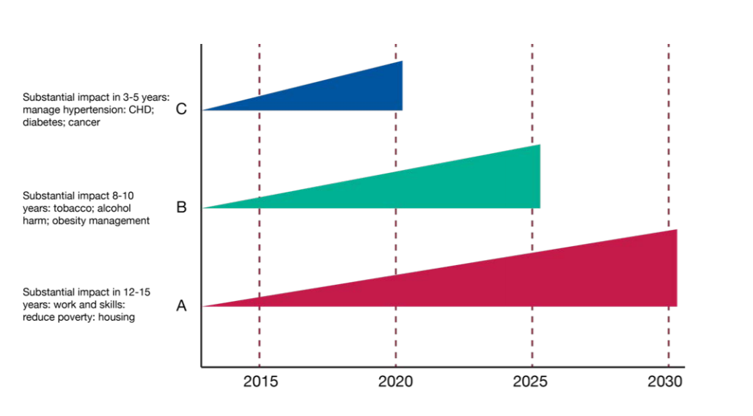
Consider short, medium and long term impact
Source: Public Health England, Reducing Health Inequalities: System, Scale and Sustainability (2017)

Slide 18
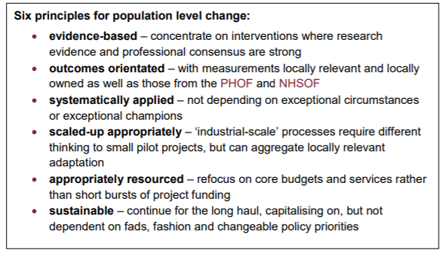
Act at population level
Source: Public Health England, Reducing Health Inequalities: System, Scale and Sustainability (2017)

Slide 19
Discussion: what could be the role of primary care in reducing health inequalities?
Hou
Establish links with other services - employment, housing, violence prevention, childcare and early years, education (eg through social prescribing)
Support people with mental illness to stay in (good) work
Role model good practice in practice employment, transport and environmental policies
Create healthy practice environment
Proactively identify smoking, alcohol & drug use, physical inactivity, diet & obesity
Address inequalities in uptake of preventative behaviour-focused services (eg NHS Health Check), offering proportionately greater support for those with greater needs
Locate services in areas of need
Ensure equity of access to healthcare for inclusion health groups and protected characteristics
Identify unmet need & improve care quality for ambulatory care sensitive conditions with wide inequalities in prevalence & outcomes (eg COPD)
Address equity of uptake for screening and vaccinations
Understand local population data, needs, assets and inequalities
Systematically engage the local community
Ensure services are culturally appropriate
Build consistent relationships with people in the greatest need (eg by offering flexible appointment types)
Diagram adapted from King’s Fund, Pillars of a Population Health System (2018)
Notes:
1

Slide 20
Primary care and health inequalities at ELFT

Slide 24
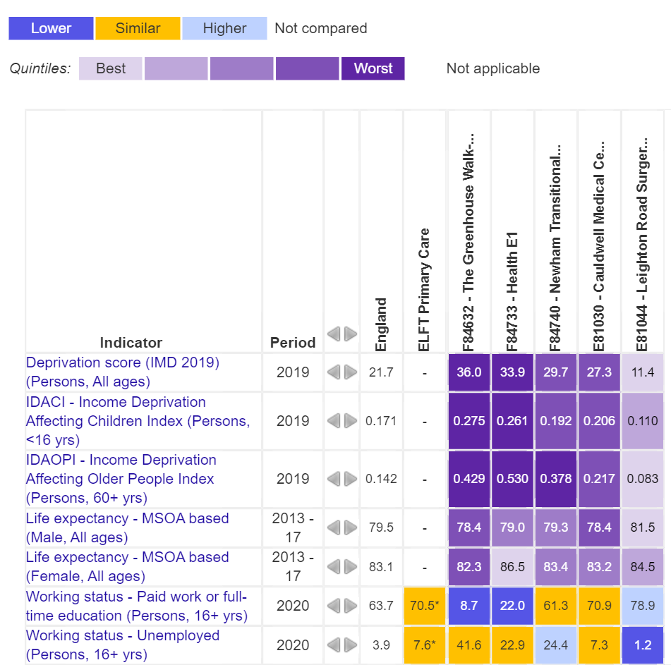
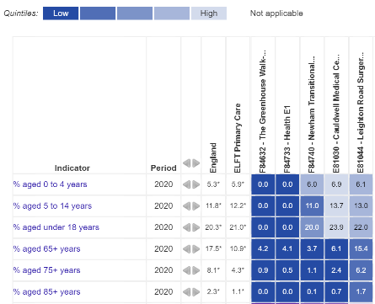
ELFT practice populations
Source: National General Practice Profiles, PHE Fingertips
Notes:
Statistical comparisons are to England

Slide 25
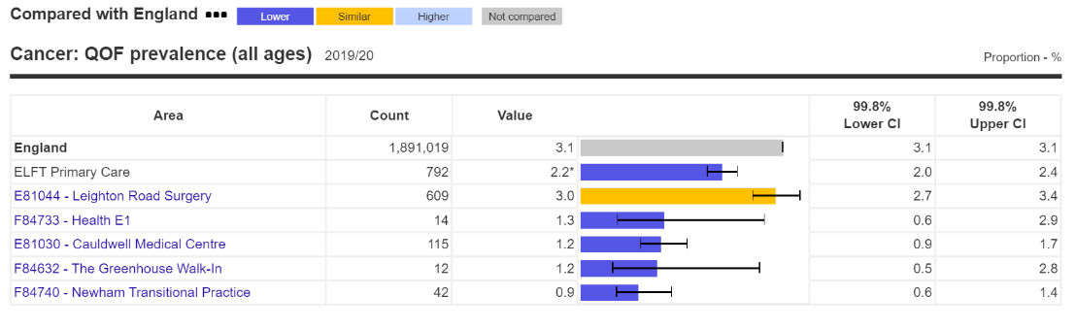
Health in ELFT practices: cancer
Source: National General Practice Profiles, PHE Fingertips
Notes:
Statistical comparisons are to England

Slide 26
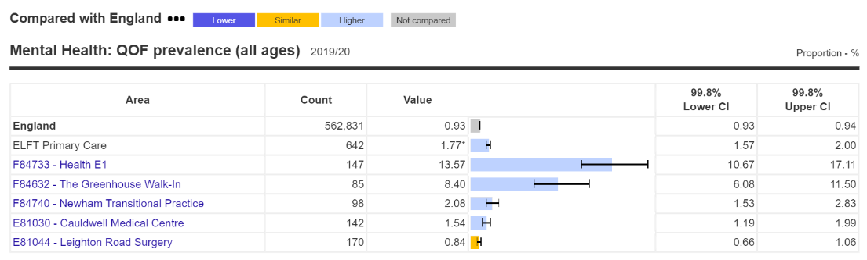
Health in ELFT practices: mental health
Source: National General Practice Profiles, PHE Fingertips
Notes:
Statistical comparisons are to England

Slide 27
Thank you!
Please give some feedback to help improve future training sessions
https://www.surveymonkey.co.uk/r/5T3YBQM

