Slide 1

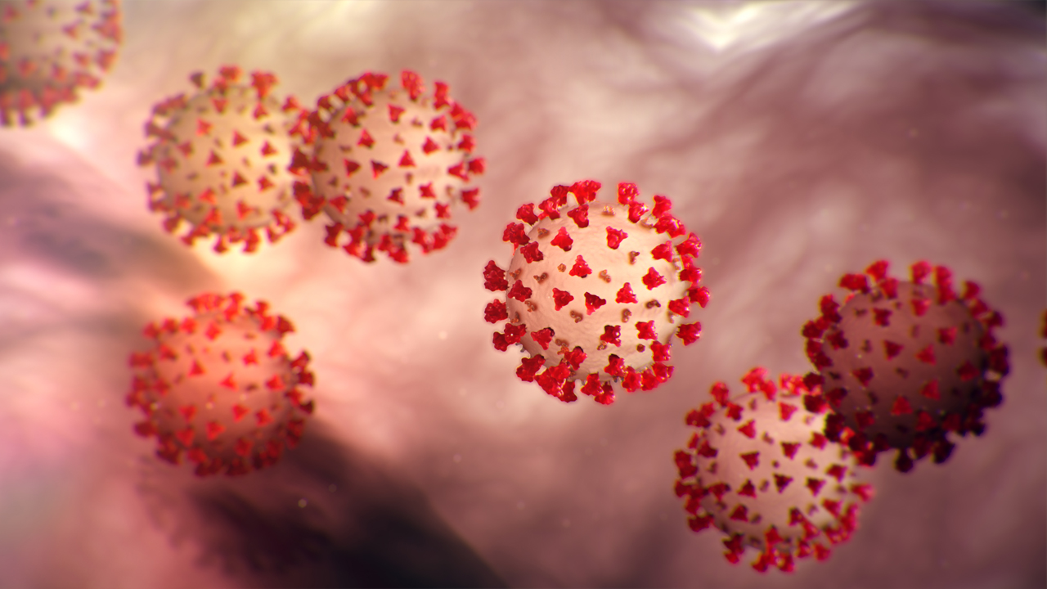
COVID-19
Guidance for in-patient areas

Slide 2
What is Coronavirus ?
The 2019 novel coronavirus, a flu-like illness that can cause serious difficulty breathing , life-threatening pneumonia and sepsis
identified in China at the end of 2019 and is a new strain of coronavirus that has not been previously identified in humans.
COVID-19 has the potential to spread widely as lack of immunity means everyone in the population is susceptible

Slide 3
How is COVID-19 transmitted?
Exposure to large respiratory droplets & vomit
  Coughing/sneezing onto mucous membranes (mouth/eyes)
  Need close contact for this to occur (within 1 metre)
Contact with respiratory secretions
  Transferred by touching mucous membranes
  Tissues/surfaces contaminated with respiratory secretions
It is NOT transmitted in air except if patient undergoing a procedure that generates aerosols e.g. airway suction, resuscitation

Slide 4
What are the symptoms of COVID-19?
Symptom | Proportion of cases
Fever >37º5 | 88%
Dry cough | 68%
Fatigue | 38%
Sputum | 33%
Shortness of breath | 19%
Muscle/joint pain | 15%
Sore throat | 14%
Headache | 14%
Symptoms start 5 -11 days after exposure
Similar to seasonal flu
Majority have fever and dry cough (rapid onset)
Symptoms last 5 - 6 days
Severe illness starts day 7
  ↑ Shortness of breath
  Lung inflammation
  Pneumonia
Notes:
Lauer et al The Incubation Period of Coronavirus Disease 2019 (COVID-19) From Publicly Reported Confirmed Cases: Estimation and Application.
Ann Intern Med. 2020 Mar 10. doi: 10.7326/M20-0504

Slide 5
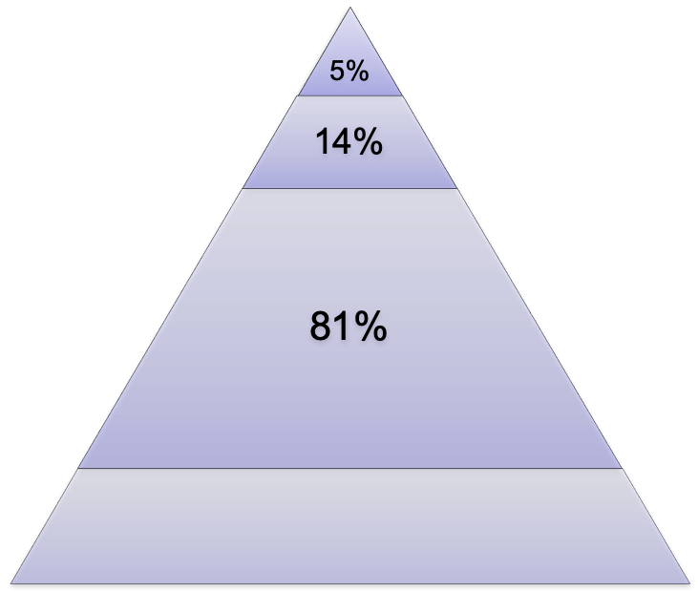
Severity of COVID-19 illness
Most people have no obvious symptoms (30-40%)
Most children get mild disease
More severe disease in:
  Older people
  Diabetics
  Heart disease
  Chronic respiratory disease
  Immune compromised
Less than 2% of cases fatal
  Highest in high risk groups
Critical
Respiratory/muli-organ failure
Severe
Shortness of breath; ↑Respiration; ↓O₂ sats
Mild
Fever, cough
Undetected

Slide 6
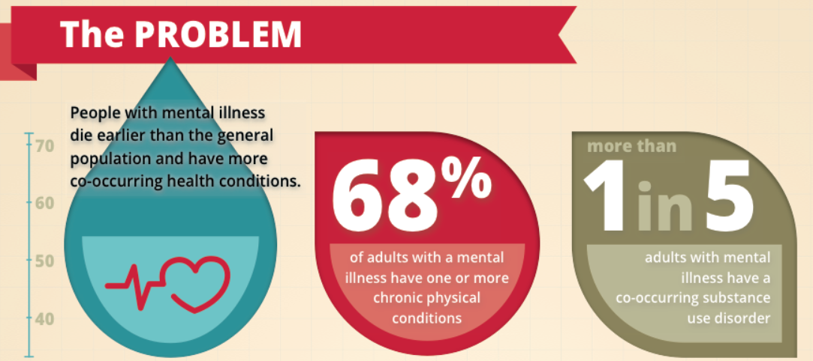
Mental Health and Physical Health

Slide 7
Assess all patients with mental health illness and Learning Disability for co-morbidity and risk – discuss with medical Doctors and monitor for signs

Slide 8
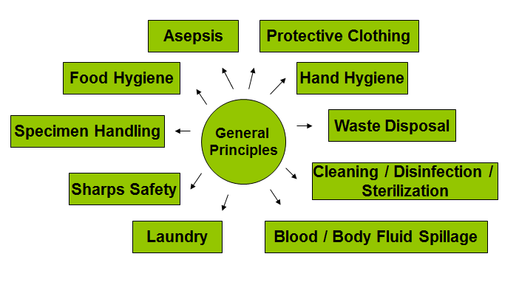
Infection Prevention & Control Principles

Slide 9
Hand Hygiene Preparations
Keep nails short and clean.
Do not wear false nails.
Remove all nail polish.
Remove wrists watches, bracelets and rings with ridges and stones.
Be ‘Bare Below the Elbow’ when implementing care.

Slide 10
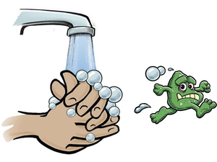
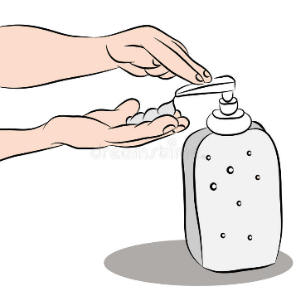
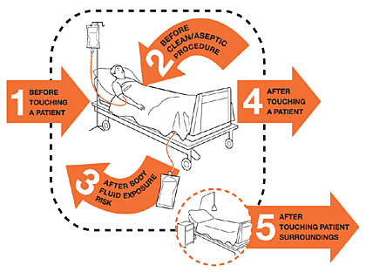
Hand Hygiene
Immediately before touching a patient
Before a clean/aseptic procedure
Immediately after touching patient or their surroundings
After removing gloves
After any contact with body fluids
Alcohol gel is effective against COVID-19
Soap and water should be used if hands are soiled
Notes:
COVID-19 is an enveloped virus and therefore destroyed by alcohol hand rubs

Slide 11
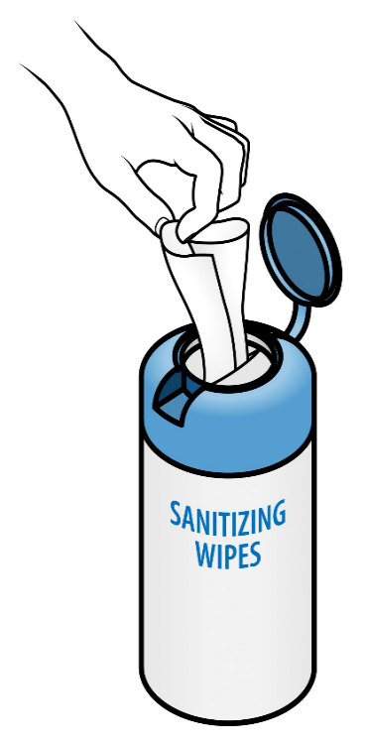
Patient hand hygiene
Encourage patients to clean their hands
  After coughing/sneezing
  Before eating
  After toilet
Make hand wipes or alcohol gel available for patients to use (ensuring safety according to the clinical environment)

Slide 12
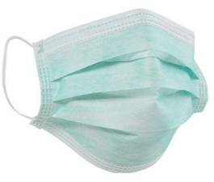
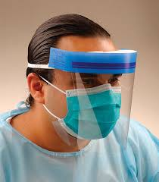
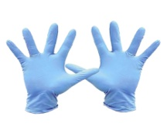
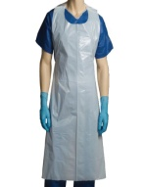
Protective clothing suspected/ confirmed COVID-19
  Surgical mask - when in close contact (1 metre)
  For a session of work, up to 4 hours or change if becomes damp
  Eye protection - if risk of splashing and taking swab
  For a session of work, some can be cleaned and re-used
  Gloves - for close contact, respiratory secretions, body fluids
    MUST be changed between procedures & patients to protect patient
    from infection
  Apron - for close contact
    change if soiled
    fluid-resistant disposable gown only for aerosol generating procedures or in high risk areas
Remember to avoid touching your mouth, nose and eyes

Slide 13
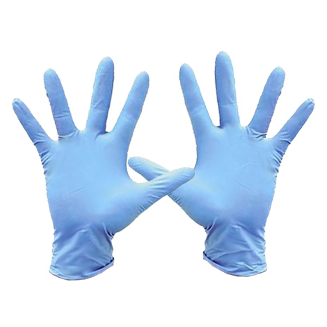


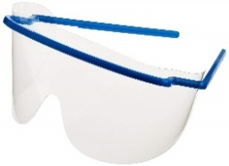
If risk of splash from body fluids add visor or goggles

Slide 14
FFP3 and gowns required for Aerosol Generating procedures & Resuscitation
Aerosol Generating Procedures
Chest compressions (resuscitation) – see Trust guidelines
Manual Ventilation
Intubation & extubation
Tracheostomy
Airway suction
Non-invasive ventilation (BiPAP, CPAP) & high-frequency oscillating ventilation (HFOV)
High flow nasal oxygen
Chest physiotherapy
Sputum induction
Bronchoscopy
Surgery - high speed devices

Slide 15
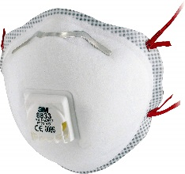
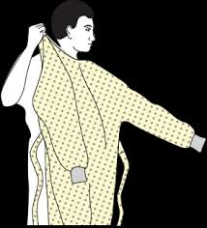
FFP3 Masks
Filters out very small particles
Protects from inhalation of fine airborne particles
Filtration effective only if sealed to contour of face (fit testing required)
Required for procedures which generate aerosols of respiratory secretions (AGP)
  with long-sleeved gowns, visor/goggles , & gloves
Aerosol Generating Procedures
Chest compressions (Resuscitation) Manual ventilation
Intubation & extubation
Tracheostomy
Airway suction
Non-invasive ventilation (BiPAP, CPAP) & high-frequency oscillating ventilation (HFOV)
High flow nasal oxygen
Chest physiotherapy
Sputum induction
Bronchoscopy
Surgery - high speed devices

Slide 16
Resuscitation/CPR is an aerosol generating procedure and will require full gown, visor/goggles, gloves and FFP3 mask
See Standard Operating Procedure on Trust intranet Covid-19 for more information on resuscitation

Slide 17
Summary of PPE for patients with COVID-19
Personal Protective Equipment | Close patient contact (within 2m) | Enter room but no contact with patient or environment | Cleaning room/area (Domestic staff) | AGP
Apron |  | ✗ |  | ✗
Surgical mask |  |  |  | ✗
Long sleeved disposable gown | ✗ | ✗ | ✗ | 
FFP3 respirator | ✗ | ✗ | ✗ | 
Eye protection | Risk assess | ✗ | ✗ | 
Gloves |  | ✗ |  | 
AGP = aerosol generating procedures

Slide 18
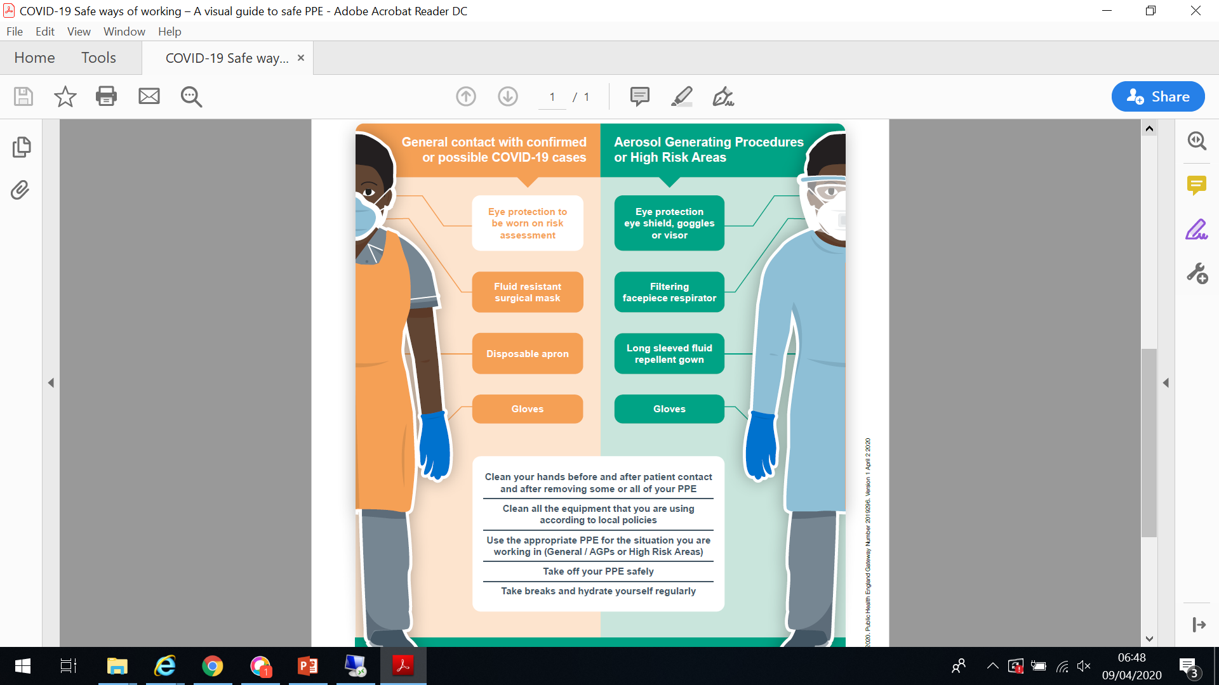

Slide 19
How to put on & take of PPE
General contact
https://www.youtube.com/watch?v=tTZvXudABCg
Aerosol Generating Procedures/High Risk Areas
https://www.youtube.com/watch?v=kKz_vNGsNhc

Slide 20
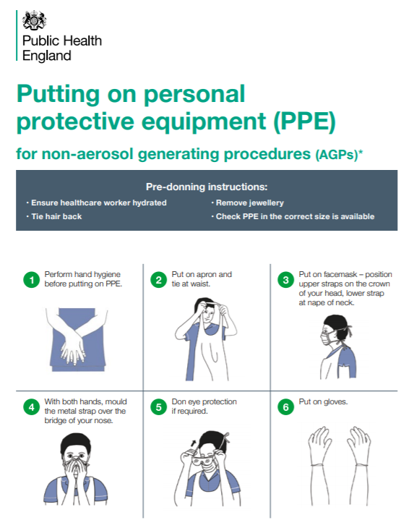

Slide 21
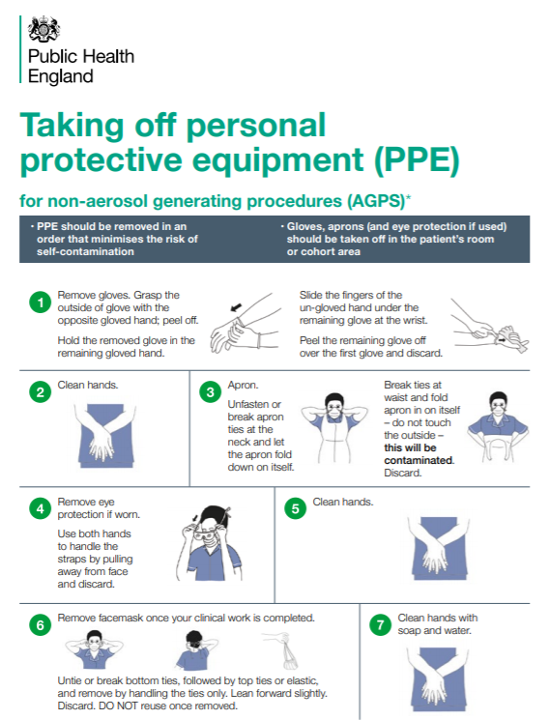

Slide 22
For Aerosol Generating Procedures you will need to attend FIT training

Slide 23
Management for patients with Suspected COVID-19- inpatient areas
  Move to single room with en-suite facilities
  Contact Infection Control team - 0208 121 5662 9am-5pm Out of hours contact Director –on-call
  Use PPE (Glove, apron, fluid resistant surgical mask & visor/goggles)
  Take Swab for Influenza and COVID-19
  Clean surfaces daily (twice a day)- Inform Facilities helpdesk
  Dedicated patient equipment Re-usable medical equipment to be cleaned with Clinell wipes then Chlorine based disinfectant wipes (Clorox)
  Complete Datix incident report
  Instruct patient to stay in their room and wear surgical mask (if safe to do so)
  Minimise number of contacts with patient by aggregating different tasks
Remember to avoid touching your mouth, nose and eyes

Slide 24
Management for patients confirmed COVID-19 infection
Key Principles
Same principles as managing suspected COVID-19 cases
Patients must have tested positive and must be nursed in a separate area from suspected COVID-19 cases
Staff should be assigned to work in COVID-19 designated areas and not care for other patients
Patient must stay in their room and wear mask if safe for them to do so
Monitor vital signs for deterioration (NEWS2/PEWS)
Must change gloves/aprons between patients
Must decontaminate hands between patients

Slide 25
Environmental contamination
Surfaces may become contaminated with respiratory secretions
  Directly from coughing/sneezing
  Indirectly by touching with contaminated hands
COVID-19 survives on surfaces 72 hours /3 days
Easily removed by cleaning
  Re-usable medical equipment (including goggles) to be cleaned with Clinell wipes then Chlorine based disinfectant wipes (Clorox)
  Chlorine tablets to be used for environmental cleaning
Notes:
The virus will contaminate surfaces in an infected patient room but can be easily removed by cleaning.
Environmental contamination studies recover viral DNA from surfaces using PCR. This detects the virus genome but give no information about whether the virus particle is able to cause infection.
Ong et al JAMA March 4 2020

Slide 26



Universal medical equipment: Wipe with Clinell universal wipes followed by chlorine disinfectant wipes
Wipes for
Cleaning
Code -VJT118
Chlorine
Wipes for Disinfectant
Code -VJT263
Chlorine tablets for environmental cleaning
Code -MRB 286

Slide 27
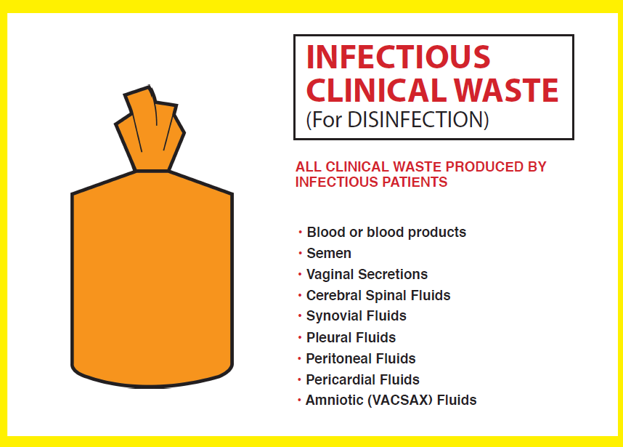
Disposal of waste & laundry
Waste - discard as clinical waste
Laundry - as infected laundry in red bags
Body fluid spillages - as usual local policy
Uniforms
  change before leaving work, wrap in plastic bag
  If washing at home wash separately, at 60 degrees and do not overfill machine

Slide 28
Staff with COVID-19
If you develop symptoms of a flu-like illness then DO NOT come into work:
  Acute onset fever >37.8ºC and/or new continuous cough
Inform your manager & complete datix incident report
Self-isolate at home for 7 days from onset of symptoms
  If your symptoms worsen contact NHS 111
Staff at high risk of complications from COVID-19
  risk-assessment to manage their deployment
  Family to self isolate for 14 days or 7 days from onset of any symptoms themselves (may develop symptoms on day 10 which would be total isolation of 17 days)

Slide 29
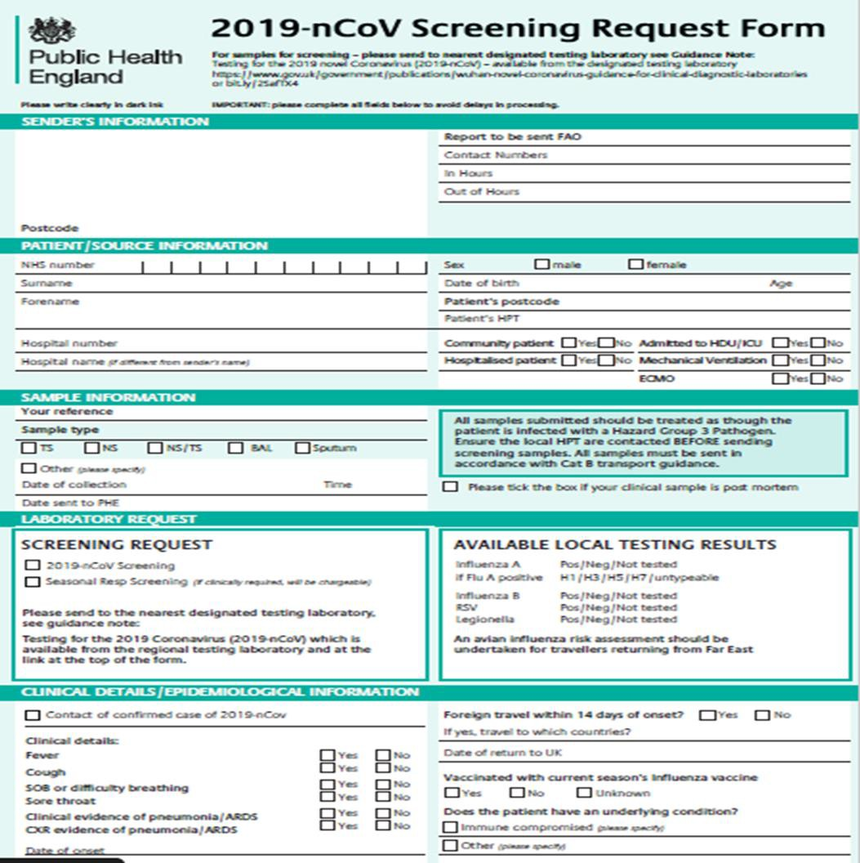
Specimen collection for COVID-19
Swabbing currently not required for patients staying at home – only hospitalised patients suspected of Covid-19
Fill in the form and swab label before taking swab from patient
PPE + visor/goggles (risk of coughing when taking throat swab)
Take swab for Influenza & COVID-19 (tick both boxes)

Slide 30
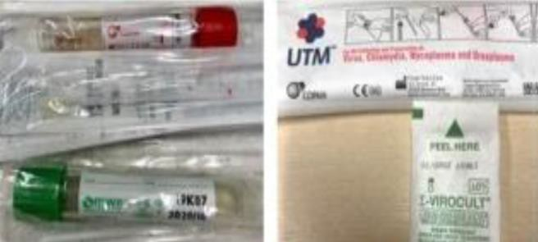
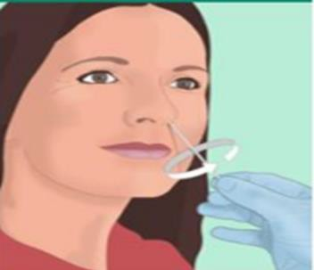
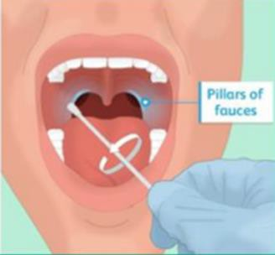
How to take a COVID-19 Specimen
1.Once PPE + visor/goggles has been put on take the swab & pre-labelled swab container as well as a plastic sample bag
2.Collect a throat and nose swab using a single swab. This can be done by swabbing the throat or nose first
3.Place swab in the swab container, break swab and seal container
4. Place sealed sample container in the sample bag & seal bag
5. Keep the broken end of the swab to discard in waste bag
6.Discard broken swab end into the waste bag
7. Follow doffing and contaminated waste procedures and double bag swab

Slide 31
Handling dead bodies
Use PPE (Glove, apron, fluid resistant surgical mask & goggles).
This is due to the ongoing risk of infectious transmission via contact.
Where the deceased was known or suspected to have been infected with COVID-19, there is no requirement for a body bag.
Advise those removing body of Covid-19 (porters/undertakers)

Slide 32
The Trust is committed to staff and patient safety and will monitor staff compliance.
Team trainers will be issued with a form to record names of staff who have been trained which they will complete and send to the Learning & Development Team (so we can be assured all staff have received training)
Team Trainers will ensure all staff in their team have completed training commensurate with their role within 2 weeks

Slide 33
You must have training in:
Donning/Doffing PPE
Additionally, clinical staff must have training in FFP3 Mask Fit and NEWS2/PEWS
NEWS2 on-line training via https://news.ocbmedia.com/
Complete, print certificate and give copy to your manager/team trainer

Slide 34
Situation and advice is constantly evolving...
Stay up to date by reading
Trust emails, bulletins and intranet

Slide 35
Useful resources
ELFT Covid-19 emails and intranet
Public Health England Campaign Resources
https://campaignresources.phe.gov.uk/resources/campaigns/101-coronavirus-
Public Health England Coronavirus (COVID-19) guidance
https://www.gov.uk/government/collections/coronavirus-covid-19-list-of-guidance
https://assets.publishing.service.gov.uk/government/uploads/system/uploads/attachment_data/file/872745/Infection_prevention_and_control_guidance_for_pandemic_coronavirus.pdf
NHS England
https://www.england.nhs.uk/ourwork/eprr/coronavirus/
NHS website
https://www.nhs.uk/conditions/coronavirus-covid-19/
Healthcare Infection Society
https://his.org.uk/resources-guidelines/novel-coronavirus-resources/
World Health Organization
https://www.who.int/emergencies/diseases/novel-coronavirus-2019

Slide 36
QUESTIONS
?

