Slide 1

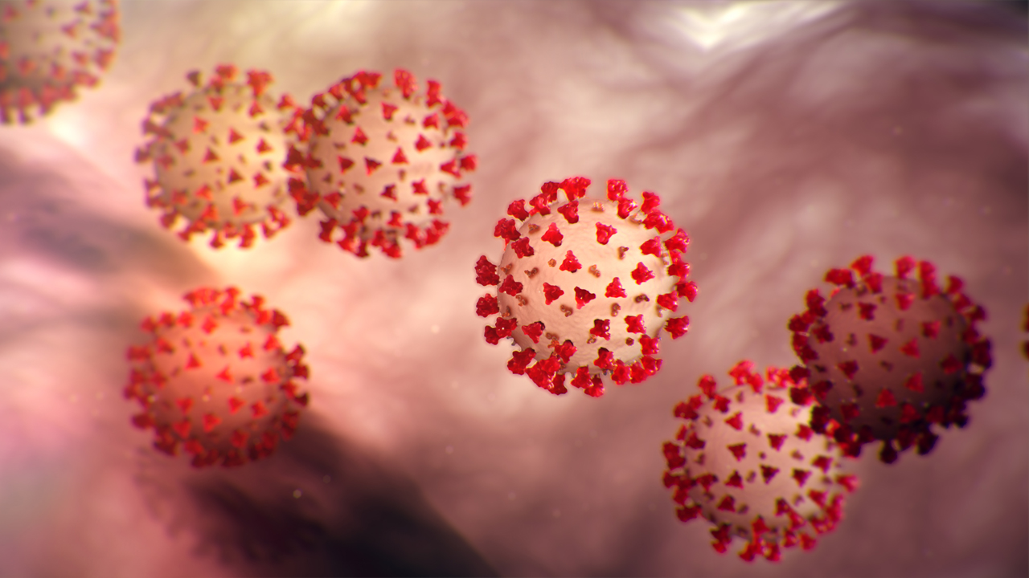
COVID-19

Slide 2
What is Coronavirus ?
The 2019 novel coronavirus, a flu-like illness that can cause serious difficulty breathing , life-threatening pneumonia and sepsis
identified in China at the end of 2019 and is a new strain of coronavirus that has not been previously identified in humans.
COVID-19 has the potential to spread widely as lack of immunity means everyone in the population is susceptible

Slide 3
How is COVID-19 transmitted?
Exposure to large respiratory droplets & vomit
Coughing/sneezing onto mucous membranes (mouth/eyes)
Need close contact for this to occur (within 1 metre)
Contact with respiratory secretions
Transferred by touching mucous membranes
Tissues/surfaces contaminated with respiratory secretions
It is NOT transmitted in air except if patient undergoing a procedure that generates aerosols e.g. airway suction, resuscitation

Slide 4
What are the symptoms of COVID-19?
Symptom | Proportion of cases
Fever >37º5 | 88%
Dry cough | 68%
Fatigue | 38%
Sputum | 33%
Shortness of breath | 19%
Muscle/joint pain | 15%
Sore throat | 14%
Headache | 14%
Symptoms start 5 -11 days after exposure
Similar to seasonal flu
Majority have fever and dry cough (rapid onset)
Symptoms last 5 - 6 days
Severe illness starts day 7
↑ Shortness of breath
Lung inflammation
Pneumonia
Notes:
Lauer et al The Incubation Period of Coronavirus Disease 2019 (COVID-19) From Publicly Reported Confirmed Cases: Estimation and Application.
Ann Intern Med. 2020 Mar 10. doi: 10.7326/M20-0504

Slide 5
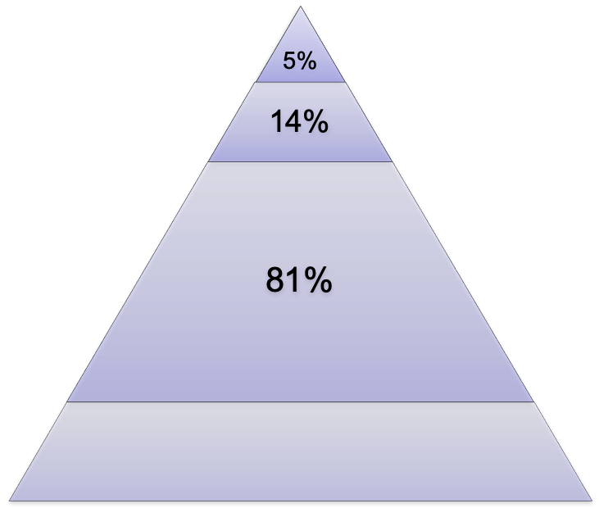
Severity of COVID-19 illness
Most people have no obvious symptoms (30-40%)
Most children get mild disease
More severe disease in:
Older people
Diabetics
Heart disease
Chronic respiratory disease
Immune compromised
Less than 2% of cases fatal
Highest in high risk groups
Critical
Respiratory/muli-organ failure
Severe
Shortness of breath; ↑Respiration; ↓O₂ sats
Mild
Fever, cough
Undetected

Slide 6
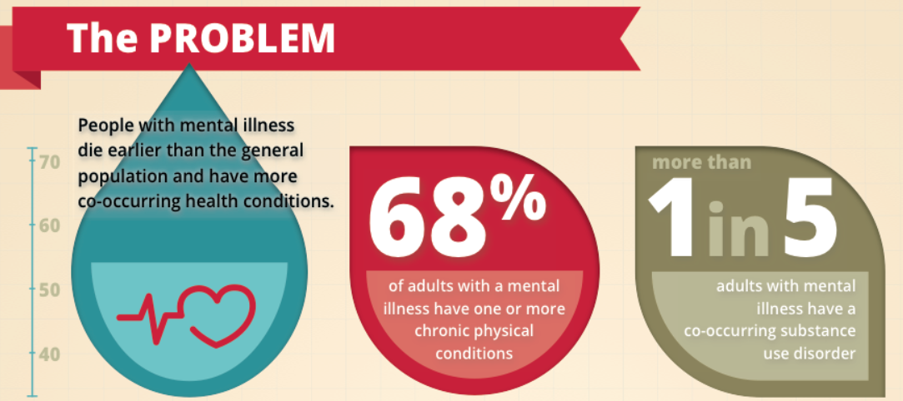
Mental Health and Physical Health

Slide 7
Assess all patients with mental health illness and Learning Disability for co-morbidity and risk – discuss with medical Doctors and monitor for signs

Slide 8
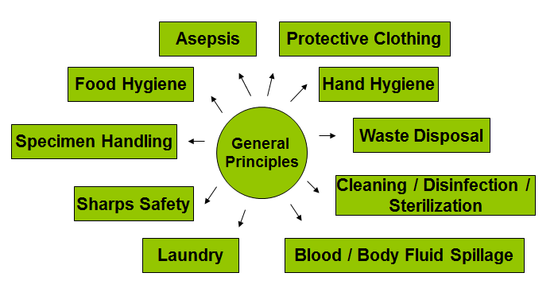
Infection Prevention & Control Principles

Slide 9
Hand Hygiene Preparations
Keep nails short and clean.
Do not wear false nails.
Remove all nail polish.
Remove wrists watches, bracelets and rings with ridges and stones.
Be ‘Bare Below the Elbow’ when implementing care.

Slide 10
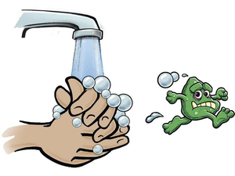
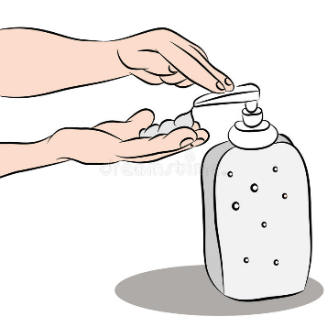
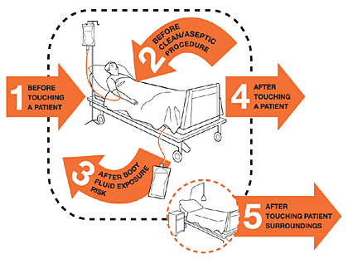
Hand Hygiene
Immediately before touching a patient
Before a clean/aseptic procedure
Immediately after touching patient or their surroundings
After removing gloves
After any contact with body fluids
Alcohol gel is effective against COVID-19
Soap and water should be used if hands are soiled
Notes:
COVID-19 is an enveloped virus and therefore destroyed by alcohol hand rubs

Slide 11
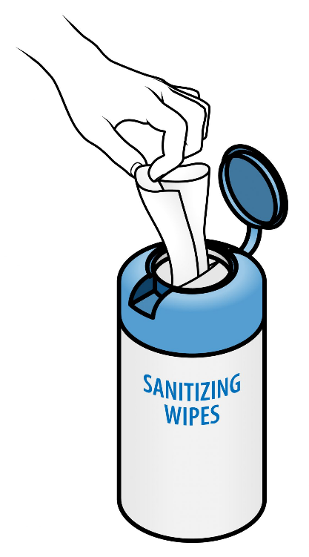
Patient hand hygiene
Encourage patients to clean their hands
After coughing/sneezing
Before eating
After toilet
Make hand wipes or alcohol gel available for patients to use (where safe to do so)

Slide 12
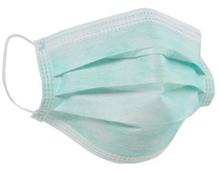
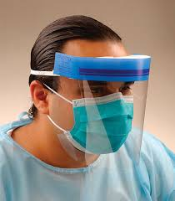
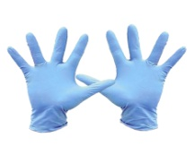

Protective clothing suspected/ confirmed COVID-19
Surgical mask - when in close contact (1 metre)
Eye protection - if risk of splashing
Some can be cleaned and re-used
Gloves - for close contact, respiratory secretions, body fluids
MUST be changed between procedures & patients to protect patient
from infection
Apron - for close contact
change if soiled
fluid-resistant disposable gown only for aerosol generating procedures
Remember to avoid touching your mouth, nose and eyes

Slide 13
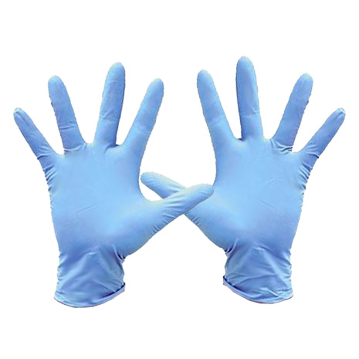
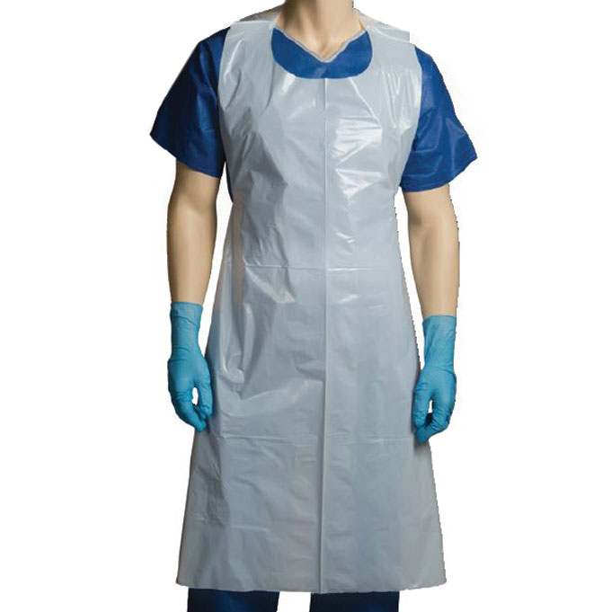

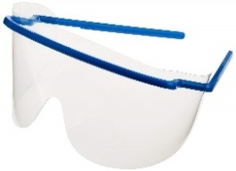
If risk of splash from body fluids add visor or goggles

Slide 14
FFP3 and gowns only required for Aerosol Generating procedures & Resuscitation
Aerosol Generating Procedures
CPR (Resuscitation) - Follow Trust Guidance
Manual ventilation
Intubation & extubation
Tracheostomy
Airway suction
Non-invasive ventilation (BiPAP, CPAP) & high-frequency oscillating ventilation (HFOV)
High flow nasal oxygen
Chest physiotherapy
Sputum induction
Bronchoscopy
Surgery - high speed devices

Slide 15
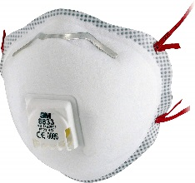
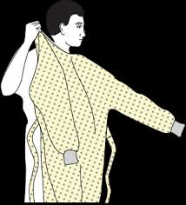
FFP3 Masks
Filters out very small particles
Protects from inhalation of fine airborne particles
Filtration effective only if sealed to contour of face (fit testing required)
Required for procedures which generate aerosols of respiratory secretions (AGP)
with long-sleeved gowns & gloves
Aerosol Generating Procedures
CPR (Resuscitation)
Manual ventilation
Intubation & extubation
Tracheostomy
Airway suction
Non-invasive ventilation (BiPAP, CPAP) & high-frequency oscillating ventilation (HFOV)
High flow nasal oxygen
Chest physiotherapy
Sputum induction
Bronchoscopy
Surgery - high speed devices

Slide 16
Summary of PPE for patients with COVID-19
Personal Protective Equipment | Close patient contact (within 2m) | Enter room but no contact with patient or environment | Cleaning room/area (Domestic staff) | AGP
Apron |  | ✗ |  | ✗
Surgical mask |  |  |  | ✗
Long sleeved disposable gown | ✗ | ✗ | ✗ | 
FFP3 respirator | ✗ | ✗ | ✗ | 
Eye protection | Risk assess | ✗ | ✗ | 
Gloves |  | ✗ |  | 
AGP = aerosol generating procedures

Slide 17
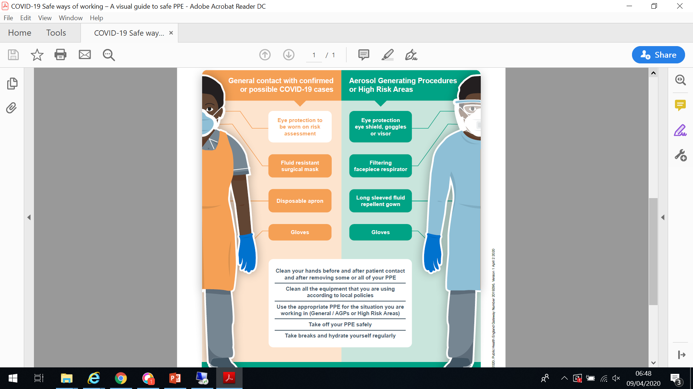

Slide 18
How to put on & take of PPE
General contact
https://www.youtube.com/watch?v=tTZvXudABCg
Aerosol Generating Procedures/High Risk Areas
https://www.youtube.com/watch?v=kKz_vNGsNhc

Slide 19
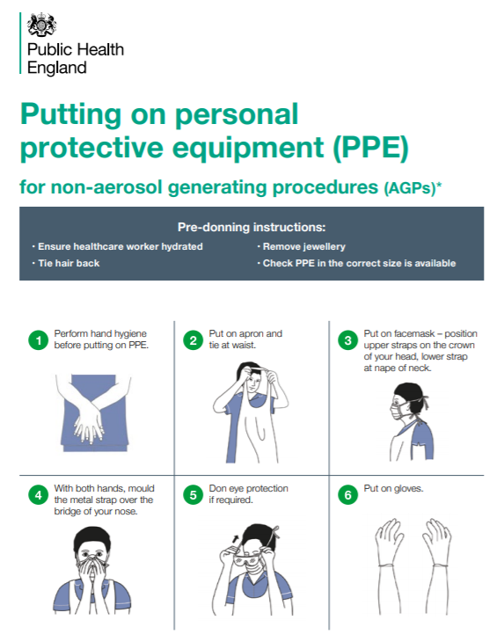

Slide 20
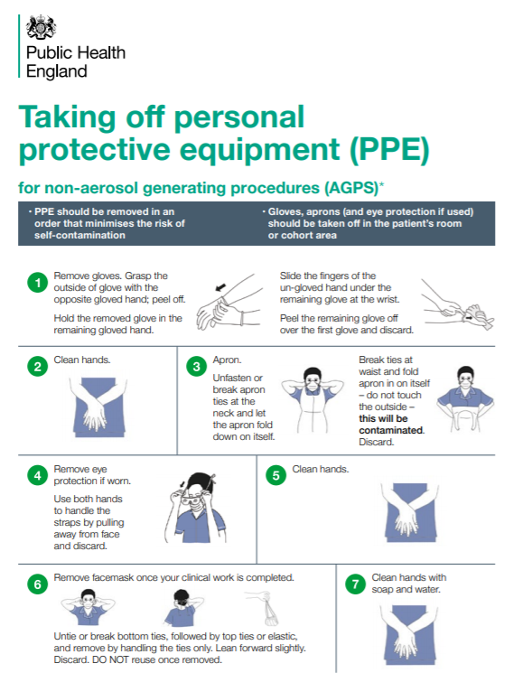

Slide 21
For Aerosol Generating Procedures you will need to attend FIT training

Slide 22
Environmental contamination
Surfaces may become contaminated with respiratory secretions
Directly from coughing/sneezing
Indirectly by touching with contaminated hands
COVID-19 survives on surfaces 72 hours /3 days
Easily removed by cleaning
Re-usable medical equipment to be cleaned with Clinell wipes then Chlorine based disinfectant wipes (Clorox)
Chlorine tablets to be used for environmental cleaning
Notes:
The virus will contaminate surfaces in an infected patient room but can be easily removed by cleaning.
Environmental contamination studies recover viral DNA from surfaces using PCR. This detects the virus genome but give no information about whether the virus particle is able to cause infection.
Ong et al JAMA March 4 2020

Slide 23
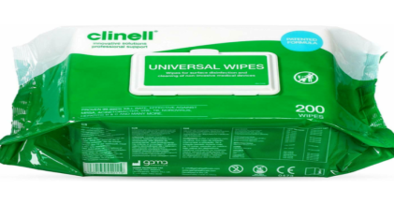

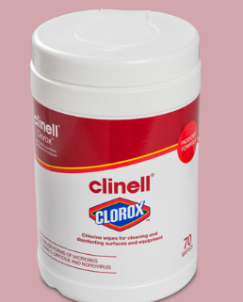
Universal medical equipment: Wipe with Clinell universal wipes followed by chlorine disinfectant wipes
Wipes for
Cleaning
Code -VJT118
Chlorine
Wipes for Disinfectant
Code -VJT263
Chlorine tablets for environmental cleaning
Code -MRB 286

Slide 24
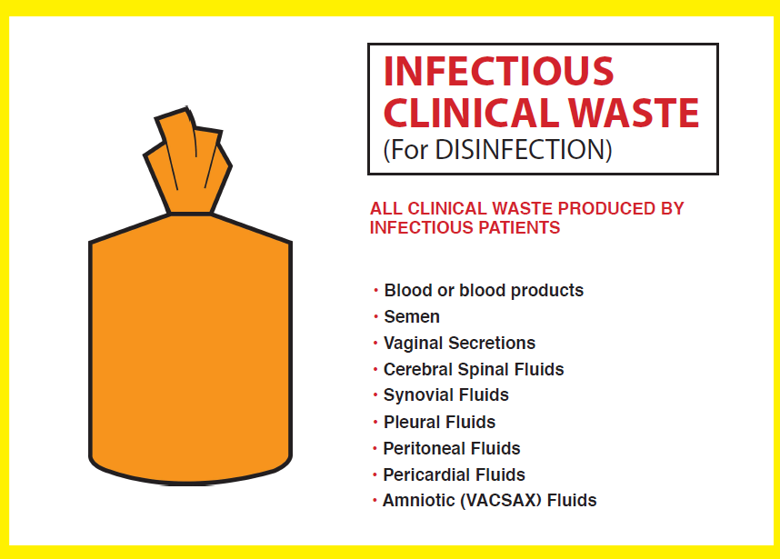
Disposal of waste & laundry
Waste - discard as clinical waste
Laundry - as infected laundry in red bags
Body fluid spillages - as usual local policy
Uniforms
change before leaving work, wrap in plastic bag
If washing at home wash separately, at 60 degrees and do not overfill machine

Slide 25
Staff with COVID-19
If you develop symptoms of a flu-like illness then DO NOT come into work:
Acute onset fever >37.8ºC and/or new continuous cough
Inform your manager & complete datix incident report
Self-isolate at home for 7 days from onset of symptoms
If your symptoms worsen contact NHS 111
Staff at high risk of complications from COVID-19
risk-assessment to manage their deployment
Family to self isolate for 14 days or 7 days from onset of any symptoms themselves (may develop symptoms on day 10 which would be total isolation of 17 days)

Slide 26
You must have training in:
Donning/Doffing PPE
Additionally, clinical staff must have training in FFP3 Mask Fit and NEWS2/PEWS
NEWS2 on-line training via https://news.ocbmedia.com/
Complete, print certificate and give copy to your manager/team trainer

Slide 27
The Trust is committed to staff and patient safety and will monitor staff compliance. Team trainers will be issued with a form to record staff training which they will complete and send to a dedicated person in the Learning & Development Team It is anticipated that Team Trainers will ensure all staff in their team have completed training commensurate with their role within 2 weeks

Slide 28
Situation and advice is constantly evolving... Stay up to date by reading Trust emails, bulletins and intranet

Slide 29
Useful resources
ELFT Covid-19 emails and intranet
Public Health England Campaign Resources
https://campaignresources.phe.gov.uk/resources/campaigns/101-coronavirus-
Public Health England Coronavirus (COVID-19) guidance
https://www.gov.uk/government/collections/coronavirus-covid-19-list-of-guidance
https://assets.publishing.service.gov.uk/government/uploads/system/uploads/attachment_data/file/872745/Infection_prevention_and_control_guidance_for_pandemic_coronavirus.pdf
NHS England
https://www.england.nhs.uk/ourwork/eprr/coronavirus/
NHS website
https://www.nhs.uk/conditions/coronavirus-covid-19/
Healthcare Infection Society
https://his.org.uk/resources-guidelines/novel-coronavirus-resources/
World Health Organization
https://www.who.int/emergencies/diseases/novel-coronavirus-2019

Slide 30
If Government advice changes and swabbing for Covid-19 in the Community is required......

Slide 31
Taking a Covid-19 Specimen Swab
Equipment:
2019 n-cov specimen form 2 biohazard specimen bags/specimen bags with biohazard sticker 1 virology swab & container
PPE: 2 pairs non-sterile gloves , apron, fluid repellant mask, visor/goggles
2 clinical waste bags

Slide 32
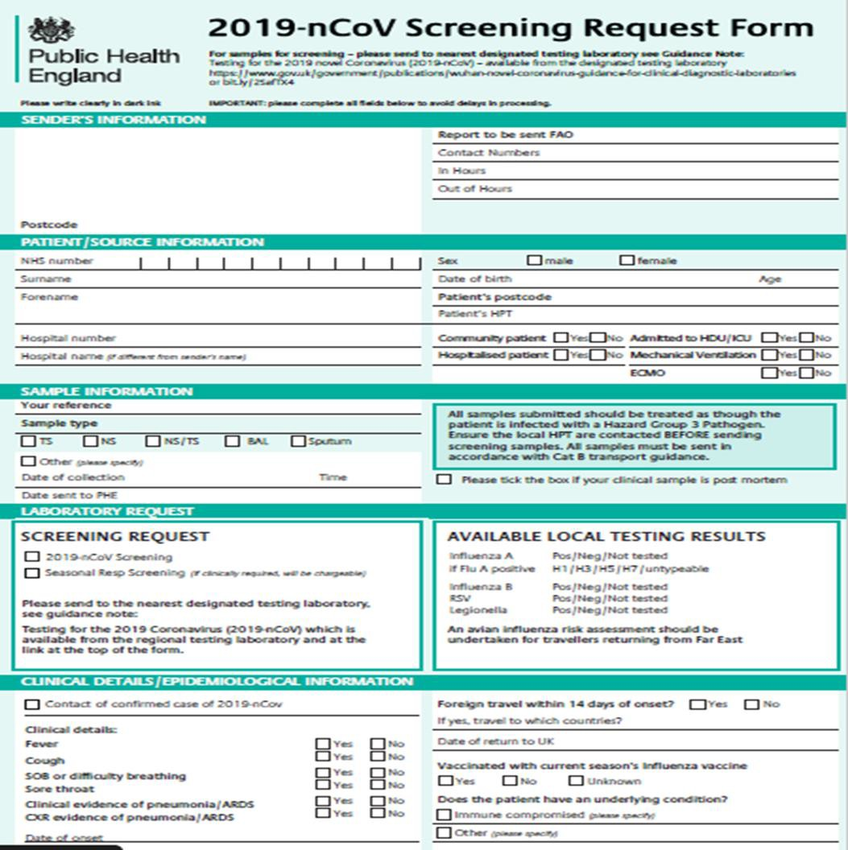
Specimen collection for COVID-19
Fill in the form and swab label before taking swab from patient
Do not take the form into the patient’s home
PPE + visor/goggles (risk of coughing when taking throat swab)
Take swab for Influenza & COVID-19

Slide 33
1. Take PPE (both sets of gloves), the labelled swab , both specimen bags and both clinical waste bags with you to the patient’s front door. Leave one clinical waste bag and one biohazard bag open by outside the front door/with your ‘buddy’ in preparation for doffing procedure. 2. Don PPE as per donning protocol ; If lone working put on both pairs of gloves. If working with a buddy each put on 1 pair of gloves. Enter the patient’s home with the swab, one clinical waste bag and one biohazard bag. Leave the clinical waste bag by the front door inside the patient’s home (there will now be a specimen bag and clinical waste bag inside and outside the property) 3. Explain the process to the patient and take the swab (see next slide) 4. Place the specimen swab into the biohazard bag and seal 5. Take the specimen bag to the front door. If working with a buddy, ask them to assist with ‘double bagging’ - buddy to hold open second specimen bag for you to place the swab inside (avoiding contact with the outside of the bag) and buddy to seal. Ask buddy to open second waste bag in readiness to receive contaminated PPE. Close the door and doff mask and gown, place in waste bag and seal. Open the door and ask your buddy to hold open the second waste bag and place first sealed waste bag and your gloves inside. Ask buddy to remove their gloves and seal the bag. Both clean hands with alcohol gel. If working alone place on ground next to you inside the front door. Doff one pair of gloves and remainder PPE as per doffing protocol training and place in clinical waste bag, Seal clinical waste bag. Pick up the swab in the biohazard bag, open the front door and place the specimen in the second biohazard bag and seal; place the clinical waste in the 2nd clinical waste bag, remove gloves and seal. Clean hands with alcohol hand rub 6. Put pre-prepared form into outer specimentbag Send Sample to the assigned laboratory and dispose of clinical waste as per Trust clinical waste policy

Slide 34
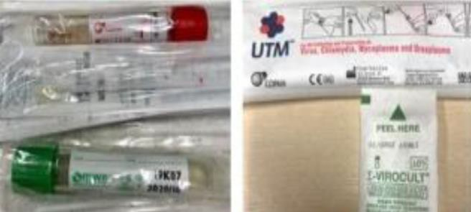
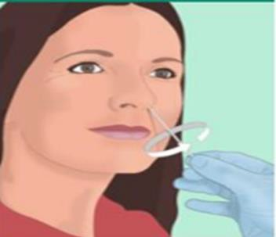
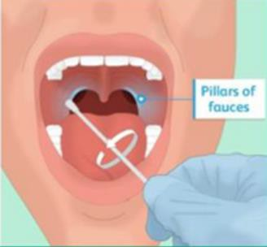
How to take a COVID-19 Specimen
1.Once PPE has been put on take the swab & pre-labelled swab container as well as a plastic sample bag
2.Collect a throat and nose swab using a single swab. This can be done by swabbing the throat or nose first
3.Place swab in the swab container, break swab and seal container
4. Place sealed sample container in the sample bag & seal bag
5. Keep the broken end of the swab to discard in waste bag
6.Discard broken swab end into the waste bag

Slide 35
QUESTIONS ?

