Slide 1

Meeting the Quality Standards CQC Bulletin Produced for Executive Directors, Quality Committee and CQC Network
January-March 2021 Update

Slide 2

Key messages:
CQC will be restarting some inspection activity from 1st April
New Transitional Monitoring Approach will remain in place and feedback from Stratford Vaccination Centre
Update on Insight Report and latest publications
Message from Lorraine Sunduza, Chief Nurse:
Throughout the pandemic we have continued to have close contact with the CQC. We have regularly fed back how we’re managing our response to the pandemic, shared positive stories and the challenges we are facing.
They have been there to support our learning and also challenge us when necessary, in their ‘critical friend’ and regulator role.
Our work with them is ultimately about continuing to improve quality and safety of services. Therefore it is important we continue to look after each other as colleagues continuing to celebrate successes and learn where things don’t go well.

Slide 3
CQC Covid-19 Updates
Following the Covid-19 pandemic beginning from March 2020, the CQC paused routine inspections and focussed activity where there was a risk to people’s safety. As a result of this, the planned Well-Led inspections at ELFT for early 2020 did not take place.
As of April 2021, the CQC will continue using a risk-based approach but will also be restarting the following activities, which may impact ELFT.
Return to inspect and rate NHS trusts and independent healthcare services that are rated as inadequate or requires improvement, or where new risks have come to light, and develop plans to review ratings for all hospital providers to make sure they are still appropriate based upon our latest assessment of risk
Carry out some core service with well-led inspections of mental health trusts and independent mental health providers
Closely monitor how hospitals are ensuring robust infection prevention and control and carry out focused IPC inspections where we have concerns about a provider’s oversight of infection risk
Continue conducting Mental Health Act (MHA) monitoring visits using new virtual methodology to ensure the rights of vulnerable people are protected

Slide 4
CQC Updates - Transitional Monitoring Approach
From November 2020 the CQC started utilising a model which is called the Transitional Monitoring Approach, and they will continue to use it over the next few months in response to Covid-19.
This approach focuses on safety, how effectively services are run and how easy they are to access. The CQC strengthening their approach to monitoring services, based on specific key lines of enquiry (KLOEs) and will be increasingly using technology, so then can target inspection activity where there is most risk. It’s important to note that while the approach may be changing, the KLOEs and measures
The CQC will be reviewing information they hold about services (e.g. previous inspection reports and ratings, monitoring information collected through the usual data sources, views of people using the service and inspector’s knowledge of the service). After reviewing this information, the CQC may arrange a phone call with representatives of ELFT and ask further questions. Following this phone call, if risk is perceived then further regulatory activity (such as an inspection) may occur.

Slide 5

Lessons Learnt: Feedback from the latest inspections
Feedback on the Transitional Monitoring Approach Virtual Meeting with Stratford Vaccination Centre
The response by the Stratford Vaccination team to set up and deliver Covid-19 vaccinations to staff and the wider public has been praised.
The CQC conducted a review against the KLOEs identified for Hospital-led vaccination centres, covering the Safe, Effective, Responsive and Well-Led domains. The service initially compiled a comprehensive bundle of information, evidencing how they were meeting standards and supporting this with relevant documentation. This was shared with CQC prior to a virtual interview with the team on MS Teams.
The CQC reported they received good assurance that the service was meeting 8 key areas including:
Safe use of medicines
Staff training and induction
Consent and capacity
Access for high risk/vulnerable groups
CQC highlighted the enthusiasm of staff and how contagious their enthusiasm was and how determined and motivated staff were. They also acknowledged the work that had been put in by the team to put together and send through the documents the team has already used to provide assurance that they were meeting key standards. The team shared their experience and learning of the experience and provided some top tips to support other teams who may go through the experience. You can read more about this here.

Slide 6
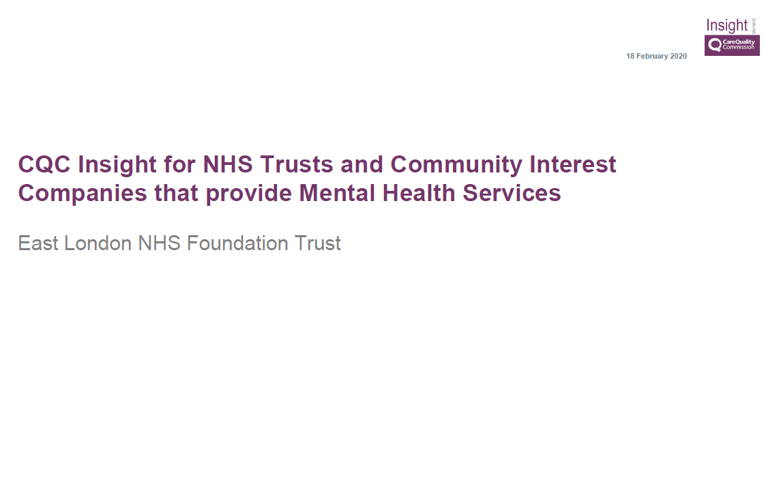
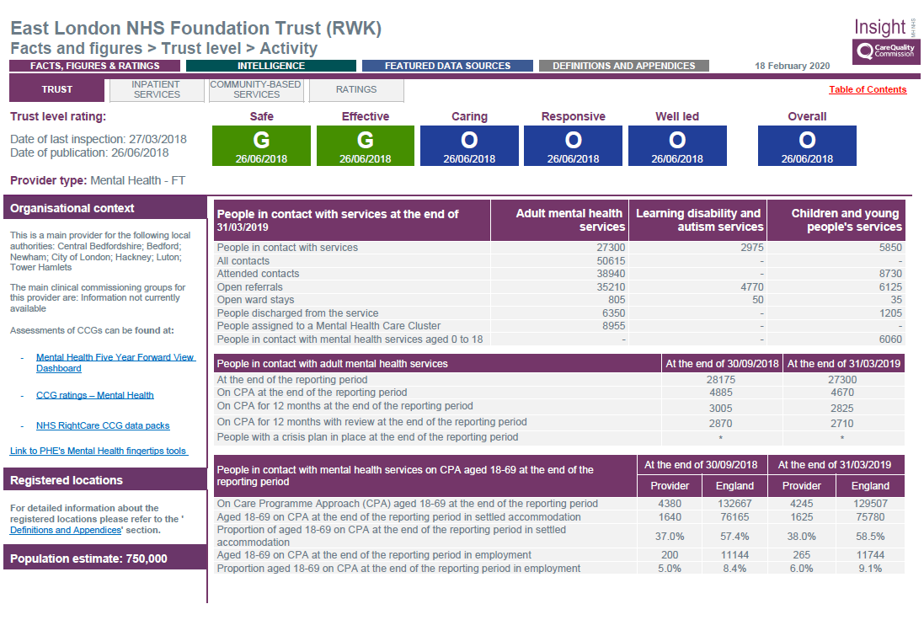
CQC ‘Engagement Meetings’ – Latest ‘Insight’ Report
The CQC have developed an ‘Insight’ report to monitor the quality of care which:
incorporates data indicators that align to key lines of enquiry
brings together information from people who use services, knowledge from inspections and data from partners
indicates where the risk to the quality of care provided is greatest
monitors change over time for each of the measures
points to services where the quality may be improving
The areas analysed indicate whether the care people are receiving is safe, effective, caring, responsive to their needs and well-led.
Click the image to view the full report

Slide 7



Latest CQC Publications
Out of Sight – Who cares? Restraint, Seclusion and Segregation Review (Oct 2020)
This report looks at the use of restrictive practices in the care of people diagnosed with a learning disability, or mental health condition. The CQC makes 4 key recommendations as a result.
To read the report >>click here<<
Monitoring the Mental Health Act: The Mental Health Act in the coronavirus (COVID-19) pandemic (Nov, 2020)
This annual report explores the use of MHA by providers during a period of unprecedented challenge, and balancing duty of care with least restriction.
To read the report >>click here<<
Protect, respect, connect – decisions about living and dying well during Covid-19
This review, which took place between November 2020 and January 2021, looks at how DNACPR decisions were made in the context of advance care planning, across all types of health and care sectors, including care homes, primary care and hospitals.
To read the report >>click here<<

Slide 8

Where to find key information?
We want staff to feel supported, you can use the intranet to keep up-to-date with inspection news, network and events that are being held and to find key documentation. Members of the project team are always there to talk to, you will find their details below:
Lorraine Sunduza, Chief Nurse
Ellie Parker, Deputy Head of Quality Assurance and CQC Lead
E-mail: elft.cqc@nhs.net

