Slide 1

Welcome to
ELFT Staff LGBTQ Conference

Slide 2
Welcome and Introductions
Andrew Horobin
Service Manager - Urgent Care and Specialist Teams
Trust LGBTQ Equality Lead

Slide 3
Housekeeping
Agenda
Timings
Breaks
Locations
Toilets
Fire alarm / exits
Phones
Special needs?

Slide 4

Please help us capture and share
this day by using
#ELFT_LGBTQ hashtag
when you tweet.
Thank you!

Slide 5

What is your pronoun?
- Table discussion
- ID badges

Slide 6
Network Journey to Date
Andrew Horobin
Service Manager - Urgent Care and Specialist Teams
Trust LGBTQ Equality Lead

Slide 7
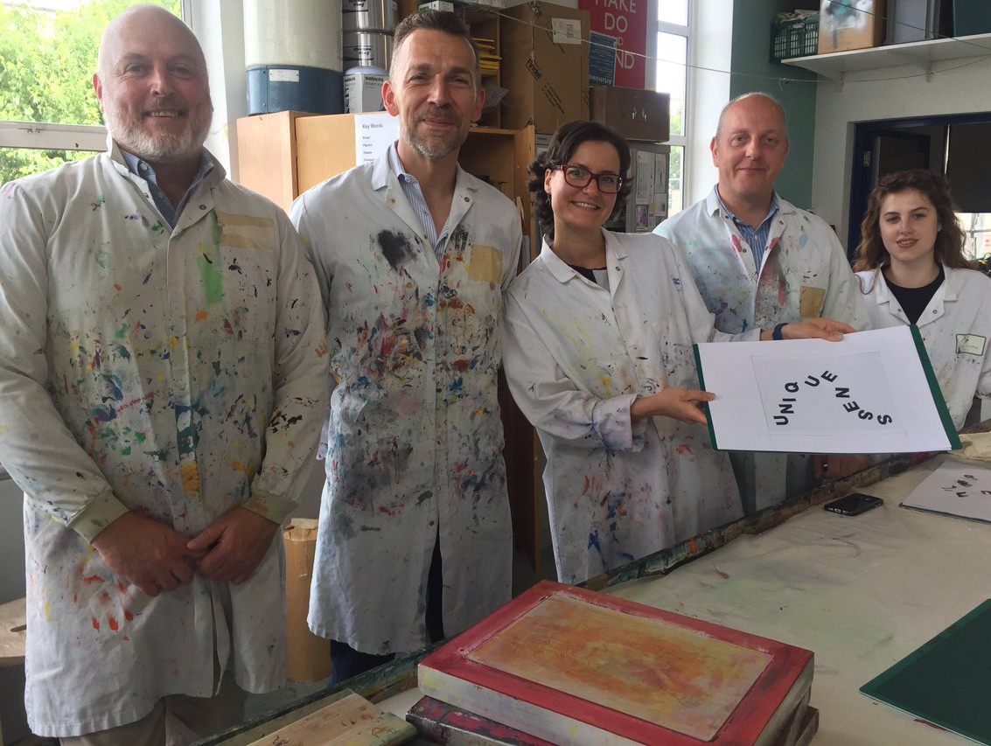
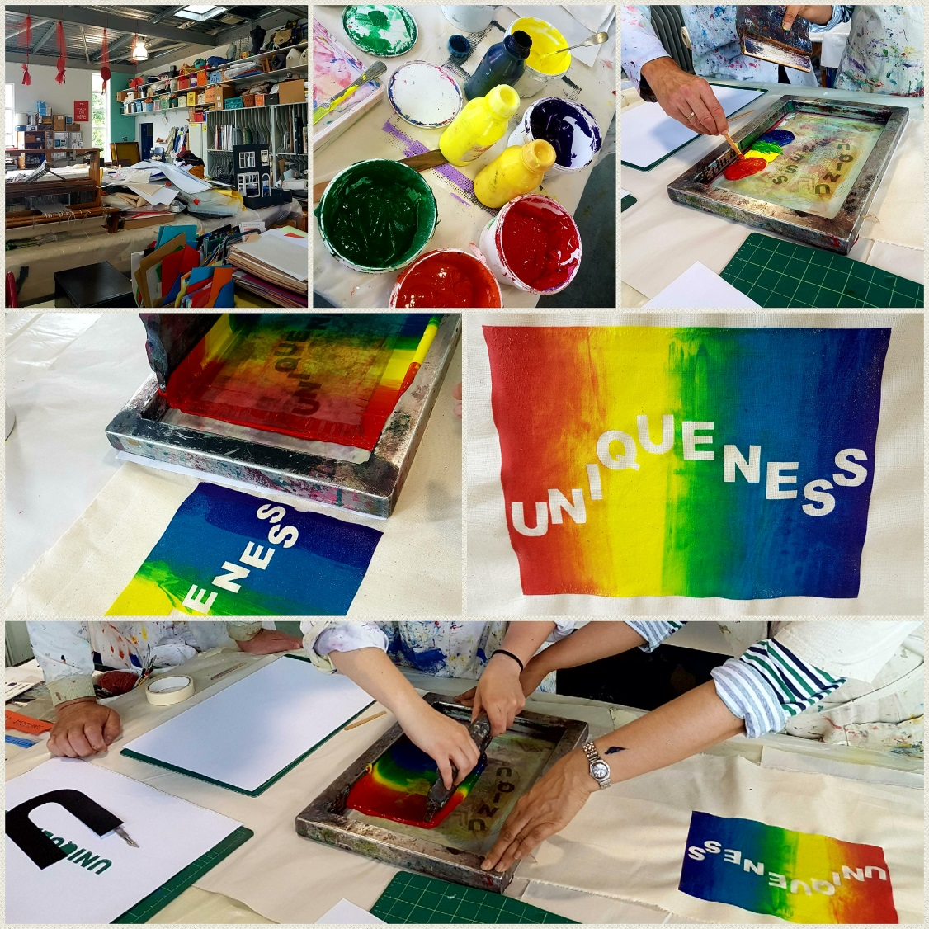
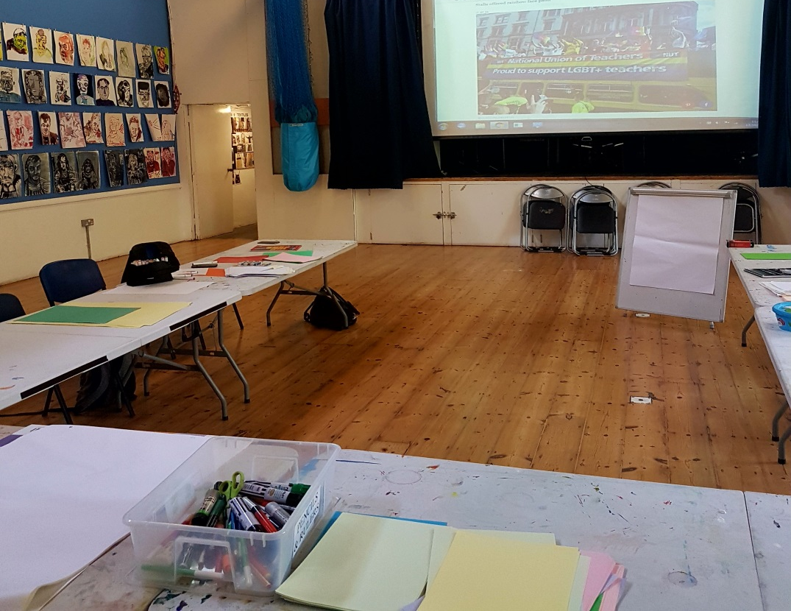
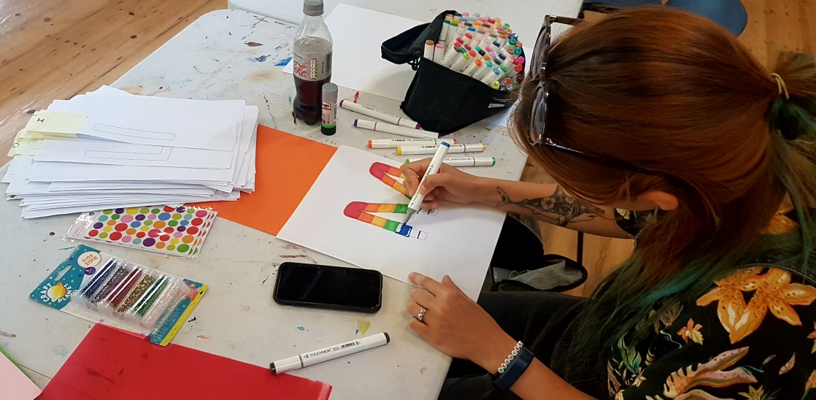

Slide 8
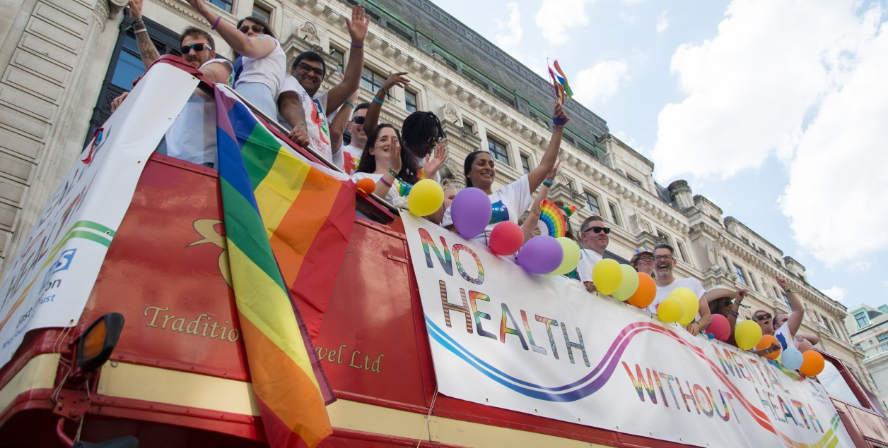
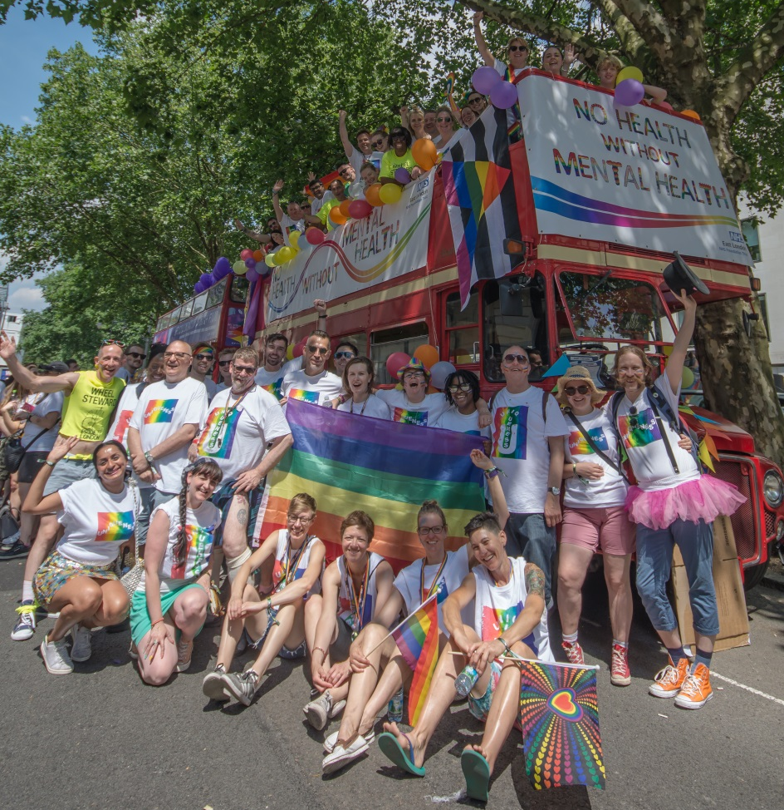
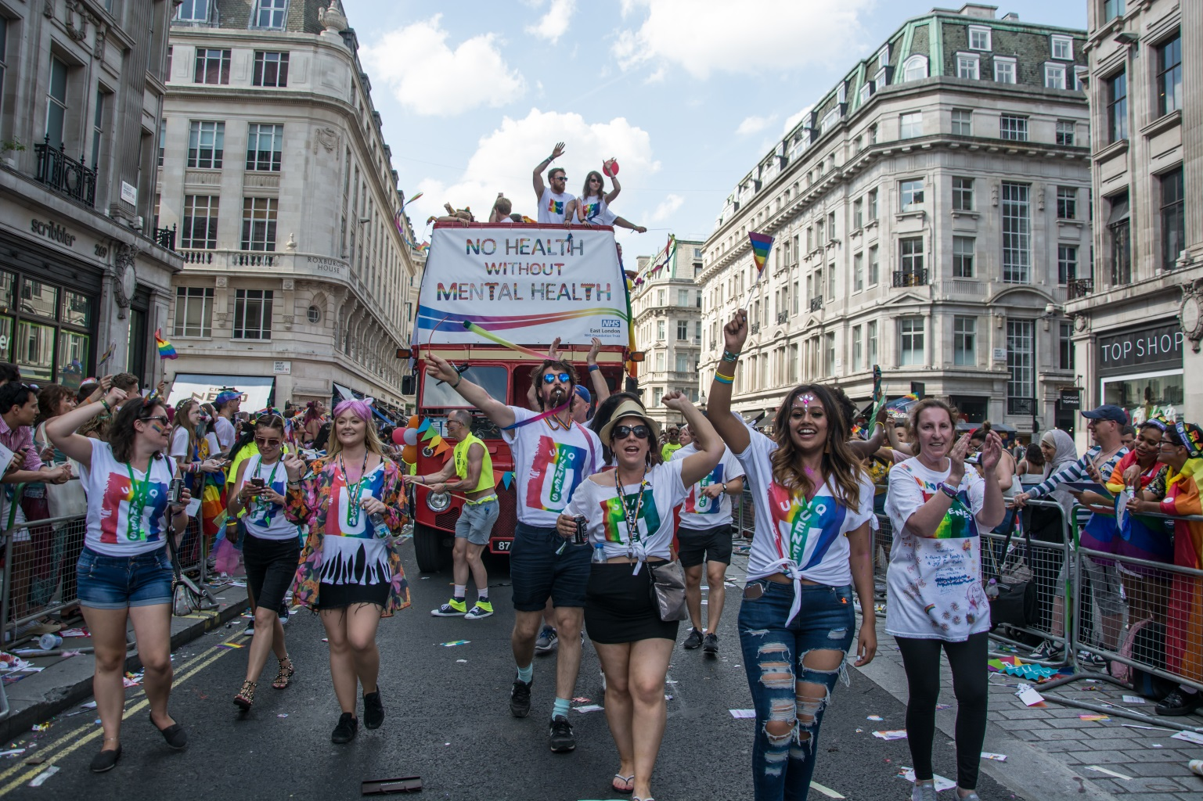
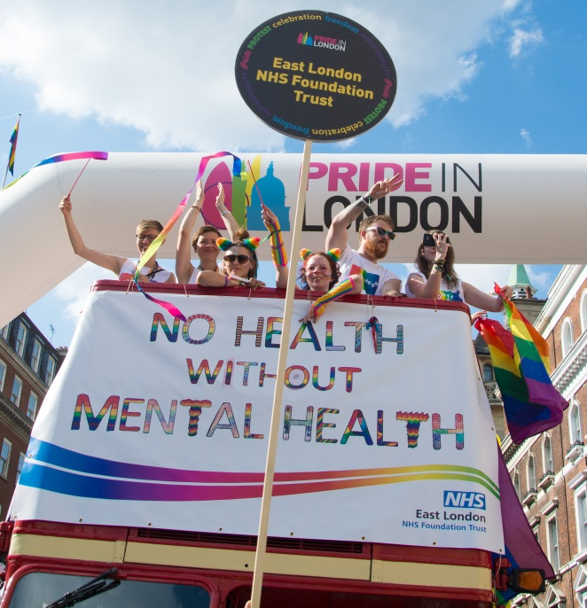

Slide 9
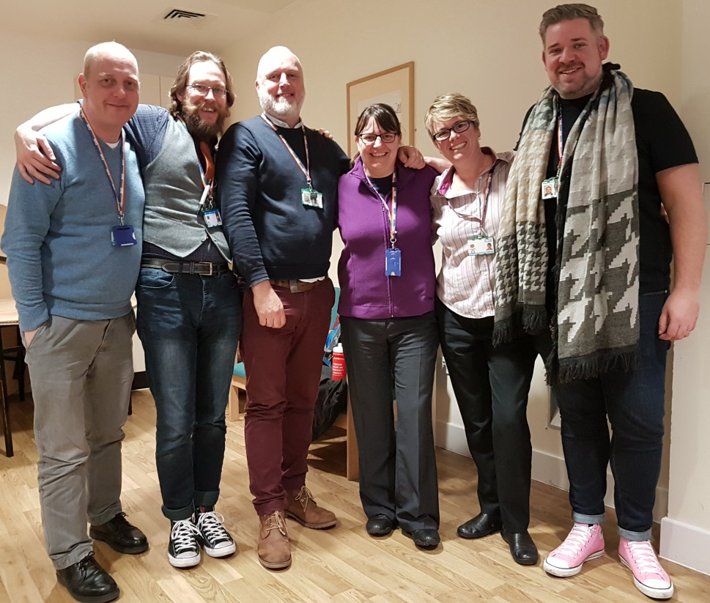
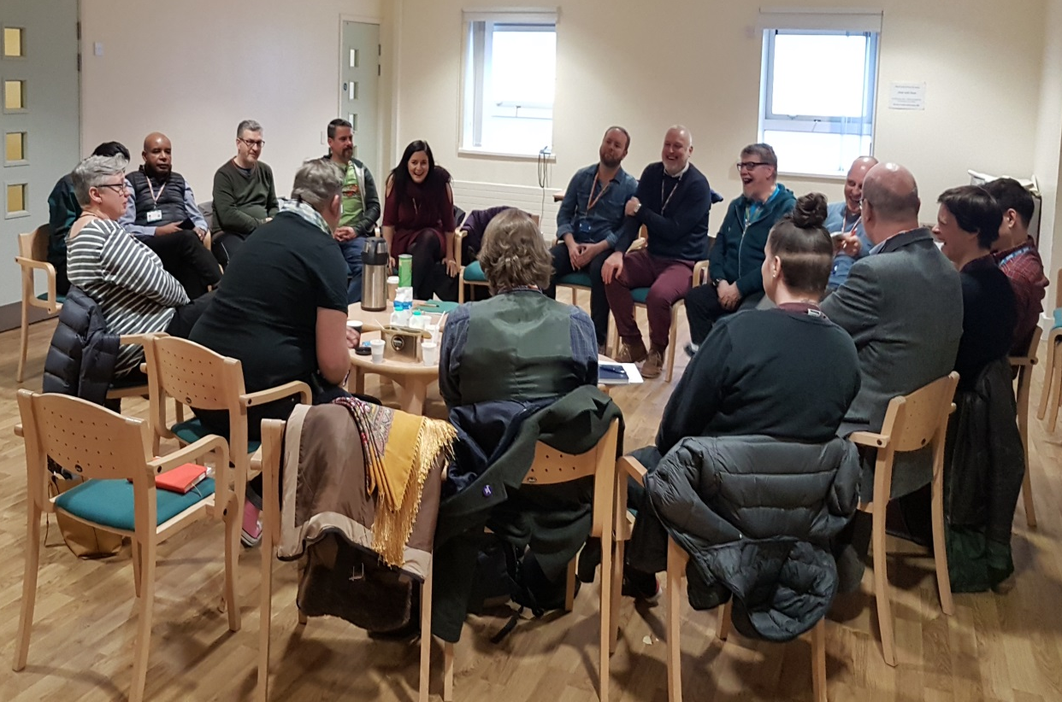
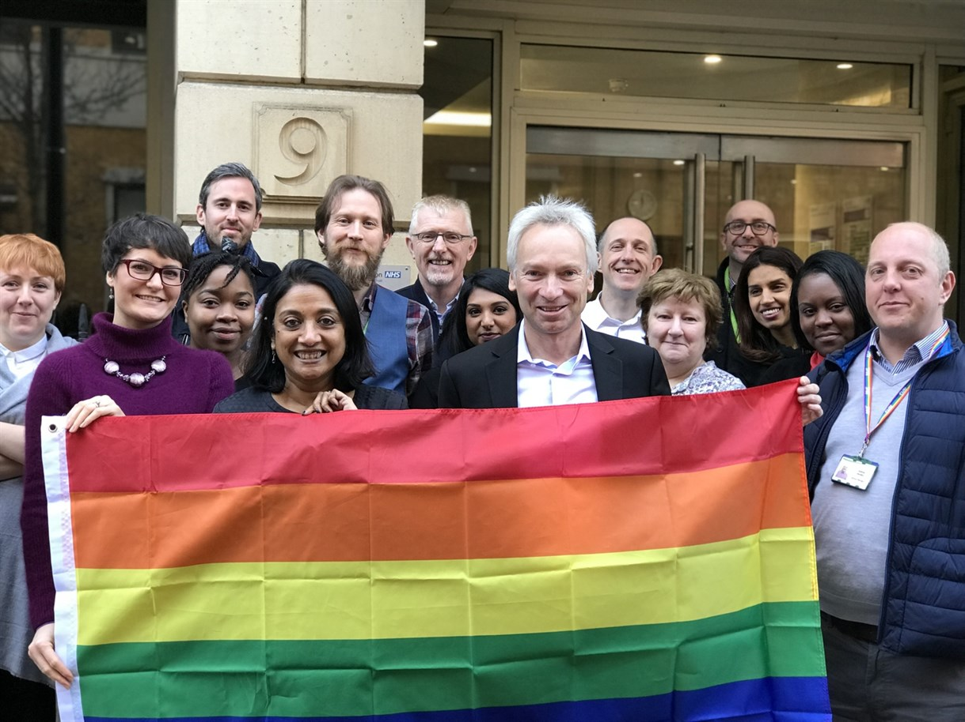

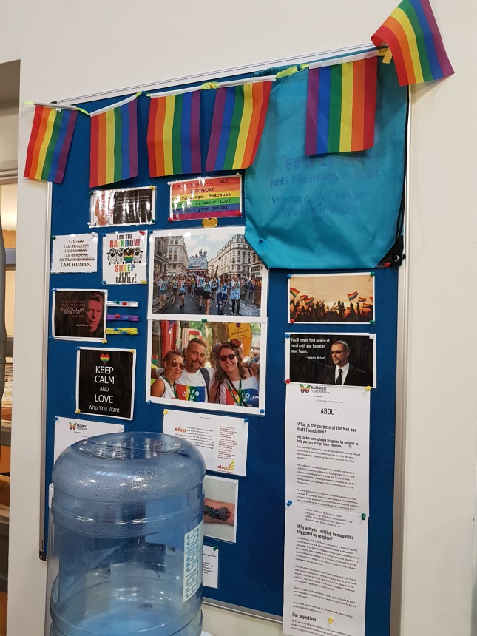

Slide 10
Opening of the Day
Marie Gabriel
ELFT Chair

Slide 11
Albert Kennedy Trust
Hugh Fell
President of The Albert Kennedy Trust
Gabriel Barnes
Speaker

Slide 12
Comfort Break
10:45 – 11:00
Refreshments are served upstairs in Meeting Rooms 1/2.

Slide 13
Panel Discussion
“Intersectionality within the LGBTQ Community”
Hosted by:
Dr Paul Gilluley
Panellists:
Dr Kamilla Kamaruddin
Gary Wilson
Ibrahim Ismael
Rachael Levett
Stuart Crawford

Slide 14
Lunch Stalls Networking
12:15 – 13:15
Lunch is served upstairs in Meeting Rooms 1/2.

Slide 15
Opening Doors
“Older LGBTQ People”
Jim Glennon
Training and Consultancy Manager at
Opening Doors London

Slide 16

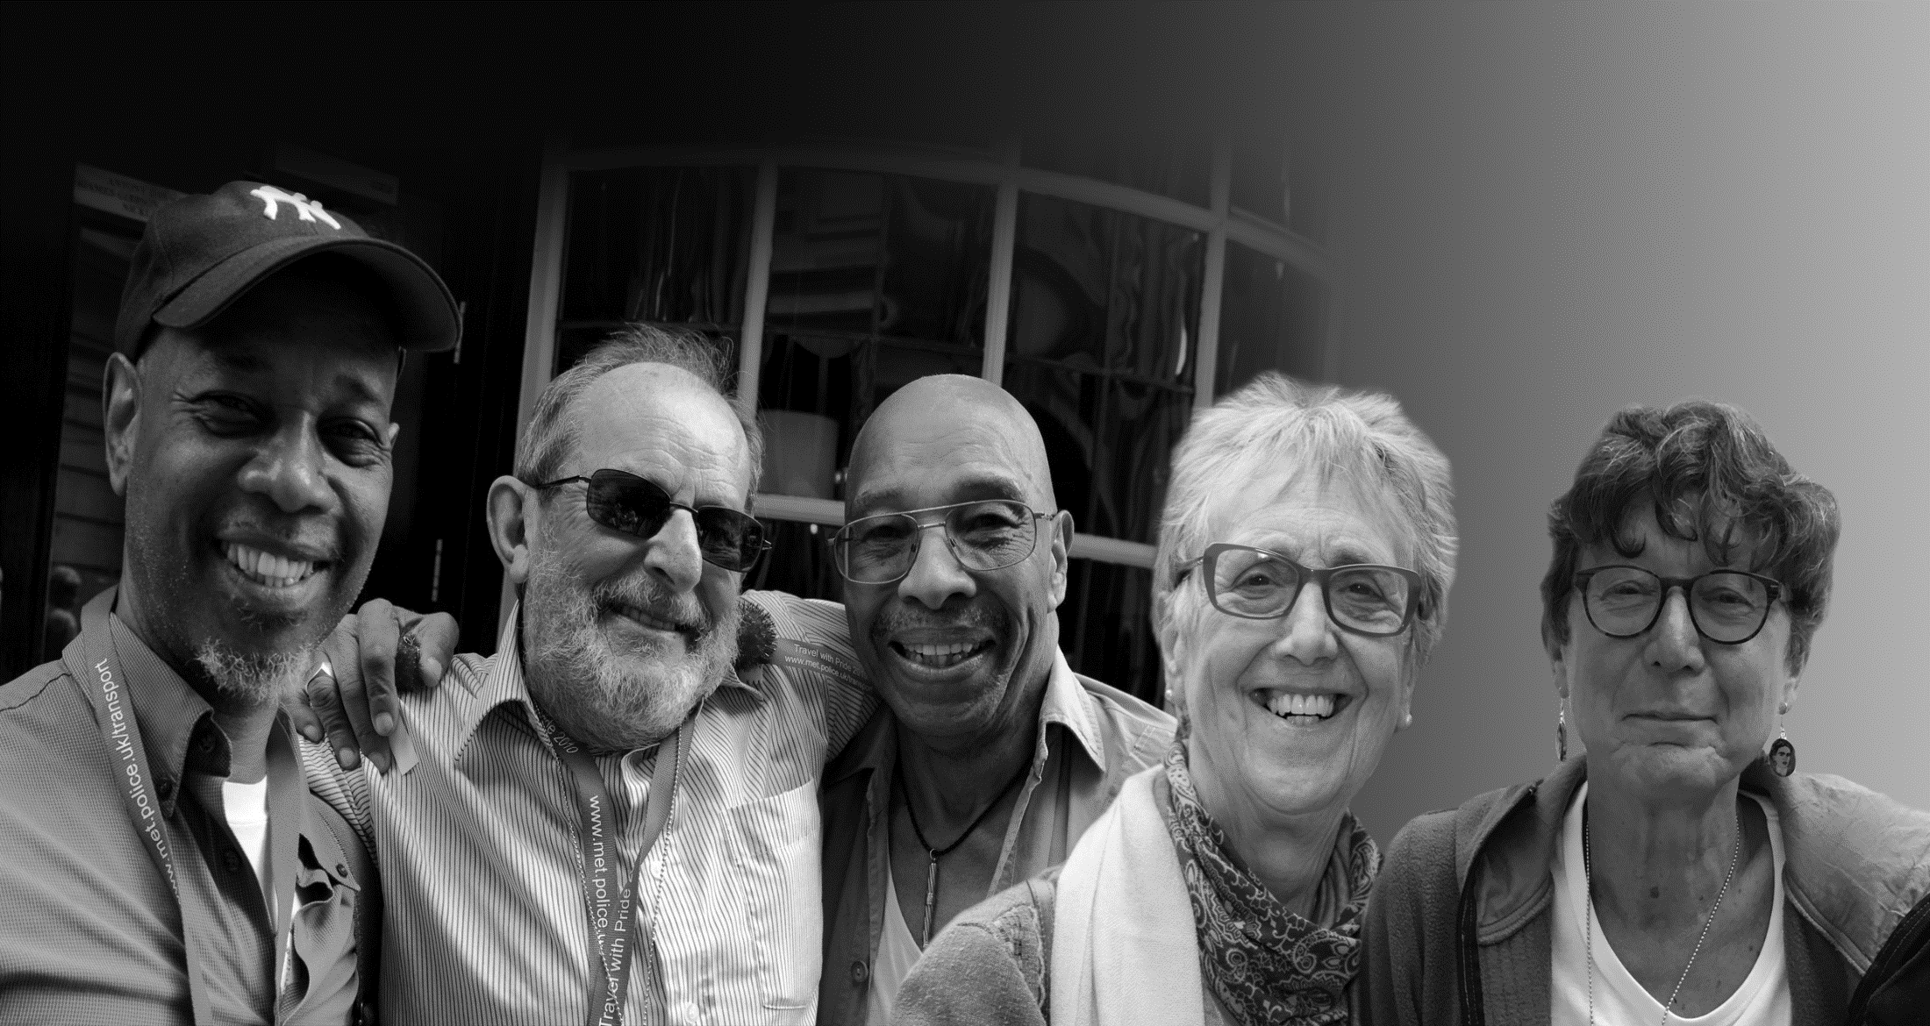
Introductions
Housekeeping
Ground rules
Programme

Slide 17
ODL Services for 50+ LGBT+
Newsletter for 1,800+ members across London
45+ social groups and activities across London
70 + befriending relationships across London
Training for health and social care providers
Quality standard for older LGBT+ services
Notes:
17

Slide 18
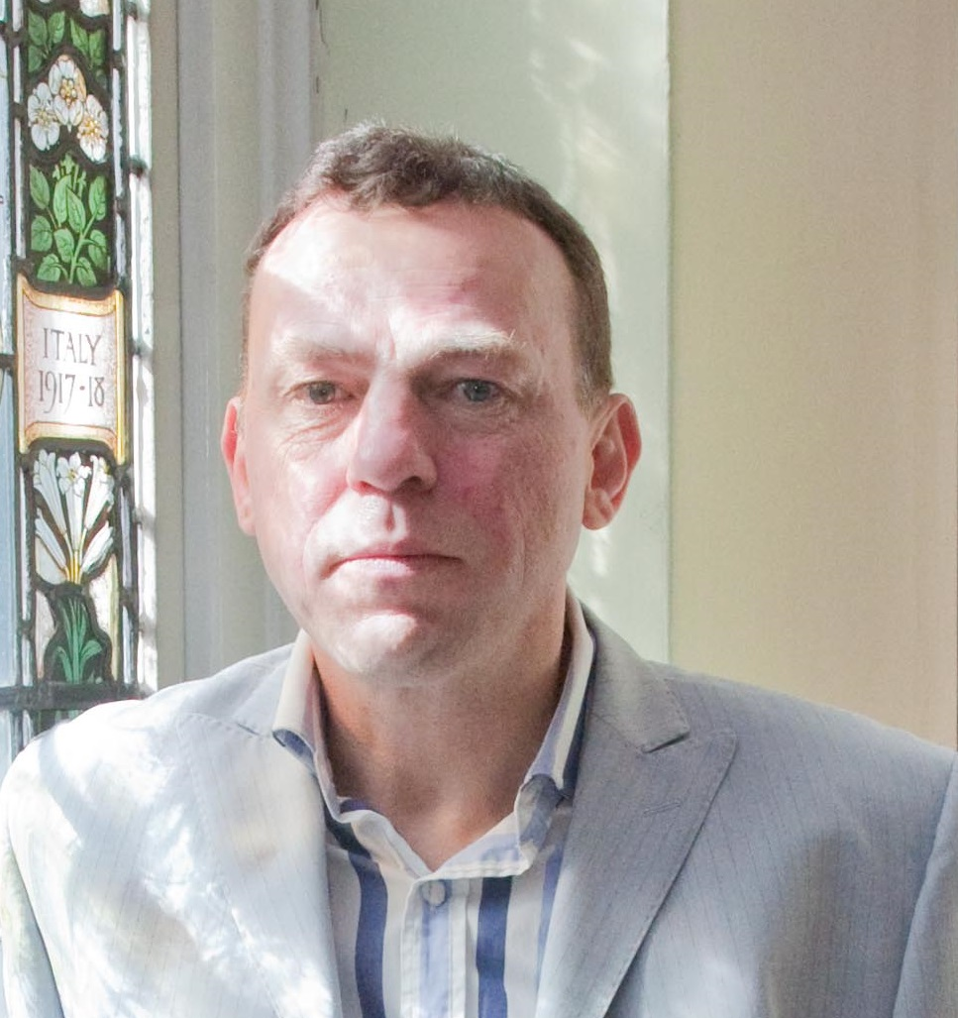
.
Jim Glennon
Training &
Consultancy
Manager
Notes:
18

Slide 19
A LOT HAS CHANGED…
2000 Government lifts ban on LGBT+ people serving in the armed forces.
2001 Age of consent is lowered to 16.
2002 Same-sex couples can apply for adoption.
2003 Section 28 repealed in England, Wales and Northern Ireland.
2004 Civil Partnership Act passed in the UK
The Gender Recognition Act gives trans people legal recognition in their appropriate gender
2008 Human Fertilisation and Embryology Act recognises same-sex couples
Notes:
19

Slide 20
2010 EQUALITY ACT
Age
Disability
Gender
Gender reassignment
Marriage and civil partnership
Maternity
Race and ethnicity
Religion or belief
Sexual orientation

Slide 21


2014 Care Act
Requires health and social care professionals to
address the health and care support of older LGBT+ people by tailoring services to their particular needs.

Slide 22

ODL Services for 50+ LGBT+
Notes:
22

Slide 23
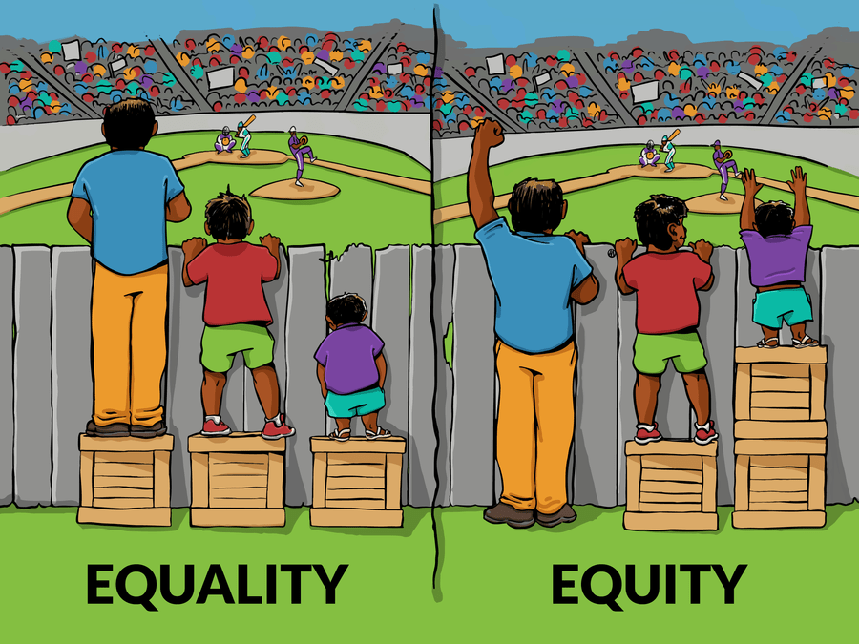
ODL Services for 50+ LGBT+
Notes:
23

Slide 24
Why is this important?
The older generations of LGBT+ people lived through very hostile times when social attitudes were much less tolerant. Many still bare the scars.

Slide 25
We grew up in fear and dread of the knock on the door at 6am. In those early days you were frightened, the police
could do what they wanted and nobody would complain
We were either to be pitied and ‘cured’ or locked away.
We lived under a stone and the only time we would hug
and kiss would be behind drawn curtains
I was referred to my GP for psychiatric treatment and, against my will, given some really horrendous medication. It’s a period I look back on with some anger
Me and my kids lived separate to my partner – she was just a “friend”. I couldn’t tell anyone in case the kids were taken off me
Quotes taken from:
Perspectives on ageing: lesbians, gay men and bisexuals – Sally Knocker (JRF)
Being Accepted Being Me – Kathryn Almack (NCPC)

Slide 26
DIFFERENCES…
Social Isolation
Mental Health
Drugs and Alcohol
Safety and Security
Confidence in Care
Notes:
26

Slide 27
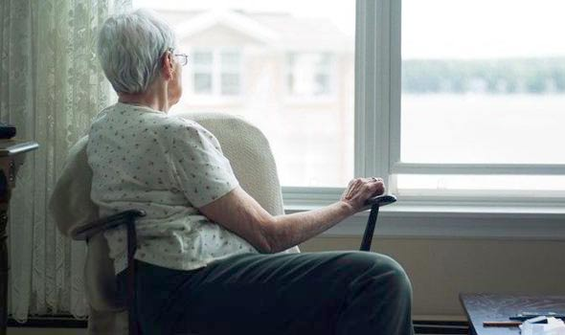
SOCIAL ISOLATION
Notes:
27

Slide 28
SOCIAL ISOLATION
More likely to live alone
Much less likely to have children
Less contact with biological families
Notes:
28

Slide 29
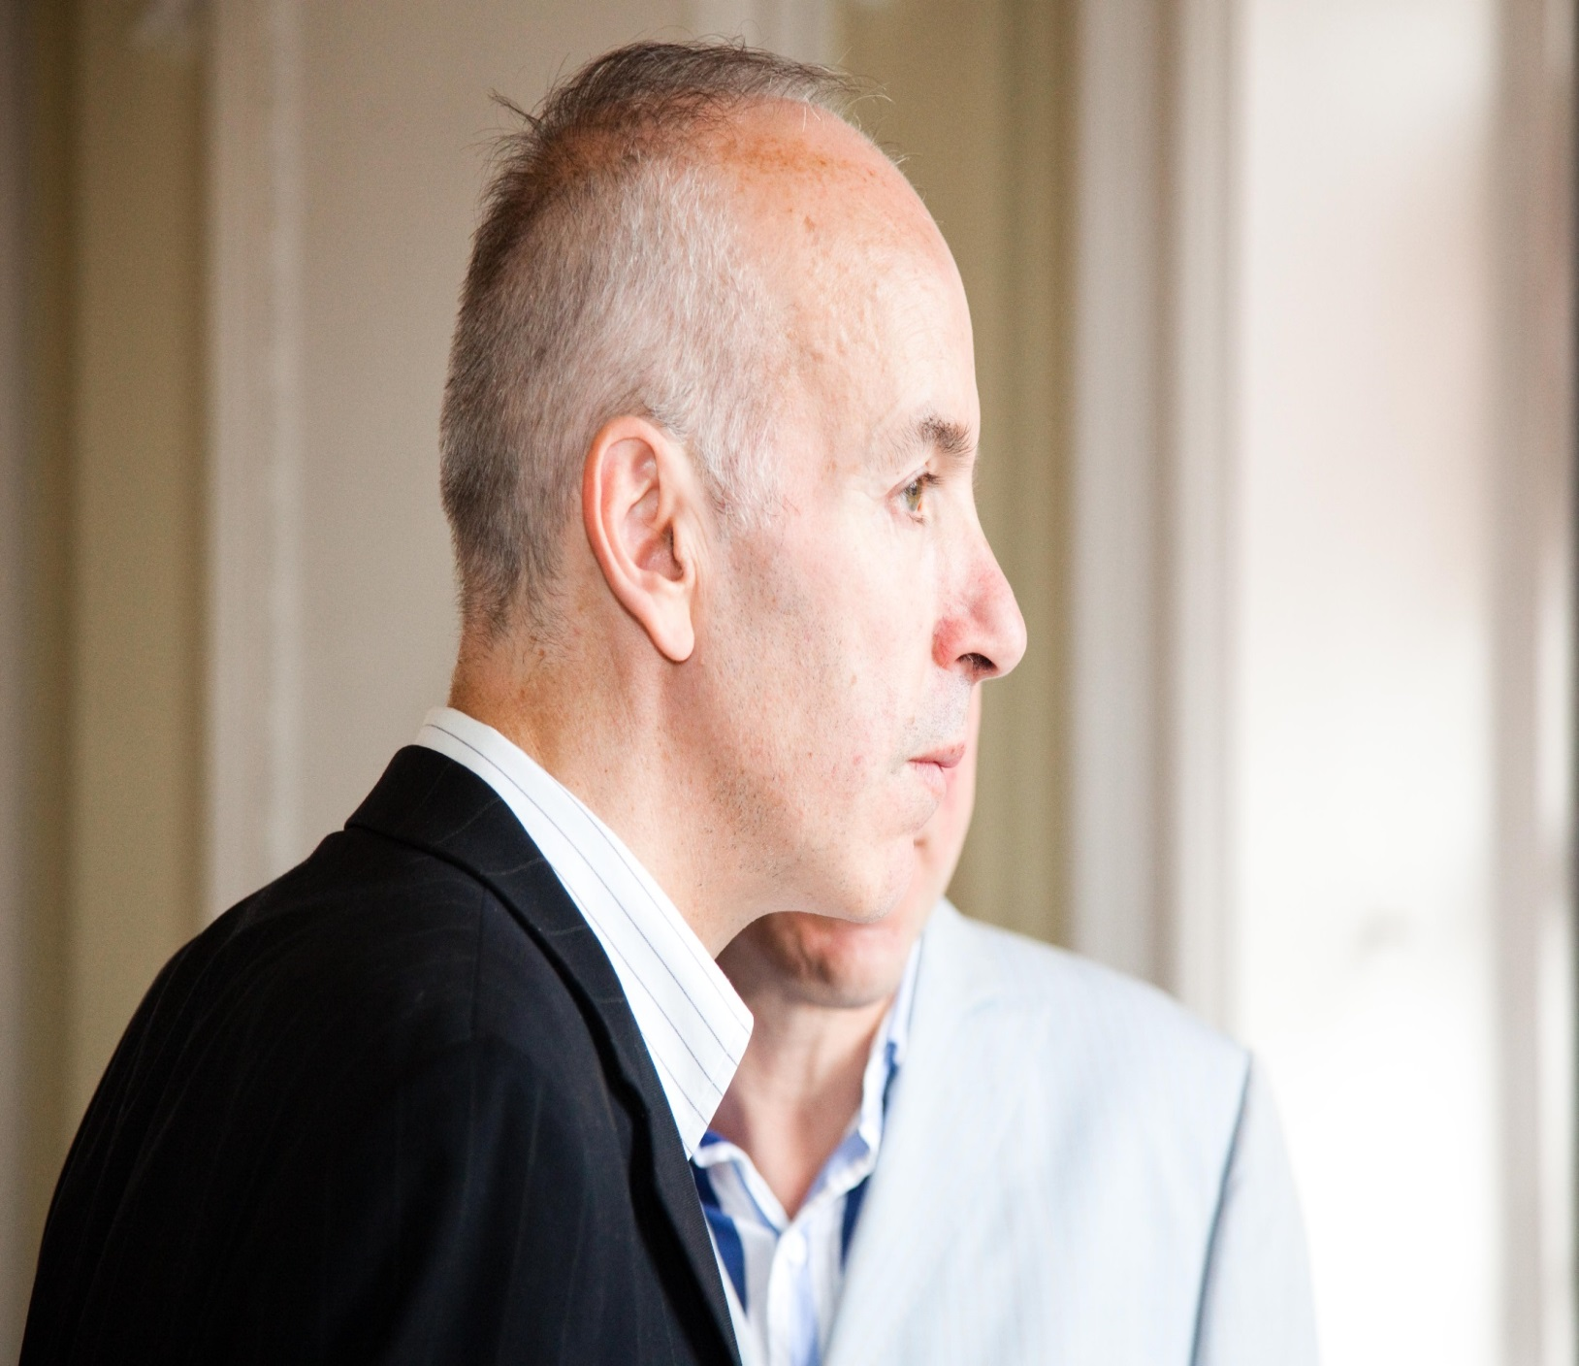
MONITORING
Notes:
29

Slide 30
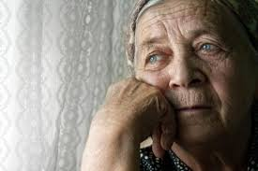
MENTAL HEALTH
Notes:
30

Slide 31
MENTAL HEALTH
More LGBT+ people report regular mental health concerns than heterosexual people
Three in five LGBT people (61%) said they’ve experienced anxiety in the last year
Half of LGBT people (52%) said they’ve experienced depression in last year
Notes:
31

Slide 32
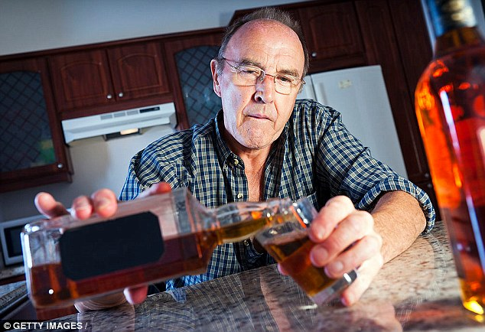
ALCOHOL
Notes:
32

Slide 33
ALCOHOL
Higher numbers of older LGBT+ people drink more regularly than their heterosexual peers
45% LGBT people drink alcohol at least ‘three or four days a week’ compared to 31% of heterosexual people
One in six LGBT people (16%) said they drank alcohol almost every day over the last year
Notes:
33

Slide 34
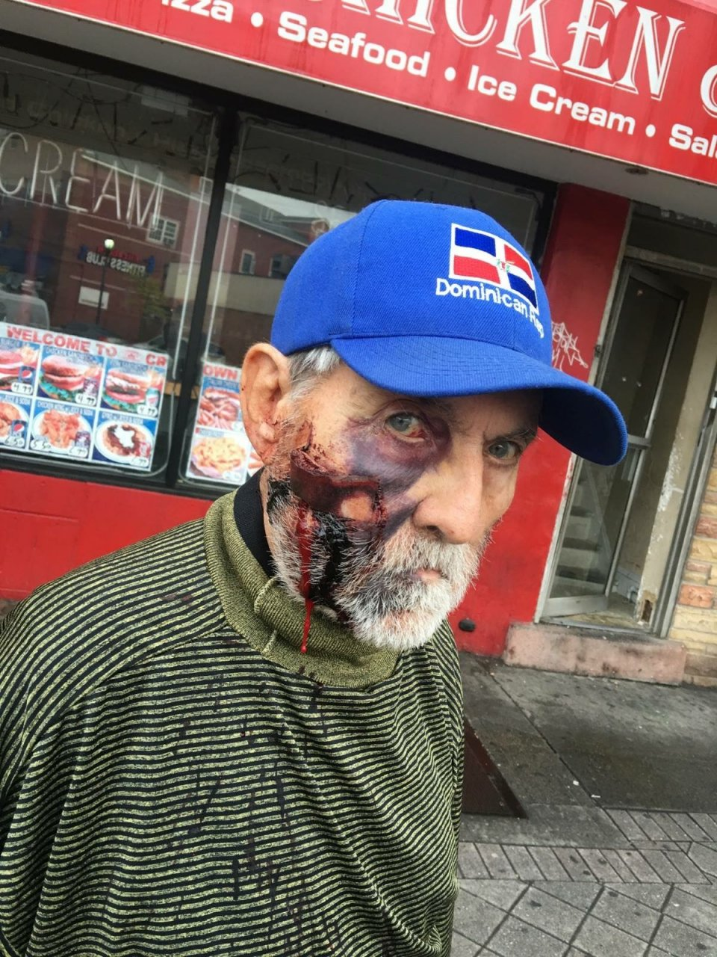
SAFETY AND SECURITY
Notes:
34

Slide 35
SAFETY AND SECURITY
4 in 5 LGBT+ people have experienced ‘hate crime’ in recent years (GALOP Hate Crime Report 2016)
2 in 5 respondents had experienced an incident because they were LGBT, such as verbal harassment or physical violence, in the 12 months preceding the 2018 Government LGBT survey
Older LGBT+ people face more peer prejudice (only 41% of people born in the 1940’s believe same-sex relations are not wrong. – BSA 2017)
Notes:
35

Slide 36

CONFIDENCE IN CARE
Notes:
36

Slide 37
EVIDENCE FROM RESEARCH
‘Older LGBT+ people lack confidence in social care services’, (Almack et al, 2015)
LGBT+ people are twice as likely as heterosexual people to rely on health and social care services
Most older LGBT+ people say that staff don’t understand them and don’t meet their stated health and social care needs
Notes:
37

Slide 38
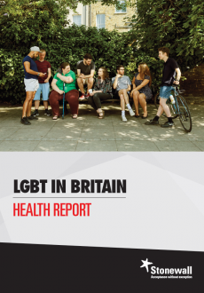
.
Notes:
38

Slide 39
LGBT IN BRITAIN
HEALTH REPORT
One in five LGBT people (19%) don’t tell staff about being LGBT
One in seven LGBT people (14%) have avoided treatment for fear of discrimination
One in eight (13%) have experienced unequal treatment from staff because they’re LGBT
Notes:
39

Slide 40
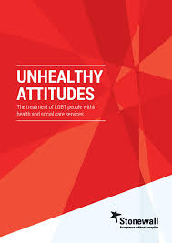

Slide 41
SOME PREJUDICE…
“In my opinion, the needs of others that are not the norm should not be forced on those who have chosen to be what we have up to now considered mainstream ‘normal’.
As human beings, we are biologically programmed to function in a certain manner and deviations, in my view, are not to be considered mainstream society.”
Donald, Doctor, South East

Slide 42
…MORE IGNORANCE, OR ‘LACK OF CONFIDENCE’
6 in 10 practitioners said they didn't consider LGBT+ to be relevant to patient health.
1 in 10 said that while LGBT+ may be relevant, they don’t feel confident to meet the specific needs of LGBT+ people.
A quarter said they were not confident to respond to the specific care needs of trans people.

Slide 43


Slide 44

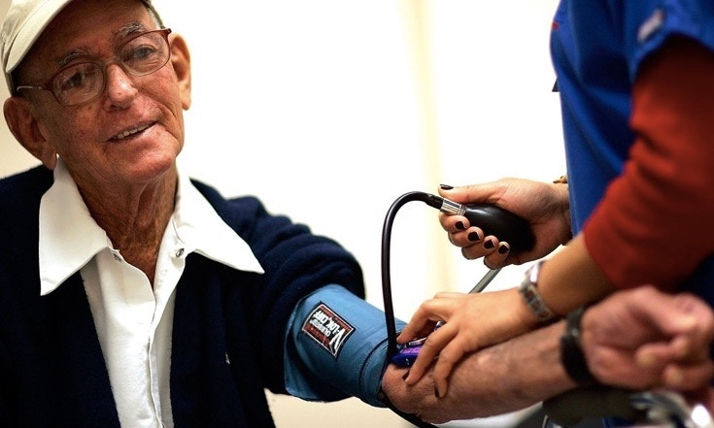
LGBT CONFIDENCE OF STAFF
STAFF TRAINING IN LGBT ISSUES

Slide 45
PROFESSIONAL EDUCATION
Three quarters of staff hadn’t received any training on the health & social care needs of lesbian, gay or bisexual people
Three quarters of staff hadn’t received any training on the health and social care needs of trans people.

Slide 46
“Our training is very basic and does not cover how to work with LGBT+ people – only policy”.
Lisa, Manager, London
“Training in LGBT+ awareness should be made a part of our mandatory education”.
Katie, Nurse, Northwest

Slide 47

“There is a shocking lack of importance placed on issues surrounding sexual orientation.
Racial issues are seen as important and information detailing these are required as part of the assessment process.
However sexual orientation is often ignored or side-lined as irrelevant to community care assessment, which I feel results in a lack of knowledge about that person.”
Jim, Social Worker, North East

Slide 48
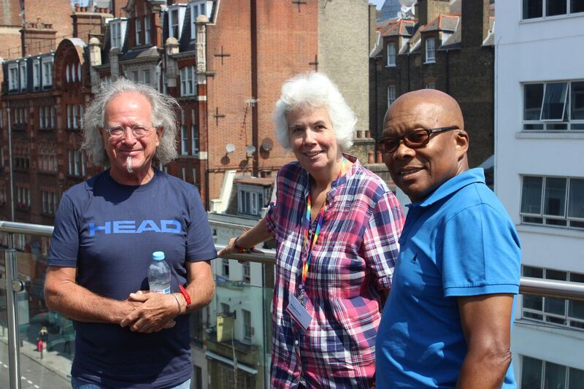
Trainers: Cailin, Maggie and Jeff

Slide 49
DIVERSE 50+ LGBT+ TRAINERS
“… a fabulous and inspirational afternoon. The older LGBT team of facilitators personal stories of care - good and bad - really brought to life what people have gone through and how this can impact on their expectations and experiences now.”

Slide 50
To summarise…

Slide 51
OLDER LGBT+ PEOPLE…
Have higher health and care needs
But have lower family care and support
So are more reliant on H&S care professionals
But many H&S professionals lack confidence
And receive little LGBT+ specific training
Notes:
51

Slide 52

Confidence to Care
Jim Glennon

Slide 53
East London Out Project
Claire McComb
Lead Officer at ELOP

Slide 54


Slide 55
ELOP
ELOP is a charity established to support lesbian, gay, bisexual, trans and questioning people around their mental health and wellbeing
As LGBT people, we each face different issues & therefore have differing needs, individually & collectively so we need to be mindful of intersectionality
Within each of our communities we also face the same life matters as other people, fall under all the other protected characteristics & experience the additional issues they bring
LGB&T people are more likely to experience:
  Low self-esteem
  Mental health difficulties
  Addictions
  Weight & body image issues
  Homelessness
  Living in isolation
  Living with HIV & AIDS
  Suicidal ideation & behaviours
  And much, much more!

Slide 56
LGBT+ Disability Matters
Disabled LGBT+ people experience complex, multi-layered exclusion and discrimination
Added layer of invisibility for LGBT+ people with disabilities
Sexuality often dismissed completely
Any deviation from heteronormativity is overlooked
Considerations of gender identity aren’t taken into account
Marginalisation from the LGBT+ scene as well as mainstream events and services
Higher prevalence of disability in LGBT adults
36% of lesbians, 36% of bisexual women and 25% of heterosexual women experience a form of disability
26% of gay men, 40% of bisexual men and 22% of heterosexual men experience a form of disability

Slide 57
Accessing Support
Health disparities
  Poorer mental health compared with heterosexual, cisgender peers
  Higher prevalence of risk behaviour e.g. smoking, excessive alcohol, drug use, risky sexual behaviour
  Higher rates of disease , e.g. some cancers
Care services
  Less likely to have options for informal care from family/ friends as more likely to be isolated
  Afraid to come out for fear of reaction
  Often belittled or abused by care staff
Health and Services
  Lack of staff training along with personal prejudices means some LGBT people are unsupported, bullied and discriminated against in services

Slide 58
Accessing Support
Education
  Many schools will deliver some degree of LGBT awareness in lessons or assemblies, but this can be a one-off session per year rather than integrating LGBT matters into the curriculum so isn’t so effective at combatting homo/bi/transphobia
  Popular culture has created an apathy to the issues with people thinking it’s all ok now
Counselling/ Therapy Services
  People present for support at ELOP having experienced some form of reparative therapy
  Often we hear that their counsellor in a previous service couldn’t relate to them & allowed their own curiosity to distract from the support
  With reduced funding for mental health services, many are turning to community services for support with quite complex issues

Slide 59
The State of the Sector
Whilst 6-10% of population are estimated to be lesbian, gay, bisexual or trans, LGB&T VCS only receive 0.038% of London VCS income and 0.015% of VCS income as a whole (KiS, 2012)
The level of expenditure amongst London LGBT VCOs is equivalent to £9 per LGBorT individual whilst the VCOs as a whole in London spend £1,796 per individual
There’s a drive towards mainstreaming so lots of targeted services for LGB&T people have disappeared
We only access services when we need support. Therefore, we simply aren’t getting the basic help we need
Consequently, there is still a need for LGB&T specific service providers like ELOP until such time as mainstream services recognise and accommodate us

Slide 60
Celebrating 24 years…

Slide 61
ELOP
ELOP was established in 1995 as a grassroots developed lesbian & gay community-led organisation
To promote the health, wellbeing, empowerment & equality of lesbian, gay, bisexual and trans communities

Slide 62
ELOP
Providing 24 years of information, advice, advocacy, counselling & support services to east London’s lesbian, gay, bisexual & trans communities
Plus information, training, consultancy & support to statutory & voluntary sector service providers & their staff teams

Slide 63
ELOP
What we have achieved is providing a dedicated LGBT space for 24 years with limited funding
We were the first organisation in the UK to recognise IDAHO, as it was then, in 2005
What we do is provide services for LGBT communities, by LGBT communities, thereby removing the fear of discrimination and stigma and allowing people to connect without pathologising their identity
We utilise the lived experiences our service users share to develop awareness training for other professionals

Slide 64
ELOP
Core Services:
Signposting
Community safety
Counselling
Youth support
Social support groups
Community library
Training, research & consultancy
Community events
Strategic Work:
LGBT community forum
LGBT Practitioner’s Network
VAWG Project
National LGB&T Partnership
HBT Project
School support
Consultations

Slide 65

Community Safety
International Day Against Homophobia, Biphobia & Transphobia
IDAHOBIT – 17th May
  Zero Tolerance Ribbon Distribution
  Candlelit vigils
  No Place for Hate
  Peace Walk
  Awareness Campaigns
    Report it
    Stamp Out
    Speak Out

Slide 66
Counselling
ELOP – Core Services
Low cost community service by LGBT people for LGBT people
Self and 3rd party referrals
Currently 36 counsellors in our team; plans to expand
Rising demand over last few years
Increasingly complex experiences
Increase in gender fluid and non-binary identification
Individual counselling of 14, 28 or 42 sessions
Couples/ relationship counselling
Youth counselling
Support approx. 250 people each year

Slide 67

Youth & Schools
ELOP – Core Services
1:1 Advice, Information &
Support for Young People
Club Mellow Youth
    Weekly 12-15 & 15-18 groups with a range of empowering activities & projects
    Youth support worker & peer support
Schools Programme
    Student workshops
    Staff training
Notes:
67

Slide 68
Community Centre
ELOP – Core Services
Community library
Club Mellow Lounge
    Two weekly asylum support groups
    Weekly 12-15 & 15-18 youth groups
    Weekly social support group
    Bi-monthly 18-25 group
    Monthly women’s group
    Monthly men’s group
    Monthly family Sundays

Slide 69
Community Centre
ELOP – Core Services
LGBT Asylum Support
Weekly social and peer support group
  For new members, giving opportunity to meet others and gain support in a dedicated LGBT space
Weekly development group
  For committed members to develop skills around volunteering and personal development
Supporting letter service
  For people known to us, fleeing persecution in their homeland

Slide 70
Volunteering Opportunities
ELOP – Core Services
Counselling
Community fundraising
Social-group facilitation
Events organising
Community outreach
Ambassador
Trustee
…….

Slide 71
How we further support our communities
ELOP’s 2nd Tier Services
Training
  Set workshops & bespoke packages of support
Research
  Service review or wider community
Consultancy
  Specialist knowledge sharing
Representation
  Meetings, consultations
Partnerships
Resources
  Posters, flyers, ribbons & wristbands

Slide 72
ELOP – Strategic work
Professional engagement
National LGB&T Partnership
HBT Training
Community forum for LBTH
Strategic meetings with LBTH
Needs assessment for LBB&D
Consultations
Perinatal mental health
Living with cancer
VAWG – LBWF

Slide 73
Tower Hamlets LGBT Voices
Community Forum
Meets monthly to provide opportunity for LGBT people who live, work, study or socialise in Tower Hamlets to have a voice and share their experiences in the borough, as well as making suggestions for change
The forum have a quarterly programme of social meet ups and each meeting has social time at the end
Discussions are fed back to the council for consideration and service review
LGBTforum@elop.org

Slide 74
Tower Hamlets LGBT Voices
LGBT Practitioners Network
Bi-monthly themed meetings for LGBT people who work in Tower Hamlets to discuss current understanding of known inequalities and barriers to service, to understand the local picture, to make suggestions for improvements and to feedback information to the practitioner’s organisations and networks, the council and other strategic fora to better improve the experience of LGBT people accessing Tower Hamlets services

Slide 75
Tower Hamlets LGBT Voices
LGBT Practitioners Network
How we can best work together:
  Support the development of best practice guidance around LGBT mental health
  Share knowledge and resources
  Work together for service improvement
  Review current practice and policies to needs assess for LGBT service users
  Ensure effective monitoring around sexual orientation and gender identity
  Ensure better visibility and inclusion of LGBT matters

Slide 76
Tower Hamlets LGBT Voices
Forward Plan
Our focus for 2018-19 is mental health, hate crime awareness, support for staff and students in educational environments and improving services for LGBT people
This will be achieved through delivery of the community forum, practitioner’s network, attendance at strategic fora, responding to relevant consultations and developing best practice guidance for practitioners
All our work aims to be mindful of inclusivity and the diversity of experience within LGBT+ communities

Slide 77
ELOP
020 8509 3898
LGBTforum@elop.org
www.elop.org

Slide 79
Comfort Break
14:15 – 14:30
Refreshments are served upstairs in Meeting Rooms 1/2.

Slide 80
Gendered Intelligence
Dex Grodner
Facilitator and Mentor at Gendered Intelligence

Slide 81
Welcome
Dex Grodner

Slide 82
About GI
About Gendered Intelligence
Community Interest Company est. 2008
Vision: a world where people are no longer constrained by narrow perceptions and expectations of gender, and where diverse gender expressions are visible and valued
Aims: to increase understandings of gender diversity and improve trans people’s quality of life
  We work with all those who impact on trans lives
  We specialise in supporting young trans people 8-30
Everyone can be intelligent about gender!
Notes:
2 mins
Introduction
Gendered Intelligence – GI - is a Community Interest Company established in 2008
Our vision is of a world where people are no longer constrained by narrow perceptions and expectations of gender, and where diverse gender expressions are visible and valued.
Our aims are to increase understandings of gender diversity and improve trans people’s quality of life.
We work with all those who impact on trans lives – employers, educators, service providers of all kinds; in our direct service provision to the trans community we particularly specialise in supporting young trans people aged 8-30.
Our vision doesn’t specifically mention trans people – this is because we see trans issues as part of a much wider picture, the picture of cultural expectations around gender and how they affect everyone in one way or another.
Trans experiences provide a valuable lens through which we can examine our cultural perspective on gender, and we believe it enhances everyone’s life to open up more possibilities and options and remove unnecessary gender-based constraints.
We believe everyone can be more intelligent about gender!
We have a range of services including consultancy, guidance writing, mentoring, workshops for students, and resources and I’ll tell you a little more about those towards the end.
Trainer info e.g.
I’ve been involved with GI in various roles since 2009 and have been part of the training team since mid 2013. My background spans both the commercial manufacturing engineering sector and the voluntary sector and I’m also a practising artist.
I am a trans man myself – that is I was assigned female at birth and transitioned in 1998 at the age of 31 to live as male.
Many of us at GI are trans – we are a trans led organisation - and standing up to be visible in my role at GI is something I feel it important to do as it increases awareness of, and puts one more human face to, our often invisible community.

Slide 83
Session Outline
What does ‘trans’ mean?
Our picture of sex and gender – the context
Language and terminology
Laws that apply
Good practice working with trans staff/students/clients
What GI can offer / other resources
Final questions
Feedback forms

Slide 84
What does “Trans” mean?
People who feel that the sex/gender they were assigned at birth does not match or sit easily with their sense of self may use the term ‘trans’ to describe themselves
‘Trans’ is usually a good choice for posters/policies
‘Trans’ is a descriptive term; it’s polite to say
“A trans person”, not “a trans” or “a transgender”
A broad term covering diverse experiences…

Slide 85
Diverse Trans Experiences
Diverse Trans Experiences
People who use the word trans include those who:
  Identify with the ‘opposite’ binary gender
  Have identities that are both male and female, neither male nor female or who have another
  sense of gender
  Have a fluid gender identity and may move
  between different genders
  May express different gender-related aspects of themselves at different times / places
  Don’t experience a sense of gender

Slide 86
Our Picture of Sex and Gender
Many cultures assume sex and gender are a simple ‘binary’ picture
Key cultural assumptions:
  Only male / female
  Physical sex automatically determines
  gender identity
  Sex and gender are fixed at birth
  and cannot change
1 in 100 - born with an intersex trait
1 in 100 - fall under the broad trans umbrella

Slide 87
Language and Terminology
Focus on the language you use every day:
  Individuals – name, pronoun, title
  Groups – collective terms e.g. ‘boys’, ‘ladies’
  Start with gender neutral language
Descriptive terms:
  Not often needed in everyday interactions
  Listen, don’t label
  Be led by the person – ask if you need to
Mistakes?
  Don’t over-worry; apologise and move on

Slide 88
The Law and Trans People
Trans people have protection under the law:
  Equality Act 2010 – makes discrimination, harassment and victimisation unlawful
  Gender Recognition Act 2004 – legal change
  of gender; protects privacy; confers right to marry or have a civil partnership / be taxed / receive a pension in that gender
  General Data Protection Regulation /
  Data Protection Act 2018 – info that someone
  is trans / has a trans history is sensitive data
Law has limitations; better to focus on positive inclusion

Slide 89

90 Second Micro Exercise
D MICRO EXERCISE #3:
What does trans inclusive practice look like?

Slide 90
Working with Trans People (1)
General Good Practice
Use language thoughtfully – ask, listen, respect
Be inclusive around facilities / spaces
Ensure privacy and confidentiality
Consider dress codes, uniform, sports kit etc
Give inclusive options on databases / forms
LGBT+ staff / student groups or networks
Remove unnecessary gender divisions
Recognise potentially difficult situations

Slide 91
Working with Trans People (2)
The Wider Setting
Good policies and procedures that cover trans people – implemented and visible
Encourage / support staff and peers with education
and training on equality issues
Become confident to challenge poor behaviour; challenge and stop transphobic comments, bullying and inappropriate questioning
Champion trans people’s rights
Celebrate / raise awareness of trans lives –
LGBT History month, TDoV, IDAHOBIT, TDoR

Slide 92
Trans People – What We Know
Trans people are particularly at risk of experiencing difficulties with their emotional health and mental wellbeing, due to the barriers they face in connection with their gender identity:
‘Gender Dysphoria Services: A Guide for GPs
and other Healthcare Staff’ (Apr 2013):
  “It should be emphasised that Gender Dysphoria and Transsexualism are not considered, in and of themselves, mental illnesses in any essential sense. The associated pressures of unmanaged dysphoria and/or the social stigma that can accompany gender diagnosis and transition may, however, result in clinically significant levels of distress.”

Slide 93
Trans Positivity
81% of participants in the 2012 Trans Mental Health Study felt they gained something as a result of being trans, transitioning or expressing their gender identity.
These included:
  Confidence;
  New friends; improved/better quality relationships;
  Community and a sense of belonging;
  Self-expression and acceptance;
  Knowledge and insight;
  Happiness and contentment; resilience;
  A future

Slide 94

Youth groups; special projects; residentials;
support for parents and carers group; resources
One to one mentoring with young trans people; workshops, lectures and assemblies for students; presentations and training for staff; consultancy
Training and professional development; consultancy; policy development & membership scheme
@Genderintell
Panel discussions; conference attendances; presentations and key notes
Notes:
94

Slide 95
Any questions?
Thank you!
Dex Grodner
Email: Events@genderedintelligence.co.uk

Slide 96
Closing Remarks and Network Plans
Dr Paul Gilluley
Chief Medical Officer at ELFT
Ken Batty
Non-Executive Director at ELFT

Slide 97
Thank you so much for attending today!
Feedback Forms and Suggestion Box
Social Event at New Bloomsbury Set Cocktail Bar (WC1N 1AG)

Slide 98


