Slide 1
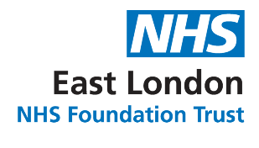
Wellbeing & Engagement
Jill Dabbs - Head of Wellbeing & Engagement
Di Aston – Wellbeing & Engagement Advisor
Robyn Tansley – Wellbeing & Engagement Officer

Slide 2
Engagement
People & Culture

Slide 3


Slide 4

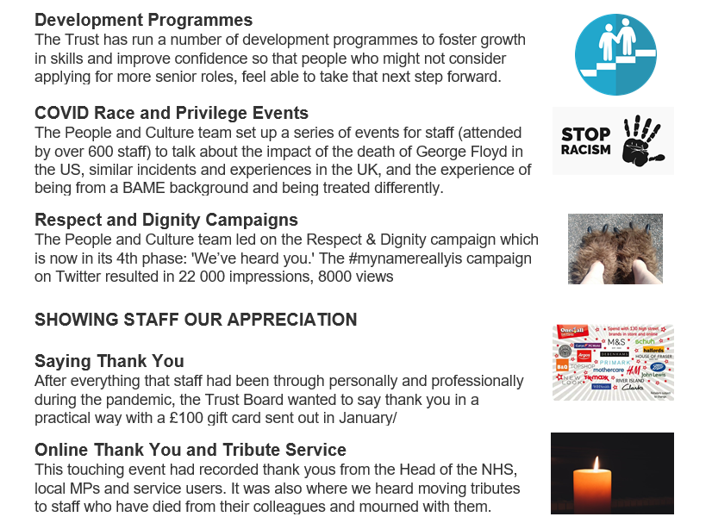

Slide 5
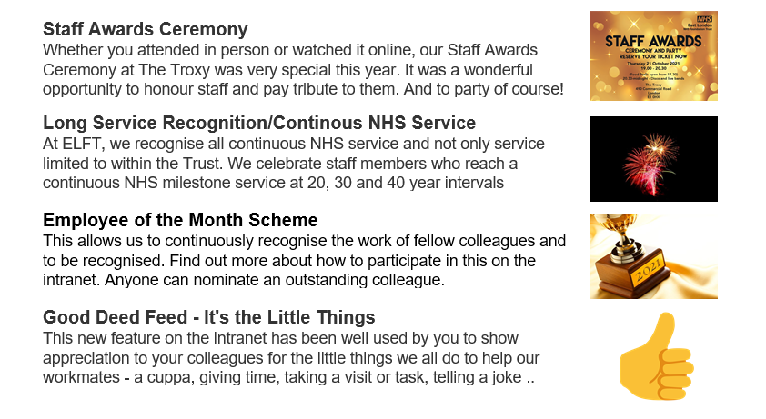

Slide 6
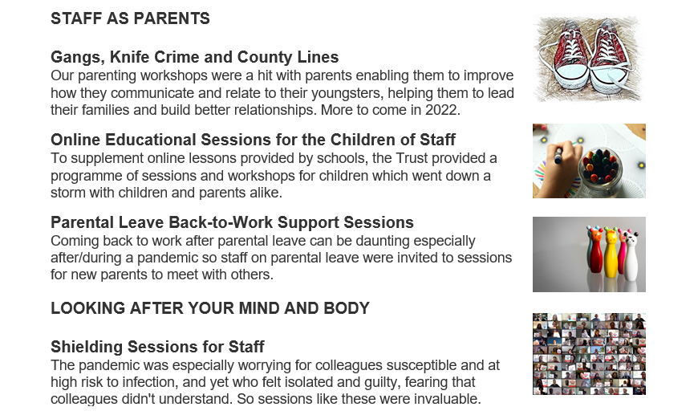

Slide 7
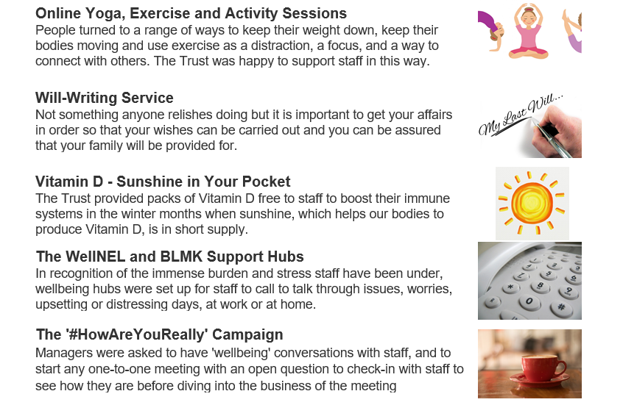


Slide 8
Wellbeing
People & Culture

Slide 9

Our Wellbeing Wheel

Slide 10
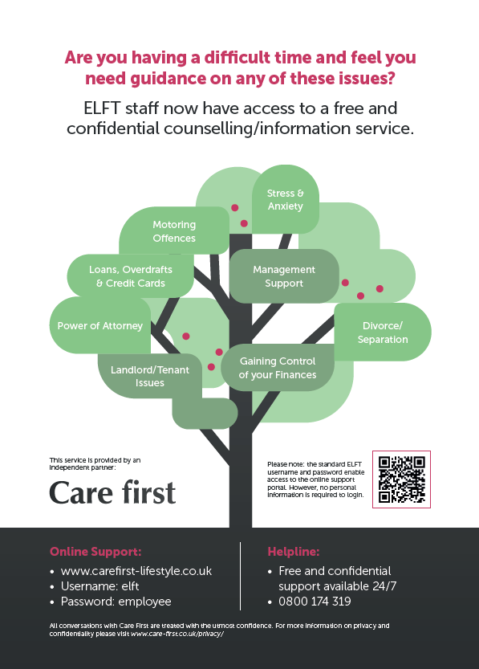
Our Employee Assistance Programme
Care First
0800 174 319
London: Contact KeepingWellNEL Hub - https://keepingwellnel.nhs.uk
Luton & Bedfordshire: Contact the KeepingWellBLMK Hub – https://keepingwellblmk.nhs.uk

Slide 11
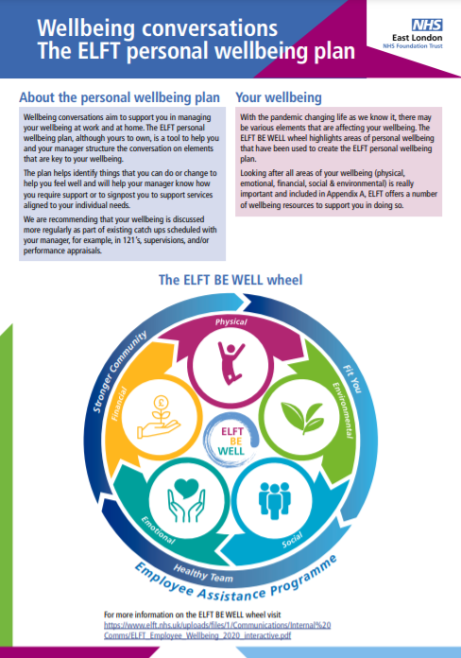
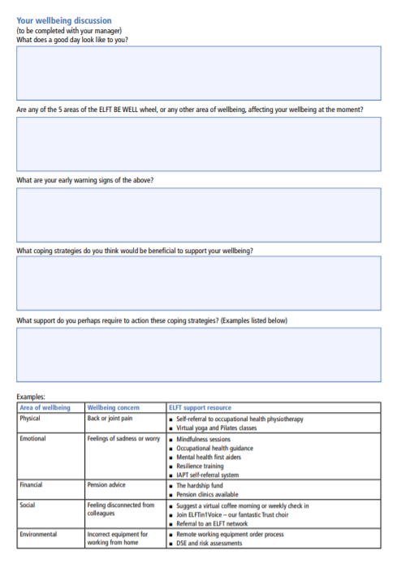

Slide 12
ELFT wellbeing offers
People & Culture

Slide 13
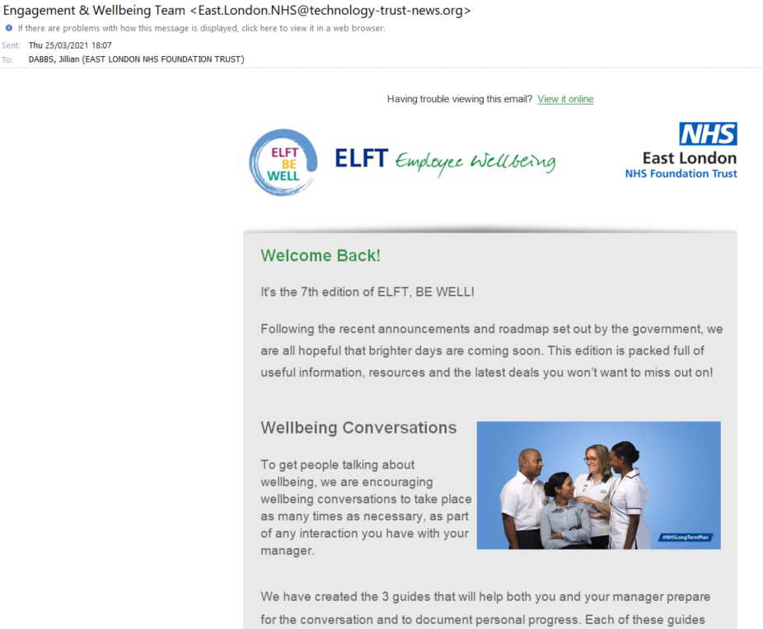
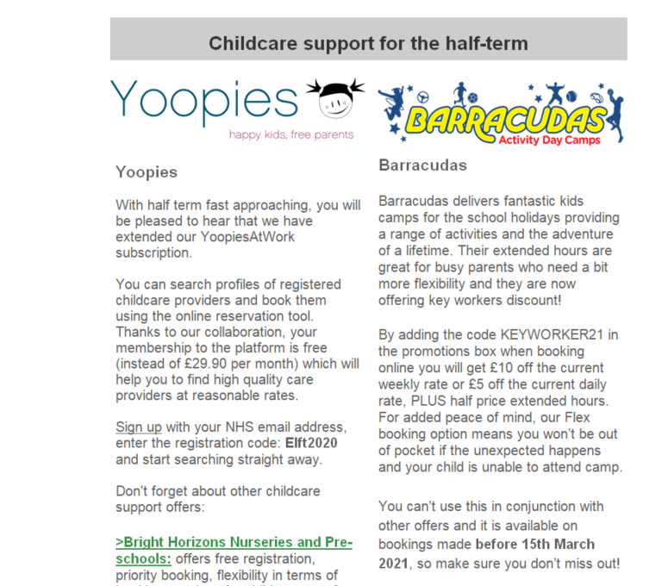

Slide 14
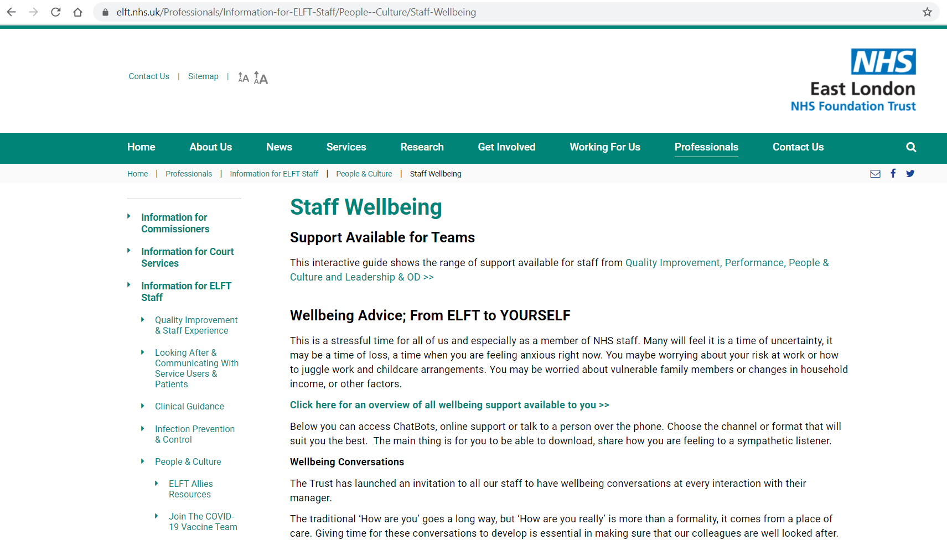

Slide 15
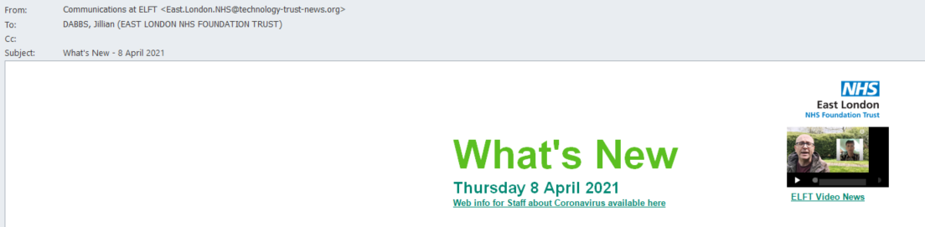
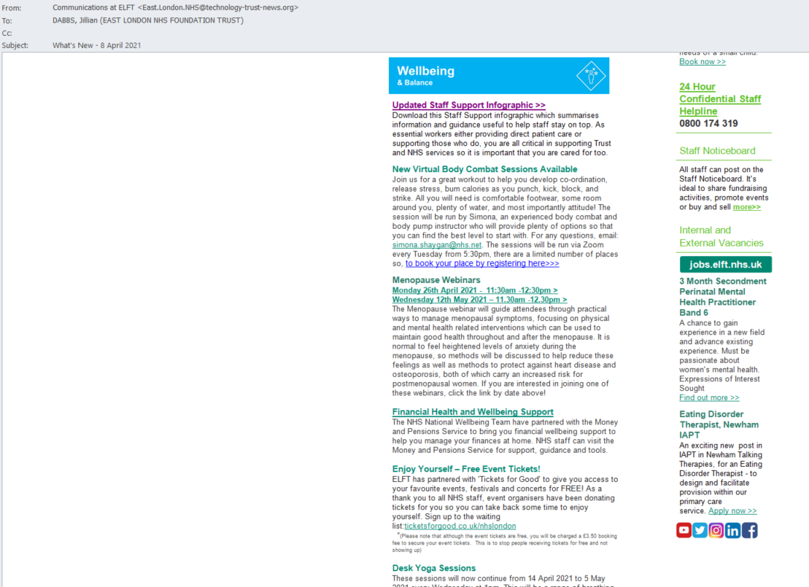

Slide 16
Discounts & benefits
People & Culture

Slide 17
NHS Discounts
Food & drink
Leon
Slug & Lettuce
Subway
Health & Beauty
My spa pass
PureGym
Skin Clinics
Travel
Jet2holidays
Travelodge
Virgin Holidays
Electronics
Apple EPP store
EE mobile
Vodafone
Days out
Go Ape Adventure
Thorpe park
London Aquarium
Shopping
Clarks
Dorothy Perkins
Gymshark
Other
Europcar
MJ driving schools
Self-storage company

Slide 18
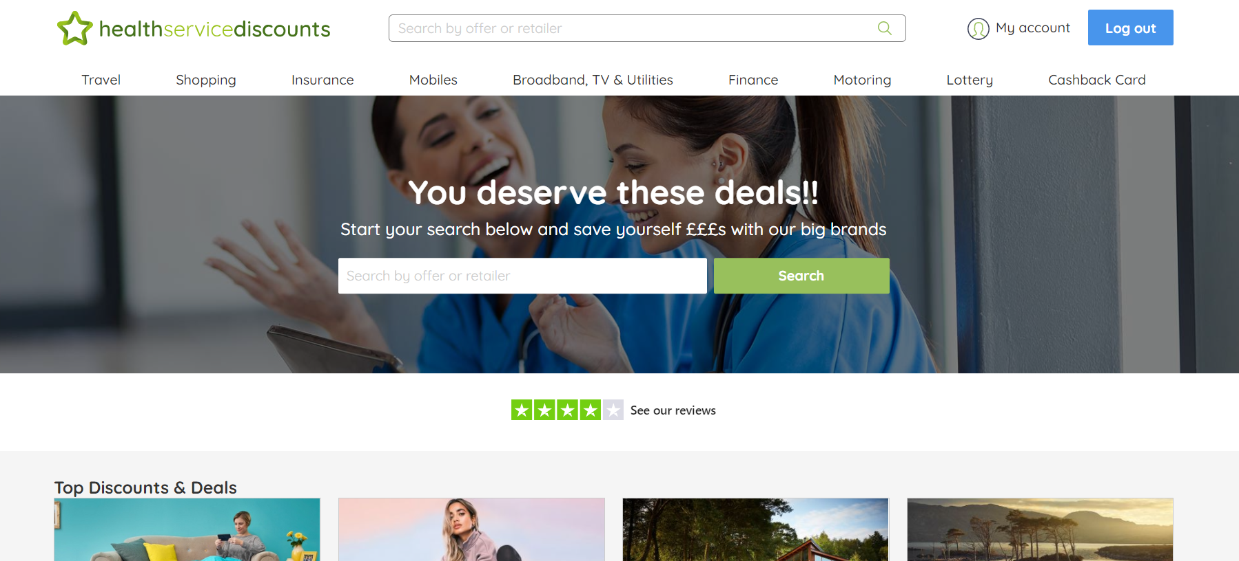

Slide 19
ELFT Flexible Working Policies
Voluntary reduced time
Employment breaks
Home working
Compressed hours
Flexi-time
Reduced annual working time
Job sharing
Unpaid leave

Slide 20
ELFT Benefits
Cycle to work scheme | Holiday Play-scheme Subsidy | Lease car scheme
Subsidised wellbeing initiatives (the Trust offers a subsidy towards Pilates/yoga courses, these are run for 10 weeks and are great fun!) | Welcome back pack for maternity/paternity returners (£50.00 high street vouchers to welcome staff on their return to work after having a baby) | Home technology scheme (order windows open: Easter, Summer & Christmas)
Exceptional leave | Free massage sessions | Annual staff awards
Employee/team of the month scheme | Holiday of a life time scheme

Slide 21
Our contact details
elft.employee.engage@nhs.net

Slide 22
Thank you & questions

