Slide 1
Adaptive General Practice
Dr Dave Triska
GP Principle
The Witley and Milford Medical Partnership, Surrey

Slide 2
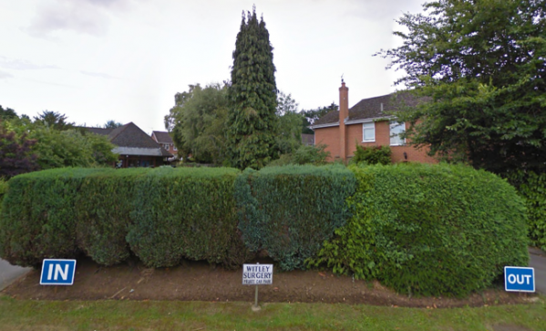
Witley & Milford Surgery
11,400 Patient Surrey Heartland Practice, 4 Partners
1. Local Challenges
3. Stable staffing
High levels of extreme frailty with most people living in their own homes
Mostly been able to avoid staffing gaps.
2. Rapid population growth over the last 10 years
4. Surrey Heartlands ICS
Commuter-belt practice with growing list size and old buildings
Part of one of the more developed ICS regions

Slide 3
No remote appointments
01
Face to face only, no phone/SMS/online.
Where we were
No duty doctor
02
Two uncapped ‘emergency’ clinics per day
Circa 2017
High home viist rate
03
Patients booked directly for them, no housebound requirement
Long term conditions
04
No structured recall or safety netting

Slide 4
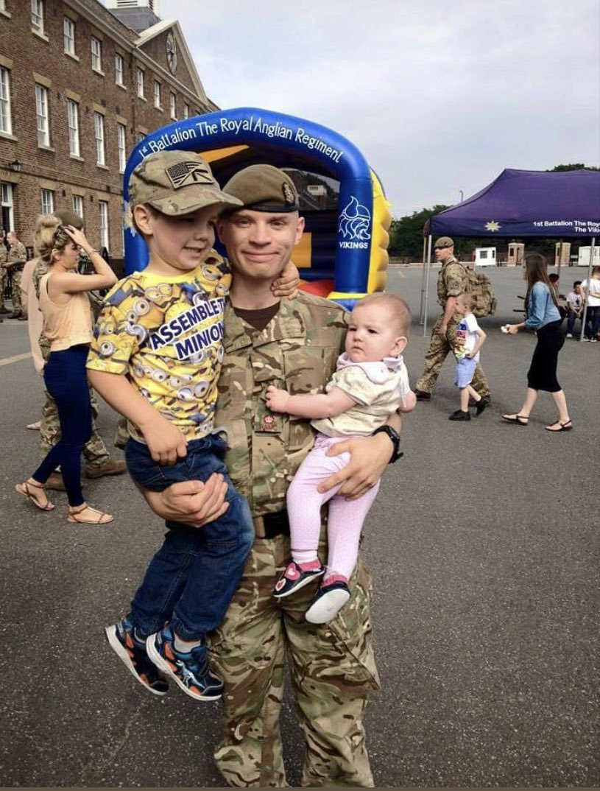
Why did we change?

Slide 5
Ethos
.
Technology
can do boring,
repetitive tasks better than us
Patients need to
be able to communicate
Their problem
Computers
can’t think for us
Wasted time
harms patients
Patients are treated promptly, with the right person

Slide 6

Constraints
.
Staffing
Fear of failure
Equilbrium
Available tech
Patient compliance

Slide 7
Goals
A
The service works
B
The service is safe
C
Staff are happy
D
Patients are happy

Slide 8
Rigid Failure
We’ve always done it like this
People may not like change
It might not work
People may not like us/me

Slide 9
Reasons to change
We can’t carry on forever like this
How do we build for the future
The way we’ve done it may not be best.
Patients will lose out

Slide 10
Iterative Design
2
Testing
Proof of concept
Initiation
Embedding
1
Small change
Re-evaluating
3
Review and renew
Are we still right?
4

Slide 11
Preventing Exclusion
15%
20%
40%
25%

Slide 12
Looking ahead – Digital to make analogue work
Equality of access
No route should be better than others in terms of care
Make it easy
Forcing doesn’t work
Protect yourselves
Decide what routes work for you, make them work for patients

Slide 13
Daily check
Maneuver Medicine
Problems occur rapidly.
Systems can fail
The best way last week
may not be today.
Static services get stuck
The world is changing quicker than the NHS
Patients are adapting quickly
React quickly
Change, change again if
needed.
Accept 80%
Perfect = never.

Slide 14
Automating information
IT systems to get info to clinicians
Adaptive Practice
01
03
02
Clinical need first
Workforce blending
Care at point of need
Sharing clinical decisions at point of contact

Slide 15
What does this look like
Acute/long term together, data from IT where you can
Problem
Solution
The team decides together, and executes together
Virtual and prioritised
Follow up
Teams flex into roles, and don’t remain rigid
Flexible

Slide 16
Enabling not disabling
Needs met
Inequalities managed

Slide 17
The future?

Slide 18
Q&A

