Slide 1
Anchor institution work at ELFT
Matilda Allen – matilda.allen1@nhs.net
Angela Bartley is leading the anchor work – angela.bartley@nhs.net
(& thanks to Claire Mulrenan for slides)

Slide 2
Anchor institutions 101

Slide 3



What is our definition of an anchor institution?
“An anchor institution is one that, alongside its main function,
plays a significant and recognised role in a locality
by making a strategic contribution to the local economy.”

Slide 4






What makes healthcare an anchor institution?
Making a difference to local communities

Slide 5
East London NHS Foundation Trust

Slide 6
Collecting Baseline Procurement Data and Testing Social Value Metrics at ELFT

Slide 7
East London NHS Foundation Trust
Delivering Community, Mental Health and Primary Care Services across:
Bedfordshire, Luton, City and Hackney, Tower Hamlets, Newham, Richmond
6,300 staff employed
£80m annual ‘addressable spend’
Operating out of 130 buildings
Over 2 million business miles claimed 2018/19 =
471 tonnes of Co2

Slide 8
ELFT Social Value Priorities
Ensuring our suppliers pay the Real Living Wage set by the Living Wage Foundation https://www.livingwage.org.uk/
Investment to grow and retention of spend in local economies
The creation of equal employment and training opportunities for local people, people with protected characteristics, service users, and groups hardest hit by the Covid pandemic
A commitment to sustainability, including a reduction in carbon emissions
Support for young workers, school leavers and apprenticeship schemes
*Voted and agreed on by Anchor Steering Group (including Service Users) and Council of Governors

Slide 9
Collecting Baseline Procurement Data

Slide 10

ELFT: Procurement Audit
Real Living Wage Compliance
ELFT drive from Oct/Nov 2020 to ensure all contracts are RLW compliant
Note: This is a work in progress and we are still awaiting a large number of supplier responses (‘TBC’)
‘Non compliant’= Either don’t comply or pending contract variation
Real Living Wage | No. Suppliers
Compliant | 168
Non-Compliant | 68
TBC | 38

Slide 11
ELFT: Procurement Audit
Proportion of Suppliers that are Registered SME
Supplier | No. Suppliers
SME | 80
Large Enterprise | 56
TBC | 138

Slide 12
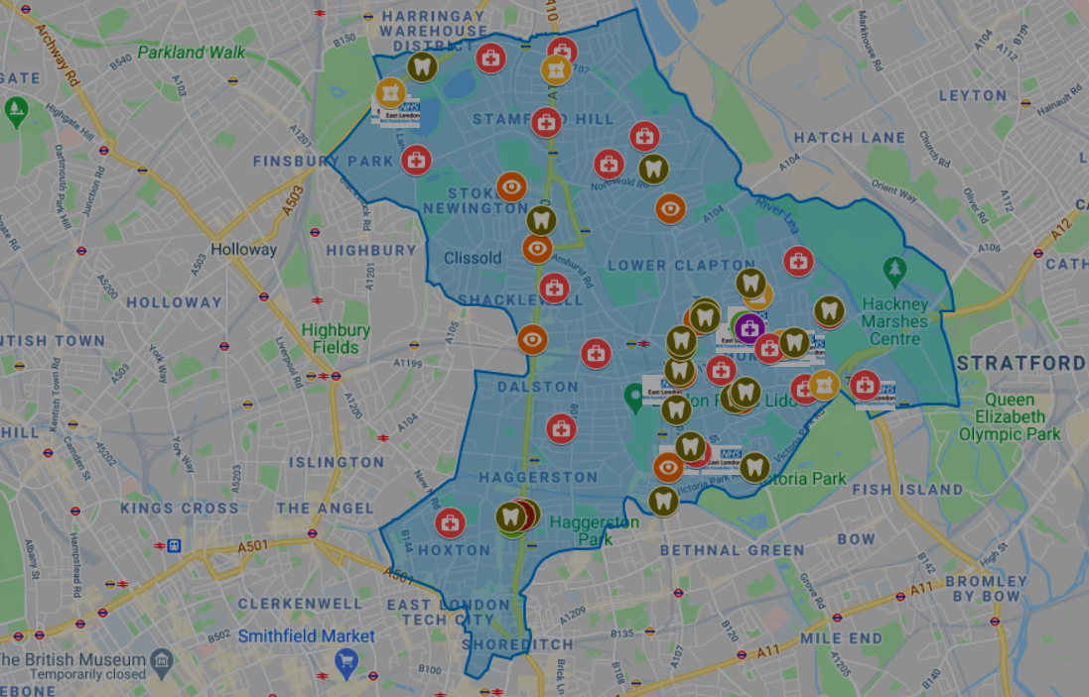
ELFT Local Spend
Borough | Spend (%)
Bedfordshire | 0.67%
Hackney | 5.69%
Luton | 1.64%
Milton Keynes | 4.16%
Newham | 4.72%
Tower Hamlets | 0.26%
All ELFT localities | 17.14%
Greater London | 28.42%
Non-Local | 54.45%

Slide 13
Testing Social Value Metrics at ELFT

Slide 14
Case Study - Website Tender
Tender for Website Developer at ELFT. £350,000 over 5 years. Commenced January 2021, concluded June 2021.
Supplier engagement February 2021 and encouraged SME participation and importance of social value
19 out of 29 Bidders were SMEs
Bidders were asked for their employment policies, sustainability and supply chain in ELFT’s catchment
Awarded bidder is an SME offering:
Employment across priority groups (including NEET, BAME and LGBTQ)
Commitment to Living wage both directly and indirectly (through supply chain)
Recruitment targeted at local communities

Slide 15
ELFT: Reflections
Gathering baseline data takes time and resource
Agreeing definitions and scope e.g. local area can be difficult and multiple discussions may be necessary
The nuance and detail needed for anchor work (e.g. where are areas of highest deprivation to target?) aren't always easy to incorporate into procurement processes
Ensuring compliance requires resource to ensure social value metrics translate to real change, as evidenced by our RLW audit.

Slide 16
ELFT: Reflections
BUT
Gathering the baseline data will allow us to measure change over time and hold ourselves and supplier to account
There is the capacity for real change as evidenced by our website tender - can serve as 'proof of concept'
Supplier engagement (e.g. in website tender), ongoing contract managements, and agreeing KPIs are essential in addition to the 'core' procurement of the service/good.

Slide 17
Anchor programme reflection and priorities

Slide 18
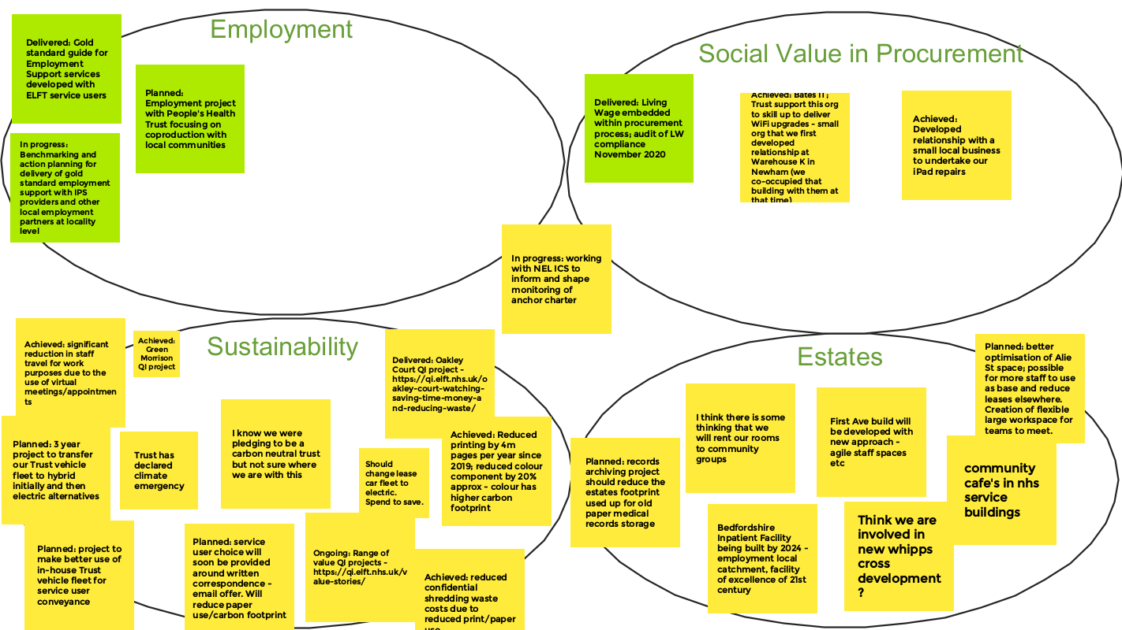

Slide 19
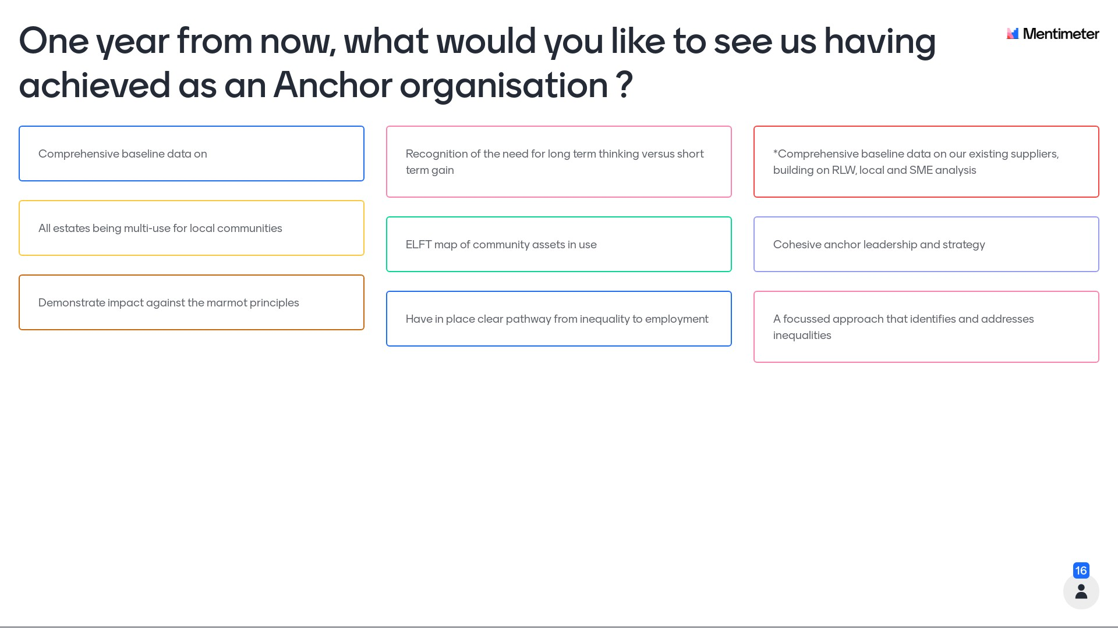
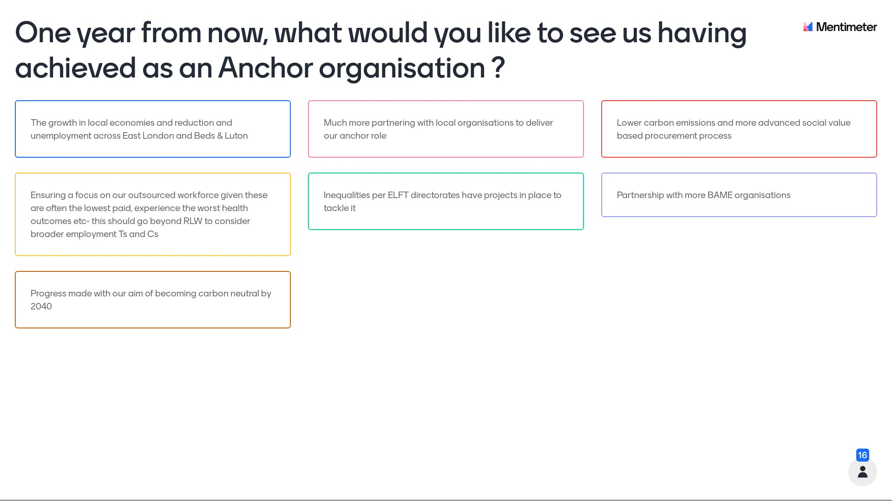
Land and buildings
Employment
Procurement
Sustainability

Slide 20
Data
Partnership
Inequalities
Strategy

Slide 21
Summary and reflection

Slide 22
There is a lot of work taking place which loosely fits into an anchor framework – what to ‘claim’ under anchor?
How to make the language, framework and strategy useful, purposeful and aligned with wider aims
Resourcing the work - should it have dedicated resource or be business as usual (or both)
What action makes sense to pursue through partnership, and at what levels (place, borough, ICS, regional…)
How to measure impact and prioritise action

