Slide 1

Digital Annual Plan 2022-23
March 2022

Slide 2
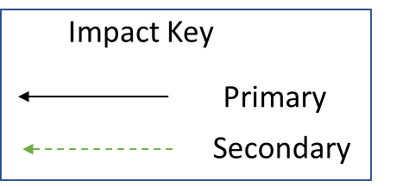

Strategic Objectives
Secondary Drivers
22-23 Priorities
Integrated Care, Partnerships & Coproduction
Digitising Mental Health Act
BLMK Shared Healthcare Record
Improved Population Health Outcomes
New Service Developments
Interoperability
Scalable Digital Infrastructure Architecture
Service User Outcomes
Electronic Observations
Improved Experience of Care
Rio 22 Upgrade & Mobile App
Staff & Service User Well-being
To improve the quality of life for all we serve
VDI - Secure Remote Access & Any Device
Digital First
Improved Staff Experience
People Participation Digital Community
Access, Demand, Capacity
Workforce, Equality & Diversity
Wi-Fi Improvement Programme
Improved Value
Cyber security and education
Estates
Virtual Appointment Management & Consultations
Bids & Contracts, Commissioning
Estates & Digital Collaborative
Value
NEL Patient Health Records (PKB)

Slide 3
Digital Annual Plan Priorities 22-23
Key Priority Area | Strategic Priority (staff experience/population health/value/experience of care) | Milestones | Local Leads | Challenges | Internal Support Required | External/Corporate Support Required | Expected Delivery Dates + Timelines | Scale
Cyber Security | Access, Demand, Capacity Service User Outcomes | Workforce Structure - Appoint CISO & CISO Team Policies and Procedures Development Dark Trace Implementation Cyber Campaign | Chief Information Security Officer | Funding | AD Digital Operations |  | Mar-23 | Trustwide
Interoperability | Integrated Care, Partnerships & Coproduction | Trust integration Engine - Rio Interface - BLMK Interface | AD Digital Development & Innovation | Funding | CTO AD Digital Operations |  | Sep-23 | Trustwide
Digitising Mental Health Act | Staff & Service User Well-being | Thalamos | AD Digital Development & Innovation | Funding | AD Digital Operations |  | Aug-22 | Local/Place-based
Virtual Appointment Management & Consultations | Digital First | EBO | AD Digital Development & Innovation | Funding | AD Digital Operations Digital Transformation Programme Manager |  | Mar-23 | Trustwide
Scalable Digital Infrastructure Architecture | New Service Developments | Wi Fi Programme Cloud Hosting | CTO | Funding | AD Digital Operations |  | Mar-23 | Trustwide

