Slide 1

Informatics, Business Intelligence and Analytics Annual Plan 2022-23
March 2021

Slide 2
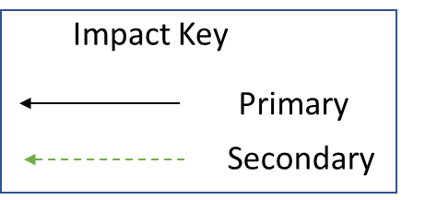

Strategic Objectives
Secondary Drivers
22-23 Priorities
Delivery of ELFTs first master patient index – visually showing the ELFT population and its interaction with our services regardless of clinical system
Maximise cloud computing and design a new modern data warehouse
Improved Population Health Outcomes
Published waiting times rules and interactive power BI dashboards for services to understand and manage waiting lists
Introduction of statutory protocols to improve consistency of reporting
Competencies in cloud data architecture, visual analytics, project management, presentational skills
Improved Experience of Care
PowerBI Apps Dashboards for 8 key service areas Mental Health Inpatient, Forensic Inpatient, CAMHS, SCYPS, Community Mental Health, Perinatal, Crisis Pathway, Primary Care utilised by 400 staff per month
To improve the quality of life for all we serve
Structured Development Plan for the whole department​
Self service dashboards to be updated with previous days data by 10am
Improved Staff Experience
Delivery of new advanced self service analytics in PowerBI​
Managed removal (including training) of all reports in reporting services where data is contained within PowerBI
Remove waste.
Optimising the reporting scripts & decommission unused reports
Introduction of a modern data warehouse with test and live environments to improve reporting consistency and assurance
Improved Value
Introduction of a enterprise modern data warehouse with single inpatient and outpatient datasets, supporting NHS Digital submissions, without manual intervention and joining data between isolated clinical systems
Timely response to ad hoc information requests
Average response time to an ad hoc request reduced to 14 days

