Slide 1

Mental Health Transformation Annual Plan 2022-23
March 2022

Slide 2
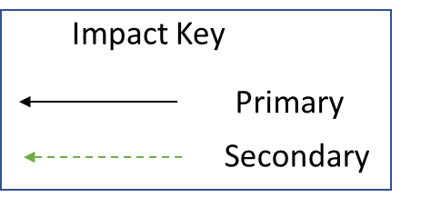

Strategic Objectives
22-23 Priorities
Work with borough-based systems to consolidate their new model of integrated Community MH care
Improving our physical health offer in Neighbourhood Teams, including Physical Health Checks
Improved Population Health Outcomes
Fully testing and implementing the recommendations of the ‘Let’s Talk’ report on access and experience of MH care for service users from BAME groups
Improved Experience of Care
Scale-up use of Patient’s Know Best to enable service users greater control and ownership over their care plans
To improve the quality of life for all we serve
Fully develop and define our replacement for CPA, and test it within our services
Improved Staff Experience
Further build on our partnership work with VCSE organisations via Compass Wellbeing, including establishing our 5yr Community Connector contracts
Deliver our Transformation OD programme focussing on engagement, stock-taking, leading and working in complexity and teambuilding
Improved Value
Stand-up our Community Eating Disorder Service
On-going pathway development work for people with Disordered Eating, Complex Emotional Needs, MH Rehab needs, Older Adults and Young Adults

