Slide 1

Quality Improvement
Annual Plan 2022-23
March 2022

Slide 2
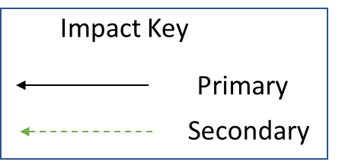

Strategic Objectives
Secondary Drivers
22-23 Priorities
Ongoing Triple Aim QI programme to use QI methods to improve population health, service user and staff experience and value. Teams include improving population health for veterans, homeless people, asylum seekers, elderly suffering form dementia, Bariatric patients.
Triple Aim QI Programme
Improved Population Health Outcomes
Pursuing Equity QI Programme
Launch in April 2022, a year long programme to support teams across the trust to address inequalities and inequity in health outcomes, experience and access to care
Improved Experience of Care
Launch in June 2022, a year long programme to support teams across the Trust to use QI methods to approach improving service user pathways
Demand, Capacity and Flow QI programme
To improve the quality of life for all we serve
Alignment of QI training with directorate priorities
Pocket QI, Improvement Leaders programme, Improvement Coaching Programme
Improved Staff Experience
Capability Building
Developing rigour while supporting improvement work to embedding QI as business as usual and pursuing equity of access to training programmes
Supporting the use of Improvements methods for all Trust wide improvement work
Improved Value
Supporting Trust wide QI coaches development
Sustainability and value
QI support using improvement methods for financial viability
Using QI methods and tools to support sustainability Green Plan

