Slide 1
Inclusion Health; A National Perspective
Elaine Goodwin
Inclusion Health Lead NHSE/I CNO and Health Inequalities Teams
Birmingham and Solihull General Practice Staff & Allies Equality, Diversity & Inclusion Network
June 2022

Slide 2
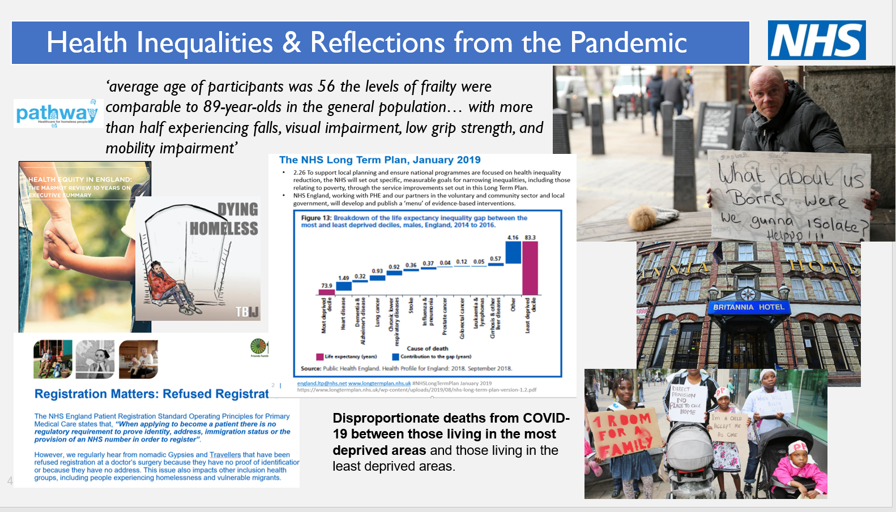
Notes:
Dying Homeless was a year-long project by the Bureau of Investigative Journalism that counted the number of people who died homeless in the UK.
We counted deaths that occurred between October 1, 2017 and March 31, 2019. In that time, we logged the stories of 800 men and women that died while sleeping rough or living in temporary accommodation.
Our investigation for January to June 2019 has revealed that a person affected by homelessness is dying every 19 hours.
We have found that at least 235 people affected by homelessness have died over the last six months – an average of one every 19 hours – despite the passage of the Homelessness Reduction Act in 2017. The people who have died range from 16 to 104 years old
Frailty – Pathway Though the average age of participants was 56 (ranging from 38-74), the levels of frailty were comparable to 89-year-olds in the general population. Conditions usually associated with old age were common, with more than half experiencing falls, visual impairment, low grip strength, and mobility impairment. Cognitive impairment was also found to be prevalent but under recognised and rarely diagnosed. In addition, all participants had more than one long-term health condition, with an average of 7 long-term conditions identified per person. This is greater by far than even the oldest people in the general population.

Slide 3
Inclusion Health
‘Catch-all’ term
Lens within health inequalities agenda on people most likely to be systematically socially excluded, typically experience multiple overlapping risk factors for poor health, experience stigma and discrimination, and are not consistently accounted for in electronic records
Can include people who experience homelessness, drug and alcohol dependence, vulnerable migrants, Gypsy, Roma and Traveller communities, sex workers, people in contact with the justice system and victims of modern slavery
Experiences and structural barriers frequently lead to poor access, experience and extremely poor health outcomes
https://www.gov.uk/government/publications/inclusion-health-applying-all-our-health/inclusion-health-applying-all-our-health
‘duty to pay particular attention to groups or sections of society where improvements in health and life expectancy are not keeping pace with the rest of the population’
NHS Constitution for England - GOV.UK (www.gov.uk)

Slide 4
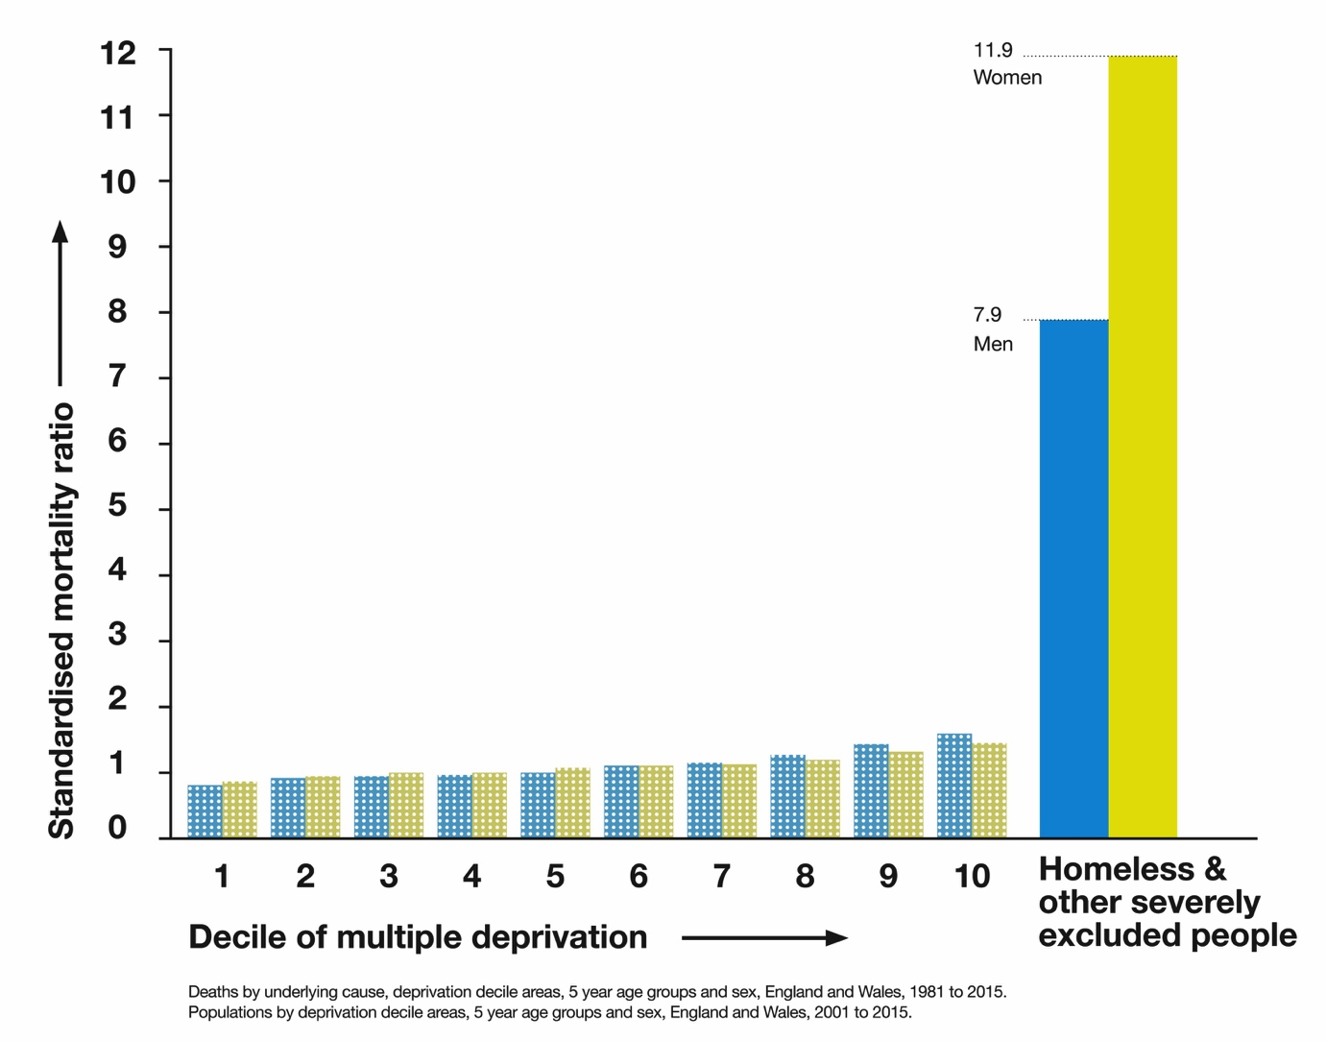
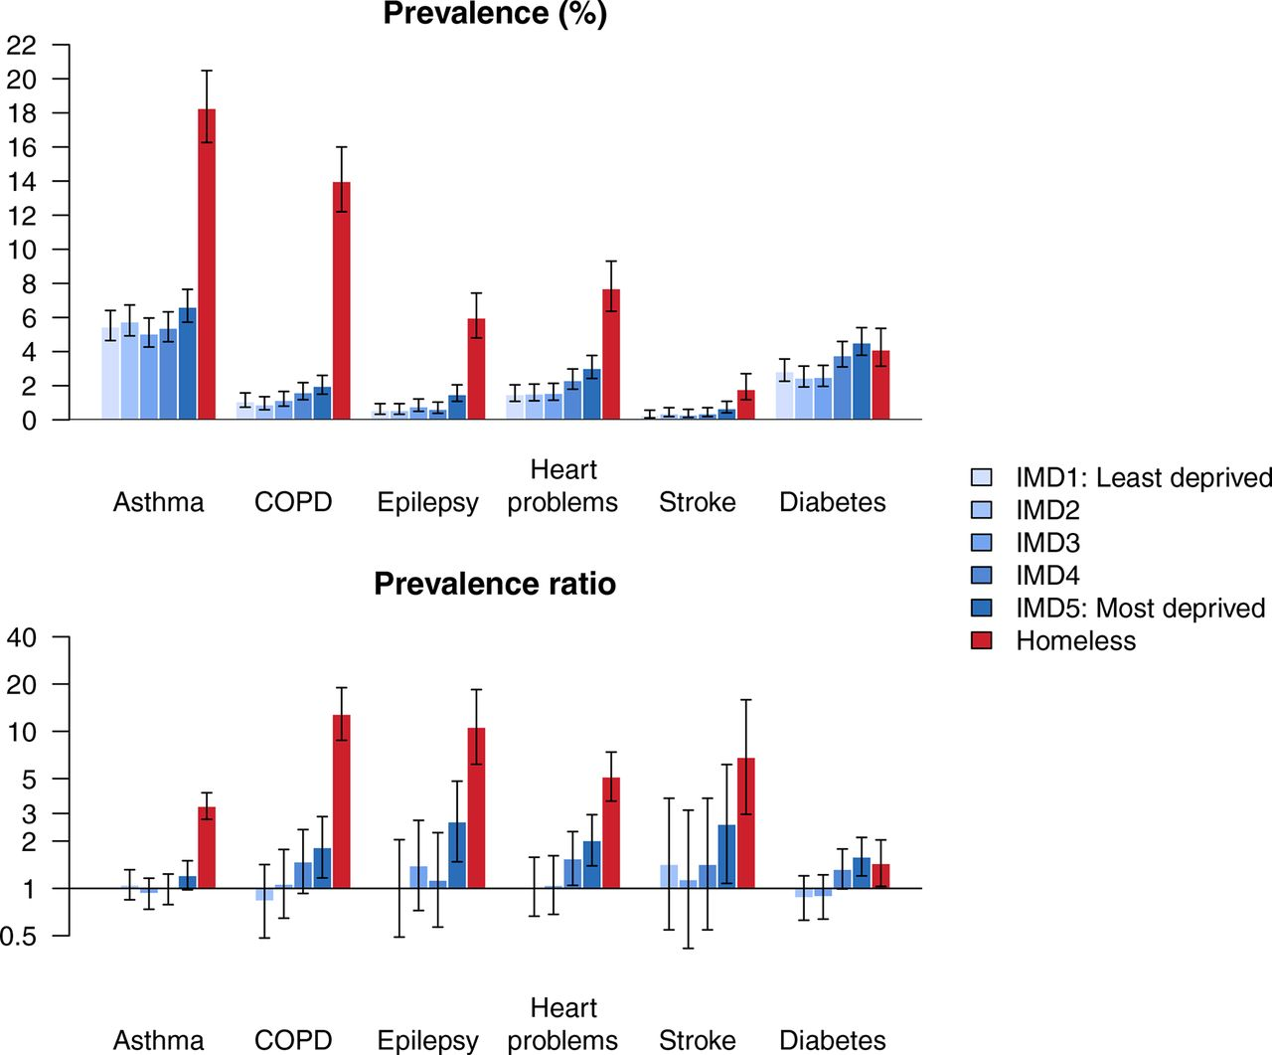
Inclusion Health & the LTP
http://www.thelancet.com/journals/lancet/article/PIIS0140-6736(17)31869-X/fulltext
Prevalence of long-term conditions and prevalence ratios, with 95% CIs. COPD, chronic obstructive pulmonary disease; IMD, index of multiple deprivation, Dan Lewer et al. BMJ Open 2019;9:e025192

Slide 5
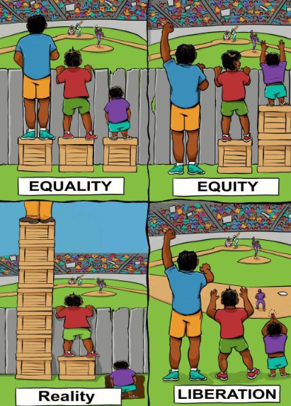
Inclusion Health priorities in last 18 months
Key deliverables
Lead for Inclusion Health clinically and for policy, planning and system support across NHSEI Health Inequality Improvement and CNO Teams aligning to CORE20PLUS5
Expertise and support to key NHSEI and cross government programmes to maximise access, experience and outcomes for inclusion health groups. These include; Changing Futures; Rough Sleeping; Vulnerable Migrants; Primary Care; Mental health; Out of Hospital and Urgent Care; Children and Young People and Covid response.
To integrate inclusion health and patient safety agendas to reduce risks of harm, improve safeguarding to support excellent experience and optimal health outcomes.
To strengthen leadership and accountability in the inclusion nursing and wider clinical workforce in line with CNO business plan; The People Plan and Health Inequality Improvement Plan priorities.

Slide 6
Inclusion Health National Drivers
White papers; Health and Social Care Integration; Health Disparities; Levelling Up and Adult Social Care Reform
Legislation; Health and Care Act, National & Borders Bill; Vagrancy Act and Mental Health Reform
Strategies; NHS Long Term Plan; Rough Sleeping; Drug; Suicide; Mental Health; Womens Health; Domestic Abuse and Ethnic Minority
Programmes; Changing Futures and Rough Sleeping
NICE; Integrated health and social care for people experiencing homelessness
National Asylum Steering Group
Inquiries; Kerslake; Health Disparities; COVID 19 and Acquired Brain Injury
Notes:
Strengths-based approach:​
Identify Exemplars​
Build from strength​
Co-Production:​
Engaging Communities in design, implementation & evaluation.​
Genuinely listen with curiosity
Data-driven Improvement – Creating virtuous circles of data generating actionable insight which then drive interventions to bring about improvement thus generating intelligence about what works

Slide 7
Key improvement themes highlighted by lived experience workshops
Treating people with humanity – ‘starting with people’
Having access to the right information at the right time
Reducing barriers to accessing GPs and other primary care services, including digital inclusion
Improving complaints processes and accountability
Improving communication across services and more consistency across geographical areas
Improving access to secondary care including mental health services
Improving community support
Notes:
Strengths-based approach:​
Identify Exemplars​
Build from strength​
Co-Production:​
Engaging Communities in design, implementation & evaluation.​
Genuinely listen with curiosity
Data-driven Improvement – Creating virtuous circles of data generating actionable insight which then drive interventions to bring about improvement thus generating intelligence about what works

Slide 8
Broad improvement themes - all stakeholders
Access:​
  Community asset-based approaches
  Equitable COVID response e.g. COVID passports
  Front door access particularly primary care
  Mental health programme
  Outreach and offers of intervention
  Digital Inclusion
  Out of hospital care and Homefirst
  Equity for waiting lists
  Health anchors
Experience:​
  Personalised, trauma informed and compassionate care where every contact counts
  Use of strengths-based approaches, patient, individual, service and system level
  Opportunities to join up health, social care and housing commissioning and provision
  Good quality translation services that are accessible to all that need them
Outcomes:
  Inclusion health being ‘everyones business’- individual and system level
  Min data set for Inclusion Health
  Inverse Care
  Measuring improvements through ‘soft’ and ‘hard’ data
  Population based health outcomes
  Vulnerable migrants and children and young people
  Mortality review processes
  CORE20PLUS5
Notes:
Strengths-based approach:​
Identify Exemplars​
Build from strength​
Co-Production:​
Engaging Communities in design, implementation & evaluation.​
Genuinely listen with curiosity
Data-driven Improvement – Creating virtuous circles of data generating actionable insight which then drive interventions to bring about improvement thus generating intelligence about what works

Slide 9
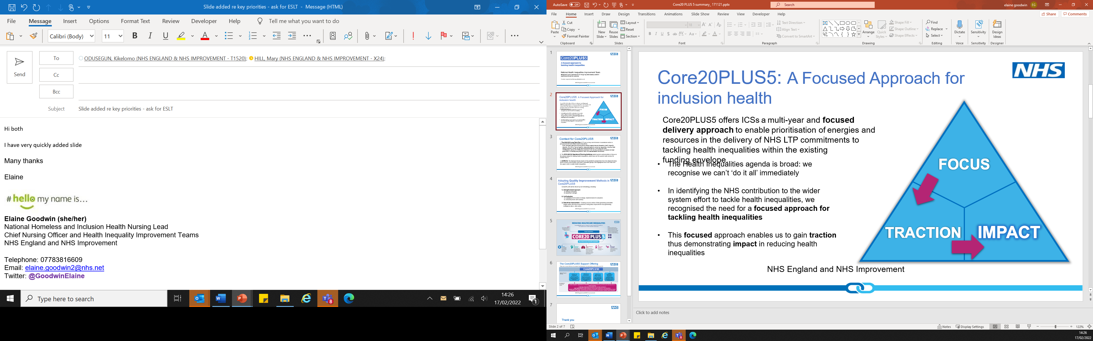
Draft national plan for Inclusion Health
Develop interactive tool to support ICSs further in meeting needs of IH groups built on PCN tool
  Build on existing evidence and tools
  Promote a call to action that aligns with key guidance including Kerslake and NICE
  Support quality improvement by identifying exemplars, building on strengths and action research
  Embed and support use of tool through regional IH leadership
Develop minimum data set for Inclusion Health
  Scope need and ambition aligned to national data set and core programme
  Identify national exemplars
  Evaluate and define national data set with recommendations for next steps
Improving health and safeguarding for vulnerable migrants
  Continue cross government focussed work for vulnerable migrants – align to Core20PLUS 5
  Align with NHSEI core programmes and agree programme support
  Provide expertise to support safe and effective system operationalisation of Home Office Policy i.e. Ukraine and Asylum Bill
Improving health and safeguarding for CYP in temporary accommodation
  Align key findings i.e. CHAMPIONS with cross cutting themes of CYP Core20PLUS5
  Scope need, gain traction though CYP programme and CYP Core20PLUS5
  Evaluate and make recommendations for next steps, implement as appropriate
The Health Inequalities agenda is broad: we recognise we can’t ‘do it all’ immediately
In identifying the NHS contribution to the wider system effort to tackle health inequalities, we recognised the need for a focused approach for tackling health inequalities
This focused approach enables us to gain traction thus demonstrating impact in reducing health inequalities

Slide 10
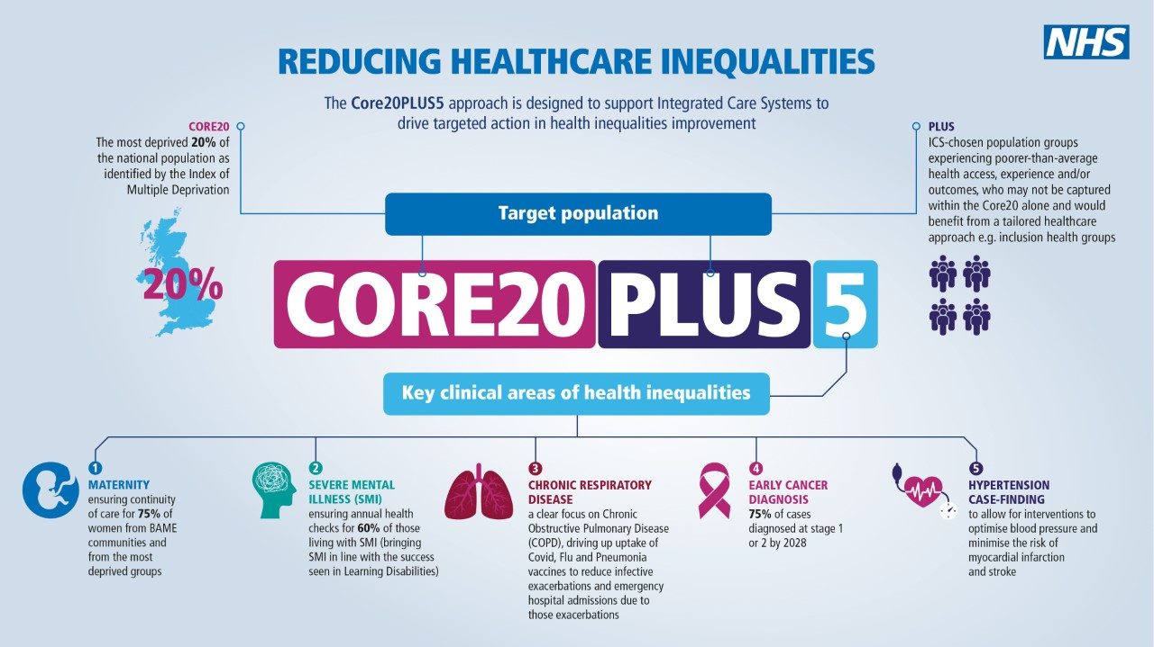
PLUS groups are ICS defined population groups experiencing poorer than average health access, experience and/or outcomes who may not be captured within the Core20 alone and would benefit from a tailored healthcare approach.
As part of the PLUS offer, ICS’ are encouraged to disaggregate their population health data by HI lenses with the aim of identifying populations where there are greatest disparities presenting an opportunity to narrow the gap in access, experience and/or outcomes.
Where hard data doesn’t exist ICS’ can be supported through national recommended priorities to consider in relation to inclusion health
Combined with guidance document and toolkits
Notes:
Strengths-based approach:​
Identify Exemplars​
Build from strength​
Co-Production:​
Engaging Communities in design, implementation & evaluation.​
Genuinely listen with curiosity
Data-driven Improvement – Creating virtuous circles of data generating actionable insight which then drive interventions to bring about improvement thus generating intelligence about what works

Slide 11
Enabling and supporting system improvements
Core20PLUS5 is a key vehicle to drive the change necessary to improve the health outcomes for inclusion health populations
Our ambition is to highlight the need for ICSs to deliver on their key responsibilities in relation to inclusion health populations within the wider health inequalities agenda that is in alignment with the:
  NHSEI Health Inequalities Improvement vision and the Core20PLUS5 approach
  NHS Standard Contract and Planning Guidance.
  PCNs health inequalities DES
All supported through scale, spread and building on what is working currently and the emphasis that inclusion health is all parts of the systems business.
Planned roadmap/ tool to support ICSs further in meeting needs of IH groups built on PCN tool
Notes:
Strengths-based approach:​
Identify Exemplars​
Build from strength​
Co-Production:​
Engaging Communities in design, implementation & evaluation.​
Genuinely listen with curiosity
Data-driven Improvement – Creating virtuous circles of data generating actionable insight which then drive interventions to bring about improvement thus generating intelligence about what works

Slide 12
Enabling and supporting system improvements
Frontline
Understanding context & rights’, learning & training, advocacy, holistic screening/ assessment, trauma informed practice, escalate concerns, challenge system and professional barriers, familiarise yourself with key support, evidence, research, resources, self care, access to supervision & escalate
Service/ Organisational Level
Work with local trusted services to identify and target populations at risk of social exclusion, know your ‘hard to reach’ services and adapt them - Localised place base approaches, know your HI, inclusion health& safeguarding leads, challenge system and professional barriers, auditing access in partnership with people with lived experience, organisations that work closely with them and the local Healthwatch. Provide the culture to support staff to practice in a trauma informed and culturally competent way, and recognise staff vicarious trauma, especially in the heat of a Pandemic response, NHS Health & Wellbeing Framework
Strategic level
Raise profile, JSNA’s, key drivers, policies and need, system collective responses working with trusted organisations, challenge current ways of working and advocating for the consideration of inclusion health groups in service design and commissioning, challenge hostile policies
Notes:
Strengths-based approach:​
Identify Exemplars​
Build from strength​
Co-Production:​
Engaging Communities in design, implementation & evaluation.​
Genuinely listen with curiosity
Data-driven Improvement – Creating virtuous circles of data generating actionable insight which then drive interventions to bring about improvement thus generating intelligence about what works

Slide 13
Inclusion Health further information
This guide is part of ‘All Our Health’, to help staff and systems to take action on inclusion health. There is also page specific to migrant health.
This tool helps Primary Care Networks to assess their engagement with Inclusion Health groups.
Language and interpreting translation guidance
https://www.nice.org.uk/guidance/ng214
The QNI Homeless and Inclusion Health Programme and the Faculty for Homeless and Inclusion Health are membership organisations for people involved in health care for excluded groups.
Doctors of the World have produced several resources including the Safe Surgeries Toolkit to support practices with new registrations and produced some helpful posters explaining how the NHS works.
NUM is a UK-wide charity working with sex workers to do research, design and deliver safety tools and to provide support services to people in adult industries.
Friends Family and Travellers policy, publications and information on issues affecting Gypsies and Travellers
Notes:
Strengths-based approach:​
Identify Exemplars​
Build from strength​
Co-Production:​
Engaging Communities in design, implementation & evaluation.​
Genuinely listen with curiosity
Data-driven Improvement – Creating virtuous circles of data generating actionable insight which then drive interventions to bring about improvement thus generating intelligence about what works

Slide 14
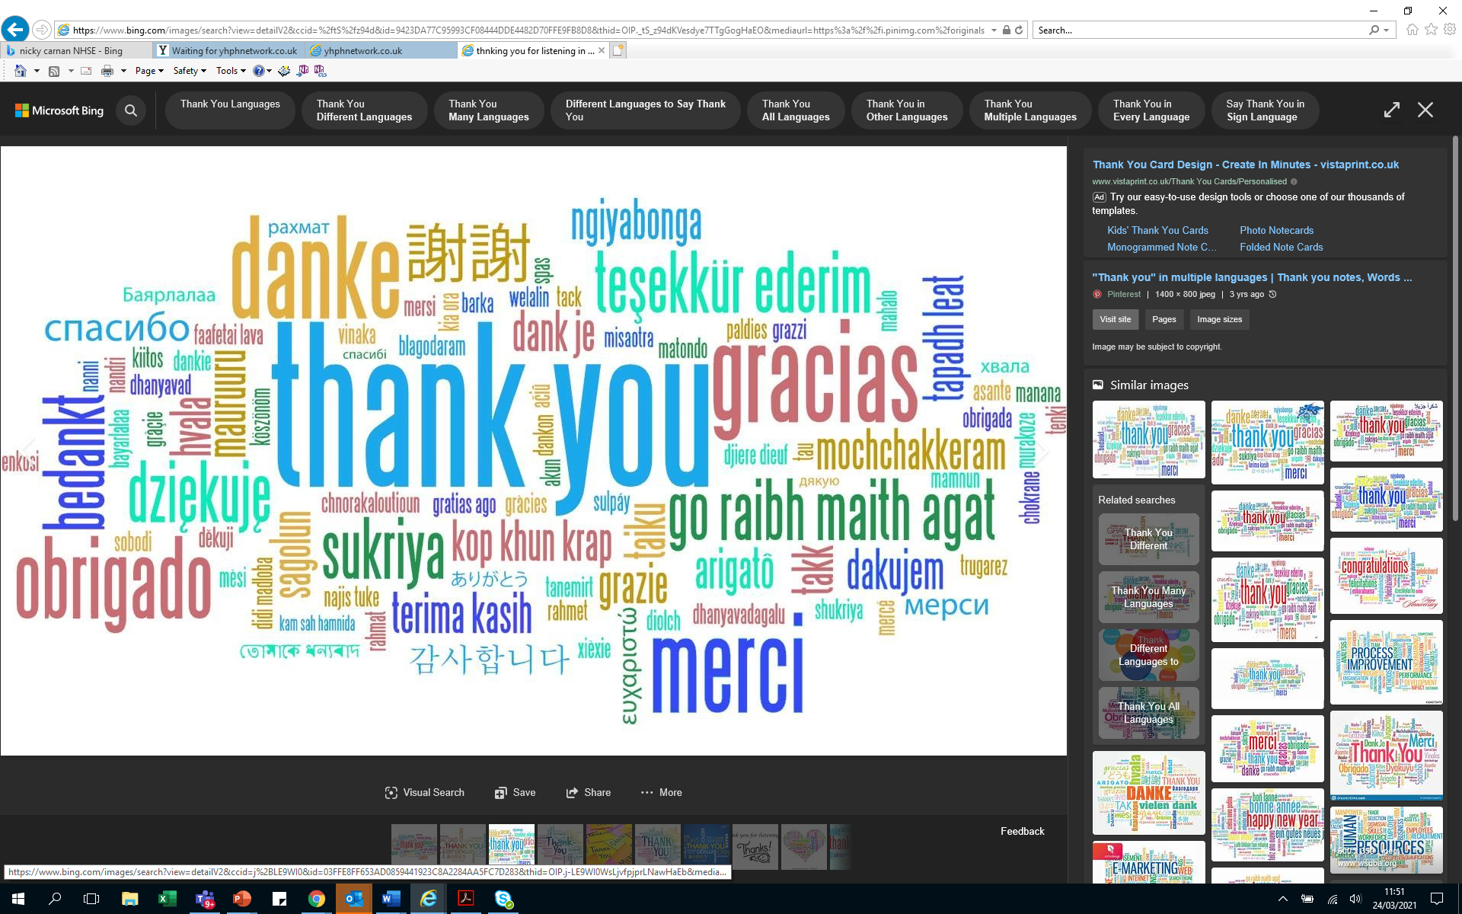
Equality and Health Inequality Network https://future.nhs.uk/EHIME/grouphome or email england.healthinequalities@nhs.net
Homeless and Inclusion Health workspace Homelessness and Inclusion Health - FutureNHS Collaboration Platform

