Slide 1
The Importance of Retaining the COVID-19 Vaccination Workforce from a London perspective Amy Stebbings, Workforce Lead, COVID-19 Vaccination Programme
24th May 2022

Slide 2
Thank you! Approximately 17 million vaccinations have been delivered across London

Slide 3
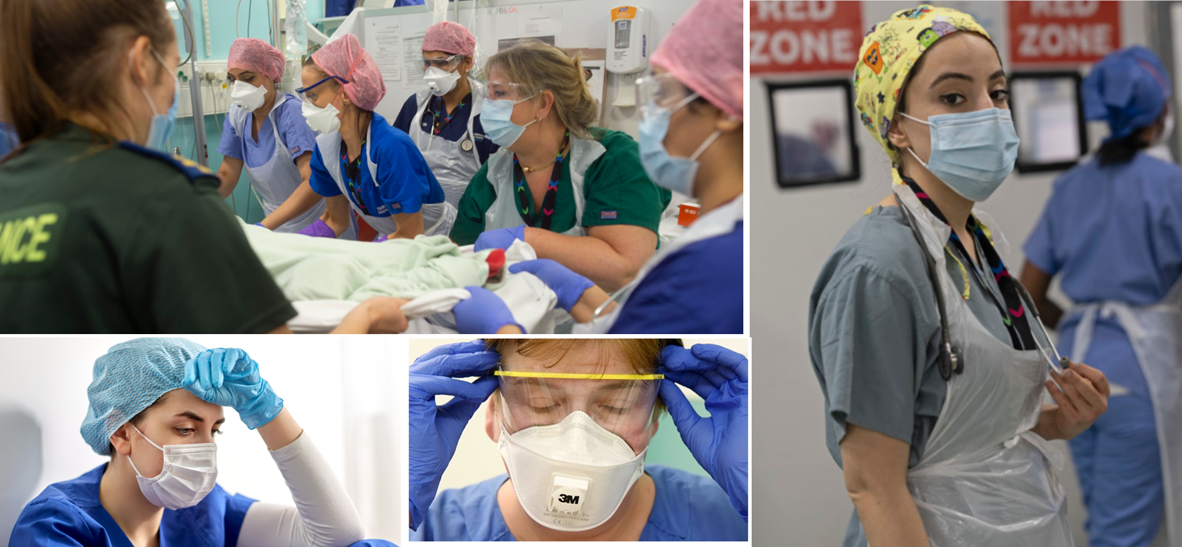
March 2020: Unprecedented healthcare crisis

Slide 4
The UK goes into lockdown (March 2020)

Slide 6
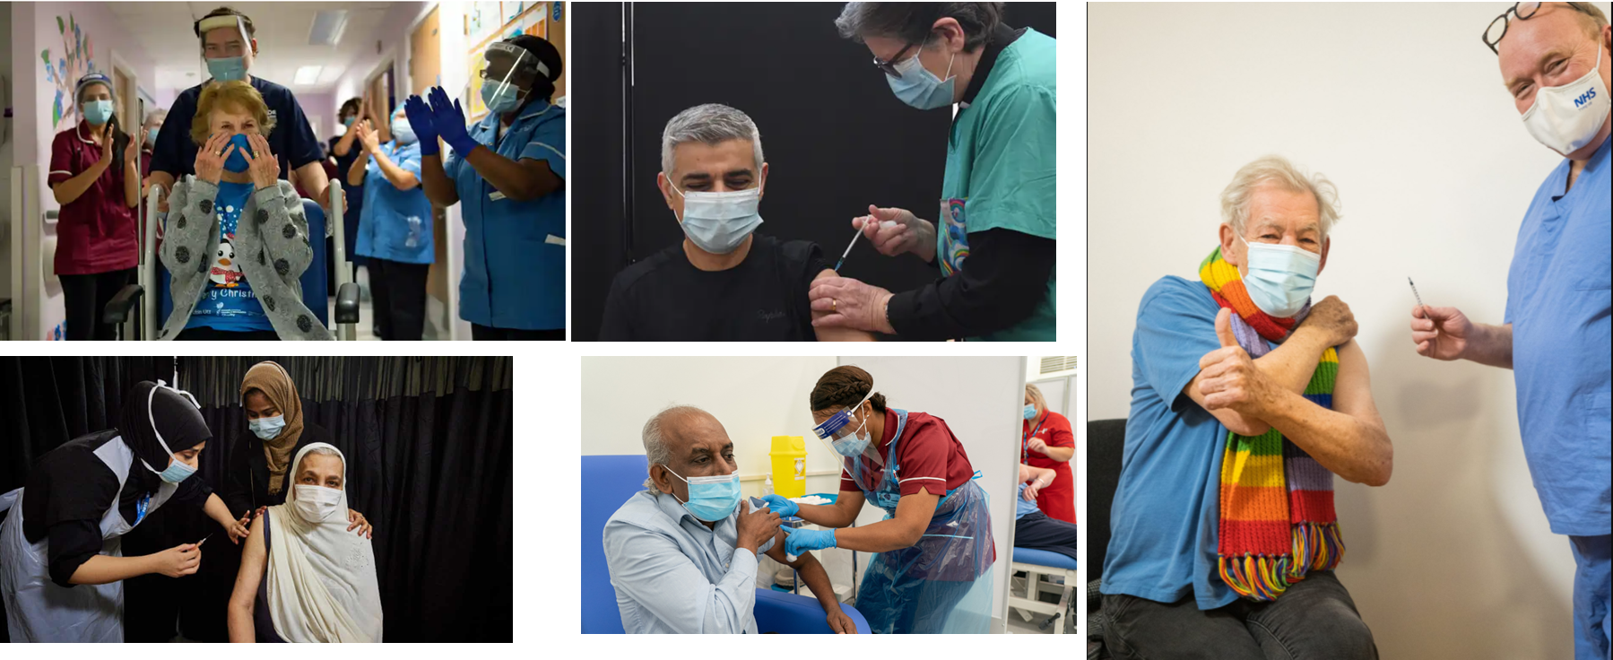
Vaccine rollout started in October 2020
“It has given people hope”

Slide 7
What we needed to deliver
The requirement was a simple one; in order to save lives we needed sufficient staffing levels to set up and run vaccination delivery and make this sustainable for the length of the programme.

Slide 8
What we did

Slide 9
Workforce initiatives

Slide 10
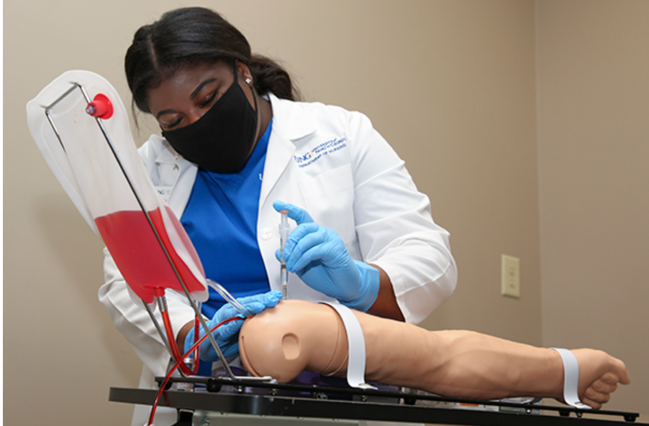
Recruitment and training

Slide 11
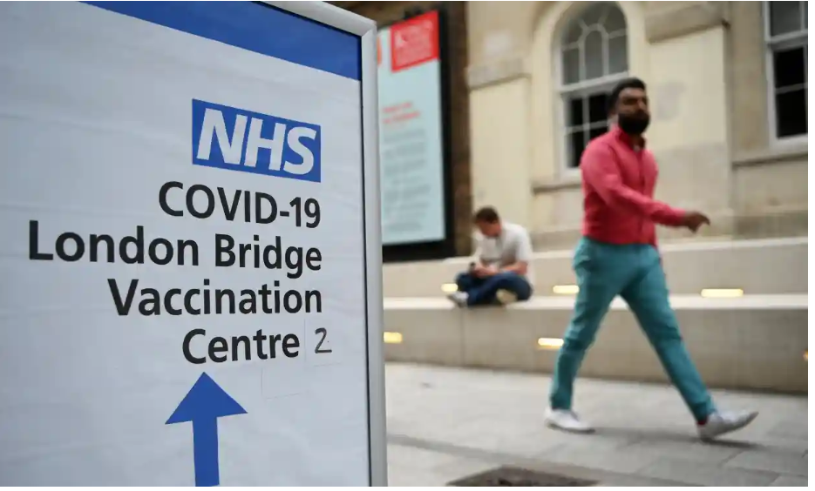
What a journey… since the first vaccine was administered over a year and a half ago… So what’s next? - Spring boosters - Autumn boosters - Staff retention

Slide 12
Retaining the vaccination workforce
In July 2021, we established the London Retention programme to improve ways of harnessing the vaccination workforce by repurposing, retraining and retaining them into wider NHS roles.
We are building a new robust workforce that is sustainable for the future!

Slide 13
The retention journey
Our aim:
National target to retain 25% of the London vaccination workforce who were interested in wider NHS roles:
= 2,553 people interested; 25% = 638 people.
We established Retention Leads in each of the 5 ICS’s.
Retention action plans were developed.
Collaborative approach across London where the Retention Leads meet regularly to monitor progress against retention action plans and share best practice.
Retention action plans have been aligned to current career pathways and existing vacancies to provide long term career options and maximise opportunities.
We have robust processes in place for data collection of the protected characteristics i.e. ethnicity, age, gender and disability.
Improved communication between ICS Retention Leads and Recruitment Managers.

Slide 14
Our key successes
Across London, we have held events to support the retention of vaccination staff into wider NHS roles (by April 2022):
57 Webinars.
1,874 Career conversations.
10 Career fairs:
Careers fairs provide candidates with the opportunities to learn about specific roles and liaise with system organisations. These have been virtual, at vaccination sites and at large scale external venues).
7,555 Surveys:
Surveys engage the recruitment pool to assess which candidates are still interested and to seek feedback on the programme so far.
Focus on retaining existing vaccination staff by developing, training and promoting where possible.

Slide 15
Our key successes (continued)
Establishing links with external organisations such as the Prince’s Trust and Skills for Care.
Disseminating regular Newsletters and Bulletins to the retention pool.
Streamlining the recruitment processes.
Linking in with the Volunteer workforce.
Hosting regular pan-London meetings where careers advisors can attend to share best practice and develop ideas.
To date, 2,125 staff have been deployed into substantive roles, long term temporary roles and other bank work (both clinical and non clinical roles) across London.

Slide 16
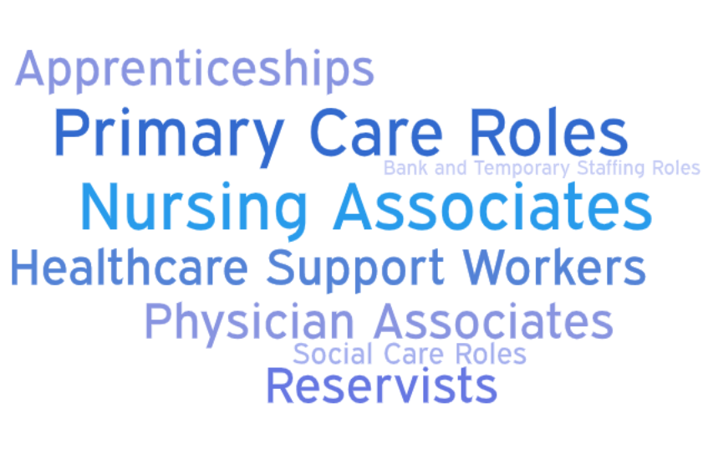
The Covid-19 Vaccination Programme Legacy

Slide 17
More information
NHS careers information:
Take our careers quiz | Health Careers
https://www.healthcareers.nhs.uk/FindYourCareer
Also check NHS Careers website here
https://www.healthcareers.nhs.uk/
Take this careers quiz to see which healthcare opportunities are most aligned with your attributes!

Slide 18
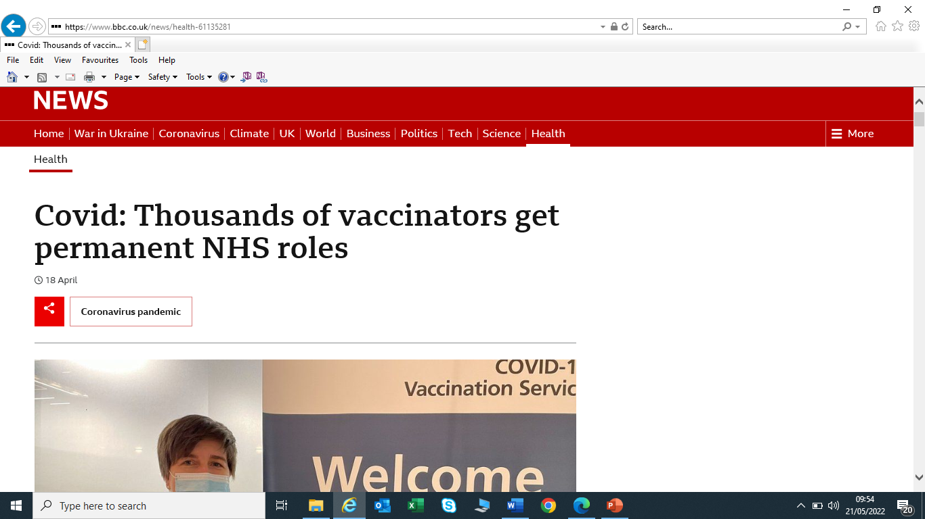
Case study
Kazeem Reaves-Odunsi worked as a gym manager before becoming a vaccinator is now an assistant service manager at GSTT.

Slide 19
Next steps for North East London (NEL)
NHS England & Improvement is committed to retaining the vaccination workforce and do not want to lose their skills and expertise.
NEL Retention activities (March – September 2022):
New joiners induction webinars.
Continuous retention webinars.
Continuous One 2 One career advice service.
Job interviews training and job searches training.
Building strong links with health and social care providers.
Build strong relationships with recruitment managers on retention activities.
NEL Team:
Simona Shaygan, HR Lead
Swallay Bandhoo, Retention Lead
Doris Holloway, Careers Adviser
Fiona Lord, Careers Adviser

Slide 20
Thank you for listening ☺
Any questions?
amy.stebbings@nhs.net

