Slide 1
Working in Adult Social Care
What work in adult social care is all about
Common myths about the sector
The number and variety of local vacancies
Answering your questions
Miranda Coates, Senior Locality Manager LSE, Skills for Care

Slide 2
Care roles in NE London
Quiz to find out more. Don’t worry if you don’t know the answers – have a guess.

Slide 3

In NEL do more people work in the NHS or in social care?

Slide 4
Adult Social Care employs 45,000 and the NHS 38,800. Many think that the NHS is bigger or that there are more health workers. The health figures include hospital and primary and community healthcare workers

Slide 5

2. How many care organisations registered with the Care Quality Commission (CQC) are there in NEL?
a) 456, b) 651, c) 822

Slide 6
b) 651 – care is delivered by a large number of organisations of all sizes and types

Slide 7

3. The majority of care services in NEL are residential?
True or False?

Slide 8
False.
The figures here are for all of NEL across the 8 boroughs. They don’t include other types of care service types but are the major ones – there are a range of types of care: residential, home care, supported living, shared lives, extra care, day centres, personal assistants.
Nursing homes | Residential homes | Domiciliary care | Supported living
51 | 190 | 302 | 29

Slide 9









4. All care roles involve personal care?
True or False ?

Slide 10
False
There are many roles that don’t involve personal care (e.g. support worker, reablement roles, activity workers, advocacy workers, care navigator, coordinators, social workers, managers, and many more)

Slide 11
5. Care is about helping the elderly?
True or False?

Slide 12
False
Social care is there to meet the needs of a wide range of people (older adults, people with physical and sensory disabilities, learning disability, autism, mental health, or substance use issues) across a broad range of settings and service models.
Helping is not always a good term to use as it can imply someone is helpless. Social care provides personal and practical support to help people live the lives they choose. Supporting individuals to maintain their independence and dignity and to make sure they have choice and control. It is focused on supporting individuals to live quality lives – empowering people to say what’s important and to make decisions about their own care and support.

Slide 13

6. There are over 30 different roles in care – how many do you know?

Slide 14
Examples include: Care worker, support worker, activities coordinator, personal assistant (PA), social worker, occupational therapist, nurse, manager, team leader, rehabilitation/ reablement worker, shared lives worker, etc and all the ancillary roles such as finance, buildings, human resources.

Slide 15

7. Care organisations tend to pay the National Minimum Wage?
True or False?

Slide 16
False.
NMW is £9.50 hour (for 23+)
Many NEL boroughs already do or are aspiring to pay at least London Living wage of £11.05

Slide 17
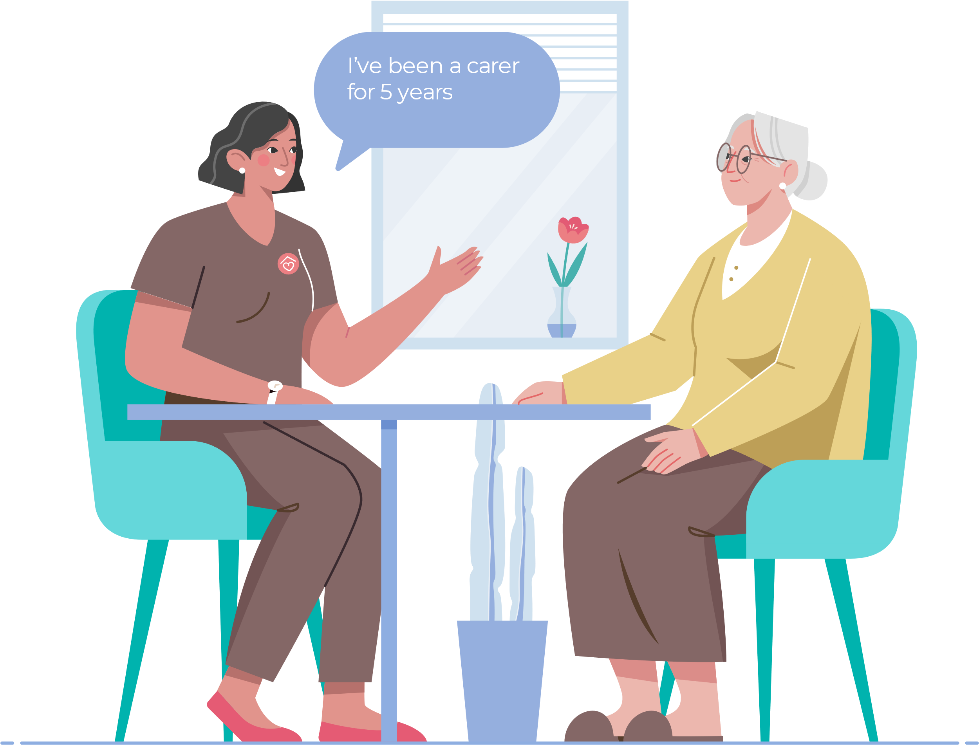
8. What is the average vacancy rate of care providers in NEL?

Slide 18
Varies, but over 10% in many boroughs so many providers have staff shortages. Turnover is around 25- 30% so there are lots of jobs available

Slide 19

10. You don’t need a specific qualification to work in care?
True or False?

Slide 20
True.
The expectation is that the employer would enable the new worker to go onto a level 2 qualification within 6 months of starting. There are strong vocational qualifications and career pathways available for people to progress in work.

Slide 21
Summary
It is a such a rewarding job which touches people’s lives and makes a real difference. You feel you are giving back to society and get real job satisfaction
There are so many different types of care role – they don’t all involve personal care and many are based in the community or someone’s home
There are development opportunities – it is a career
You don’t need to have any relevant experience or qualifications to start as you can use your transferrable skills and will get a thorough induction and training once you start work
You can get training and qualifications whilst working and there are career pathways. You could go right up to being qualified as a Social Worker, Occupational Therapist or Nurse via work-based apprenticeships
The role of a care worker is all about building relationships and watching the changes you can make to people’s lives through the care you provide. You also meet amazing people along the way
You can have real job security as there are an increasing number of jobs available
Don’t write off the idea straight away. It’s good to find out more – do research to gain an understanding of the requirements of the roles
The job is really varied, and no two days are the same so it isn’t boring

Slide 22
Further Resources
The NEL careers project website give lots of information, videos and examples of local people’s jobs https://careers.eastlondonhcp.org.uk/ and a career matcher tool to help people think about the roles they may be interested in
The national recruitment campaign for social care - Made with Care has a lot of videos and resources https://www.adultsocialcare.co.uk/home.aspx and Facebook page: https://www.facebook.com/adultsocialcarecampaign
Skills for Care website – there is a lot of information about working in care https://www.skillsforcare.org.uk/Careers-in-care/Think-Care-Careers.aspx

