Slide 1




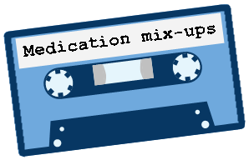
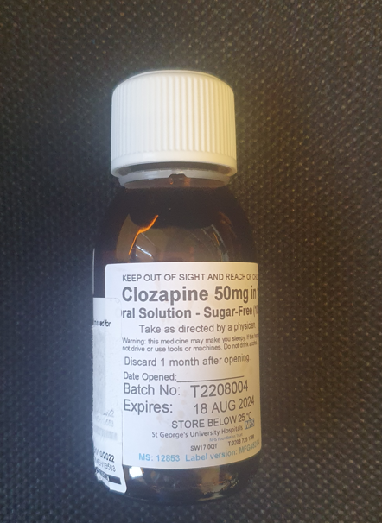
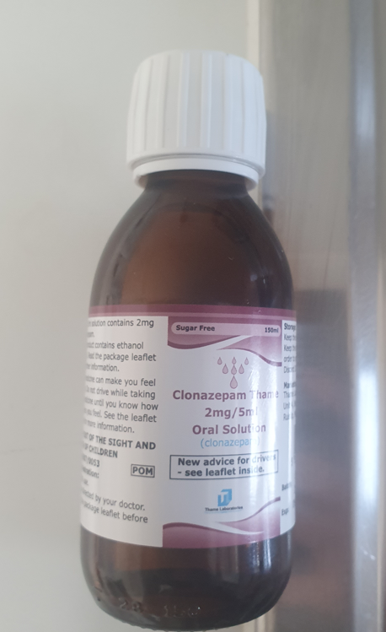


MEDICINE MATTERS (December 22) – Medicines Safety information at your fingertips
Learning from incidents
ELFT Flu vaccination programme 2022/23
Watch out for posters around your place of work as to when the next flu clinic will take place.
The flu vaccination is safe and effective. It’s offered every year through the NHS to help protect people at risk of getting seriously ill from flu.
The trusts public health team have provided some Q&A on the staff intranet.
Incident report- SU was administered 5ml (250mg) Clozapine liquid 50mg/ml in error instead of 5mls of clonazepam (2mg/5ml) liquid. Following the incident, the SU was drowsy and hypersalivating.
Immediate actions : SU was taken to A+E to be medically cleared for clozapine overdose. Regular vitals were taken as well as ECG and bloods. Duty of Candour was carried out.
Learning/recommendations:
To ensure safe drug administration, nurses must follow the 10R’s (Page 13, Trust Medicines Policy)
To ensure all nurses complete and pass the e-learning course “The safe administration of medicines” Available on ELFT Learning academy
To ensure that any medication no longer in use to be disposed/removed from the treatment room. Consult local pharmacy team for more advice.
Flu Vaccination Forms CONSENT FORM
Flu Vaccination
http://finweb:81/forms/forms.php?form=i8laJJQoAO
Had Vaccination Elsewhere
http://finweb:81/forms/forms.php?form=38Vr4pfkMf
DECLINE - Flu Vaccination
http://finweb:81/forms/forms.php?form=jCzrHkRtJO
The current staff Flu uptake percentage is 27.46%.
Two for One at Mile End
Staff based in London are reminded that they can have their flu jab AND their seasonal COVID booster during one visit. Just drop in to the East London Vaccination Centre at Mile End Hospital. The clinic is open from 11.30-18.30 Monday to Saturday.
Targocid 200mg powder for solution for injection/infusion or oral solution
Recall of 2 batches of the antibiotic Targocid (teicoplanin) 200mg powder for solution for injection/infusion or oral solution (batches 0J25D1 and 0J25D2; expiry 30/04/2023).
This is due to out of specification results obtained for bacterial endotoxins, which has been confirmed through testing of retained samples.
Bulletin produced by Rajesh Jethwa Medication Safety Officer and Janan Kabir Tower Hamlets Pharmacist

Slide 2

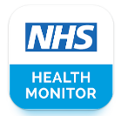
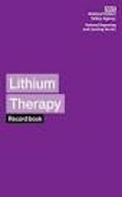
MEDICINE MATTERS (December 22) – Medicines Safety information at your fingertips
Safe use of lithium
Lithium is licensed for the treatment and prevention of mania, bipolar depression, recurrent depression (unipolar) and aggressive/self-mutilating behaviour.
Lithium has a narrow therapeutic window of between 0.4 and 0.8 mmol/L for most indications, although a narrower range is usually specified for individual patients. Lithium has numerous side effects but can be toxic if the dose is too high.
Toxicity usually occurs with levels above 1.5 mmol/L but can emerge at lower levels in susceptible patients such as the elderly or those with renal impairment.
Lithium should always be prescribed by brand and form; tablets and liquids are not interchangeable.
Resources for patients to monitor their Lithium
Key medicine shortages
Aripiprazole Dec 22 – Supply problems continue with more impact on 10mg tablets and liquid formulation
Bupropion (Zyban®) 150mg modified-release tablets will be out of stock until further notice.
  Various nicotine replacement therapies are available. NICE guidance highlights a range of other types of interventions to aid smoking cessation.
  Specialist advice is required on alternative products where bupropion is used off-label.
Off-label use
Bupropion 150mg modified-release tablets have been used off-label, for example, for the treatment of resistant depression. Specialist input will be required on alternative treatment options on a case-by-case basis.
Please consultant your local pharmacy team for further advice.
Journal Club:
NHS Physical Health Monitor’ app available on Google Play store
Lithium Purple book –
available from either the Specialist/community pharmacies
Gabapentin and pregabalin in bipolar disorder, anxiety states, and insomnia: Systematic review, meta-analysis, and rationale
The gabapentinoids, gabapentin, and pregabalin, target the α₂δ subunits of voltage-gated calcium channels. Initially licensed for pain and seizures, they have become widely prescribed drugs.
Many of these uses are off-label for psychiatric indications, and there is increasing concern about their safety, so it is particularly important to have good evidence to justify this usage.
The results of this systematic review and meta-analysis show that the widespread and often off-label psychiatric prescribing of gabapentinoids is not supported by robust evidence except for some anxiety states. Thus, despite the attractive genetic and pharmacological rationale for their use, caution is indicated, and further evidence of efficacy and safety is required.
SPC updates
1. Zypadhera (olanzapine powder and solvent for prolonged release suspension for injection patient alert card)
• Patient alert card lists the common side effects of this treatment and contains information on the risks of the medicine entering the blood stream too quickly, including the symptoms of this and the monitoring that should be carried out after each injection.
2. New product: Atomoxetine 4mg/1ml oral solution
Licenced for the treatment of ADHD in children> 6 years old, in adolescents and in adults as part of comprehensive treatment programme. Solution should not be mixed in food or water as it can prevent the patient receiving a full dose.
National Institute for Health and care research (Antipsychotics are commonly prescribed to SU with Personality Disorder, contrary to guidelines.
The study highlights the difference between guidelines and practice. The researchers call for greater awareness of treatment guidelines for people with personality disorders. More appropriate care pathways need to be identified. People with personality disorders need better access to mental health support, they say, especially in areas that are less wealthy.
Bulletin produced by Rajesh Jethwa Medication Safety Officer and Janan Kabir Tower Hamlets Pharmacist

