Slide 1
Introduction to After Action Review
Dr Deborah Dover
ELFT

Slide 2
What is After Action Review?
Military, General Electric, BP, Motorola
Brought to NHS at UCLH in 34 years ago
Widely adopted – acute and MH trusts, public health.
Facilitated group discussion focussed on learning
Close to frontline, and soon after event.
Captures multiples perspectives
In-group learning + onward sharing
Notes:
First used by the US army on combat missions, the after action review is a structured
approach for reflecting on the work of a group and identifying strengths, weaknesses and
areas for improvement. It is routinely used by project teams in corporations such as General
Electric, British Petroleum and Motorola. An after action review (AAR) conducted after
Hurricane Katrina led to new systems for communications during natural disasters. One team
member reported, “Without an AAR you keep learning your lessons again the hard way!”
An after action review method of evaluation usually takes the form of a facilitated discussion
following an event or activity. It enables understanding of the expectations and perspectives
of all those involved and it captures learning, which can then be shared more widely.
AARs can be used after any activity or event that has been particularly successful or
unsuccessful. It is also often used at the end of a project to help populate a lessons learnt
log. It is important to disseminate learning widely so that good practice can be shared and
others can learn from mistakes.

Slide 3
Principles
About learning not holding people to account
All perspectives are useful – first person experiences are what we want to learn from.
Need psychological safety in order to maximise learning – content is confidential
Learning happens in the room by listening and thinking together
Hierarchy left outside – we are all learners
Not here to judge/allocate blame to ourselves or anyone else.

Slide 4
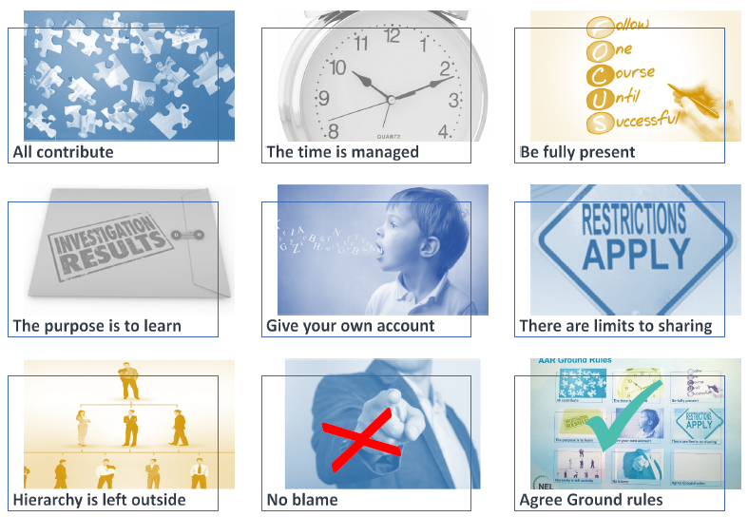
Ground Rules
Notes:
To help us get to really good learning we have a set of universal ground rules for AARs.
1. The first one is that all contribute. To build a full picture of the action, we need to assemble all pieces of the puzzle so I will be inviting each person to contribute in turn.
2. We have a finish time of ….. and it is my job to keep us to that so I may have to ask you to be brief sometimes if we are getting short of time
3. To get the most out of our time together, it is vital that you are all fully present and so I ask that you switch off your phones and emails and focus instead on listening and learning.
4. Our purpose here is to learn not investigate. Please come with a curious and open mind, ready to reflect and learn together
5. I will expect you to be sharing your own first person account of what you were expecting and what actually happened and describe these from your own perspective. This is your truth and we need to understand where the similarities and differences lie
6. This is a learning environment, so we will not be writing down all the discussions for others to read. I encourage you to share your learning coming out of the AAR, I do not expect you to share the details of who said what. This is a confidential process.
7. Central to every AAR is this concept that hierarchy is left outside. We are all learners here, whatever our rank in the organisation and there is no hierarchy in learning.
8. Whilst there may well have been issues that arose that were less than perfect, we are not here to allocate blame on someone else, or ourselves. Blame is about the past and learning is about the future. That is what we are here to do. Learn for the future benefit of all.
9. Are we able to work together with these ground rules?

Slide 5
How to Use It
Define the scope/focus beforehand
As many people as possible
Diverse viewpoints
Independent Facilitator (conductor)
Maximum one hour discussion
Share ground Rules
Explain the Questions
Afterwards – facilitator shares back the summary
Notes:
Try to include as many people as possible who were involved in the activity or event so that a
wide range of viewpoints can be explored. A prerequisite of an AAR is that everyone feels
able to contribute without fear of blame or retribution. AARs are about learning, not holding
people to account.
It is useful to involve an experienced independent facilitator who can guide the group through
the discussion and help create a safe and open atmosphere.
The discussions tend to last a maximum of one hour. The facilitator will guide the group
through a series of questions:

Slide 6
The Process
COMMON UNDERSTANDING of the experience under review
REFLECTING on what happened
LEARNING
Notes:
COMMON UNDERSTANDING of the experience under review:
What did we set out to do/What is our usual process/pathway/offer for patients in this situation?
What happened in this instance?
REFLECTING on successes and failures:
What allowed us to provide what we set out to offer/what explains the difference between what we usually do and what happened in this instance? What got in the way of providing ordinary care in this instance? What could we have done better?
LEARNING
Based on these reflections, what can we learn from what we’ve discussed? What might you/we want to do differently as a result/any actions you want to take forward locally or propose for wider action?
What have you personally found most valuable to take away from this AAR?

Slide 7
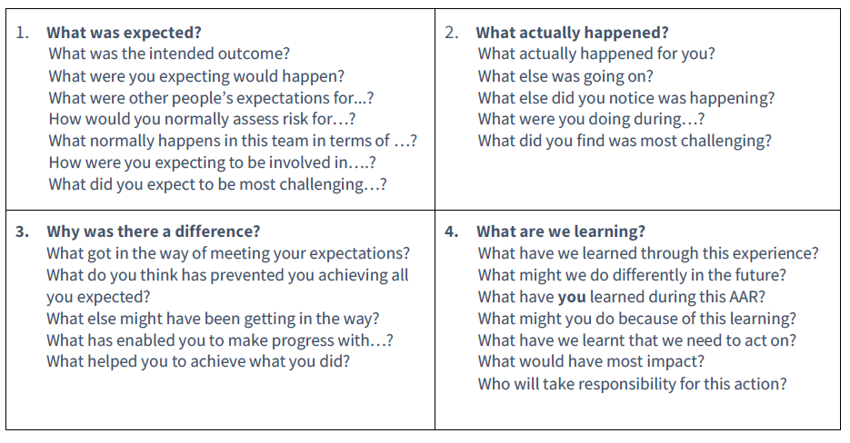
The Four Questions

Slide 8
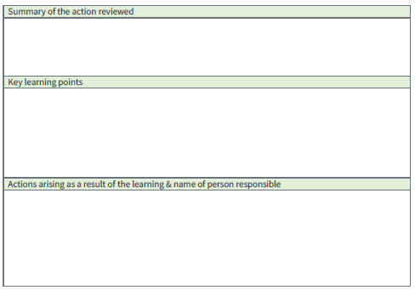
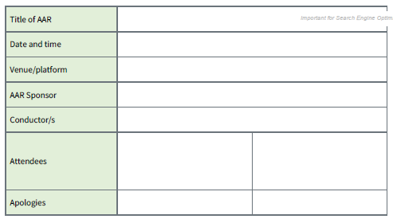
Writing Up the AAR

