Slide 1


Initiating Conversations around Self Harm
Mental Health Support Team

Slide 2
Talking about Self-harm
Every child or young person is an individual and their experience of self-harm is going to be unique.
It’s important that we consider language that we use when talking about self-harm.
Unhelpful language can look like:
Attention seeking
Just a cry for help
Failed suicide
It's not that serious
You’re not thinking of doing something silly?
Helpful language can look like:
“Let’s see how we can work this out together… I may not have the skills to give you the help you need, but we can find that help for you together if you would like…”
“Can I just check with you that I have understood that correctly?”
Can you tell me a bit more about how you are feeling
Take your time
Sounds like things are really hard
Have you felt like hurting yourself?
Have you felt that life is not worth living?

Slide 3
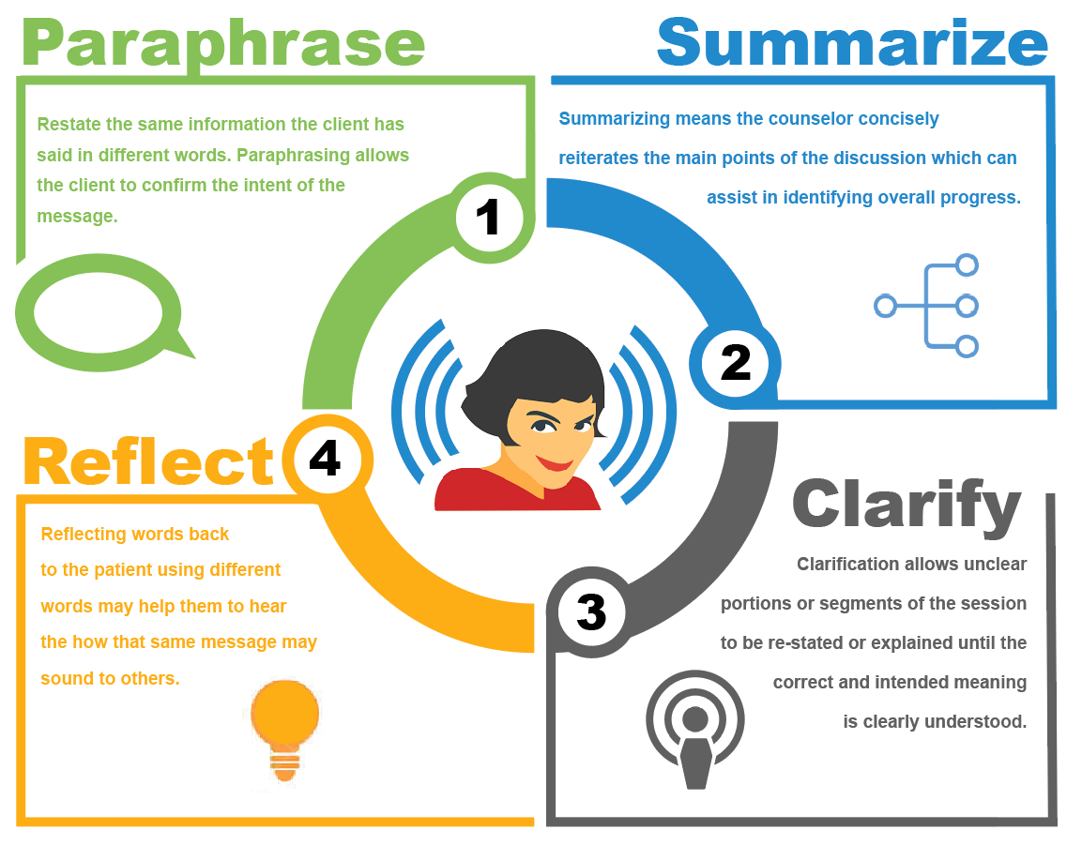
Active Listening and Validation
Try to stay away from “why” questions which more often put an adolescent on the defense and might make them feel embarrassed or ashamed for feeling a certain way.
Stick to “what” and “how” questions instead to show curiosity.
For example:
Instead of asking: “Why are you so mad?”
Ask: “How did that affect you?”, “Tell me what that was like for you?” or “What made you so mad?”
Showing curiosity can help you learn more about what has caused the young person distress. It also shows interest in the young person's world.

Slide 4

Validation
Connecting with young people when they are struggling is a very important first step to helping them be able to manage strong feelings themselves and problem solve effectively.
When people feel like others don’t understand them, they can become defensive and may feel angry, irritable, abandoned and isolated.
Without feeling understood, problem solving rarely works. Try not to jump straight into problem solving or reassuring.
Validation leads to improved trust between people.
It makes people feel valued and cared for.
It reduces defensiveness, lowers emotional arousal and increases someone’s willingness to talk.
It prevents conflicts when emotions are escalating.

Slide 5


Confidentiality
Professionals should adhere to their own school guidelines regarding information sharing and confidentiality.
The child/young person must be involved wherever possible and consulted on his/her views.
Professionals should always take age and understanding into account when involving children and young people in discussions and decision making.
There should be clear explanations about what is going to happen and the choice and rationale for certain courses of action.
It is important not to make promises of confidentiality that you cannot keep.
Professionals should tell a child/young person when they may have to share information without their consent.

Slide 6

Information Sharing
Information given to professionals by a pupil should not be shared without the child/young person’s permission except in exceptional circumstances.
Such exceptional circumstances will include:
A child is not old enough or competent enough to take responsibility for themselves
Urgent medical treatment is required
The safety and wellbeing of a child/young person is at risk or there is the possibility of harm to other (i.e., child protection or suicide)
By virtue of statute or court order
For the prevention, detection or prosecution of serious crime

Slide 7
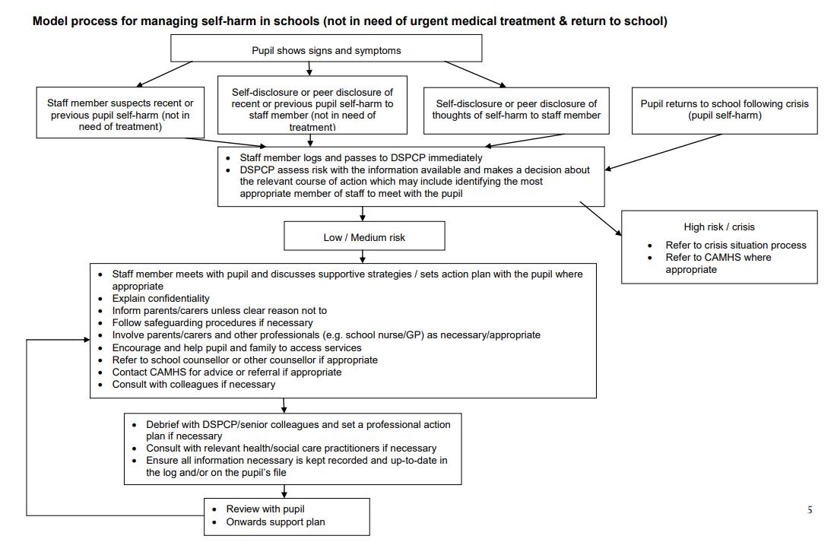
Managing Risk

Slide 8
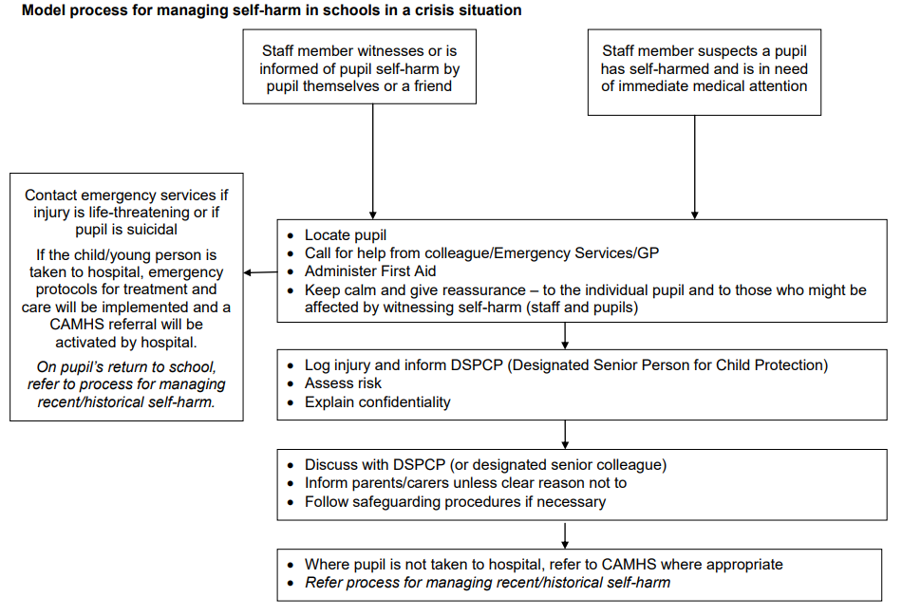
Managing Immediate Risk (with crisis)

Slide 9
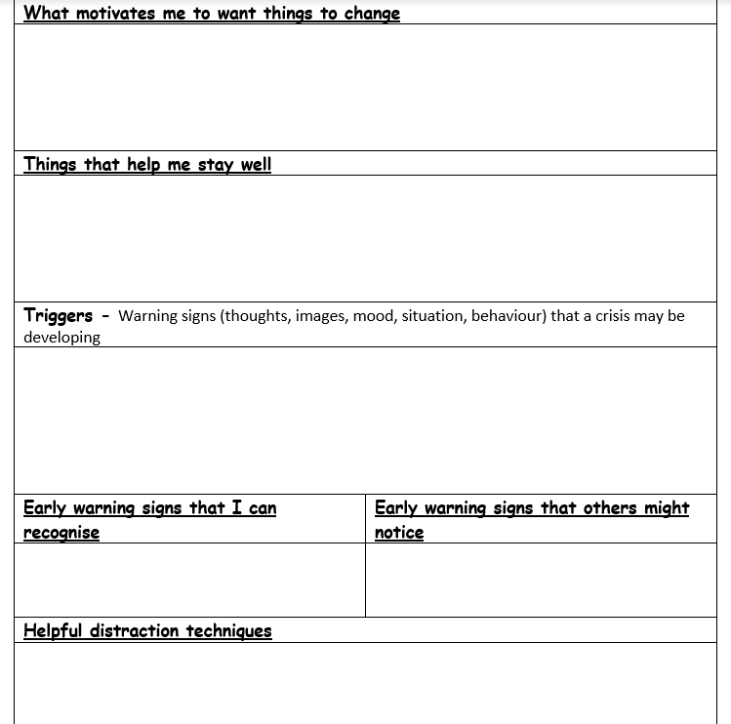
Risk Management (Safety Plan)

Slide 10
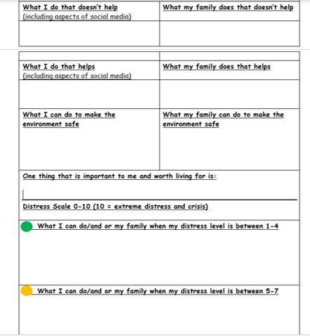
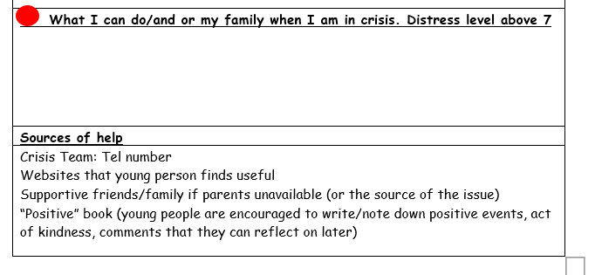
(Safety Plan)

Slide 11
Ways to help young people manage and tolerate distress
Part of safety planning is to help young people find alternative ways to manage and cope with distress
Helping young people to identify a range of coping skills can help with their ability to tolerate feelings of distress.
Replacing self-destructive coping strategies with positive coping strategies can help increase capacity for crisis survival and get through the moment
Increasing ability to use positive coping behaviours help young people to realise that self-destructive coping strategies can lead to pain being prolonged and cause longer term difficulties.

Slide 12
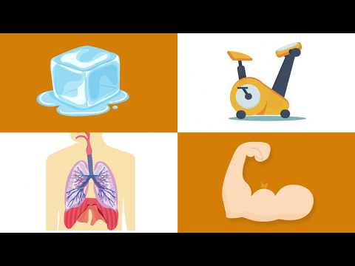
TIPP

Slide 13
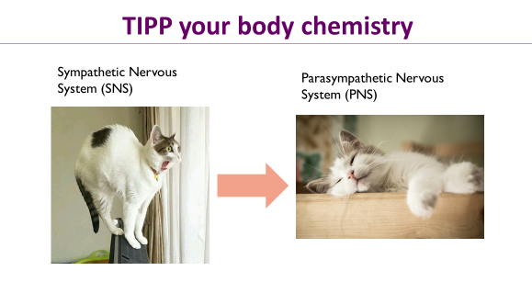
Notes:
Temperature, intensive exercise, pace your breathing, progressive muscle relaxation

Slide 14
Applying skills to a school setting
•Whole school approach/ethos
•Classroom exercises
•Individual support and skills coaching

Slide 15
Alternative coping tools
When feeling anger and frustration:
- Exercise, go for a run
-Hit cushions
-Shout/dance
- Tear something up
-Kick a football against a wall
Suggestions for young person feeling sad and scared:
- Use weighted blanket
-Walk in nature
-Listen to soothing music
-Deep breathing
-Talk about how they are feeling
- Allow them space in a safe space
If a young person is feeling numb and disconnected:
- flick elastic band on wrist
- hold ice cubes
- splash cold water on face
-eat a hot chili pepper
Suggestions If a young person feels a need for control:
- Write lists
-Tidy up
-Write a letter then tear it up
-Clench then relax muscles
If young person is expressing self hatred:
-Write a letter then write back with self-compassion and acceptance
- express how they feel through writing, drawing, poetry
-intense physical exercise

Slide 16
Crisis Numbers
CAMHS Crisis Line: 0800 073 0066
NHS: 111
Emergency services: 999
The Samaritans 24-hour hotline: 08457 90 90 90
Childline : - 0800 1111

