Slide 1

Ground Rules
Notes:
To help us get to really good learning we have a set of universal ground rules for AARs.
1. The first one is that all contribute. To build a full picture of the action, we need to assemble all pieces of the puzzle so I will be inviting each person to contribute in turn.
2. We have a finish time of ….. and it is my job to keep us to that so I may have to ask you to be brief sometimes if we are getting short of time
3. To get the most out of our time together, it is vital that you are all fully present and so I ask that you switch off your phones and emails and focus instead on listening and learning.
4. Our purpose here is to learn not investigate. Please come with a curious and open mind, ready to reflect and learn together
5. I will expect you to be sharing your own first person account of what you were expecting and what actually happened and describe these from your own perspective. This is your truth and we need to understand where the similarities and differences lie
6. This is a learning environment, so we will not be writing down all the discussions for others to read. I encourage you to share your learning coming out of the AAR, I do not expect you to share the details of who said what. This is a confidential process.
7. Central to every AAR is this concept that hierarchy is left outside. We are all learners here, whatever our rank in the organisation and there is no hierarchy in learning.
8. Whilst there may well have been issues that arose that were less than perfect, we are not here to allocate blame on someone else, or ourselves. Blame is about the past and learning is about the future. That is what we are here to do. Learn for the future benefit of all.
9. Are we able to work together with these ground rules?

Slide 2
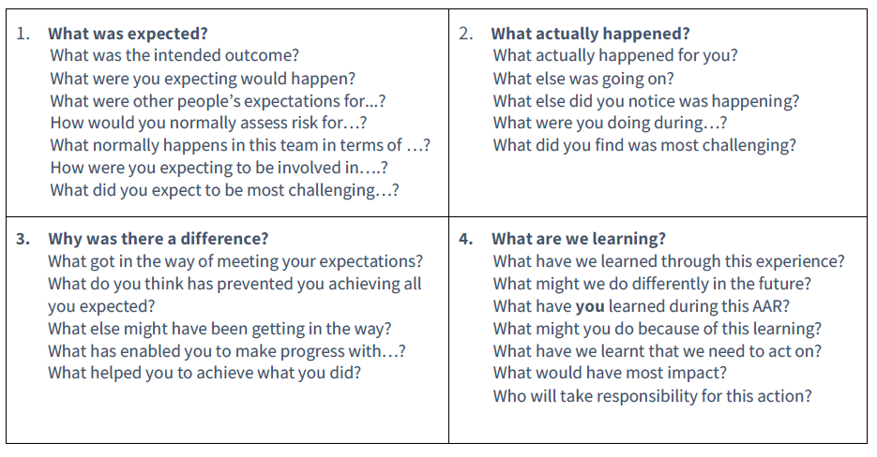
The Four Questions

