Slide 1


Clinically Ready for Discharge – Brief Guidance

Slide 2
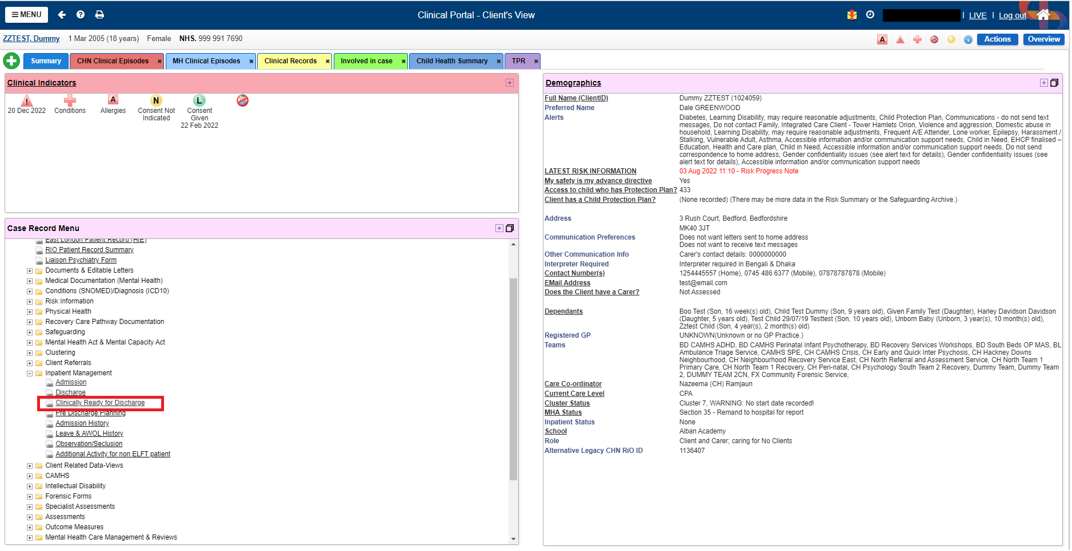
The Clinical Ready for Discharge form can be accessed through the Inpatient Management folder as shown below

Slide 3
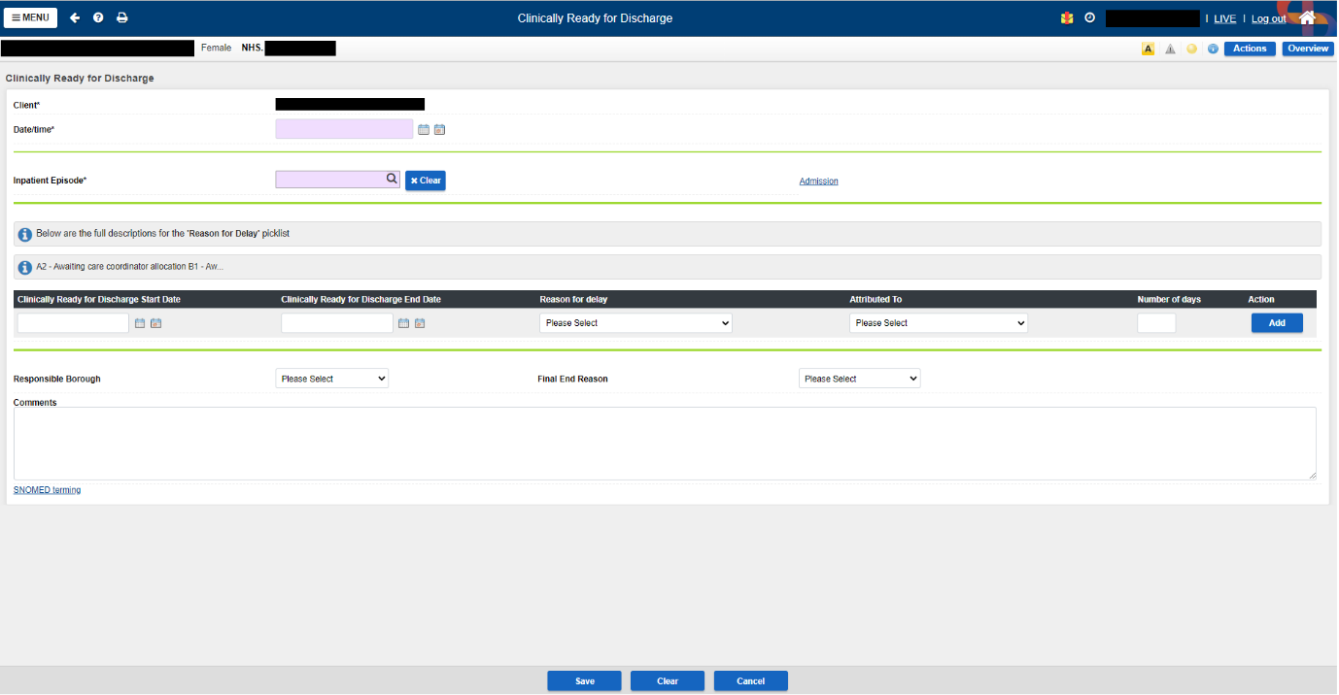
Clinical Ready for Discharge form screenshot

Slide 4
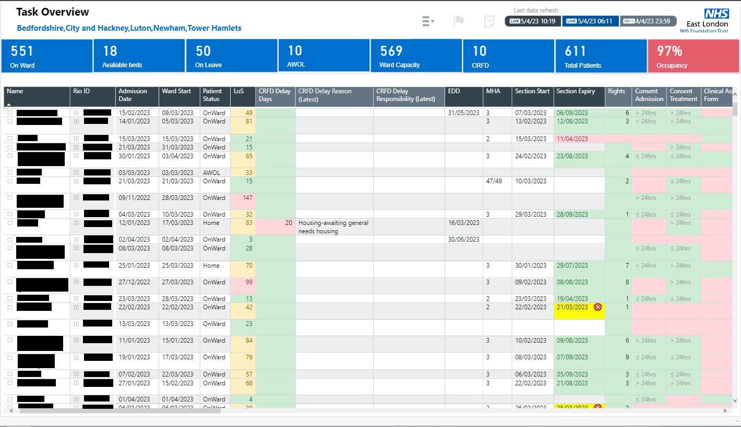
Reporting in PowerBI – Inpatients Dashboard
CRFD details
Total number of CRFDS

