Slide 1

Our Vision
Our Future
Shaping Our Team
Consultation
Continued
04/05/2023

Slide 2

Introduction
Purpose of today is to;
  Continue the consultation process
  Recap where we got to before the pause
  Set out how the remainder of the consultation process will work
  Confirm next steps
  Answer your questions

Slide 3

But first, a word of apology…..
  Sorry
  Sorry that organisationally the process didn’t work well - we have all learned from it and positive changes are being put in place as result
  Sorry for the delay and the frustration this has caused
  Sorry for the missed opportunity to keep the momentum going…
  Thank you
  Thank you for your patience
  Thank you for your rich feedback
  Thank you for just wanting to get on with it - we also have continued support from the Trust to move forward with the significant investment and commitment to our ambitious strategy
  We are now able to continue where we left off ……..

Slide 4
Where did we get to….
  Why did we pause?
  To enable job descriptions and person specifications to be evaluated and banded
  What stage were we at in the consultation process?
  At week 15 of the process
  Ongoing positive discussions and engagement with staff-side colleagues
  Milestones completed:
    Leadership appointments made
    Consultation document and proposed structure published
    Draft job descriptions published to team
    30 day consultation period completed
    1-1’s and team meetings undertaken
    4 sets of Q&A’s published

Slide 5
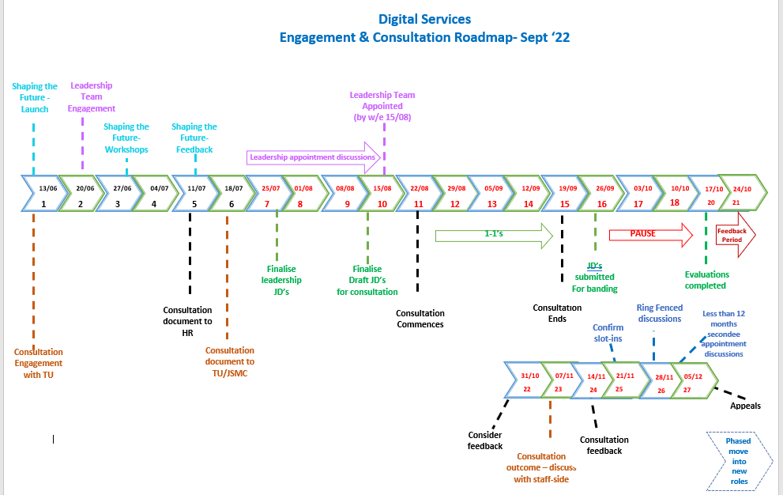

Engagement & Consultation Roadmap

Slide 6
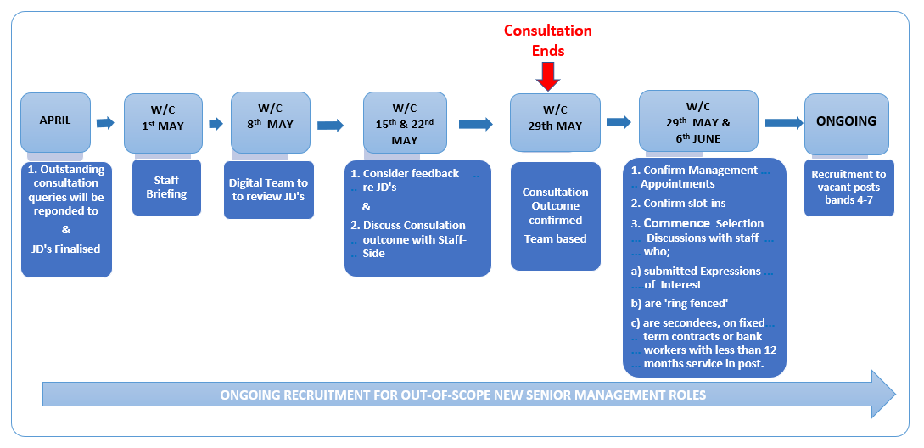
Restart - Last Stages of Consultation

Slide 7
Reminder - Roles in scope
All substantive staff (excluding the newly appointed leadership team) employed within the Digital Directorate
Internal fixed term, seconded or bank staff, for the purpose of this consultation only;
  staff who have more then one year’s continuous service in an internal fixed term, seconded or bank role will be considered to hold that role substantively
  those with more than one year’s continuous service in an internal fixed term, seconded or bank role may express an interest in the ‘seconded into’ role if the role remains vacant after the slotting-in/ringfenced process

Slide 8
Reminder - Definitions
Mapping & Matching
Review current roles and map them to roles in the new structure based on job content and skill & knowledge etc required
Slotting In
Process by which staff are confirmed into a post in the new structure which is similar (70%) to their current post and where that individual is the only contender for that post.
Ring-Fencing
The process by which staff will be considered for a post, or posts, in the new structure similar to their current post and where there is;
more than one contender for that post
more than one role for the contender to consider

Slide 9
How will appointments be made?
Slotting In;
(Match is >70%)
No selection or appointment process required
Selection/appointment discussion required to discuss the suitability of the role match
Appointment will be subject to a selection discussion/
interview
Slotting In;
(Match is <70%
or a higher band)
Staff have already completed an Expressions of Interest Form indicating which (2 or 3) of the ring-fenced roles they are interested in
A selection/appointment discussion will take place to discuss the preferences (the aim will be to appoint to 1st or 2nd choice but this may not always be possible)
Ring-Fencing
Applying for new roles
Applications welcome - using the Trust’s recruitment process. Guaranteed interview where criteria met

Slide 10
Selection/Appointment Process
Leadership Appointments
Appointment will be confirmed
Secondees
With more than 12 months service in post will be considered to be a substantive member of staff and will be slotted into roles following a brief selection discussion
Fixed term Contracts
Bank

Slide 11
In summary - Next Steps
Actions | Dates
Job descriptions finalised and banded – will be uploaded onto the intranet – 5 working days for staff to review and consider them and then give any final feedback about the bandings/content | w/c 08/05
Final consideration will be given to all comments received from staff and staffside during the 30 day consultation period and in respect of updated JD’s | w/c 15 & 22/ 05
A written response will be prepared, discussed with staffside and agreement reached about the final proposals | w/c 22/05
The consultation outcome will be confirmed to staff | w/c 29/05
Phased implementation Confirm in writing; Management Appointments and Slot-ins Commence; Selection discussions with staff who; submitted Expressions of Interest are 'ring fenced' are secondees, on fixed term contracts or bank workers with more than 12 months service in post. | w/c 29/05 & 05/06

Slide 12
Thank you for taking part
Any Questions?
elft.digitalconsultation@nhs.net

