Slide 1
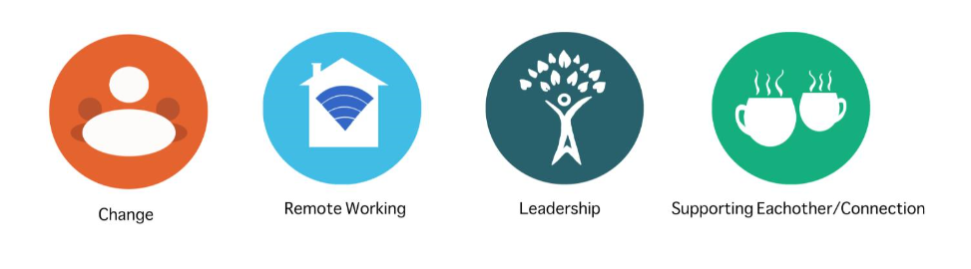
Primary Care Event – Exploring Race & Diversity
Thursday, 15th July 2021, 9:30 – 12:00hrs
Supporting the event:
Anita, Heeba, Liz, Louise, Mairead, Marina, Olga, Princess and Shade

Slide 2

Welcome and Introductions

Slide 3
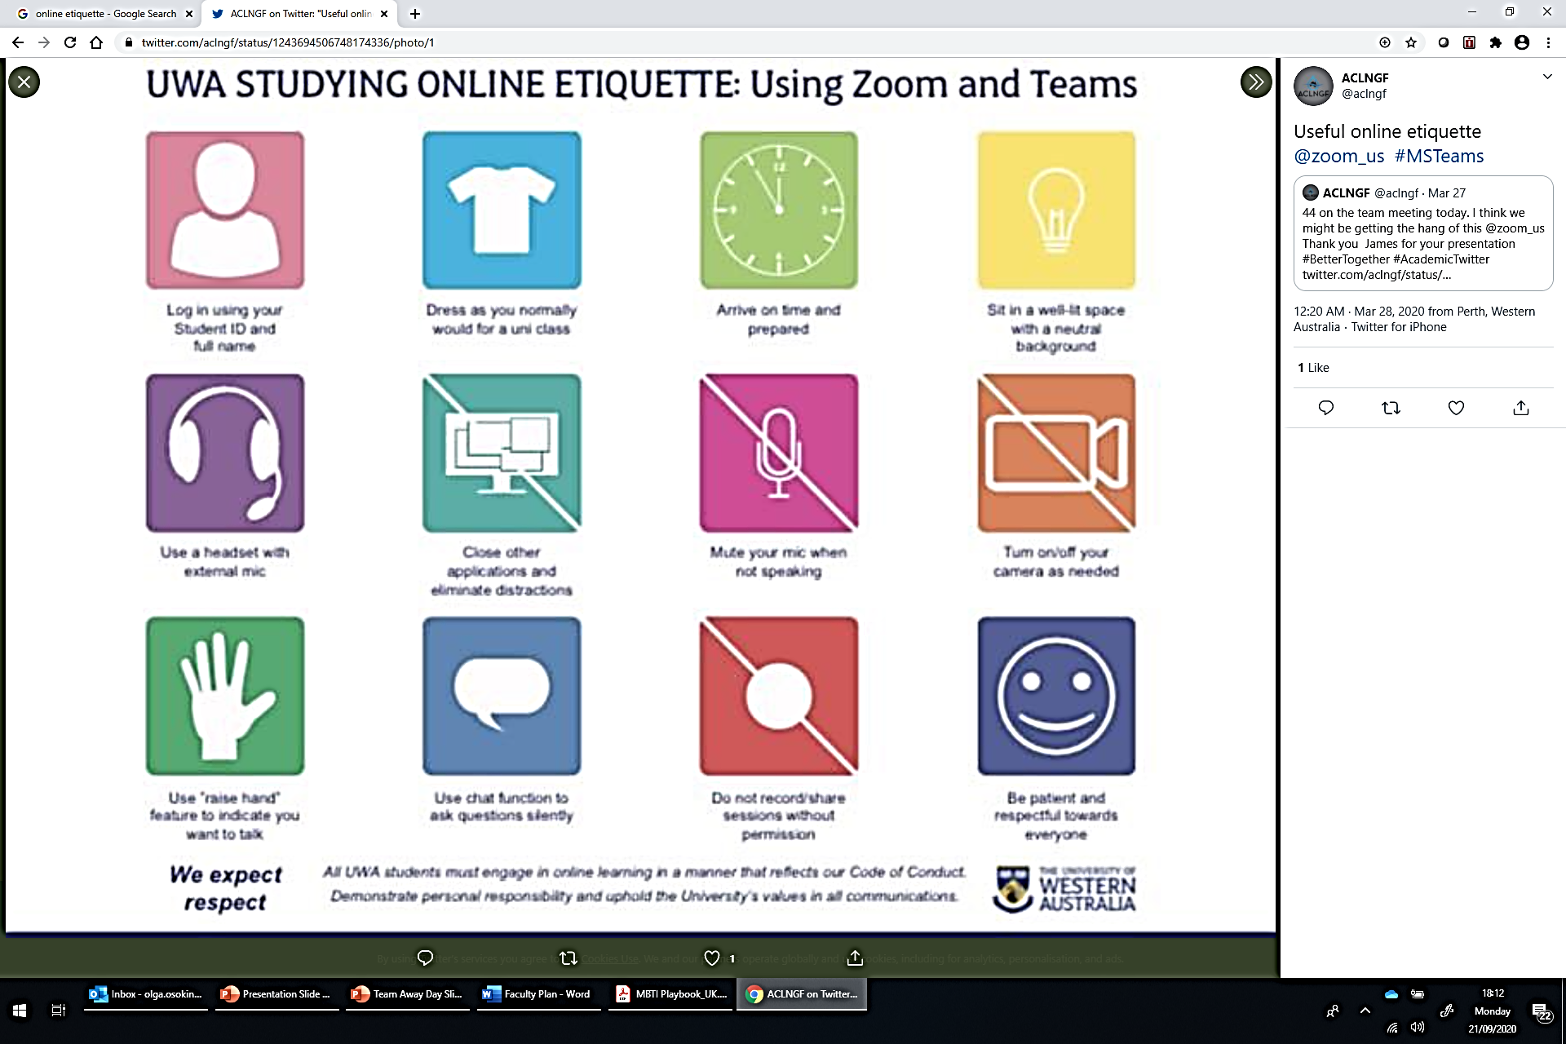
Online Etiquette

Slide 4
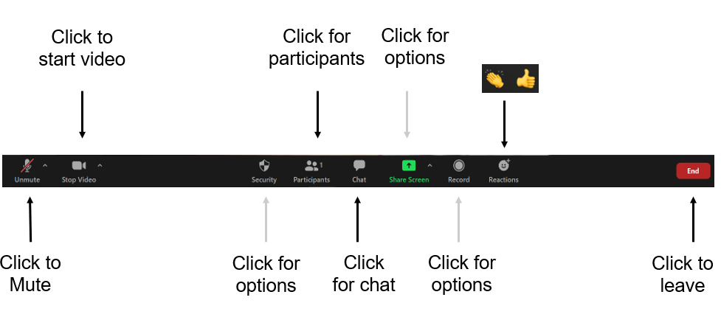
Zoom Controls
Please rename yourselves – FIRST NAME & LAST NAME
Delegates List → Your name → Rename

Slide 5
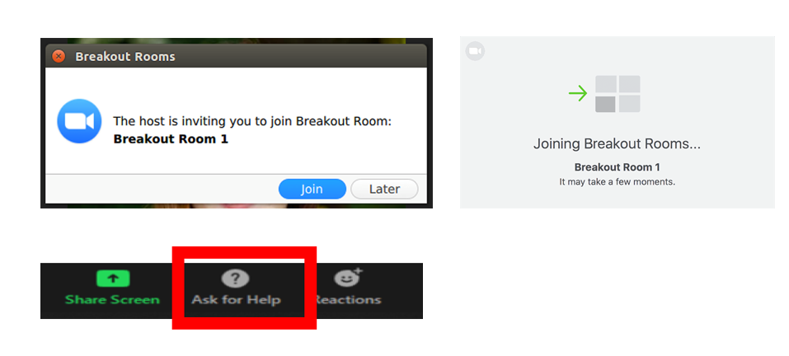
Break-out Rooms

Slide 6

Speed Greetings
Getting to know You - Speed Greetings
Name, Role, and what you like most about your job (time dependent)
You will meet X no of people and move x no of times …..

Slide 7
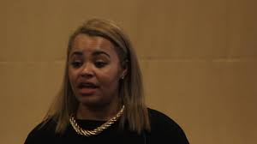
Welcome from Marina
Welcome
Intention for session

Slide 8

Aims for the Session
To enable Primary Care staff to have difficult conversations, based around curiosity, with each other, carers, service users, family members and other stakeholders;
To encourage people to feel comfortable sharing their experiences;
Briefly look at Diversity and Inclusion;
Increase your knowledge and confidence in talking about diversity issues;
To equip staff with skills to enable ongoing conversations around difference (in particular race), to happen at a service level.
Notes:
Is that the kind of session everybody is expecting?
Deal with any differences and suggest when those will be addressed.

Slide 9

Group Agreement
Chatterbox
Type answer in chat – Don’t send yet – all go together
What would I like to give to today's session?
What would I like to get from today’s session today’s session?
What we should avoid/would be ghastly to do in today’s session?

Slide 10

Living and Working while being a Person of Colour
Louise
Marina

Slide 11
Discussion and Feedback
What did you feel while listening?
Is there anything new that you learnt about the experience of working while being BAME?
What will you do differently as a result of this experience?

Slide 12
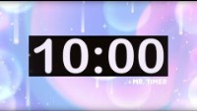
Comfort Break

Slide 13
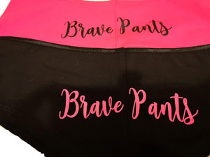
Put on YOUR brave pants…
Let’s talk about diversity issues at work.

Slide 14

“The ultimate measure of a man is not where he stands in moments of comfort and convenience, but where he stands at times of challenge and controversy”

Slide 15
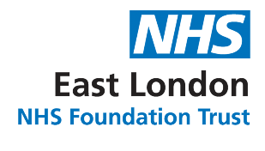
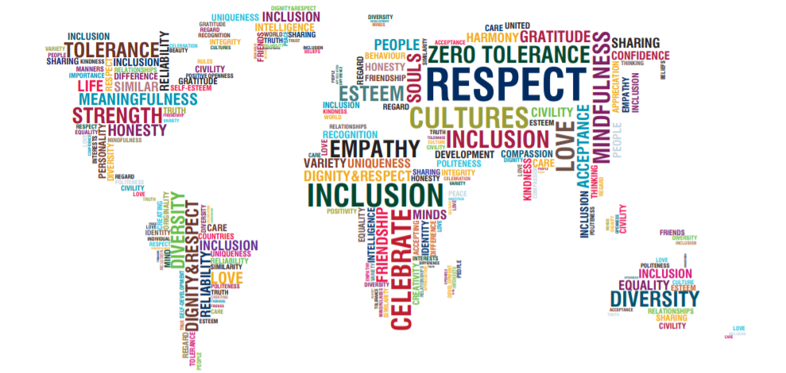
Notes:
No matter where you are from, you should never feel that you are treated differently to everyone else. You should be made to feel welcome. Race equality isn’t a new world idea, it has sadly been a continuous struggle for many ethnic minorities.

Slide 16
The Equality Act 2010
The Equality Act 2010 brought together a range of existing legislation, so the majority of equality law is now contained in this single Act.
The Equality Act 2010 gives legal protection to nine 'protected characteristics’.

Slide 17
The Equality Act 2010
There are two key aspects of the Equality Act:
In health and social care we must not discriminate against our patients, people who want or need to use our services, staff members or job applicants.
The Public Sector Equality Duty is part of the Equality Act and requires NHS and social care organisations to pay due regard to the need to:
Eliminate discrimination
Advance equality of opportunity between people who have protected characteristics and people who don’t
Foster good relations between people who have protected characteristics and people who don’t
The Public Sector Equality Duty means that organisations have to think about inequality and take action to reduce inequalities

Slide 18
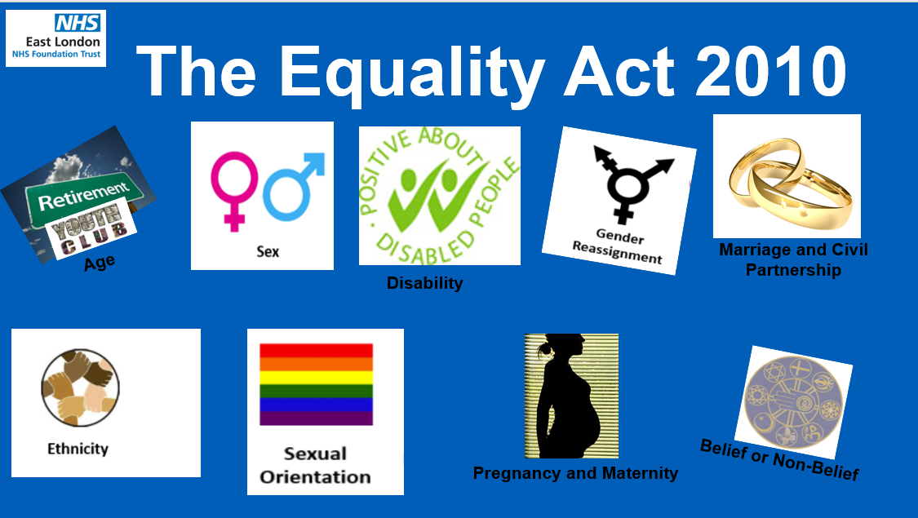
The Equality Act 2010

Slide 19
Acceptable or not acceptable?
Referring to someone as “half caste”.

Slide 20
Acceptable or not acceptable?
Asking a Muslim lady the name of the head dress she is wearing.

Slide 21
Acceptable or not acceptable?
Making a joke to your gay male colleague that you assume he is not in a hurry to settle down.

Slide 22
Exercise – I am BUT I’m not
Fold a piece of paper in half to create two separate columns.
In the first column, write “I Am”.
In the second column, write “I Am Not”.
In between these two columns, write the word “But”.
The final phrase will read “I am _____, but I am not _____.”
Fill in the first blank with some kind of common identifier, such as your race, religion, sex etc. and the second with a common stereotype about that identifier which is not true (this can be a positive or negative stereotype).
E.g. “I am Asian, but I am not good at maths.”
Notes:
Everyone should write at least 5 statements.
Share your statements with colleagues and have an open and respectful discussion on stereotypes
5 mins to do exercise
10mins to feedback

Slide 23
Unconscious Bias
Breakout Room Exercise - 10 minutes
What is unconscious bias?
Where does it show up?
What influences unconscious bias?
Notes:
In breakout rooms have a discussion on the three points and nominate one person to feedback
10mins
10mins to feedback

Slide 24
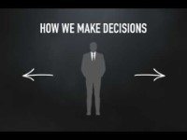

Slide 25
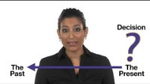

Slide 26
Unconscious Bias
https://www.youtube.com/watch?v=dlwkvB0Diz4
https://www.youtube.com/watch?v=Q5vhUPRygWk

Slide 27
Unconscious Bias
Bias that we are unaware of
Is outside of our control
Happens automatically
Triggered by our brain making quick judgements and assessments of people & situations
It sifts through visual, verbal and behavioural cues
It helps us to quickly determine whether someone is friendly or hostile
It does all this outside of our awareness
Our ‘unconscious mind’ processes 200,000 times more information than our conscious frontal lobes

Slide 28
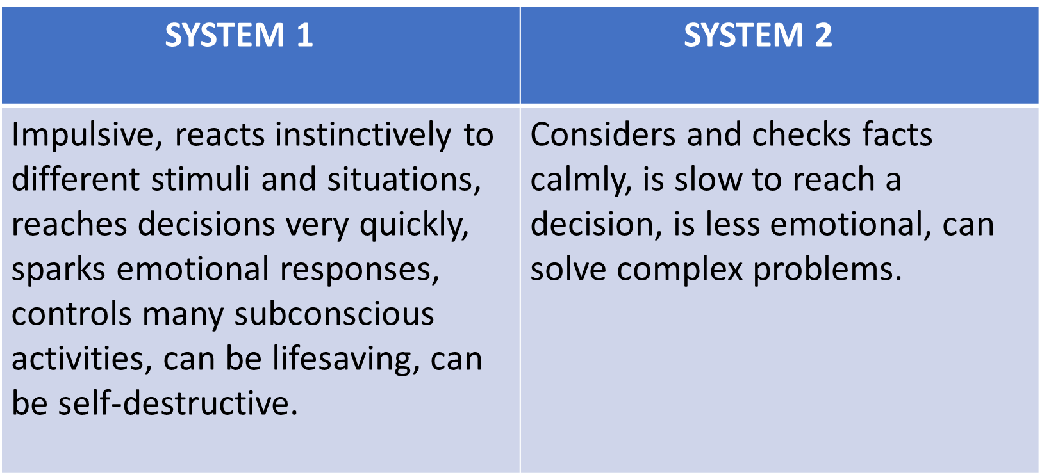
Unconscious Bias

Slide 29
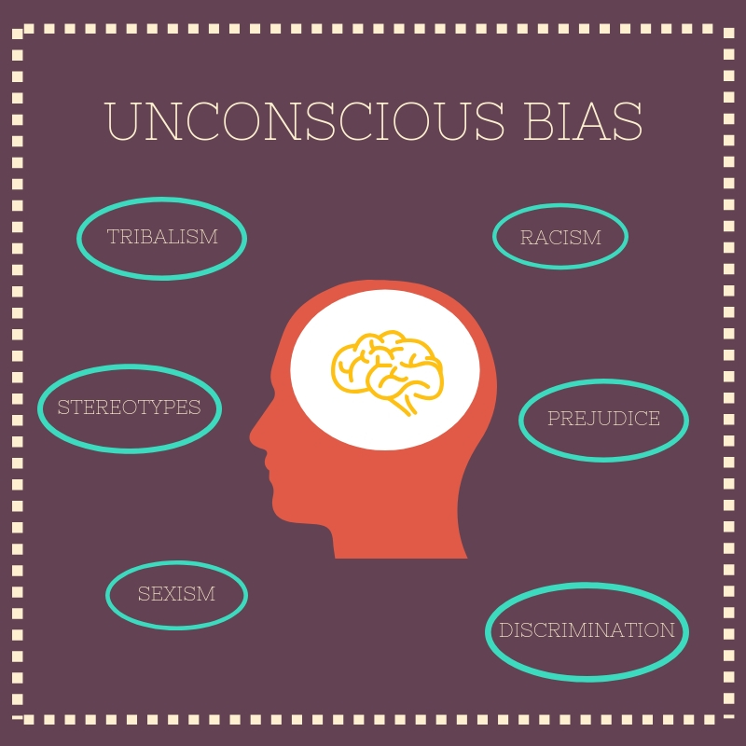
Unconscious Bias
Media exposure
Family
School
Friends
Experiences
Work culture
Background
Culture
Personal experiences
Beliefs

Slide 30
Types of Unconscious Bias
Affinity Bias
This refers to when we unconsciously prefer people with whom we share similar qualities. It occurs because our brain sees them as familiar and relatable, and we all want to be around people that we can relate to.
Attribution Bias
This generally applies to how we assess other people; i.e. how we perceive our actions and those of others. We usually attribute our own accomplishments to our skill and personality, and our failures to external factors.
Beauty Bias
With this bias, we tend to think that the most attractive individual will be the most successful. We all notice the appearance of others because appearances are important, particularly in a workplace setting, as they reflect on professionalism and self-awareness.
Confirmation Bias
This refers to how we search for evidence that backs up our own opinions, rather than looking at the whole picture. This can lead to selective observation, meaning we overlook other information and instead focus on things that fit our viewpoint.

Slide 31
Types of Unconscious bias
Gender Bias
This is simply a preference for one gender over the other and often stems from deep-seated beliefs about gender roles and stereotypes. This can cause us to unconsciously lean towards an individual based on their gender and the qualities we associate with it.
Halo effect
This occurs when we focus on one particularly impressive feature about a person. Thereafter, we view everything about the person in a positive “halo” light, which makes us think that they are “more” perfect than they really are.
Horns effect
This is the opposite of the halo effect: we focus on one particularly negative feature about an individual, which clouds our view of their other qualities. It is important to remember that one mistake or flaw does not represent the person as a whole.
Notes:
Other triggers for unconscious bias:
•Ambiguous evidence
•Emotional overload; stress, anger, frustration
•Cognitive overload; complex decision
•Fear of threat
•Emotional and cognitive resources are depleted; tired, low blood sugar
•Short on time

Slide 32
How to overcome unconscious bias
Recognise we all have bias
Stop and think! Learn to mistrust your first impressions
Don’t ignore difference – be curious
Challenge negative assumptions and stereotypes
Don’t consciously try to suppress bias
Don’t be too hard on yourself – the emotional impact makes bias more likely

Slide 33
Comfort Break

Slide 34
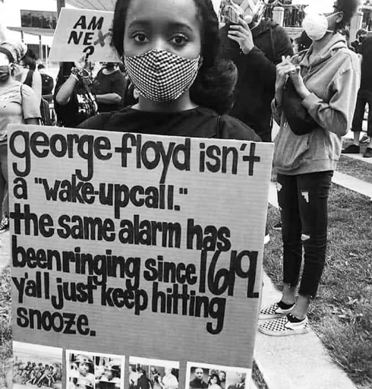
Breakout Room Discussion – 10 minutes
Nominate someone to feedback
How did we get here?
How did you feel about the murder of George Floyd?
Notes:
Sadly George Floyd has not been the first, nor the last regarding racial injustice. Ahmaud Arbery, Sean Reed and Breonna Taylor before him. Additionally most recently Jacob Blake. In the UK Stephen Lawrence and many others. Many are not spoken about The impact of racisim is profound and can affect every element of society. The link to inequality and how society manages this is linked to implicit bias and structural/systemic racism.

Slide 35
Have you heard of these?
White Privilege?
White fragility?
Code switching?
Notes:
Breakout room 10mins discussion

Slide 36
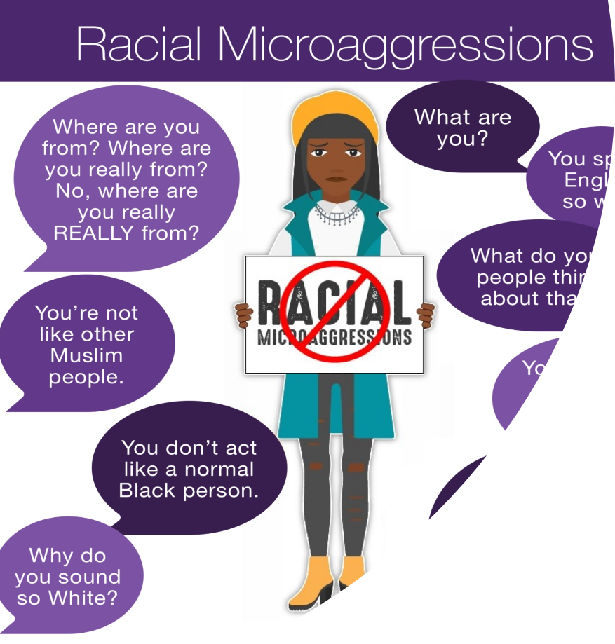
Micro Aggressions – What are they?
Notes:
Microaggression is something that someone says to someone without knowing that it maybe offensive. It is not racism but it is unconscious in the way that you view people. Most microaggression are subtle and indirect. They happen frequently. Most often when we commit microaggression we think we are well intentioned, not racist, not sexist etc.
While microaggressions may appear to be harmless or even seem like a compliment (telling a person of colour ‘you are so articulate’), they contain demeaning hidden messages that often stem from unconscious biases. Employees who are frequent targets of microaggressions can experience health problems, burnout and other negative effects from what’s been called a “death by a thousand cuts.”
And with more employees now working from home, it’s important to raise awareness that microaggressions can occur on live chats and video meetings, too.
Because microaggressions are often communicated through language, it is very important to pay attention to how we talk, especially in the workplace

Slide 37
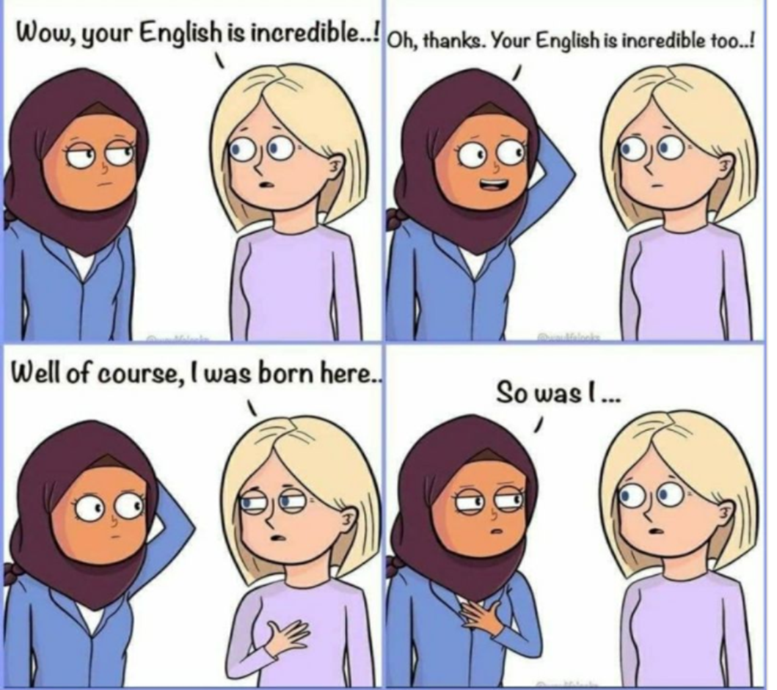
Where are you from?

Slide 38
3 kinds of microaggression?
Microassult – Conscious and intentional discriminatory actions based on someone's identity, e.g. using racial language, displaying white supremacist symbols.
Microinsult – verbal, non-verbal or environmental communication that subtly conveys rudeness of insensitivity towards a person’s racial background or identity. e.g. ‘you’re so pretty for a black girl’; you don’t look gay’ ‘wow you speak really good English’
Microinvalidation – communications or actions that dismisses the experiences of historically disadvantage group members.
e.g. I don’t see colour…

Slide 39
Breakout Room – 10 minutes
Discuss a time where you have witnessed / experienced microaggression either in the work place or outside.
Which type of microaggression was it:
Microinsult
Microassault
Microinvalidation
Did you do anything about it? If so what? If not why not?

Slide 40
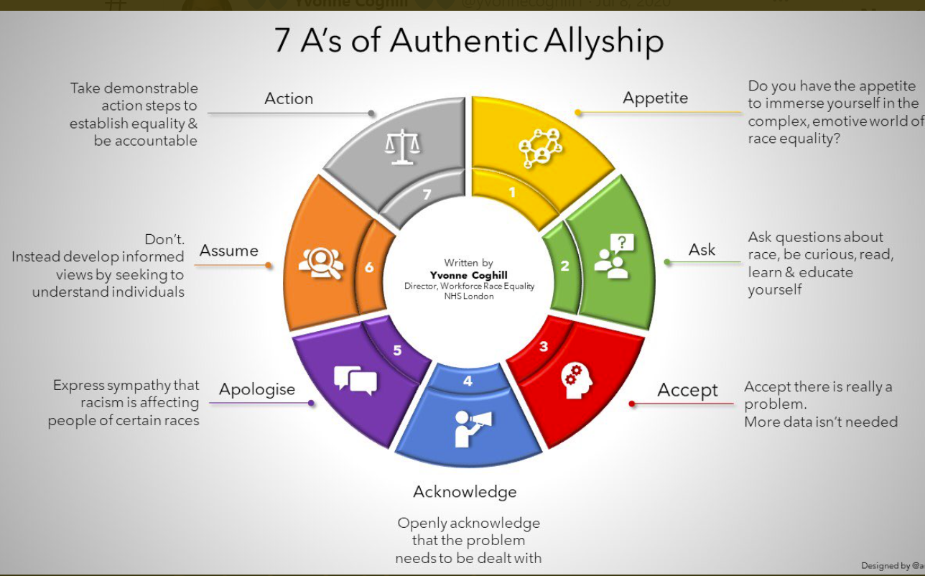

Slide 41
Ally Continuum
APATHETIC
AWARE
ACTIVE
ADVOCATE
Knows basic concepts but not active on behalf of self or others
Well informed; sharing & seeking diversity when asked / prompted
Committed; routinely and proactively championing inclusion
No understanding of the issues
Notes:
To be an effective ally, you need to spend more time listening than you do speaking. Don't just listen to their words but hear where they are coming from. By doing so you will be better equipped to communicate diverse perspectives in the future.
There are 4 Equality Ally practices
Explain how to
ask,
listen,
show up,
speak up as an Equality ally.
PROMPT: Where do you think that you are now on the continuum? How easy is it to always be an advocate rather than passively supporting allyship?

Slide 42
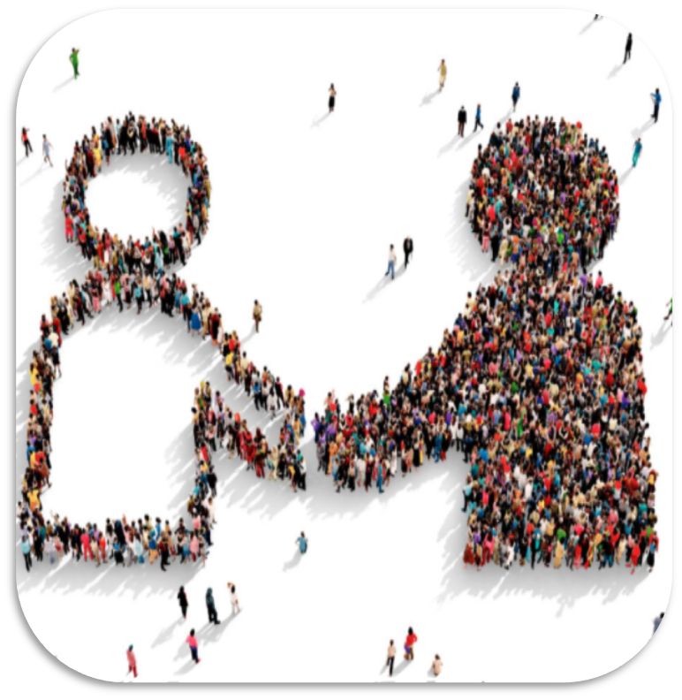
Things YOU can do….
Educate yourself and Share Your Learning
Show empathy
Address and challenge
Understand ally vs advocate
Notes:
Educate Yourself and Share Your Learnings
You don’t have to lean on Black people or other people of color for recommendations: You can seek guidance from other white people who have done this work already. Ask about which resources they’ve found to be insightful and the practical ways they’ve expressed allyship.
Allies are needed to show up and be ready to call out instances of micoagressions, prejduce or exclusion. You need to believe in underrepresented groups when they share experience. You need to offer genuine empathy with a view to understand and create change. Being an ally isn’t wearing a badge or just attending training.
Silence is betrayal. Allyship matters most when its inconvenient and uncomfortable. Don’t be a closet Ally.

Slide 43
Active Bystanders
Direct action
Directly intervene, for example, by asking the person to stop. Immediately act or call out negative behaviour, explaining why it is not okay.
Delay
Wait for the situation to pass and check in with individual. Act at a later stage when you have had time to consider. It’s never too late to act.
Distraction
Indirectly intervene, for example, de-escalating by interrupting or changing the subject or focus. Useful where the direct approach may be harmful to the target or bystander.
Delegation
Inform an appropriate member of staff. Use someone with the social power or authority to deal with it.
Notes:
In the NEL Survey, less than 10% of respondents were very confident in managing a situation involving discrimination
We can all be bystanders. Every day events unfold around us. At some point, we will register someone in danger. When this happens, we will decide to do or say something (and become an active bystander), or to simply let it go (and remain a passive bystander).
When we intervene, we signal to the perpetrator that their behaviour is unacceptable. If such messages are constantly reinforced within our community, we can shift the boundaries of what is considered acceptable and problem behaviour can be stopped.

Slide 44

One thing you’ve learned?
One thing you will do differently?

Slide 45
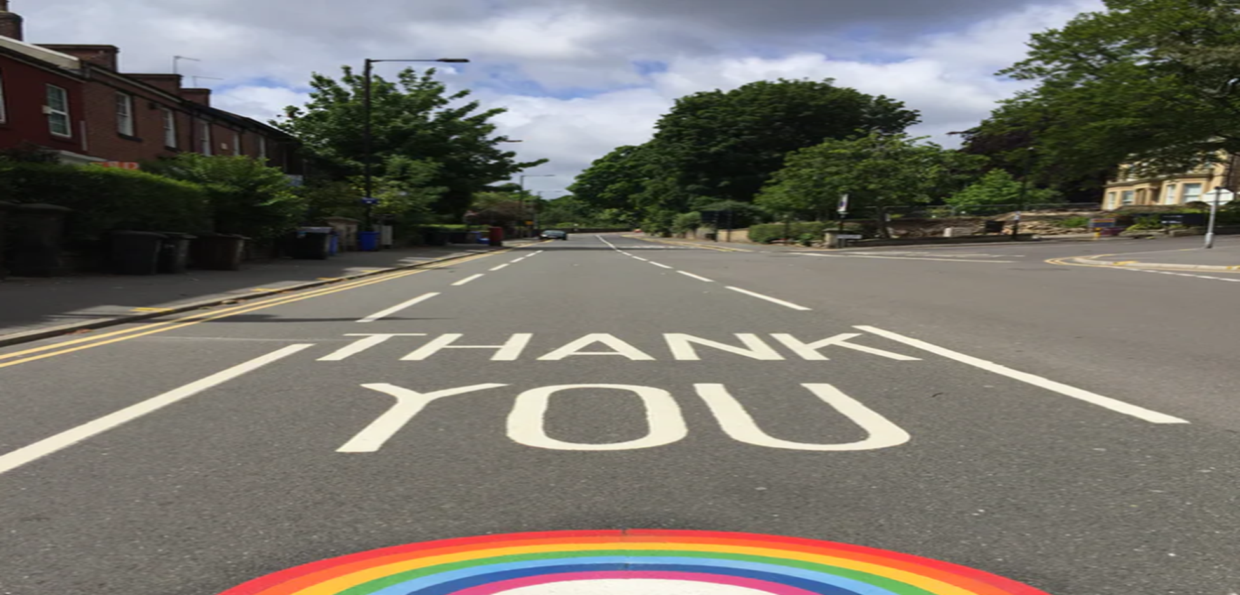

Slide 46
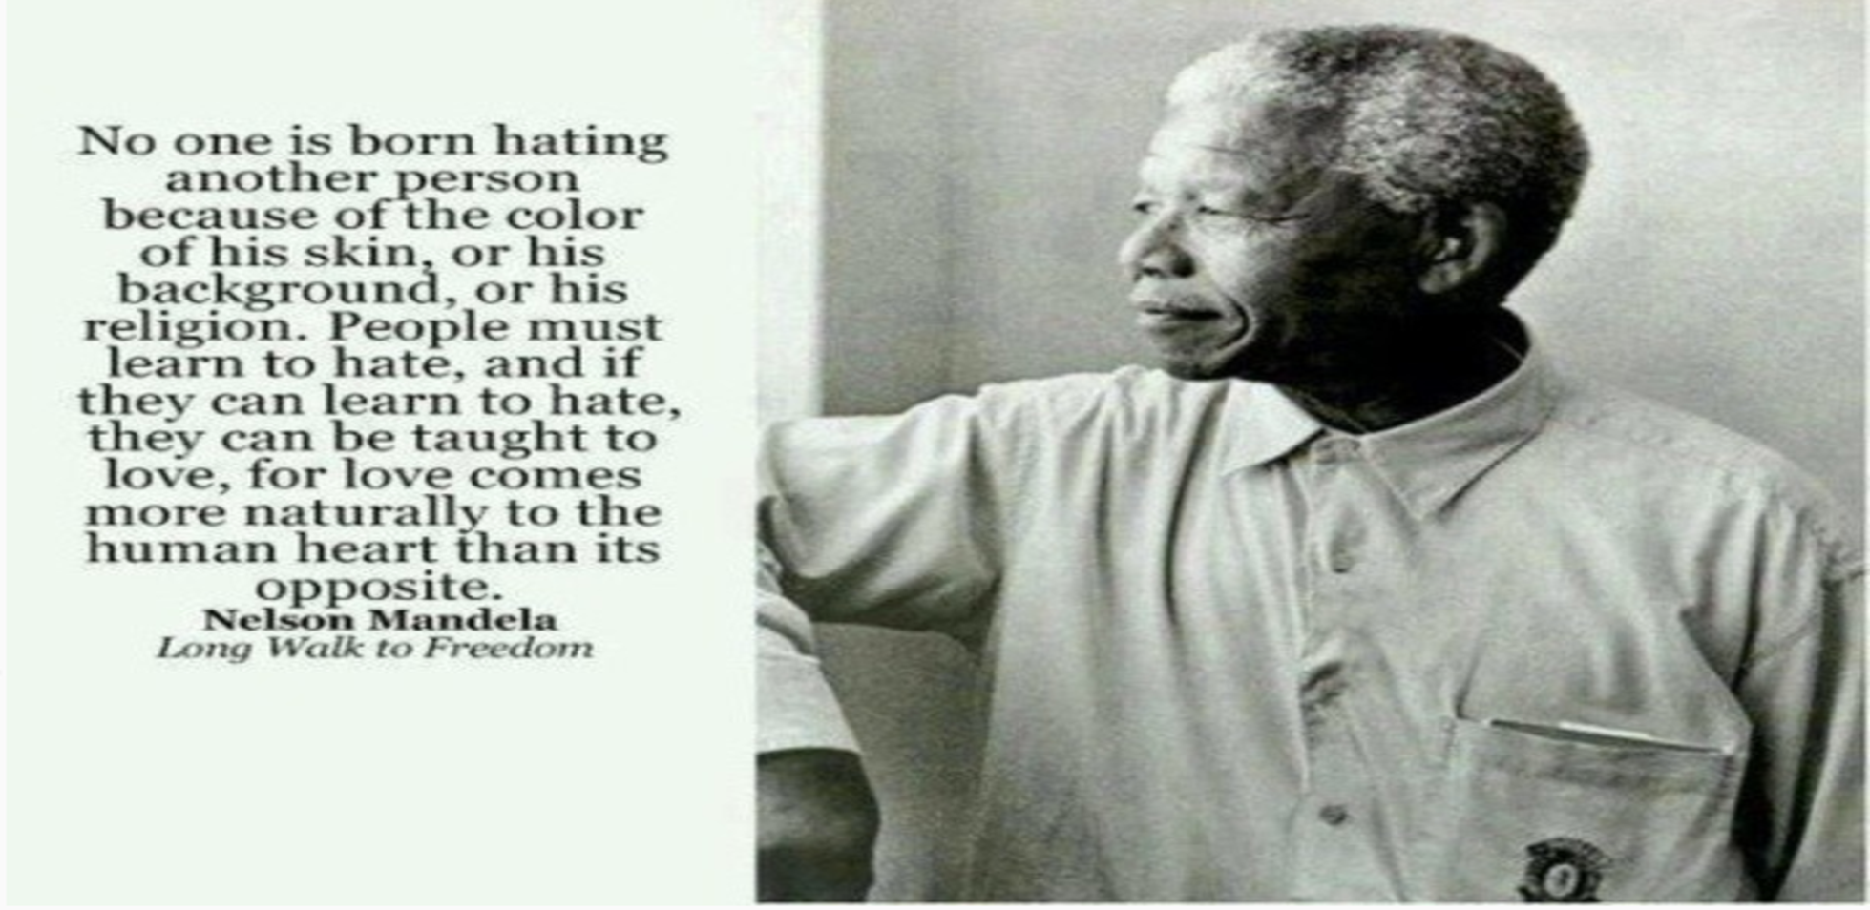

Slide 47

Evaluation
Next steps
Thank you and close
Any immediate reflections or feedback?
Next steps
Thank you

