Slide 1

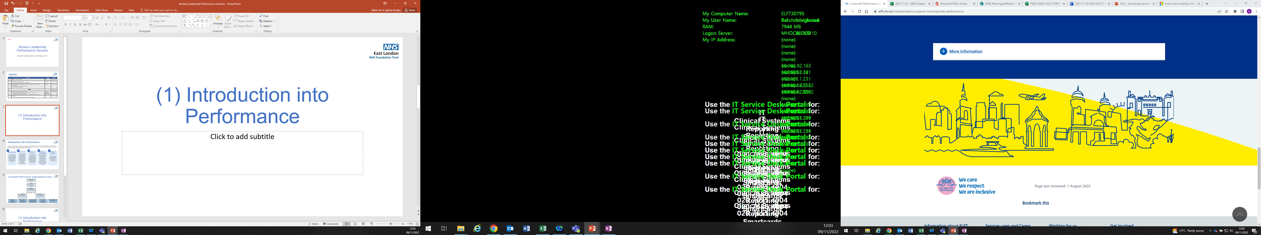
Improving Discharge Notifications – Lessons Learned and Reflections

Slide 2









Project Overview
Project Milestones
Project Start
July 2022
Scoping of issue and stakeholder feedback
August – September 2022
Options appraisal
October – December 2022
Development of new Hospital Discharge Form
January – March 2023
New shorter Hospital Discharge Form deployed
March 31st 2023
Stakeholder feedback
April – July 2023
Bi-weekly Trustwide learning forum
April – July 2023
Project End
August 2023
An internal review has been completed of the 24-hour notification of discharge standard to ensure that we were closer to meeting the target and offered appropriate and timely support for our service users. This prepared us for the national move from sending discharge notifications to GPs within 48 hours to 24 hours. All directorates fell below the 95% national target and were not able to account for all discharge notifications because there were delays in local processes which caused bottlenecks across the pathway. After completing the review, we were able to identify and implement a number of improvements that have results in improvements in performance across the Trust.
Purpose & Objectives
To support the delivery of the 24-hour discharge notifications standards. As such a Trustwide project board was established to:
  Develop a unified process and solution to capture compliance of this standard for reporting
  Identify best practice by liaising with external partners to understand what processes are most efficient
  Organise training and supporting material to embed new practices.
  Support teams to enhance the quality of contacts with service users.
Risk
Description | Likelihood | Impact | Mitigating Actions
Patient safety | High | Failure to meet national standard results in GPs not having access to timely information which can affect care planning and delivery. | Performance reviews monitored locally and reports in place to support improvement. Establishment of Discharge Notification project board with membership from key areas including local and corporate performance, pharmacy, clinical directors, and digital

Slide 3
Why this matters: Learning from service users
Discharge Process
Discharge Liaison Form
“Not as well as staff think I am”
“More Pre-discharge conversations”
“Lack of follow-through on agreed plans”
“Missing letter delayed medications”
“No accountability”
“Poor communication”
“Better advance planning with me”
“Had to chase for letter”
“Did not get a discharge letter”
“Felt rushed”
“Content written without service user voice”
“Had to go to A&E to get support”
“Format is good”
“Didn’t know about HTT”
“Lack of community support ”
“Telephone check-in provided limited help”
“Wording can compound feeling stigmatised”
“Chaotic discharge”
“Be more inclusive, language barriers”
“Staff should incorporate both professional and user perspective to reduce stigma”
“Staff too busy ”
“Less jargon”
“Transition to community care was disjointed”
“Felt Abandoned”
“Randomly discharged on weekend”
“Discharge letter is very helpful tool ”
“Felt unsafe on discharge”
“Not involving carer sufficiently”
“More detail about the follow-up plan so its clear who is responsible and by when”
“Plan for discharge from B&B was unclear”
“Relapsed”
“Letters don’t always get to GP electronically ”
“Everything feels like a battle”
“Loss in trust and faith in staff”
“More opportunities to discuss this before discharge ”
“Benefit from information leaflet post discharge”
“Staff not listening”
“Repeatedly fell through the cracks”
“Appointments not organised in community”
“Need more help navigating system”

Slide 4
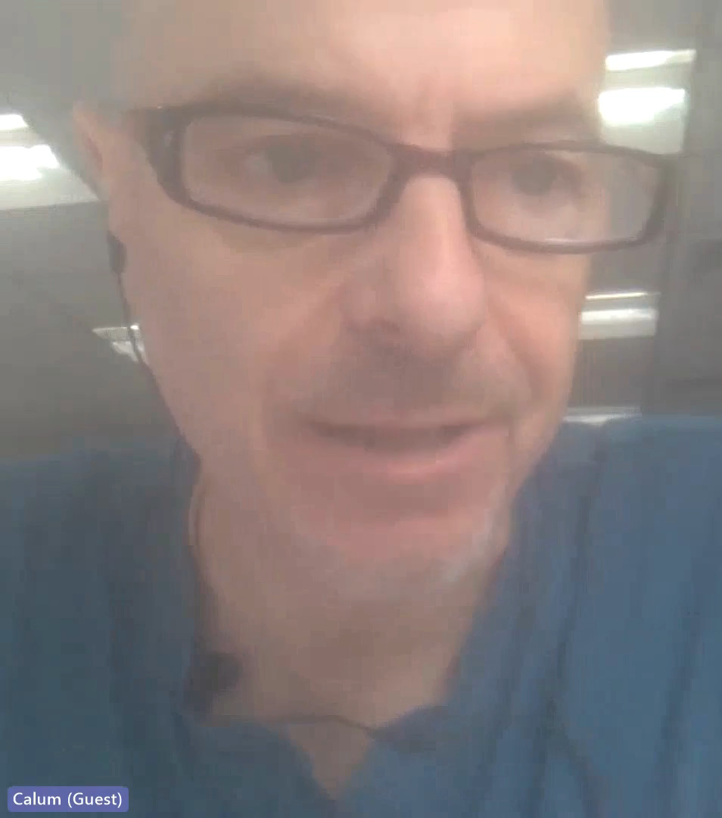
Why this matters: Service user experience
Video: 2 minutes watch time

Slide 5
Why this matters: Learning from staff and GPs
Stakeholder Feedback
Junior Doctors/Pharmacists | Generally the process feels faster The removal of the progress and treatment summary makes it harder for Junior Doctors to refer back to previous admissions if a service user is readmitted - This is now being managed through progress notes, existing records and as part of the follow-up plan
GPs | The discharge letter can sometimes lack clarity of what’s happened during the admission – the information provided can be long and unnecessary contextual information The discharge letter should provide a short, concise summary of the reason for admission, diagnoses, and any changes in medication If there are requests for the GP to complete specific actions, they would like to know why, if not already mentioned in the discharge letter

Slide 6
Key changes to the process
1
The Discharge Liaison Form in RiO has been redesigned to be shorter and more concise, resulting in fewer sections that clinicians need to complete.
2
The ‘Treatment and Progress Summary’ has been removed and the ‘Follow-up Plan’ section has been reorganised, resulting in clearer post-discharge guidance for GPs and community teams
3
The Trust Informatics team has developed new Power BI dashboards to help wards more closely monitor performance
4
The project group clarified the scope and purpose of the discharge letter to ensure that only vital information pertaining to the admission and discharge plan is conveyed.

Slide 7
Performance Highlights and Change Ideas
MDT ward huddles to support discharge planning
Ward round template developed by Junior Doctors to capture essential information prior to discharge
Daily reminders for outstanding discharge notifications – reduced the backlog by over 60%
Broadening of Power BI displays on the wards to allow for better monitoring of performance
Change Ideas
Establishment of QI flow project
Establishment of clear oversight to ensure doctor reviews the quality of the letter
Improve communication with service users prior to discharge through posters/leaflet
Local performance training with Junior Doctors and Pharmacy
Performance Highlights
The Trust has seen improvements in the average time taken for the discharge notification to be uploaded
Tower Hamlets has reduced the average time for the discharge notification to be uploaded by 58%
Tower Hamlets has improved their oversight and governance processes around the completion of the discharge liaison form
Newham has reduced the average time for the discharge notification to be uploaded by 35%
Newham have implemented a ward round template that allows them to capture key aspects of the service users admission prior to discharge and as a result are not completing the discharge letter at the point of discharge.
Across the Trust, daily reminders are being issued by admin staff on the wards to ensure that junior doctors are aware of any service user
In Luton & Bedfordshire, the patient is unable to leave the ward without TTA medication and as a result performance has been better

Slide 8
Doctor
Review Final Discharge Letter
Pharmacy
Ward Nurse
Send to GP (local Lead)
Recommended process flow
Prior to discharge (24 hours of earlier)
Send to Pharmacy by 2pm to validate same day
Share with service user and send to GP within 24 hours of discharge
The Junior doctor will complete the "Hospital Discharge" form.
Junior Doctor to ensure that all the information on the form is correct including admission and discharge date.
Establish or follow existing governance process for reviewing final discharge letter. Use ‘DLF Data Report’ to view contents of complete form.
Doctors are responsible for the quality and accuracy of the discharge letter prior to pharmacy sign off and/or admin sending to GP
Junior Doctor or the Consultant will email Pharmacy to notify pharmacy that their form is ready for validation
Ward pharmacist will validate the form and digitally sign. Please note that the pharmacist will just be reviewing medication and allergies.
Pharmacy will validate medication on the same day if received before 2pm.
Ward pharmacist will use editable letters to create the discharge liaison letter (see email below for guide on how to complete this)
Gold standard is a copy of discharge letter printed and given to patient
Patient to be given medication, which has been sense checked by Ward Nurse
Patient discharged
Depending on the borough the ward administrator, Pharmacist, or Doctor will send the discharge letter to the GP.
Please note, it is the Junior Doctors responsibility to check the final letter before it is sent to the GP and ensure all quality checks have been completed

Slide 9



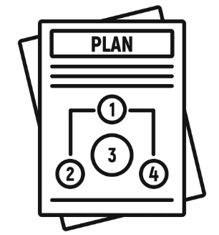



Recommendations for Directorate Teams
Establish a way for doctors to view the completed discharge letter before it goes to the service user and GP, to ensure high quality
Develop the discharge plan during the ward round or pre-discharge meeting, so that all information is captured in advance
Coproduce the discharge plan with the service user, prior to discharge, and use this opportunity to ensure contact information is up-to-date for the 72-hour follow-up
Use the data in PowerBI at ward level to view performance
Provide the “My Recovery Plan” to the service user at the point of discharge, together with the discharge letter
Consider creating an information leaflet or ward poster that helps explain the support available from community services following discharge
Explore expanding the peer support offer on wards to help the transition from hospital to community care settings

Slide 10
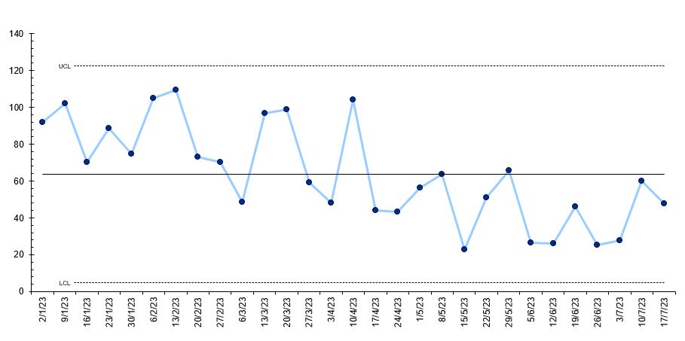
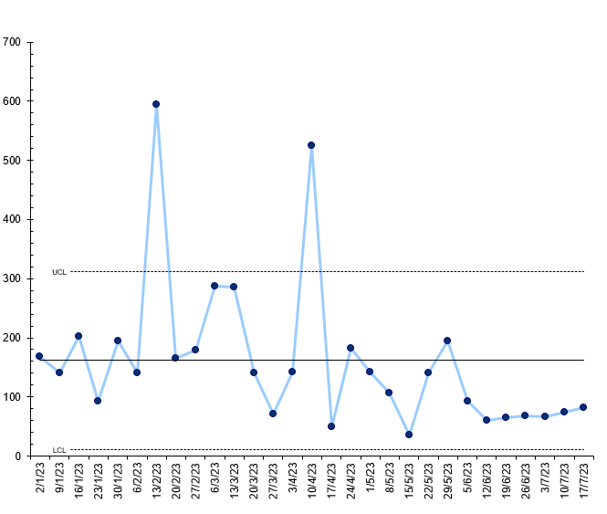
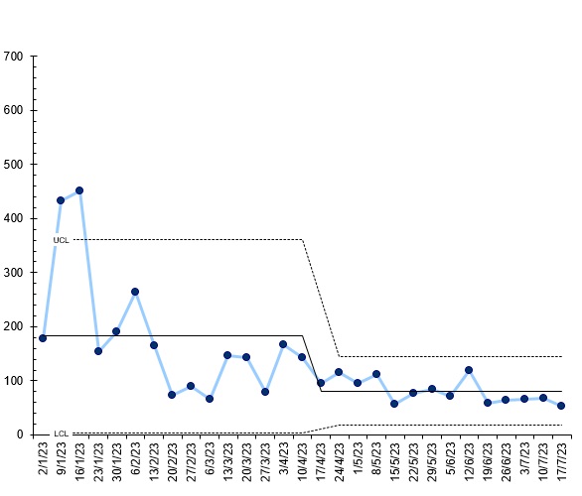
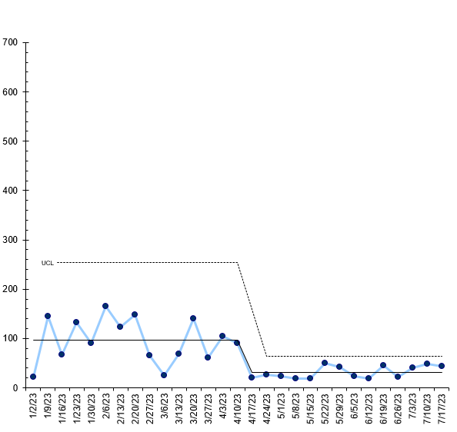
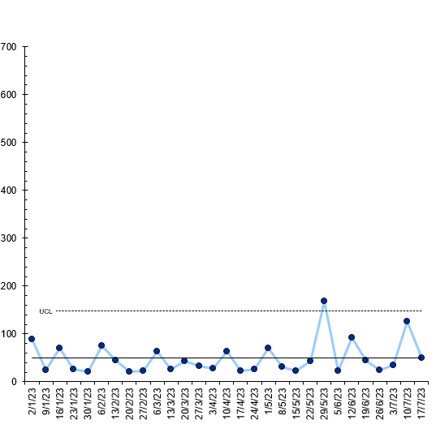
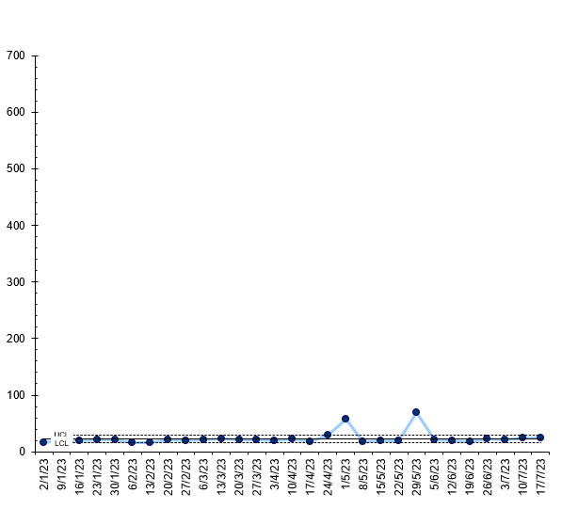
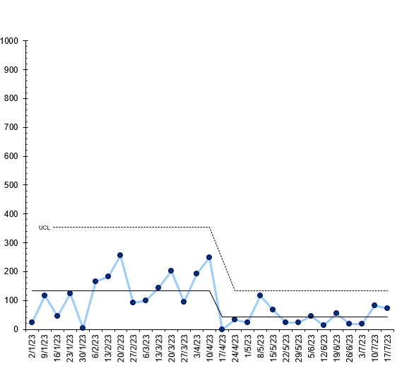
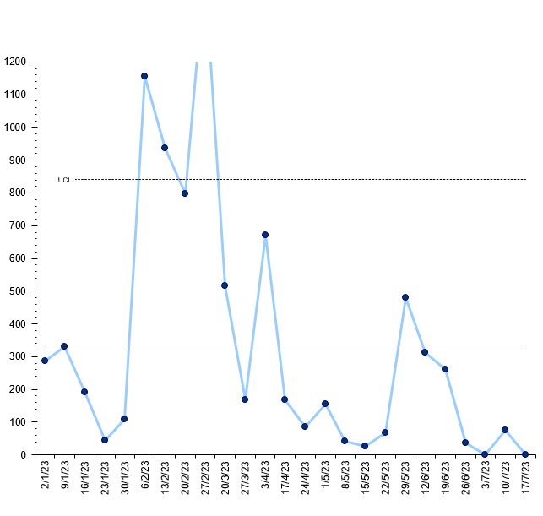
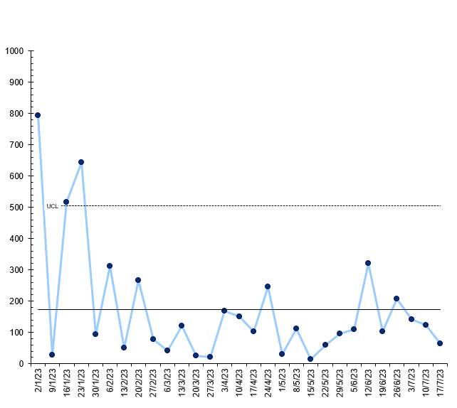
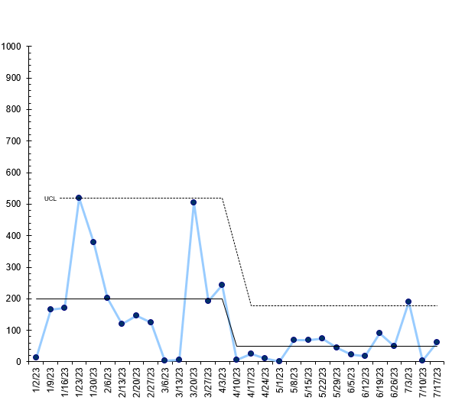
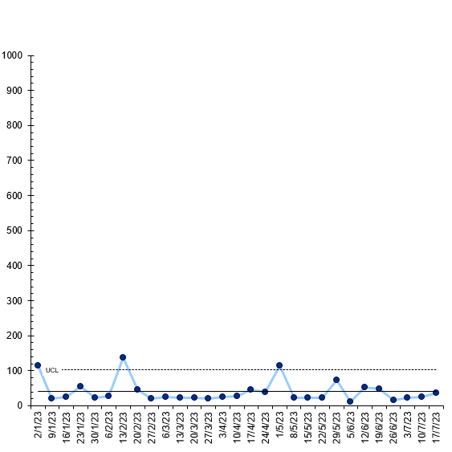
Data
Hours taken for discharge notification to be uploaded each week (median)
Borough | Number of discharge notifications not uploaded
City & Hackney | 27
Newham | 10
Tower Hamlets | 7
Luton | 3
Bedfordshire | 0
Trustwide (48) – I chart
17th – 23rd July (median hours)
Trust | 48 | Ivory Ward | 61
City & Hackney | 88 | Ruby Ward | 72
Newham | 44 | Bricklane Ward | 65
Tower Hamlets | 53 | Joshua Ward | NA
Luton | 49 | Crystal Ward | 37
Bedfordshire | 24
Trustwide
City & Hackney (88) – I chart
Tower Hamlets (53) – I chart
Newham (44) – I chart
Luton (49) – I chart
Bedfordshire (24) – I chart
Borough
Ruby Ward (72) – I chart
Joshua Ward (0)– I chart
Bricklane Ward (65) – I chart
Ivory Ward (61) – I chart
Crystal Ward (37) – I chart
Project Wards

