Slide 1

Progress with delivering our strategy and annual plan
September 2023

Slide 2
People with substance misuse problems
REPORT TO THE INTEGRATED CARE AND COMMISSIONING COMMITTEEE September 2023
Title | Progress with delivering our strategy and annual plan
Author Name and Role | Amber Iglesia, Trustwide Planning and Performance Manager Amrus Ali, Associate Director of Performance
Accountable Executive director | Dr Amar Shah, Chief Quality Officer Richard Fradgley, Executive Director for Integrated Care & Deputy CEO
PURPOSE OF THE REPORT
This report updates the ICCC on delivery of the ELFT strategy, through a series of five annual plans over the life-course of the strategy. This report provides a progress update of Quarter 1 for the 2023-24 annual plan. The ICCC is asked to RECEIVE and NOTE the report for information.
KEY MESSAGES
This paper provides an update on the delivery of our ELFT strategy, with a focus on the 2023-24 annual plan. Many of the 2023-24 annual plan priorities are progressing well, with progress made in Quarter 1. This paper also features identified deliverables and measures to monitor progress.
STRATEGIC PRIORITIES THIS PAPER SUPPORTS
Improved population health outcomes | ☒ | This report relates to achieving the 2023/24 annual plan priorities, which outlines our planned activity this year to contribute towards achieving the trust-wide strategy across all four strategic priorities.
Improved experience of care | ☒
Improved staff experience | ☒
Improved value | ☒

Slide 3
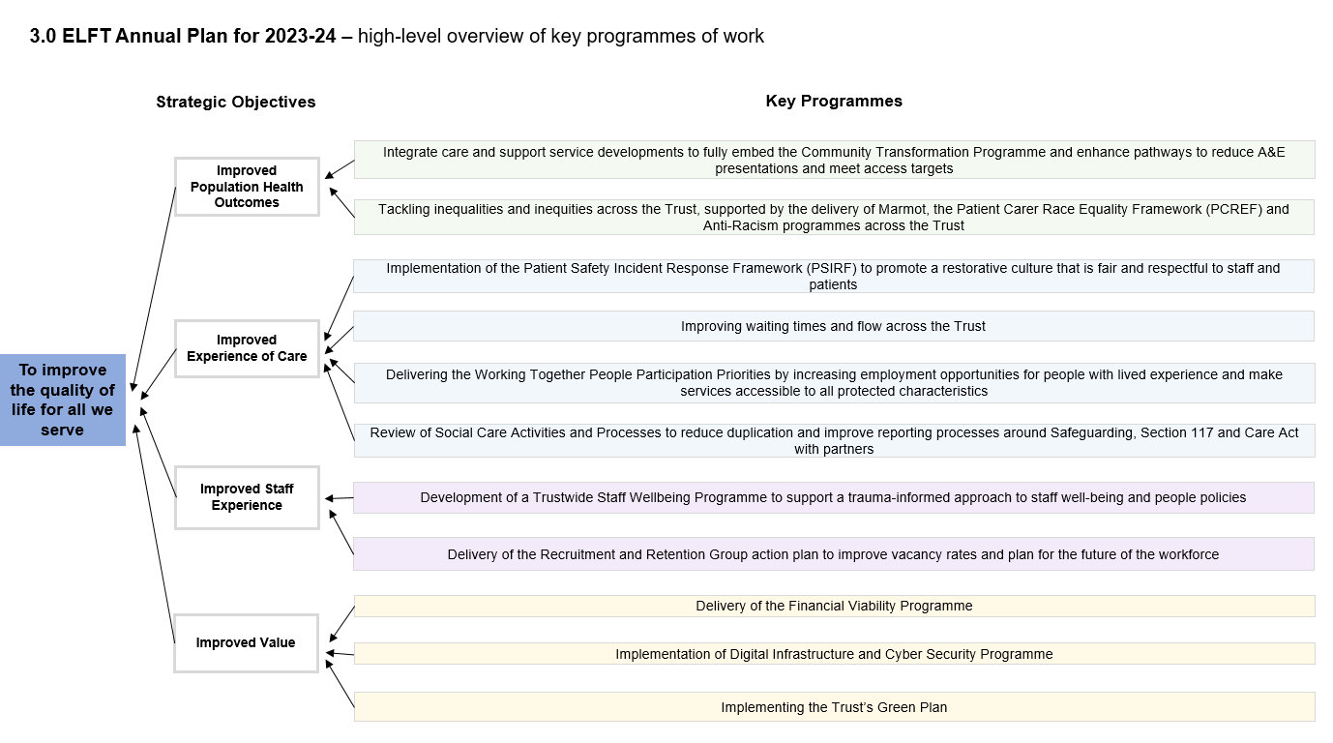
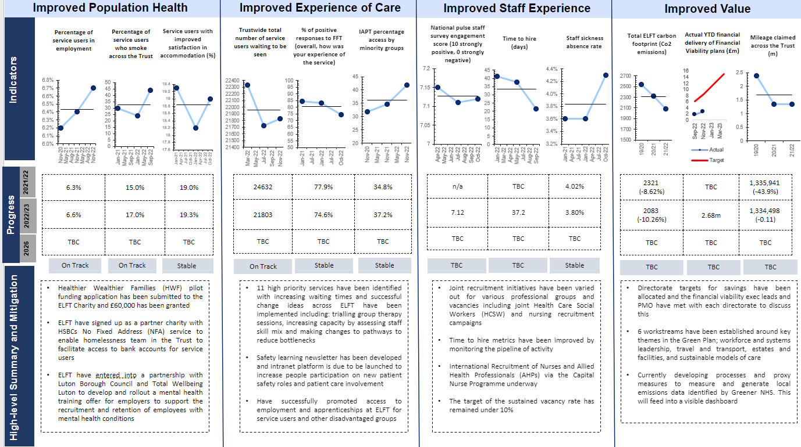
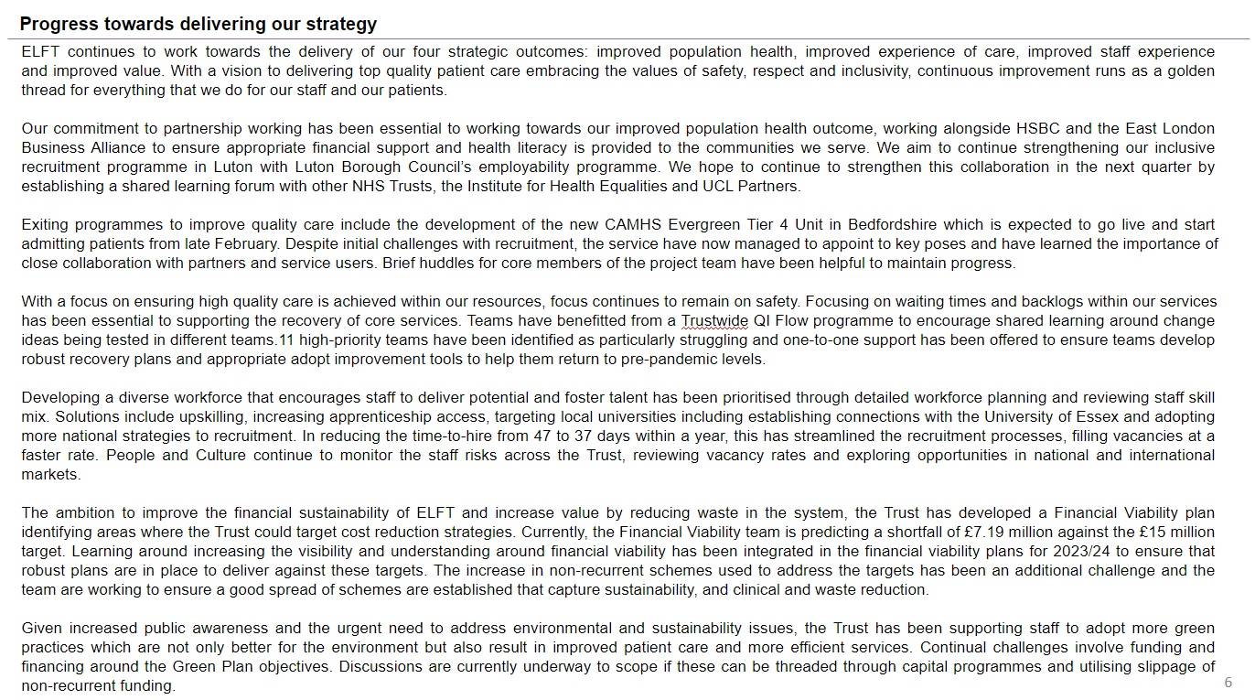
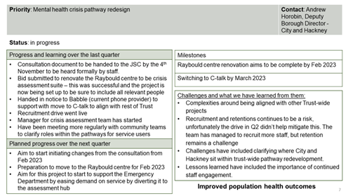
People with substance misuse problems
Introduction: How this report is structured
Trustwide 2023-24 annual plan
This section contains a draft of the 2023-24 annual plan with identified deliverables and measures to track progress
1
Progress against our 2023-24 strategy – dashboard
This section contains a one-page overview, highlighting our progress in shifting key measures that link to the four objectives in our strategy
2
3
Progress against our 2023-24 strategy – narrative
This section contains narrative that describes the progress we have made, challenges, and the mitigations being taken
4
Appendix
The appendix contains a detailed summary of progress on the key priority programmes of work in the 2022/23 annual plan for ELFT, designed to move us closer to achieving our strategy

Slide 4
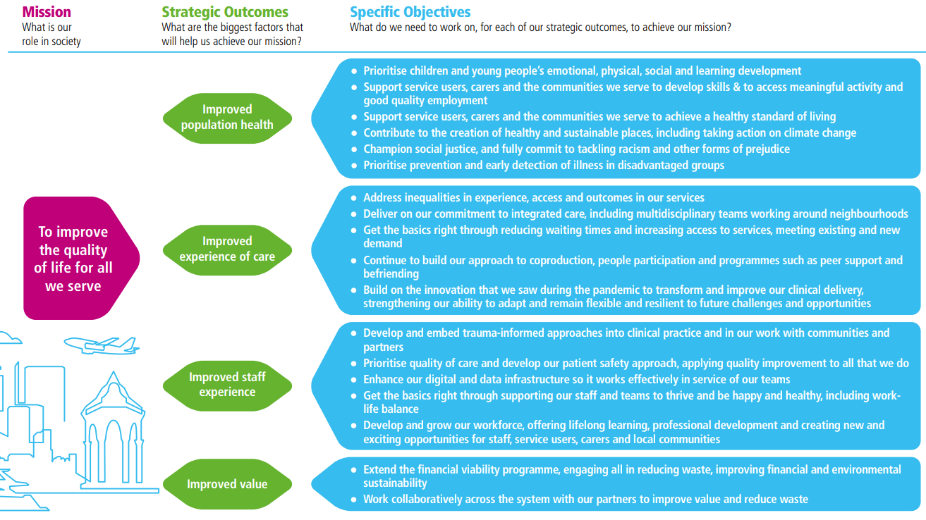
People with substance misuse problems
1.0 ELFT 2022-2026 Strategy
The ELFT 2022-2026 Strategy was developed through a ‘Big Conversation’ undertaken between June and August 2021. This engaged a range of stakeholders within and outside the Trust to help us better understand what our priorities should be for the next five years.

Slide 5

Annual plan 2023-24
Strategic Objectives
Key Programmes
Integrate care and support service developments to fully embed the Community Transformation programme and enhance pathways to meet access targets
Improved Population Health Outcomes
Tackling inequalities and inequities across the Trust, supported by the delivery of Marmot, the Patient Carer Race Equality Framework (PCREF) and Anti-Racism programmes across the Trust
Implementation of the Patient Safety Incident Response Framework (PSIRF) to promote a restorative culture that is fair and respectful to staff and patients
Improved Experience of Care
Improving waiting times and flow across the Trust
To improve the quality of life for all we serve
Delivering the Working Together People Participation priorities improving the opportunities for people with lived experience and make services accessible to all protected characteristics
Review of Social Care Activities and Processes to reduce duplication and improve reporting processes around Safeguarding, Section 117 and Care Act with partners
Improved Staff Experience
Development of a Trustwide Staff Wellbeing Programme to support a trauma-informed approach to staff well-being and people policies
Delivery of the Recruitment and Retention Group action plan to improve vacancy rates and plan for the future of the workforce
Delivery of the Financial Viability Programme
Improved Value
Implementation of Virtual Desktop Infrastructure (VDI) and improvement of cyber-security resilience
Delivery of the Estates Strategy
Implementing the Trust’s Green Plan

Slide 6

Improved Population Health
Improved Experience of Care
Improved Staff Experience
Improved Value
% of service users in employment across the Trust with Severe Mental Illness
% of service users who smoke across the Trust
% of service users with improved
satisfaction in accommodation
% of service users who report good experience of care
Number of service users waiting to be seen across the Trust
IAPT percentage access by minority groups
Staff engagement score from National Pulse Survey
(10 strongly positive, 0 strongly negative)
Average time taken to hire (days)
% of staff sickness absence rate
Total ELFT carbon footprint (Co2 emissions)
Actual YTD financial delivery of Financial Viability plans (£m)
Mileage claimed across the Trust (million miles)
Indicators
22/23
6.86% | 25% | 17.79%
7.2% | 25% | 16.97%
13% | 18% | 29%
96% | 25,343 | 37.8%
97.3% | 27,248 | 41.3
100% | 12,316 | 50%
7.08 | 37.8 | 4.11%
7.0 | 37.4 | 3.8
8.5 | 37 | 4%
2083 (-10.26%) | 7.24m (against 15m target) | 1,334,498 (-0.11%)
(yearly figure) | 3.7m | (yearly figure)
1580 (-26.4%) | Subject to national FV guidance | 1,014,218 (-26.2%)
23/24
Progress
2026
On Track
Stable
Stable
On Track
Not on Track
On Track
Stable
On Track
Stable
On Track
On Track
On Track
Focused work is underway looking at increasing migrant support, establishing an offer for neurodiverse populations and those with severe mental illness in their employment journey
An Individual Placement Service (IPS) Fidelity Review revealed that Tower Hamlets is one of the best performing London teams working with service users unsatisfied with their employment status and supporting service users with serious mental illness to retain their jobs
The Trust’s smoking cessation programme has seen an increase in referrals to the stop smoking service across mental health
As part of Getting It Right First Time (GIRFT) programme, Bedfordshire inpatient services are developing an integrated discharge hub with partners to tackle housing issues. In East London, services are working with local authorities to review housing provision in borough
The implementation of the Patient Safety Incident Response Framework has identified a switchover date of the 1st November to promote a restorative culture and improve experience of care
The number of service users waiting to be seen continues to increase, with the largest increase among ADHD and Autism services. Trustwide action plans have been developed across both focusing on exploring digital opportunities, a primary care offer and long term planning options to consider service redesign optoins
Within IAPT services, local work is ongoing through an outreach programme with the Muslim community and other communities to increase engagement and recovery rates. The team has successfully gained a Population Health Fellow to work on inequalities in access and outcomes from IAPT services in North Each London
People and Culture have developed an internal wellbeing tracker to monitor uptake of different wellbeing initiatives. Further metrics are still being identified to track staff wellbeing Trustwide
An ELFT BEWELL newsletter has been developed which gets the most engagement out of all other newsletters distributed to the Trust
International recruitment is ongoing via the capital nurse programme and in order to expand the pool of applicants, People and Culture are working with specialist firm agencies to recruit into medical roles and improving current advertising processes so more adverts are visible on the website
Trac authorisation rollout is complete and has eliminated the Budget Authorisation Forms (BAF) which has resulted in more streamlined recruitment and it is hoped that this will reduce the time it takes to hire
Most DMTs have outlined specific green plan goals that each directorate will be focusing on across 2023/24 as part of their annual planning process
Projects currently starting across the Trust include implementing reusable gloves, reducing single-use plastics and rolling out sustainable walking aids
The first face to face Financial Delivery session was held in June 2023 and this proved a helpful forum to encourage directorates to think about where they could make cost savings, this is due to be repeated 3 times a year to monitor progress and offer support
Financial Viability workstreams have improved with less reliance on schemes related to income. 26% are focused on income generation, 28% are on service transformation and 46% focus on waste reduction.
High-level Summary and Mitigation

Slide 7
People with substance misuse problems
3.1 Improved Population Health
ELFT continues to work with communities and partner agencies to ensure a population health approach to care delivery. As a Trust, we have several programmes underway to support this, including being a Marmot Trust, supporting smoking cessation, creating more equal employment opportunities, and supporting the retention of spending in local economies to build healthier communities. Work on adopting the Marmot principles, which has previously been brought to the ICCC, continues to focus on promoting access to employment and apprenticeships at ELFT for service users who may experience barriers to employment. Population Health indicators show an increase in the percentage of service users employed across the Trust with Severe Mental Illness (SMI). To support service users in employment, they are being offered guidance from Individual Placement Support (IPS), which is a team embedded within community mental health providing evidence-based support to help people return to employment or retain their jobs. In City & Hackney, a recent Art Exhibition was held and run by users of IPS services to build employment skills and confidence for those wanting to enter the creative industry. Through a recent IPS Fidelity Review, Tower Hamlets was branded as the "Best Performing London Team" particularly supporting those with serious mental illness. It was revealed that Black African and Somali groups are particularly underrepresented when engaging in employment, and "Progress to Work" spaces have been developed to help upskill these service users. Across Bedfordshire, IPS workers are embedded within blended community teams and are successfully meeting their access targets. A promotional video is currently being produced, showcasing successful recruitment practices that have resulted in job placements and service user recovery stories and achievements. This video serves the purpose of promotion, highlighting the program's effectiveness and its positive impact on individuals' lives. The percentage of service users who smoke across the Trust remains stable, however there has been an increase in referrals to the Trust's Stop Smoking service for Mental Health service users. Over the past year, there has been a decrease in the satisfaction rate for accommodation across the Trust. An integrated discharge hub has been established to manage this across Bedfordshire and Luton as part of the Getting It Right First Time (GIRFT) programme, which has brought stakeholders together to identify and unblock issues such as addressing housing and support needs at an earlier stage. In East London, services are working with local authority partners to review local provision of supported living schemes and temporary accommodation to ensure that existing accommodation gaps are addressed. The Trust has developed an options appraisal to be a Real Living Wage (RLW) employer which will require all ELFT contracts to pay the Real Living Wage. It is hoped that accreditation will be obtained in Quarter 2 to ensure equality in salary standards. The Healthier Wealthier family's pilot in SCYPS has supported 12 families so far and identified a potential £70,000 of unclaimed benefits and debt support to the families that are available. A dedicated focus on inequalities has led to the launch of the Learning Disabilities Health Needs Assessment aimed at exploring the ways to enhance care for individuals with learning disabilities in East London. Through the Inequity Steering Group, it is hoped that this will provide a platform to share learning and best practice. The Community Transformation Programme has focused on designing the Care Programme Approach (CPA) replacement framework, including the latest proposals around Care Act, Dialog and Dialog+. Two Organisational Development practitioners have been working closely with teams to review the culture and current processes to support the rollout of the CPA replacement framework. The focus of the next quarter will be to plan a stocktake event session with each of the boroughs to clearly understand local progress that has been made and ascertain the next steps of the programme to help realise the NHS Long Term Plan aspirations.

Slide 8
People with substance misuse problems
3.2 Improved Experience of Care
Several Trustwide initiatives support this area of the strategy: dedicated sessions and meetings led by Corporate Performance to work through demand and capacity challenges, a Patient Safety workshop, and delivering on the Working Together People Participation Priorities. Experience of Care indicators show a slight decrease in the number of patients reporting good experience of care. All services have plans in place to address these concerns, for example trauma-informed care training is being adopted by services to enhance the experience and quality of care and an East London mental health newsletter is being developed to share learning from complaints and serious incidents. The number of people waiting to be seen also continues to increase, particularly across Autism and Adult ADHD services across the Trust. In East London, a Triple Aim ADHD project co-led by ELFT and the ICB has been established to develop an East London-wide action plan to tackle some of the main challenges. A number of work streams have been identified and include reviewing processes at a Primary Care level to alter the ways in which GPs are supported to manage requests and referrals differently. Services have also begun exploring digital solutions to reduce assessment times and improve capacity. Furthermore, additional attention is being directed towards determining the optimal configuration of services as part developing a long-term plan strategy. A Trustwide Autism workshop was held to discuss similar challenges, supported by the development of a Trustwide Autism Diagnostics Strategic Action Plan. Across IAPT services, there has been an increase in the number of service users accessing services from minority backgrounds. Deep dive analysis has been done to understand which communities are not engaging with the services and dedicated work is underway among BAME and white working-class populations with high levels of deprivation to improve access and ensure that this is part of the local health strategy in Newham. Services have also highlighted gender disparities, with women accessing services more than men, particularly black young men. The implementation of the Patient Safety Incident Response Framework (PSIRF) is on-going, and a switchover date has been identified as the 1st of November. The team have started to develop a new incident pathway and held an away day with Trust leaders, incident graders and the incident team around the rollout. 2 patient safety partners have been recruited into the role and are due to start in September. The next quarter will focus on finalising the plan and policy to align the new operational processes. A Review of Social Care activities is also underway through a wider Social Care Project to improve processes around Safeguarding, Section 117 and Care Act with Local Authority partners. It is hoped that this will increase communication with partners to improve the experience of care for service users across health and social care. Solutions have been identified across all three areas. A Safeguarding dashboard and digital solution to share safeguarding clinical records have been developed to improve the visibility of safeguarding activities between ELFT and local authorities. A dedicated Section 117 form is being designed and the minimum standards have provisionally been agreed, subject to further testing. A Care Act screening proposal has been drafted to be incorporated as part of the Dialog assessment process. We are currently working towards the end of September to roll out the Social Care solutions. Delivering on the People Participation priorities continues to remain a focus to improve opportunities for people with lived experience, making services accessible to all protected characteristics. The team has been enriching the volunteering service by broadening the array of available opportunities. Additionally, they have recently introduced an Academy of Lived Experience (ALE), utilising the expertise of service users and caregivers to provide training and enhance staff development using best practices. Over the next quarter, a People Participation conference has been planned with internal and external partners with the goal of building relationships with ICS partners and other NHS Trusts to foster the advancement of People Participation initiatives.

Slide 9
People with substance misuse problems
3.3 Improved Staff Experience
ELFT has maintained a strong focus on improving staff experience, ensuring that staff continue to feel engaged, involved, and valued to create a strong workforce to achieve continuous improvement in delivering healthcare. The Trust has seen an increase in the number of teams applying QI on the topic of enjoying work. This includes improving staff satisfaction, wellbeing, promoting teamwork, embracing new ways of working to reduce staff turnover, increasing relationship building, and improving cohesion across the Trust. Improved Staff Experience indicators show that staff engagement scores from the National Quarterly Pulse Survey have seen a slight increase since the previous quarter. Average time-to-hire metrics have seen a slight increase but remain stable overall. This can be attributed to the increase in overall applications and recruitment activity for positions. Recruitment events have been held and led by the nursing directorate and People and Culture to target potential community and inpatient nurses, nursing associates, and allied health professionals. The percentage of staff sickness absence rates has seen a decline in the past few months from 4.1% to 3.8%. People and Culture are continually reviewing this as part of the People Plan. The ELFT BE WELL newsletter continues across the Trust on a monthly basis providing support for staff around self-care, well-being, resources to manage stress and anxiety, webinars, and saving opportunities for staff to deal with the cost of living. This month, the newsletter included discounts to activity camps for children to attend during the summer holidays and ELFT's exclusive cost-of-living guide. Care First, our employee assistance programme offers 24/7 independent support around health, relationships, employment, bereavement, and legal and financial advice. Care First has also recently launched weekly well-being webinars for staff, which include the topics of mental well-being and how to manage stress and pressure. More offers and suggestions of how to engage staff further in ELFT's wellbeing initiatives are explored in the Staff Wellbeing Forum on a quarterly basis. International recruitment via the capital nurse programme continues to expand the pool of potential candidates. The International Recruitment Strategic Group has been launched to support recruitment across all staffing groups. The trust is currently working with specialist firm agencies to recruit into medical roles and improve advertising processes so more adverts are visible on the website. Trac authorisation rollout is complete and has eliminated the Budget Authorisation Forms (BAF) which has resulted in more streamlined recruitment and it is hoped that this will reduce the time it takes to hire and get staff into post quicker. In Quarter 1, the main challenges are around international recruitment across staffing groups. While there are increased efforts to recruit internationally and there is a good pastoral support care package offered, there remain challenges around sourcing accommodation and housing for overseas nursing. There are plans to continue with recruitment fairs establishing a targeted approach to recruiting into hotspot vacant roles in various staff groups focusing on Band 7 psychologists and Band 6 community nurses.

Slide 10
People with substance misuse problems
3.4 Improved Value
The Trust’s strategic priority around improved value focuses on ensuring efficient use of resources, time, removing obstacles, bottlenecks, delays, and adopting systems and processes to support streamlining practices. The Financial Viability Team leads a programme of work to ensure that the Trust is offering good value for money to everyone it serves, utilising our funding efficiently. The Trust’s Green Plan also forms part of this vision which has been co-designed with senior leaders, the sustainability and value group, and representatives from the People Participation Team. Improved Value encompasses priorities around efficient workforce and system leadership, sustainable models of care, and digital transformation among other important themes. The main programmes of work under improved value include the delivery of the Trust’s Financial Viability programme, implementation of the Trust’s Green Plan, The Trust's Estates Strategy and The Digital Infrastructure and Cyber Security programme. Improved Value indicators show that at the end of Quarter 1, the actual delivery of the financial viability plans was 2.5 million against a target of 3.1 million. The overall target for the year is 20.8 million with the current identified value of schemes at 18.5 million. Monthly financial viability monitoring meetings are in place where all directorates report back on plan progress. The Financial Viability team held the first face-to-face delivery session in June which proved a helpful forum to get directorates to think through their plan and identify further cost-saving initiatives. It is hoped that this will be repeated 3 times a year to keep momentum. Indicators for monitoring progress against the Green Plan are being reviewed as currently the ELFT carbon footprint and mileage claimed can only be calculated on a yearly basis. New measures for 2023/24 have been developed as part of the Quarterly Greener NHS Returns to closely monitor the recycling of waste, gas consumption, and electric consumption which can be recorded quarterly, as highlighted in the appendix. Projects currently starting include implementing reusable gloves, reducing single-use plastics, and rolling out sustainable walking aids. Many DMTs have outlined specific green plan goals that each directorate will be focusing on across the year as part of their annual planning process. As part of the Digital Infrastructure and Cyber Security Programme, Multi-Factor Authentication (MFA) is being rolled out across all staff in the Trust to protect and prevent compromised NHS email accounts that account for most "Phishing" attacks. Staff cyber awareness and Trust culture around cybersecurity is extremely important and the Trust's cyber webinars are providing cyber awareness. The delivery of the Estates Strategy is currently being supported by the Estates Strategy Board which plans to be officially launched in November. For 2023/24 there are plans to commit to assessing all 54 inpatient wards through the Patient Led Assessment of the Care Environment (PLACE). The Estates People Participation Lead is also starting in November, and it is hoped that they will be able to work with service users more closely and feedback on the progress made on items identified through PLACE. The Estates Team plans to solidify their Project Management Office (PMO) structure along with the Digital team to develop dashboards and enhance reporting functionality to identify specific areas around compliance to conduct a trend analysis for each directorate.

Slide 11
Appendix
Progress on our priority areas of work for 2023-24

Slide 12
Priority: Integrate care and support service developments to fully embed the Community Transformation programme and enhance pathways to meet access targets | Contact: Jamie Stafford
Status: in progress
Progress and learning over Quarter 1
Quarter 1 focused on designing the CPA replacement framework including the latest proposals around Care Act, Dialog and Dialog+ 2 Organisational development practitioners have been working closely with teams to look at culture and current processes to support the rollout of the wider CPA replacement framework A Community Connector Continuing Professional Development (CPD) has been published to support these roles in further learning and development Fixed-term people participation roles have been recruited substantively into the boroughs as part of the business-as-usual processes New investment funds have been coming into the boroughs alongside a new inequalities fund in Tower Hamlets, this money will be invested in new roles as part of the Community Transformation programme, with key projects currently being mobilised.
Next Steps…
CPA guidance document due to be finalised, confirmed and circulated to staff to commence the implementation of the new framework Stocktake events are planned with each of the boroughs to clearly understand local progress that has been made and ascertain the next steps, particularly off the back of the NHS Long Term Plan Shared learning exercises are planned to learn from successful models elsewhere for wider consideration
Progress Measures
Challenges and what we have learned
Work around implementing Care Act processes have been complex, particularly when liaising with local authority partners to get buy-in around new solutions proposed The team has experienced disruption around changing roles and there is a need to rethink the next steps Unwarranted variation across the boroughs makes performance difficult due to different structures and frameworks in place Challenges remain around how teams are using data to monitor their performance and there is variation around the extent to which PowerBI is embedded as a routine monitoring tool
Improved population health outcomes

Slide 13
Priority: Tackling inequalities and inequities across the Trust, supported by the delivery of Marmot, the Patient Carer Equality Framework (PCREF) and Anti-Racism programmes across the Trust | Contact: Fran Bury
Status: in progress
Progress and learning over Quarter 1
The focus of our population health work to address inequalities (Marmot work and Anchor work) is addressing the underlying determinants of health; employment, increase in financial support and prevention. The Trust is assessing it's application to be a Real Living Wage employer which will require all of our contracts to pay the RLW. Healthier Wealthier families pilot on SCYPS has supported 12 families so far and identified 70K of unclaimed benefits and debt support to the families Increase in referrals to Trust stop smoking service for MH service users. Launch of Learning Disabilities Health Needs Assessment highlighting inequalities in access to prevention services.
Next Steps…
IAPT population health fellow to start with the remit to understand and address inequalities in access to services Trust has established an Inequity Steering group to support shared learning and best practice ELFT to sign up to RLW accreditation Continue to review employment data across the Trus
Progress Measures
Challenges and what we have learned
Challenges in obtaining valid and reliable employment data to give an accurate picture across the Trust Options appraisal produced for RLW accreditation as there are financial implications for ELFT which need to be considered Healthy wealthy families is showing promising results and should continue to be supported with a view to expand the model across Trust sites
Improved population health outcomes

Slide 14
Priority: Implementation of the Patient Safety Incident Response Framework (PSIRF) to promote a restorative culture that is fair and respectful to staff and patients | Contact: Deborah Dover
Status: in progress
Progress and learning over Quarter 1
Identified a switchover date as the 1st of November Conducted a data analysis of the last 3 years and analysed the Trust safety profile, creating and co-producing a list of the top 10 safety improvement priorities for the year ahead Started to develop a new incident pathway and had an away day with Trust leaders and incident graders and incident team around the rollout Completed a first cohort of PSIRF training and trained up 3 after action review leads alongside 2 training sessions Scheduled and booked 30 staff for the next PSIRF training sessions Recruited 2 patient safety partners into role and due to start in September Been working with the in-phase team to align PSIRF implementation with LFPSE
Next Steps…
Running a series of PSIRF training sessions to train 50 co-reviewers and a large cohort of staff Set up an after action review drop-in peer learning set Working towards the transition date and taking the potential support pathway and learning improvement pathways to the CEO discussion in September and getting a consensus from directorates around the new pathway Finalising plan and policy and piloting the new operational processes Piloting the use of RcPsych as a method of reviewing and learning from safety Piloting PSII which is a new form of SIs
Progress Measures
Challenges and what we have learned
Challenges remain around the specific measures that are going to be regularly reviewed in the new system to monitor improvement. These are yet to be identified while also ensuring that we compassionately involve people in the process
Improved experience of care

Slide 15
Priority: Improving waiting times and flow across the Trust | Contact: Amrus Ali
Status: in progress
Progress and learning over Quarter 1
15 high priority services across the Trust have been identified to focus efforts on and we have support teams to set up regular performance meetings where demand and capacity are regularly monitored A large focus remains around ADHD and Autism waiting times across the Trust and robust action plans are in the process of being developed for both as these teams are experiencing the greatest increase in waiting times. Through workshops, the key themes highlighted included exploring a primary care offer, digital solutions to reduce backlogs and reviewing the wider service model with a longer-term solution to develop a neurodevelopmental pathway across the two The North East London (NEL) Crisis Improvement Network has been set up bringing clinical and operational leadership teams from providers to improve flow across the system. There are plans to introduce a “crisis think tank” led by service users to drive innovation, reduce the length of stay and demand for admission
Next Steps…
A Flow event has been scheduled for the 21st of September to share learning from this work across all providers A further workshop session across all Autism services across the Trust has been scheduled in September for teams to present their local action plans with robust change ideas that will result in improvement. PCNs, Memory and Perinatal Services are being stepped up into the “high priority” waiting list as their waiting times continue to increase beyond manageable levels and a recovery plan will be developed Tower Hamlets EPCTs may be stepped down as their waiting times are starting to see a decrease
Progress Measures
Challenges and what we have learned
Access to accurate and timely data to review waiting times and flow data has been challenging but most of this has been resolved through highlighting data inconsistencies with the informatics team Working closely with local performance and clinical leads has been essential to ensuring that regular updates on the recovery plans are provided. As such, since Q1, corporate performance have been joining DMTs across the Trust to streamline assurance processes and offer more direct support to teams Teams have been struggling with capacity due to ongoing recruitment challenges, therefore we have been working with teams to think about innovative ways of expanding capacity with the resources available
Improved experience of care

Slide 16
Priority: Delivering the Working Together People Participation priorities improving the opportunities for people with lived experience and make services accessible to all protected characteristics | Contact: Paul Binfield/Millie
Status: in progress
Progress and learning over Quarter 1
The People Participation team has expanded in the last quarter with more People Participation leads in different services The team continues to prioritise recruitment of People Participation leads to work alongside ICS collaboratives to support greater partnership working across the Trust Barts People Participation Collaboration continues to support partnership working with system partners The befriending service continues to expand to help combat loneliness and isolation among ELFT service users and carers The team has been reinvigorating the volunteering service by expanding the opportunities available The team has recently started an Academy of Lived Experience (ALE) to use the skills and knowledge of service users and carers to train and develop staff through best practice
Next Steps…
In the next quarter a People Participation conference has been planned alongside internal and external partners to share learning, through this process, the team hope to build relationships with ICS partners and support other NHS Trusts in their People Participation development The People Participation awards in the next quarter is an opportunity to celebrate the achievements and contributions that service users, carers and volunteers make to improving health services Continuing to develop and strengthen the team
Progress Measures
% of service users in employment across the Trust with Severe Mental Illness
Challenges and what we have learned
Developing relationships with wider ICS partners has been a challenge due to different levels of engagement, this has been particularly the case around the ELFT and NELFT relationship Numerous priorities across the Trust make it hard to know which key aims to prioritise, leading to confusion around what teams should focus on when they are expected to deliver on numerous priorities
Improved experience of care

Slide 17
Priority: Review of Social Care Activities and processes to reduce duplication and improve reporting processes around Safeguarding, Section 117 and Care Act with partners | Contact: Mary Brazier
Status: in progress
Progress and learning over Quarter 1
Safeguarding All Local Authority partners have provisionally signed up to test the proposed Safeguarding form on ELFT clinical systems A Safeguarding dashboard has been designed and has been shared with informatics for development to improve reporting processes. A digital solution has been tested to enable sharing of records related to safeguarding activity, which will optimise care delivery and improve communication between operational staff in ELFT and LA Care Act Proposed changes have been made to the Dialog form to add on a “Care Act Screening” section which ensure that we able to evidence delegated Care Act duties more effectively Section 117 A dedicated Section 117 form is currently in the process of being designed and the minimum standards have been provisionally agreed subject to further testing before being built and deployed
Next Steps…
We are currently working towards a deadline of the end of September to rollout all of the Social Care solutions. Safeguarding Luton and Hackney are due to share their Standard Operating Proceedure as they have already implemented the Safeguarding solution. The learning from this will inform the approach across other boroughs. Care Act Due to formally review agreed changes with the Dialog committee and incorporate as part of the Dialog assessment documentation in September Section 117 Commence the development of the S117 form with the RiO team
Progress Measures
TBC - Data under development
Challenges and what we have learned
Engagement from Local Authority Partners has been a challenge to build and there has been a reluctance to sign-up to the Social Care proposals. The engagement has improved within local partnership forums where testing of the solutions have been conducted allowing partners to see the end-to-end process to help co-produce the final solution Managing borough-specific variation has been challenging as there is not always a one-size-fits-all solution, however through regular forums we have managed to incorporate feedback from all boroughs into the proposal and co-design a solution that works for all parties.
Improved experience of care

Slide 18
Priority: Staff well-being programme | Contact: Jillian Dabbs/Lisa Baker
Status: in progress
Progress and learning over Quarter 1
National Quarterly Pulse Survey Q2 2023 -2024: the NQPS launched on the 3rd of July. Response rate as at 21/07/2023 is 8%. Staff awards: 697 staff award nominations were received (the most ever, and close to double the amount received in 2022). A league table for nominations has been collated. All shortlisting panels are now complete, with the final judging panel taking place on the 6th of September. Men’s Health Week Campaign: 2900 DIY health check information booklets were sent to ELFT male staff’s home addresses in order to be inclusive, ensuring this booklet was recyclable. A men’s health webinar, with experts, was hosted in Men’s Health Week (w/c 12th June 2023), this has been recorded for further publishing. 65 in person MOT health checks have been scheduled with ELFT male staff, with 47 of these being completed. ELFT BE WELL newsletter: Edition 22 of the ELFT BE WELL newsletter was sent out to 12433 ELFT staff. We measured 3652 unique opens and 1145 click throughs to the articles published in this edition. Other: the Wellbeing & Engagement Team hosted stalls at both the Bedfordshire and London NHS 75th Birthday community fayres. Business as usual salary sacrifice schemes, wellbeing offers, wellbeing newsletter, cost of living tips etc.
Next Steps…
Big ticket items for the team for Quarter 2 & Quarter 3: Quarter 2 (July, August, September): Start of the staff survey data collection period, staff awards planning & organising (incl. catering, venue, comms, all behind the scenes) & final judging panel. A pilot project for a self-sustainable emergency sanitary product supply will launch by the end of July 2023 in Newham, continuation of all business as usual salary sacrifice schemes, wellbeing offers, wellbeing newsletter, cost of living tips etc. Quarter 3 (October, November, December): Hosting of the staff awards ceremony, closing off of the staff survey data collection period, launching of the long service awards, launching of the vitamin D winter campaign, continuation of all business as usual salary sacrifice schemes, wellbeing offers, wellbeing newsletter, cost of living tips etc
Progress Measures
Link clicks on the ELFT BE WELL Wellbeing Newsletter*
Registrations to wellbeing schemes at ELFT (incl. childcare vouchers/maternity/paternity vouchers/benefits portals etc.)*
National Quarterly Pulse Survey Response – Employee Engagement
*please note: the first two graphs are taken from a recently developed wellbeing tracker which only goes as far as April 2023. Improvement will be monitored on a monthly basis for 2023/24
Challenges and what we have learned
Key challenge shave been around obtaining the staff survey response rates and reaching people effectively Key learnings have been around automating manual processes as much as possible including the staff awards emails and nominations The team are constantly trying to objectively measure the impact of wellbeing with the introduction of the wellbeing tracker to monitor progress in a more quantitative way
Improved staff experience

Slide 19
Priority: Recruitment and retention Group action plan to improve vacancy rates and plan for the future of the workforce | Contact: Sonia Kaur
Status: in progress
Progress and learning over Quarter 1
Now that the financial year is gone, the apprenticeship team is reviewing how much apprenticeship funding was diverted back to the government to understand the unused apprenticeship levy Continuation of international recruitment via the capital nurse programme Over-recruitment has happened, and the Luton & Bedfordshire medical recruitment is ongoing Recruitment events have been held and led by the nursing directorate and People and Culture, used communications resources and social media to publicise the events in advance over the last 3 events which took place this quarter. Recruited into community and inpatient nurses and nursing associates and allied health CAMHS recruitment numbers Working with specialist firm agencies to recruit into medical roles and improved our advertising process so more adverts are visible on the website International Recruitment Strategic Group has been launched to support recruitment across all staffing groups Trac authorisation rollout is complete and has eliminated the Business Authorisation Forms process resulting in more streamlined recruitment
Next Steps…
International recruitment - and the numbers that have been recruited Carry out more joint recruitment campaigns Consolidate international recruitment workstreams Continuation of the QI project for medical recruitment in Luton & Bedfordshire (inpatient, adult and community) Continuation of the recruitment fairs and a targeted approach to recruiting into hotspot vacant roles in various staff groups e.g. psychologists Band 7 and community nurses Band 6
Progress Measures
Challenges and what we have learned
Although a good pastoral support care package is developed and offered, there remains challenges around accommodation and housing for oversees nursing Continuous pipeline meetings with managers have proved beneficial and helped towards a better candidate experience Increase in overall applications and recruitment activity has been a challenge Increase in bank recruitment requests throughout the organisation needs to be moderated going forward
Improved staff experience

Slide 20
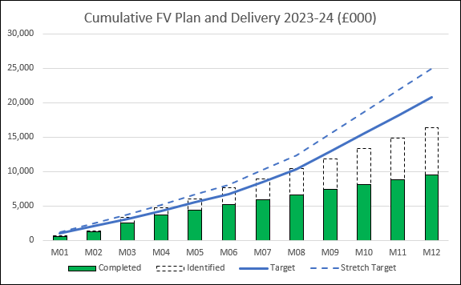
Priority: Financial Viability programme | Contact: Sarah Barnett
Status: in progress
Progress and learning over Quarter 1
Target of 20.8 million, the value identified of schemes is currently 18.5 million, (88% of the schemes are recurrent) Spread of identified schemes across the FV workstreams has improved with less reliance on schemes related to income - Income generation (26%,) Service transformation (28%), Waste reduction (46%) At the end of Quarter 1, the actual delivery is 2.5 million against a target of 3.1 million Have a monthly financial viability monitoring meeting in place where all directorates report back on plan progress Held the first face-to-face FV delivery session in June 2023, this proved a helpful forum and will be repeated 3 times a year Put in place improved monitoring, governance, and reporting structures Seeing increased ownership within directorates of FV plans
Next Steps…
Expedite understanding and delivery of centrally held FV schemes Provide additional support to directorates who have not developed a plan to fully meet their FV target. This may include dedicated project management support Identify central non-recurrent schemes to support year-end delivery of target Further work required with directorates and finance business partners to improve FV forecasting
Progress Measures
Cumulative FV Plan and Delivery 2023/24 (£000)
Challenges and what we have learned
Continue to have a gap in plans and this is hoped to be managed through the additional support provided Work to do in directorates to fully develop schemes e.g. quality impact assessments, project initiation documents Ownership around central FV schemes and how they release cash lacks clarity and these schemes are currently assessed as being high-risk
Improved value

Slide 21
Priority: Digital Infrastructure and Cyber Security Programme | Contact: Michael Loughlin
Status: in progress
Progress and learning over Quarter 1
Multi-Factor Authentication (MFA) is being rolled out across all staff in the Trust to protect and prevent compromised NHS email accounts, that account for the majority of ‘Phishing’ attacks. Once a NHS email account has been compromised by a hacker, they then use these NHS trusted credentials to spread ‘Phishing emails’ and the spread of potential Fraud, Ransomware and various malware that will cause severe disruption to staff and patients as well as the time and cost to the trust. This is a major change management program that will be rolled out from this quarter. Staff cyber awareness and the trust culture around cybersecurity is extremely important and our cyber webinars are providing cyber awareness. It is everyone's responsibility in the trust to be responsible for their cyber hygiene and this is a key learning point.
Next Steps…
The Trust has recently approved the digital cybersecurity strategy and it is imperative that we follow the digital cybersecurity strategy over the coming years and review this strategy every 6 months due to the complex and changing cybersecurity threat landscape. Continue our cybersecurity projects to protect and defend the trust against the ever dynamic and increasing risk. The Ukraine and Russia war has increased attacks on government supply chains and also introduced new ‘cyber warfare’ techniques that will be evolved against the NHS. We must meet that challenge to protect the trust
Progress Measures
Challenges and what we have learned
Recent Cyber attacks on Barts Health NHS trust and NHS 111 have shown the challenges to the trust and the cybersecurity threat to the trust is exponentially increasing. We are learning from these cyber attacks on these organisations and the healthcare industry. We have reflected that exfiltration of healthcare data is on the increase and we need to be dynamic in this area. Continued capital and revenue support is required to ensure we keep aligned, ahead of the threats and defend against the increasing threats and our zero-day vulnerabilities.
Improved experience of care

Slide 22
Priority: Progress against the Estates Strategy | Contact: David Stevens
Status: in progress
Progress and learning over Quarter 1
The Estates Team has launched its first Estates Strategy Board with a planning meeting held in Quarter 1 ahead of the Quarter 2 launch A Patient Lead Assessment of the Care Environment (PLACE) is planned and ELFT commits to assess all 54 inpatient wards in 2023/24 which goes above and beyond the minimum requirement. These plans have been presented at the Service Delivery Board A review of last year's spending for the Capital Projects programme highlighted that the outturn spend was £17.85 million against a capital developmental expenditure limit of £18.25 A review was conducted by Introba, an engineering and consulting firm to review the premises at ELFT. Suggestions were made to consider appropriate repurposing of space across the Trust, review underuse against overuse in certain buildings, and review the Equality Act and access audits to ensure that requirements and obligations concerning equality and access are upheld. Some of the key issues highlighted included a failed boiler at Vivienne Cohen House and signs of mould or damp in Wolfson House, 26 Shore Road and the Tower Hamlets Centre for Mental Health
Next Steps…
Launch of the Estates Strategy Board in November There are plans to employ an Estates People Participation lead starting in November to with service users and feedback on progress made on items identified through PLACE The Estates Team plan to solidify their Project Management Office (PMO) structure along with the Digital team to develop dashboards and enhance reporting functionality to identify specific areas around compliance to conduct a trend analysis
Progress Measures
Challenges and what we have learned
Close monitoring of data has been a challenge and it is hoped that by uniting the Estates and Facilities Green Plan goals as well as the newly developed Digital PMO, this will help improve visibility around compliance and improvement Engagement around Estates has been a challenge and currently, there are only 12 active QI projects related to Estates. The team is hoping to increase engagement around this, so it becomes more visible and present progress regularly at the Estates Strategy Board
Improved value

Slide 23
Priority: Trust's Green Plan | Contact: Adam Toll
Status: in progress
Progress and learning over Quarter 1
6 workstreams have been developed focusing on different areas of the Green Plan with service user representation now established in each Many DMTs have outlined specific green plan goals that each directorate will be focusing on across 2023/24 as part of their annual planning process Projects currently starting include implementing reusable gloves, reducing single-use plastics and sustainable walking aids An external audit highlighted that the controls in place at ELFT to manage Green Plan implementation are of sound design and are operating effectively Examples of good practice highlighted in the external audit around Green Plan development include the Trust's provision of educational resources and Board oversight
Next Steps…
As part of the revised Green Plan, the team are keen for there to be a greater focus on the Green Plan Support Tool targets Measures have been identified as part of the Quarterly Greener NHS Returns and next steps will focus on how to monitor this more closely internally Next quarter there will be a focus on ensuring that the Trust supports teams that may be struggling to integrated principles or show change in key measures, so they are able to closely monitor improvement
Progress Measures
Challenges and what we have learned
Not all DMTs (less than 50%) and few corporate teams have an explicit mention of sustainability in their annual plans Workstreams remain mainly green team led with a lack of local ownership More clinical projects are required particularly across medicines Waste has proven hard to measure with current suppliers Training targets around sustainability are significantly off, as suggested centrally
Improved experience of care

