Slide 1
ELFT Protocol to manage service user admissions to Trust inpatient units outside of normal catchment area

Slide 2
ELFT Operational Protocol
This protocol supports the Trust to maintain continuity of care for adult mental heath service users placed Out Of Area (OOA) across East London and Luton and Bedfordshire.
The decision to place a service user OOA is only taken as a last resort measure, after all other alternatives have been exhausted to identify bed capacity within local service provision. This includes working closely with Crisis Resolution Home Treatment Teams (CRHTTs) to avoid admissions, and inpatient wards to create capacity and facilitate timely discharge.
Where local admission is not achievable, DSN leads will identify and organise the most suitable placement across Trust adult inpatient services. Where bed capacity is not available, external providers will need to be explored.
The responsible admitting team will inform family members and carers of the plan and provide relevant contact details of ward/inpatient unit where service user will receive care and treatment. They will also provide a copy of the leaflet (supporting families and carers to maintain contact with service users placed OOA) and explain the process of maintaining regular contact.
Admitting DSN will organise transport and documentation and facilitate transfer to assigned inpatient unit. They will also inform relevant community teams that the service user is known to, so that they can be involved in the care planning process and offer support to service users, families and carers. Services will ensure they have a process in place to support OOA admitting teams identifying the relevant CMHT/community service so they can action referrals in a timely manner as necessary.
The ward/inpatient unit receiving the service user will contact family and carers within 2 hours of admission to update them and provide relevant details to support on-going communication and contact with ward management team. They will ensure that they have received and understood the contents of the leaflet and make necessary arrangements that is requested.
All OOA admissions are recorded on our DSN reports across the Trust and RIO by discharge coordinator weekday and DSN/Psychiatric Liaison Team out of hours using the ‘virtual Out Of Area wards’ for Adults, CAMHS, Learning Disability services (see recording guidance below). This is used to track the activity and plans to manage flow across the Trust.
All DSNs will monitor service users identified for repatriation and organise beds through leasing with East London/Luton Bedfordshire DSNs to arrange handover and time for transfer. Arrangements for on-going care and treatment will always take into account views of the service users, families and carers.
To support inpatient bed capacity and flow across the Trust, CRHTT’s will maintain a daily check in with the all wards to confirm repatriation plans for service users admitted OOA in East London or Luton and Bedfordshire. If they are likely to need ongoing inpatient treatment and require transfer back then the CRHTT will highlight this in daily morning huddles .

Slide 3
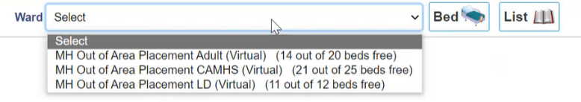
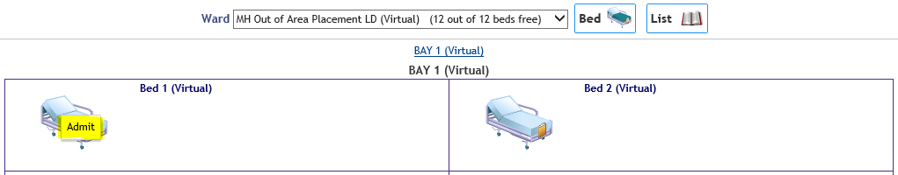
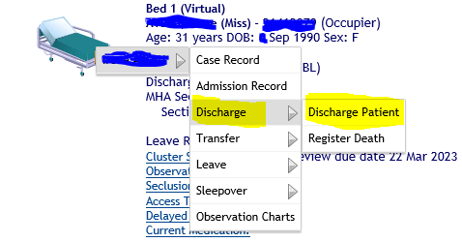
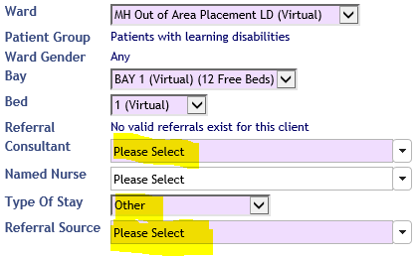
Recording Out of Area Placements in RiO
The ward on RiO has been set up with 3 virtual wards for different specialties that may need to place service users out of area. Services should ensure that they use the most appropriate ward for their respective service users:
MH Out of Area Adult
MH Out of Area CAMHS
MH Out of Area LD
To access this, go to Menu > Inpatient Management > Wards.
Choose the ward from the drop down menu and click on the bed icon. This will display the current ward view
How to Admit a Service User to a Virtual Ward
To admit a client, click on an empty bed in Bay 1 and click on “admit”. If all the beds in Bay 1 are occupied use the “overbooking bay”
Search for the client by name, date of birth and gender, or by the NHS or RiO number.
Once you have registered the relevant client the admission page will open.
2. How to Discharge a Service User from Virtual Ward
To discharge a client, click on the relevant bed. Select Discharge, then Discharge Patient.
Record the discharge date and time and select the method and destination from the drop down list (this helps us understand where the client was discharged to).
Please note, you can associate documents to Inpatient Discharge. At the bottom of the page, click on the + next to “No Document Associated”.
Services should ensure that discharge data is captured on RiO as soon as possible after the decision to discharge has been taken.
You will notice additional fields will be visible as soon as you select the consultant and referral source
Please ensure that you complete all of the necessary fields related to admission date/time and admission source/method.
Click “save” and you will return to the ward view and the bed will now be occupied.

Slide 4
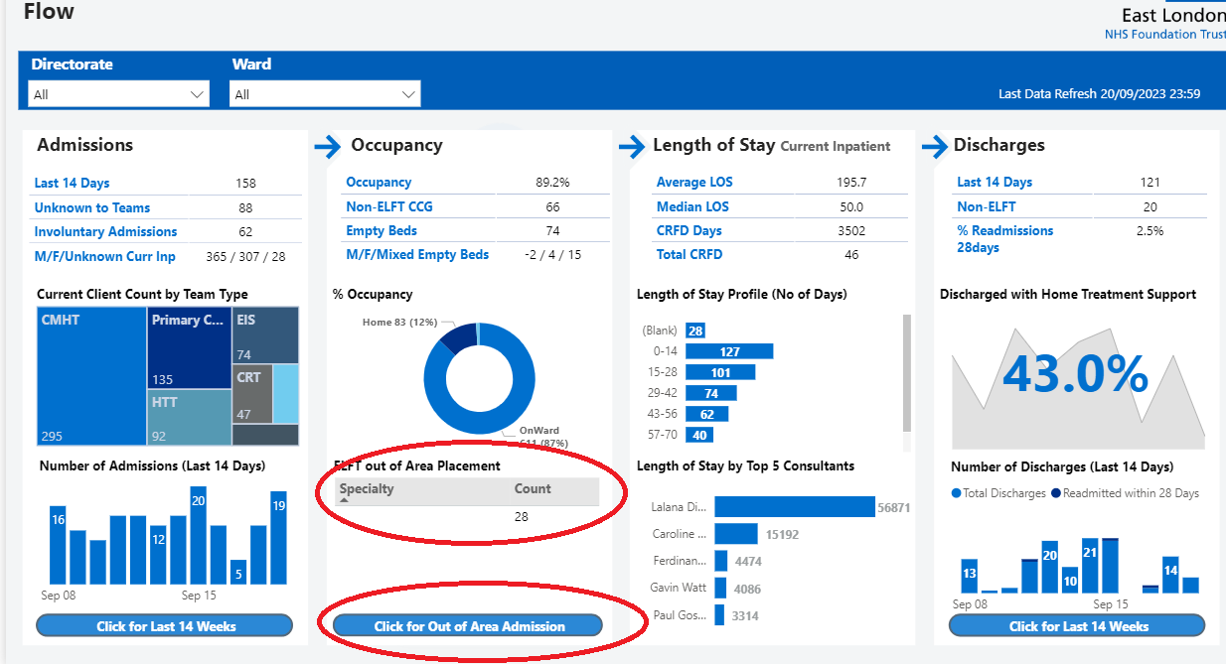
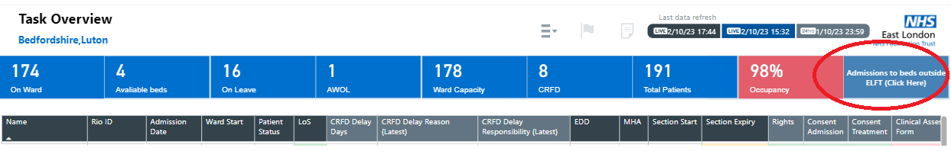
How to monitor Out of Area Admissions and Discharges
You will need access to the PowerBI Inpatient App. You can request access by logging a request through the IT Portal Application. Following are direct links to reporting services reports. Further resources can be found using the links below:
Resources for Out of Area Placements (Videos & Protocols)
PowerBI Out of Area Report
OAP data is available through “Flow Page” and “Task View”

