Slide 1
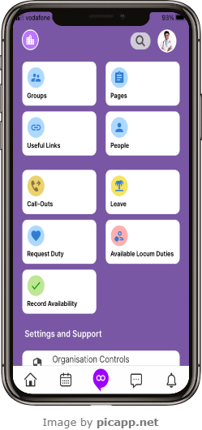
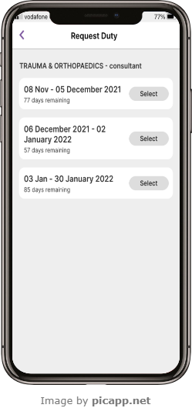
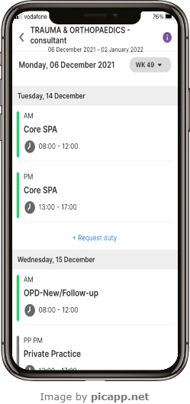
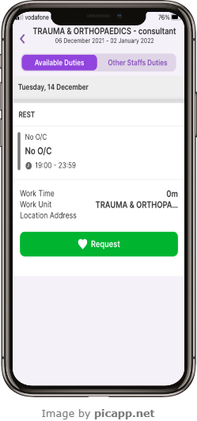
Loop – Request Duties
1
Select Request Duty from the Loop main screen
2
Select a date range.
3
Select + Request Duty blue text beneath the date of the duty you would like to request.
4
From the Available Duties list, select the duty you wish to request and then select the Request button.
ALL1.1 April 2023

Slide 2
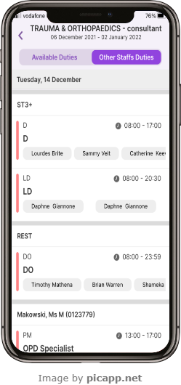
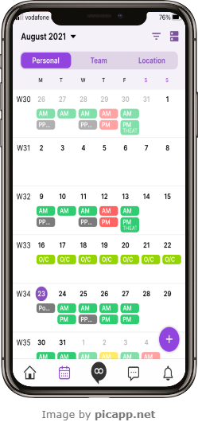
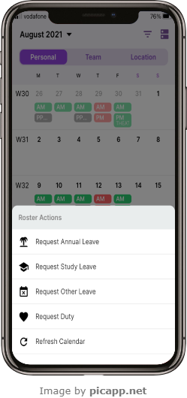
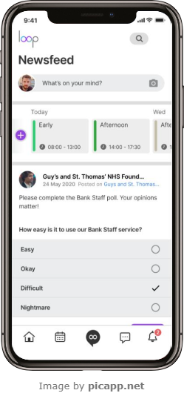
Loop – Request Duties
5
To view Other Staffs Duties, select the option at the top of the screen
6
You can also request a duty via the calendar. Select the Calendar at the bottom of the screen, then select the purple + button in the bottom right of the screen to see Roster Actions.
7
From the Roster Actions list, select Request Duty and follow Steps 2, 3 and 4 as before
8
You can also request a duty from the Newsfeed page. Select the Home button and then select the purple and white + button and follow Steps 2, 3 and 4 as before.
ALL1.1 April 2023

