Slide 1

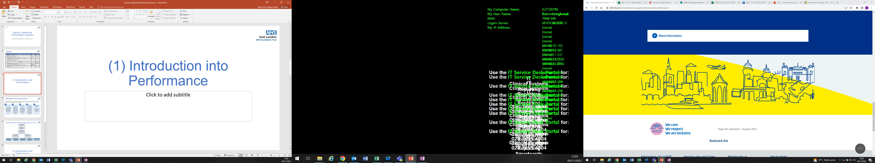
Resources for Documenting Section 117
September 2023

Slide 2
Table of Contents
1.0 | Background
1.1 | Project Trajectories
1.2 | Why this matters
2.0 | RiO
2.1 | How to access the Section 117 form
2.2 | How to complete the Section 117 form on RiO
3.0 | Process
3.1 | Recommended process flow for different Section 117 scenarios
3.2 | Section 117 Standard Operating Procedure
4.0 | Tips & Guidance

Slide 3




1.0 Background
In August 2022, a Social Care Project was launched which included a workstream to agree on common standards, improve reporting through a new documentation process and formalise roles and responsibilities to documenting Section 117 aftercare needs.
At the start of the project, it was clear that there were loose processes to recording, monitoring and reviewing Section 117. Across ELFT and Local Authority systems, there were separate processes and registers around Section 117.
Over the past 10 months, meetings have been in place with Local Authority partners across the Trust to design a revised documentation process that improves the transparency, visibility and accuracy of Section 117 arrangements.
Project Aims and Objectives
Identify digital solutions to streamline recording and monitoring processes to support Section 117 activities, including the consideration of developing a dedicated RiO form to document Section 117. This will help to remove the need for manual reporting processes by strengthening performance reports so that they are readily available to enable staff to self-validate work and plan reviews
Formalise roles and responsibilities to support delivering Section 117 standards to ensure that clear governance arrangements are in place to manage Section 117 and staff members are clear around the expectations for documenting Section 117 after care needs
Establish a standard operating procedure (SOP) around Section 117 processes, assessments and reviews across the Trust. This will help to establish a clear understanding of what Section 117 elgibility entails across the Trust by reviewing the current policy and establish a shared understanding around who is responsible for this care, what the agreed standards are and when you can discharge from Section 117
Develop and mobilise training for Section 117 and rollout across the Trust to consolidate understanding

Slide 4
1.1 Section 117 Project Trajectories
Following the development of the form, a PowerBI dashboard is in development by the Informatics department to ensure visibility and transparency of Section 117 activities at all levels of the organisation
Establishment of a Section 117 workstream with a clear terms of reference. The group agreed to meet on a monthly basis with representation from all directors including social workers, operational leads and performance colleagues
ELFT and Local Authority Summit was held in March 2023 to discuss what this proposal would look like to start designing the Section 117 minimum standards for the form
Review of current Section 117 documentation including the Dialog form and Mental Capacity Act Section 117 eligibility form
Decision obtained to develop a dedicated Section 117 RiO to document all activities and liaise with Local Authority partners to co-produce a solution
Standard operating procedure and guidance document developed to support staff with the rollout of the new form to ensure clear governance arrangements are in place
Exploration of digital solutions that could be implemented to establish a clear Trustwide standard for Section 117 reporting and documentation
Minimum standards of the form agreed by all partners. This was tested with social workers across the Trust and feedback was incorporated into the design
High-level process maps were produced in each directorate to highlight the borough-specific variations around Section 117 process and review potential digital solutions that could help streamline this process
Once the minimum standards for the Section 117 form were agreed, this was presented to the Digital Team for development in RiO
Jan 2023 | Feb 2023 | Mar 2023 | Apr 2023 | May 2023 | June 2023 | Jul 2023 | Aug 2023 | Sep 2023 | Oct 2023

Slide 5





1.2 Why this matters
Streamlining Section 117 documentation improves staff visibility of service users accessing aftercare support and allows staff to document and capture any evident changes when Section 117 is reviewed. Previously there has not been transparency and visibility of these cases
Improves the reportability of Section 117 activities through the development of a PowerBI dashboard that can be accessed across ELFT and local authorities.
Putting together a robust Section 117 plan ensures that service users have the resources and support required to stay well and understand who is going to be providing ongoing care and support. It is a bespoke support plan based on personal needs
Improves the interface between local authority partners and ELFT to coordinate care packages for service user and helps to document disputes around responsible Local Authority and ICB responsible for funding Section 117 packages of care
Section 117 plans must be reviewed at least once a year involving carers, family and people involved in the service users’ care. This ensure that support needs are regularly updated according to ongoing changes

Slide 6
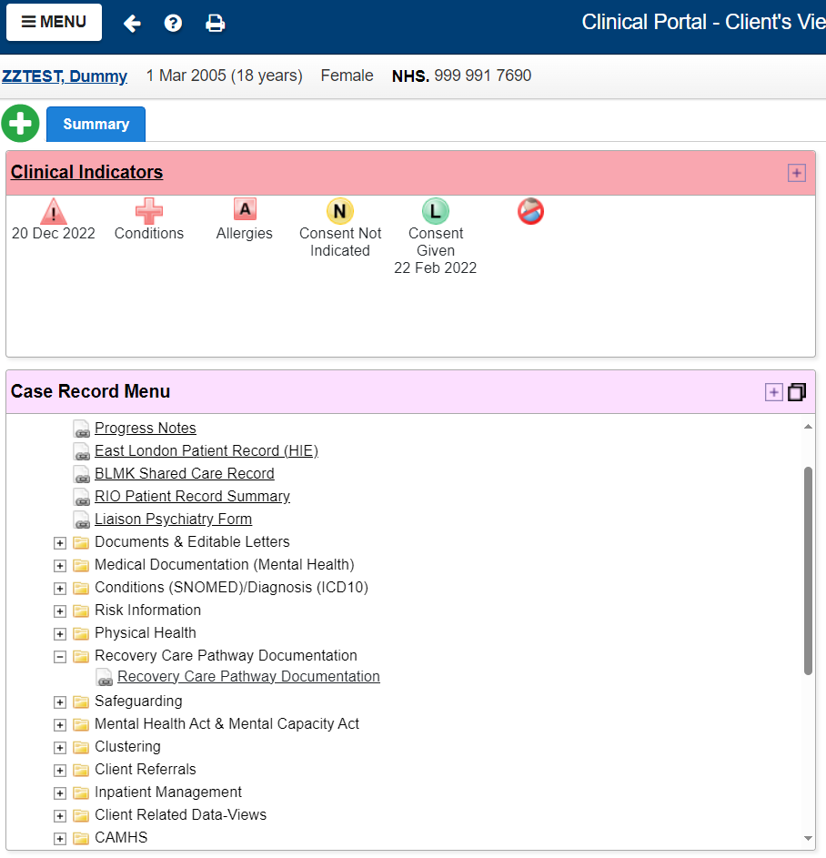
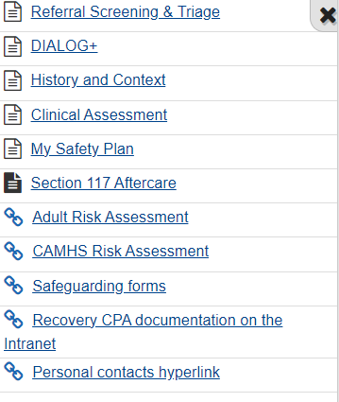
2.1 How to access the Section 117 form on RiO

Slide 7
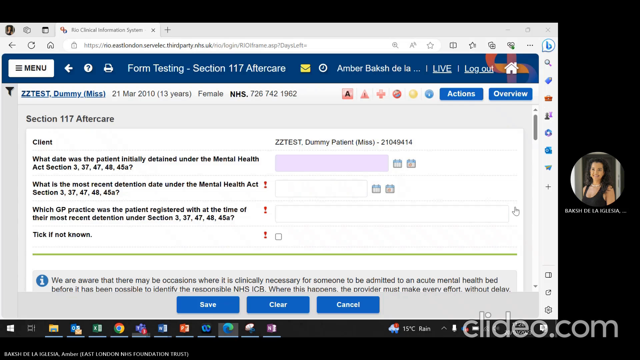
2.2 How to complete the Section 117 form on RiO

Slide 8
3.1 Recommended Process Flow
Has the patient been detained under Section 3, 37, 47, 48 or 45a by the Trust? If yes – MHA Administrator to add them on the Trust’s Section 117 register
When the patient is ready for discharge from the ward, the responsible clinicians should follow ELFT discharge planning procedures. An MDT pre-discharge Section 117 meeting should take place with the inclusion of the patient carer, clinician, care coordinator, social worker and representation from the community team. The outcome of this meeting should be recorded on the RiO care plan documentation
When the patient is discharged from section, the responsible clinician must complete the RiO Section 117 form and indicate if the patient is subject to Section 117 or not
Following discharge from the ward, the patient’s care coordinator must include a review of the Section 117 arrangements as part of any ongoing care and support plan reviews as per the ELFT policy. A minimum 12 month review requirement for Section 117 aftercare will be part of the care coordinators active caseload
Care coordinator to arrange a Section 117 review. This must be updated in the RiO Section 117 form as well as in the care plan. Relevant risk assessments must be considered in the My Safety Plan. The Section 117 review must involve the patient, carer, care coordinator, consultant and social worker
Following Section 117 review, is Section 117 aftercare still required?
Following Section 117 review, is Section 117 aftercare is no longer required?
If following the review, it is decided that the patient is still eligible to be subject to Section 117, then the patient cannot be discharged from ELFT services and will remain on the care coordinators caseload.
The RiO Section 117 form must be completed outlining this decision has been agreed by all individuals and emailed to the local MHA Administrator.
The care coordinator will document the outcome of the review on the patients’ care plan and co-produce a care plan with their patient and carers/relatives. A follow-up review should take place when necessary or within 12 months from last review
If following the review and in collaboration with the service user and their carer/relatives, the agreed outcome is that the patient should be discharged from Section 117, this should be indicated in the RiO Section 117 form and agreed by all individuals. This should then be emailed and shared with Local MHA Administrator and Local Social Care Lead.
The Care Coordinator will confirm the outcome in writing

Slide 9
3.2 Section 117 Standard Operating Procedure
​ | Who is responsible?​ | What will they be expected to complete​ | When will the documentation process take place?​ | What would service user communication look like?​
Pre- admission Assessment process​ | Mental Health Law Department is responsible for uploading section papers and recording the section on RiO. | The Mental Health Act Office will complete the Mental Health Act (MHA) form on RiO entering the qualifying section and the start of section date. | The Section 117 RiO documents need to be completed 24 hours after the initial clerking is uploaded at the MHA office or community team following the handover from an external provider | Dialog Care Plan (TBC)
Inpatient admission​ | 3 options to be locally determined to completing the Section 117 form being explored: A hybrid approach including the discharging ward nurse and community team Sole responsibility to community team Discharge coordinators | The dedicated Section 117 form will need to be completed and then it will be combined with the My Recovery Care Plan Documentation as an output. This documentation process takes place within the discharge MDT huddle | Post-discharge from the ward, or if the hybrid approach is preferred then some of the details of the Section 117 form can be documented as part of the Section 117 pre-discharge planning. | Dialog Care Plan (TBC)
Open solely to GP care (not discharged from S117)​ | For patients that are open solely to the GP, is subject to local arrangements
Cross provider transfers​ | ELFT Community Teams or dedicated team (e.g. rehab) and relevant care coordinator | Trainer of information from the referrer and ascertaining all of the details to complete S117 need to be updated on the RiO form accordingly. | Upon agreement to transfer the patient where the care coordinator and relevant community team are responsible for making transfer arrangements | Dialog Care Plan (TBC)
Process for determining ICB/LA responsibility​ | Local Authorities and ICBs | This is expected to be recorded on the dedicated Section 117 form. Under the who pays guidance, the originating ICB covering the GP practice where the patient registered is responsible for commissioning and payment. The Local Authority responsible for providing or commissioning aftercare services is the local authority in which the person is ordinarily resident | As soon as the requirements to provide Section 117 aftercare services have been established | n/a
S117 Reviews | Care Coordinator | Reviews should be documented in the Section 117 RiO form in order to assess whether the patients after needs still exist. This should be done as part of the MDT and any changes to the support plan must be formally recorded | The frequency for review is minimum of once a year when there is evidence of change. This will be driven by significant changes in clinical needs. | Dialog Care Plan (TBC)
Section 117 Discharge​ | Care Coordinator (in agreement with the relevant ICB and Local Authority) | A proposed discharge for Section 117 aftercare must be documented in the Section 117 form on RiO and documented in the patients Dialog Care Plan. This should be formally presented to the ICB and LA to formally discharge from Section 117. Local S117 policies will need to determine how this is done | Proposal to discharge from Section 117 should be done as part of the review process (minimum once a year) and reviews between the relevant processionals, individual, carer, nearest relatives and service where possible. | A letter will be sent to the patient should eligibility be rescinded. A Section 117 leaflet will be distributed around the patients' rights.
More detailed guidance can be found here:

Slide 10
4.0 Tips & Guidance
1
Explore ways in which staff responsibilities can be shared between inpatient and community teams to complete the Section 117 form. More support around this can be found in the Section 117 principles and guidance document to identify what works best locally
2
To help avoid disputes around the responsible Local Authority, it is recommended that staff document the named person and relevant contact details of who this was agreed with in the patient’s clinical documents
3
The Section 117 form will sit alongside the “My Recovery Plan” documentation. At the point of discharge, this should be provided to the service user
4
Use the data in PowerBI to view and regularly monitor performance
5
Consider creating an information leaflet that explains Section 117 and what this means for service users for additional guidance and support

