Slide 1

Coercive Control
How to Recognise, Respond, Refer, Record
Emma Mc Manus Dr Rachel Tolfree
Intervention officer Clinical Psychologist
Domestic Abuse Intervention Service City & Hackney Centre for Mental Health
dais@hackney.gov.uk
020 8356 4458 / 4459

Slide 2
Definition of Domestic Abuse
The Domestic Abuse Act 2021 states that the behaviour of a person towards another person is “domestic abuse” if the following 3 elements are met:
People concerned are each aged 16 or over
Personally connected to each other
The behaviour is abusive.
Personally connected to each other means -
- they are, or have been, in an intimate personal relationship with each other;
- they each have, or there has been a time when they each have had, a parental relationship in relation to the same child;
- they are relatives
Behaviour is abusive if it consists of any of the following—
(a) physical or sexual abuse;
(b) violent or threatening behaviour;
(c) controlling or coercive behaviour;
(d) economic abuse;
(e) psychological, emotional or other abuse;
It does not matter whether the behaviour consists of a single incident or a course of conduct.
Children have been given statutory recognition as “victims” if they see, hear or experience the effects of abuse.

Slide 3
What is coercive control?
Coercive behaviour is an act or a pattern of acts of assault, threats, humiliation and intimidation or other abuse that is used to harm, punish, or frighten their victim.
Controlling behaviour is a range of acts designed to make a person subordinate and/or dependent by isolating them from sources of support, exploiting their resources and capacities for personal gain, depriving them of the means needed for independence, resistance and escape and regulating their everyday behaviour.
Women’s aid

Slide 4
Coercive tactics
Degradation - name calling, swearing, bringing up the past, sexual abuse, anal intercourse, denied toilet and sanitary products
Sexual control - when and how to have sex, who to have sex with, not having sex, watching pornography, rape and sexual assault
Financial control - not allowed to work, where to work, check credit card spending, take money
Shaming – reveal personal information about you, forced to take intimate photos and show them to people, reveal information about sexual preferences, past behaviour, medical conditions
Surveillance - timing activities, calls, visits with friends and family, stalking, check the car mileage, using a recorder, checking clothing
Violence - physical assaults, ‘marking’
Intimidation – threats to kill, threats to family, destruction of property
Isolation – not talking, move someone to a new area, locking in the house, not seeing family and friends, removal of self (perpetrator)
Control – what to wear, how to dress, who you can see or speak to, rules at home, not eat certain foods, sleep where and when, take care of the house, not to read, watch tv, hobbies
Communication - Searching through drawers, phones, handbags, bank statements, mobile phone messages, computers

Slide 5
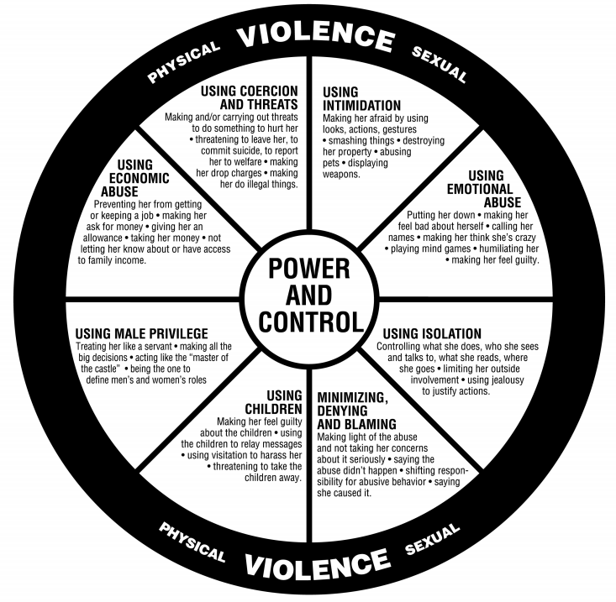
Duluth's Power and Control wheel
The power and control wheel was developed by the Domestic Abuse Intervention Project in Duluth, Minnesota in 1984 to help describe the experience of victims of violence and the tactics that abusers used.

Slide 6
Section 76 of the Serious Crime Act 2015
A person (A) commits an offence if:
(a) A repeatedly or continuously engages in behaviour towards another
person (B) that is controlling or coercive
(b) at the time of the behaviour, A and B are personally connected
(c) the behaviour has a serious effect on B, and
(d) A knows or ought to know that the behaviour will have a serious effect
on B.
Offence looks at the intent and the impact; 5 years custodial sentence, fine or both
Prosecutions for coercive behaviour, however, remain disappointingly low. In England and Wales, between April 2020 and March 2021, there were just 1,403 defendants prosecuted for controlling or coercive behaviour. There were 33,954 offences of coercive control recorded by the police in England and Wales in the year ending March 2021, suggesting only a small proportion (4%) of perpetrators are being prosecuted – Women’s aid
Must be:
in an intimate personal relationship with each other
live together
they are members of the same family, or they have previously been in an intimate personal relationship with each other.

Slide 7
3 Key things to hold in mind
Domestic abuse is widespread and largely hidden
Almost one in three women aged 16-59 will experience domestic abuse in her lifetime (Refuge)
2. Domestic abuse is gendered
Women are more likely than men to experience any domestic abuse, multiple incidents of abuse, different types of domestic abuse (intimate partner violence, stalking and in particular sexual violence
Domestic abuse exists as part of violence against women and girls; which also includes different forms of family violence such as:
Forced marriage
Female genital mutilation
Honour based abuse
3. Domestic abuse can kill
On average 2 women a week are killed by a current or former male partner (Refuge)
In Hackney since 2012 8 women and 1 man have been killed by a current or former partner

Slide 8
The 4 R’s - Recognising and Responding to Domestic Abuse
Recognise
Respond
Refer
Record
For particular consideration of colleagues who might be at risk or are being hurt, please see Responding to colleagues experiencing domestic abuse
Notes:
Emma onwards

Slide 9
Recognise
Recognise the signs
Withdrawn
Change in presentation
Depression
Anxiety
Suicidal thoughts
Always on their phone
Regularly missing appointments
Someone always accompanies them to appointments
Health issues that will not resolve
When on the phone only answering in one word answers, speaking quietly on the phone as if someone is listening.
Ask
“How are things at home?”
“What are your relationships like?”
“Do you ever feel put down at home”
“Do you ever feel hurt by someone you're close to?”
“Do you ever feel unsafe at home?”
“Do you ever feel controlled at home? Do you feel dependent on your partner/parents?”
“It's common for people who are presenting with some of your symptoms to be experiencing abuse”
If discussing or asking about DA, make sure to meet discreetly, in a safe confidential space alone with the survivor. Use interpreters if they don't speak english and not family members. Also be aware if over the phone, someone could be listening in.

Slide 10
Respond
The abuse is not your fault
We believe you
Respond
Be clear the victim is not to blame for the perpetrator’s behaviour
Don’t ask for proof of abuse
Don't push your opinions on what they should do i.e. to leave
Don’t involve the perpetrator in discussions
Make sure you know a safe way or time for the victim/survivor to discuss again either with you or the specialist professional you will be referring to
Be clear on confidentiality and sharing information
Ask if they feel safe to go home/stay home
Take advice if necessary e.g. from DAIS if needed
Call police 999 in an emergency
I am so sorry you have experienced this
Support is available for you, would you like me to make a referral?
What's being done to you is abuse and it is not okay

Slide 11
Refer, Record
Share and gather information with professionals
Refer to DAIS (Hackney)
Make a referral to DAIS via referral form and email to dais@hackney.gov.uk.
If you are unsure, contact DAIS duty line on 020 8356 4458, 020 8356 4459 or 0800 056 0905.
Refer to MARAC
Make a MARAC (multi agency risk assessment conference) referral if the abuse is high risk.
The MARAC is a fortnightly meeting attended by core agencies in the Borough to discuss all high-risk cases of domestic abuse
Agencies share information and make plans to reduce risk through targeting the perpetrator and supporting the victim
Sharing information, targeting perpetrators and reducing risk should begin right away; do not wait for the MARAC meeting
Follow your children and adult safeguarding procedures
Children: Refer to to MASH Multi Agency Safeguarding Hub.
Adults: Refer to adultprotection@hackney.gov.uk/ elft.safeguardingadults@nhs.net
Record
Keep information confidential
Keep a record of what you’ve been told and the action you have taken.
Your agency’s records could be an exhibit and should be given to the police if there are criminal proceedings
Remember children are now victims if they see, hear or experience the effects of domestic abuse
Notes:
Gathering information about the professional system
Ensure that information is captured about the professional network around any client and relevant family members
Information sharing
Establish what information can be shared routinely and make clear to the client when information will need to be shared
with or without consent if there are concerns about the safety of the client or their family members.

Slide 12
Hackney Domestic Abuse Intervention Service - what we do
Intervention to reduce risk
(advocacy, liaison with professionals)
Emotional support
(signposting to counselling services)
Risk Assessment
+
Intervention
Intervening with perpetrators
Exploring + pursuing legal and housing options & signposting to solicitors

Slide 13
Hackney Domestic Abuse Services
The Council’s Domestic Abuse Intervention Service works with anyone:
- living in Hackney
- aged 16 or over
- experiencing or perpetrating domestic abuse
- at any ‘level’ of risk
- service is for everyone: any language, ethnicity, sex, gender, immigration status and (dis)ability
Identification and Referral to Improve Safety (IRIS) is provided by Nia, commissioned by Public Health is the primary referral mechanism for GPs to access support for patients experiencing domestic abuse
Nia also offer specialist services for female domestic abuse survivors who have substance misuse issues, older women and women seeking to exit prostitution and also run the East London Rape Crisis service
There are specialist services aimed at domestic abuse victims/survivors of particular cultural and ethnic backgrounds:
- Claudia Jones Organisation - support for women and girls of African and Caribbean heritage
- SistahSpace - support for African heritage women and girls
- IMECE - support for Turkish and Kurdish women
- Jewish Women's aid
- Latin American Women’s Aid - support for Latin American women
Galop provide domestic abuse support to LGBTQ+ victims/survivors of domestic abuse
There are services that provide counselling:
- Woman’s Trust and Solace Women’s Aid
- counselling / therapeutic support can also be accessed by residents approaching their GP
*** Please see the DAIS Hackney Webpage for links to the above and more London and national agencies ***
Notes:
To look at in their own time

Slide 14
Domestic Abuse Service by Borough
*If you search your local council/borough and domestic abuse, the service for that borough should come up.
Services close to Hackney include:
Tower Hamlets (Solace women's aid)
Waltham Forest (Solace women’s aid)
Islington (Solace Womens aid)
Newham (Hestia)
Please remember to use the police liaison officer
Notes:
To look at in their own time

Slide 15
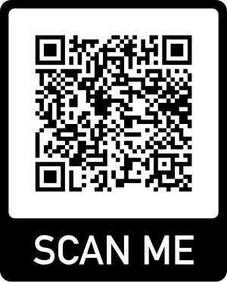
Thank you! Questions / Discussion?
To ask any questions and or for future case consultation and advice, you can contact emma.mcmanus@hackney.gov.uk and or anila.ismaili@hackney.gov.uk
If you are interested in becoming a Domestic abuse Champion for Hackney, please fill out this form here.
Further training on domestic abuse and on child safeguarding:
City and Hackney Safeguarding Chldren Partnership online platform
Further reading:
Hackney posters on domestic abuse and
public-space women safety of women and girls
Hackney Domestic Abuse Intervention Service Protocol
Hackney Intergenerational Domestic Abuse Protocol
Hackney Domestic Abuse and Adult Safeguarding Pathway
Scan to provide feedback

