Slide 1

Newham Cardiac Rehab Service
Swallay Bandhoo
16/10/2023
cLINICAL lEAD/oPERATIONAL mANAGER

Slide 2
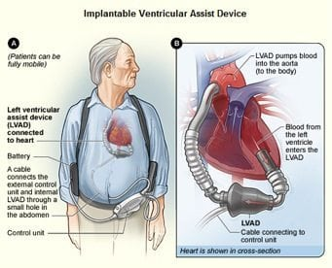
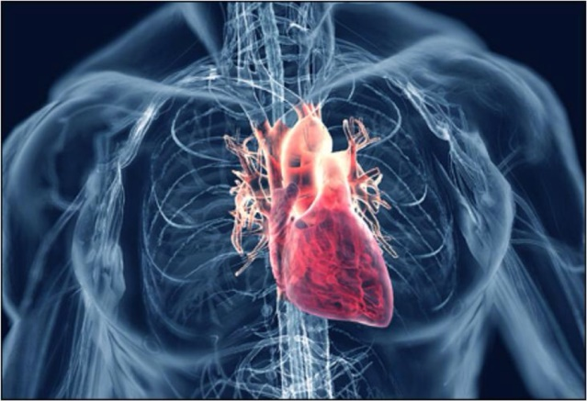
Who do we see
MI:Myocardial Infarction
Angioplasty/PCI:
CABG: Coronary Artery Bypass Graft
Valve Disease
HF/LVSD: Heart Failure
Heart transplant
LVAD: Left Ventricular Assisted Device
PPM: Permanent Pace maker
ICD: Implantable Cardioverter Defibrillator
Medical Management patients

Slide 3


What do we do
Clinics
Shrewsbury Health Centre : East Ham
Appleby clinic : Canning Town
The Centre : Manor Park
Home Visits
Cardiac Rehab Classes
Katherine Road Community Centre
Romford Road Physiotherapy services (TO BE REINSTATTED

Slide 4

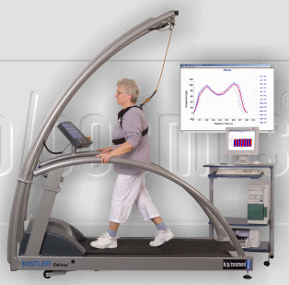


Secondary Prevention
Risk factors:
Smoking, Diet Exercise, Diabetes, FH, Cholesterol, Obesity, Alcohol
Management: Clinic, Class or HV
Medication review
Signs and symptoms assessment
Referrals
ECGs, 24HR :Holter/BP, Blood tests
Goal setting

Slide 5

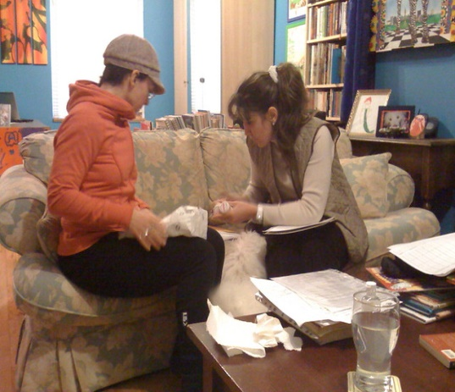
Home visit
Criteria:People on dialysis/ House bound/reduced mobility and different comorbidities
Undertaken by: Nurses/Physio/ Health Advocates
Assessment: BP, HR, Exercise, Health promotion, Meds review
Referrals: Telehealth /District Nurse/DM Nurse
GPs/Cardiologists

Slide 6
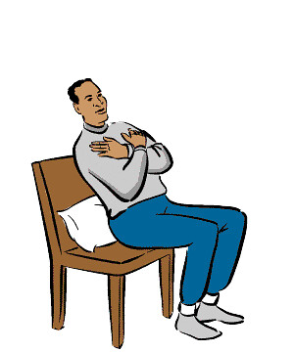

Classes
Duration: 150 mins/ 6 weeks’ programme
Led by : CR Lead & Nurses, Physio, CR Assistant, Newham Talking Therapies/Psychologist, Pharmacist & Dietician/Health Advocates
What we do : One to One review
Exercise sessions (Standing and Chair-based)
Education: Diet, Stress, Meds, Relaxation
HADs
PAMs

Slide 7
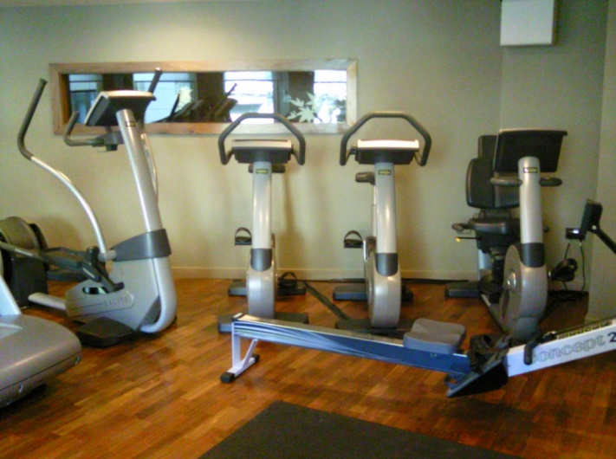

Ongoing care
GP, F/U Annual review by GP
Follow-up appointments
Tele-Health

Slide 8
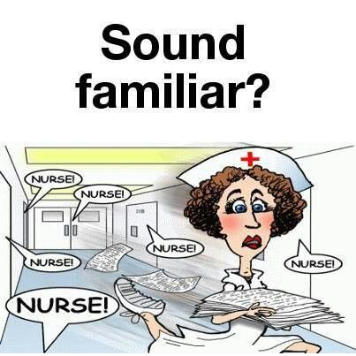
Our Students
As Team Member
Mentor/Co-mentor
Uniform/Badge/Rota
Punctuality/Confidentiality/flexible/Participation
Access information: www.bhf.org.uk/ www.nice.org.uk, www.bacpr.com, www.diabetes.org.uk , www.stroke.org.uk
BHF leaflets, magazines…
Cardiac Diseases/Tests/Treatments/Medicines….

Slide 9

Contact Details
Cardiac Rehabilitation Department Newham
The Centre
30 Church Road, Manor Park, London
E12 6AQ
02079094950
Monday to Friday : 08.30 to 16.30
Cardiacrehab.team@nhs.net

Slide 10


Good Luck
Your Feedback is very important too.
So please kindly do so at the end of your placement .
Thank You.

