Slide 1
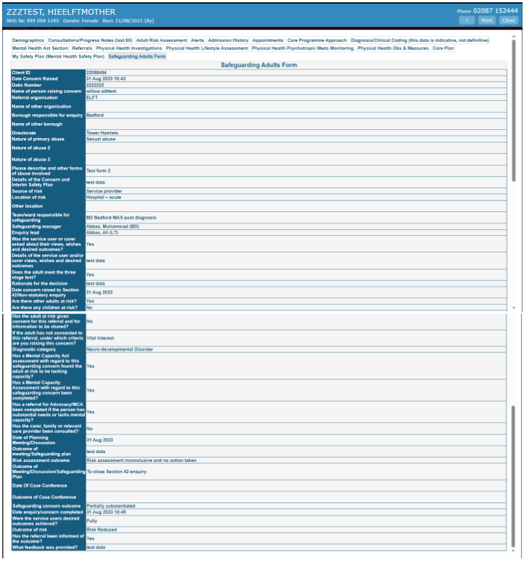
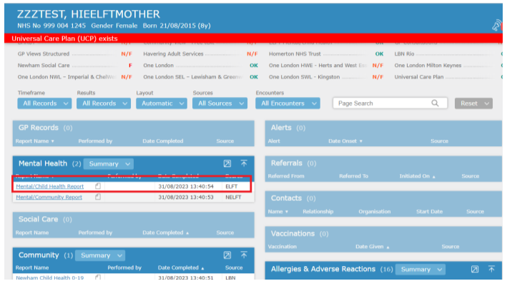
RIO Safeguarding Form live on HIE/Patient Information Exchange
Benefits of RIO Safeguarding Form: Local authorities, acute partners, primary care will now be able to view ELFT records in relation to safeguarding investigations/activities in real-time. This will improve operational oversight and delivery of care, and reduce duplication of effort for our staff
Accessing Information: All stakeholders across BLMK and East London can access Patient Information Exchange immediately. This is located in the mental health tab with the red box around it.
Once staff have clicked on the ELFT Mental/Child Health Report link they will get the below screen. They need to click on the Safeguarding Adults Form tab (highlighted in blue on the screenshot below to see the latest ELFT Safeguarding information.

