Slide 1
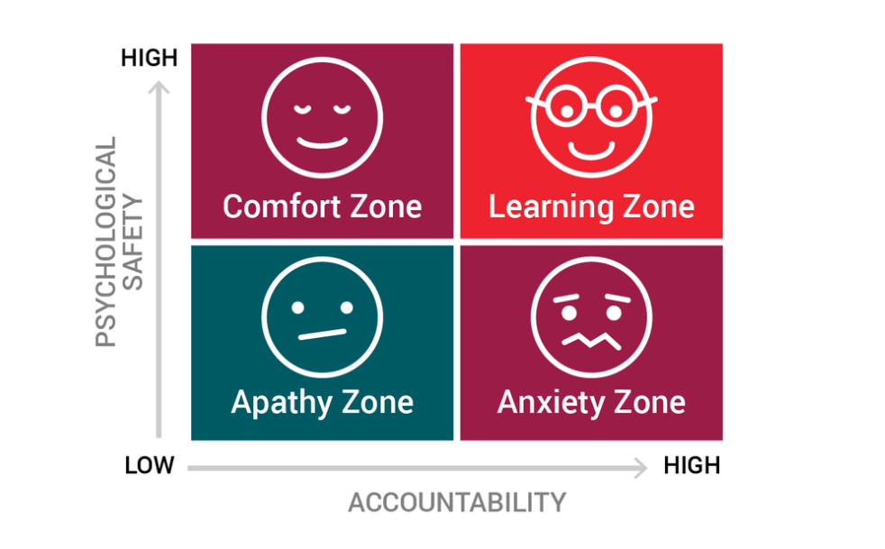
The 4 zones of Psychological Safety
Notes:
20 mins group discussion. Feedback from each group

Slide 2
The 4 zones of Psychological Safety
Learning zone: In a learning zone, team members experience high accountability and high psychological safety. This is the ideal learning environment for innovation and growth, because even though members are responsible for their actions, their team offers continuous support.
Comfort zone: Team members have high psychological safety and low accountability. While this zone is more relaxed, almost like a vacation, there is no push for creativity and growth.
Apathy zone: With low psychological safety and low accountability, team members fall into the apathy zone. There are no repercussions for mistakes, teams lack adequate communication and support, and individuals struggle to care about their work.
Anxiety zone: Team members experience low psychological safety and high accountability. Communication breaks down and when mistakes are made, people are often too scared of punishment or humiliation to take responsibility. Opportunities for learning and innovation are scarce.

