Slide 1
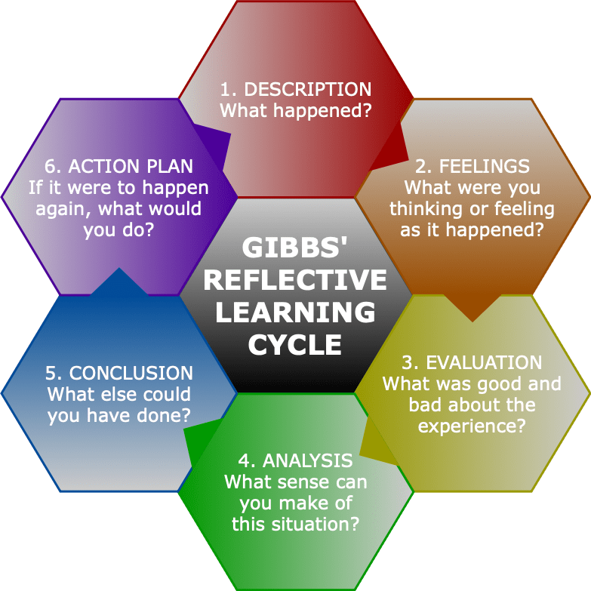
Action Learning Set
This Photo by Unknown Author is licensed under CC BY-SA-NC

Slide 2
The ACT Triflex
Be Present
Contact with the present moment
Self-as-context
Psychological Flexibility
Defusion
Committed action
Open Up
Do What Matters
Acceptance
Values
Notes:
Acceptance and Commitment Therapy
Simple acronym that encapsulates this modeL
A – accept your thoughts and feelings, and be present
C – choose a valued direction
T – take action

Slide 3
Four stages of learning
PAINFUL AWARENESS
Conscious Incompetence
KNOW HOW
Conscious Competence
SECOND NATURE
Unconscious Competence
BLISSFUL IGNORANCE
Unconscious Incompetence

Slide 4
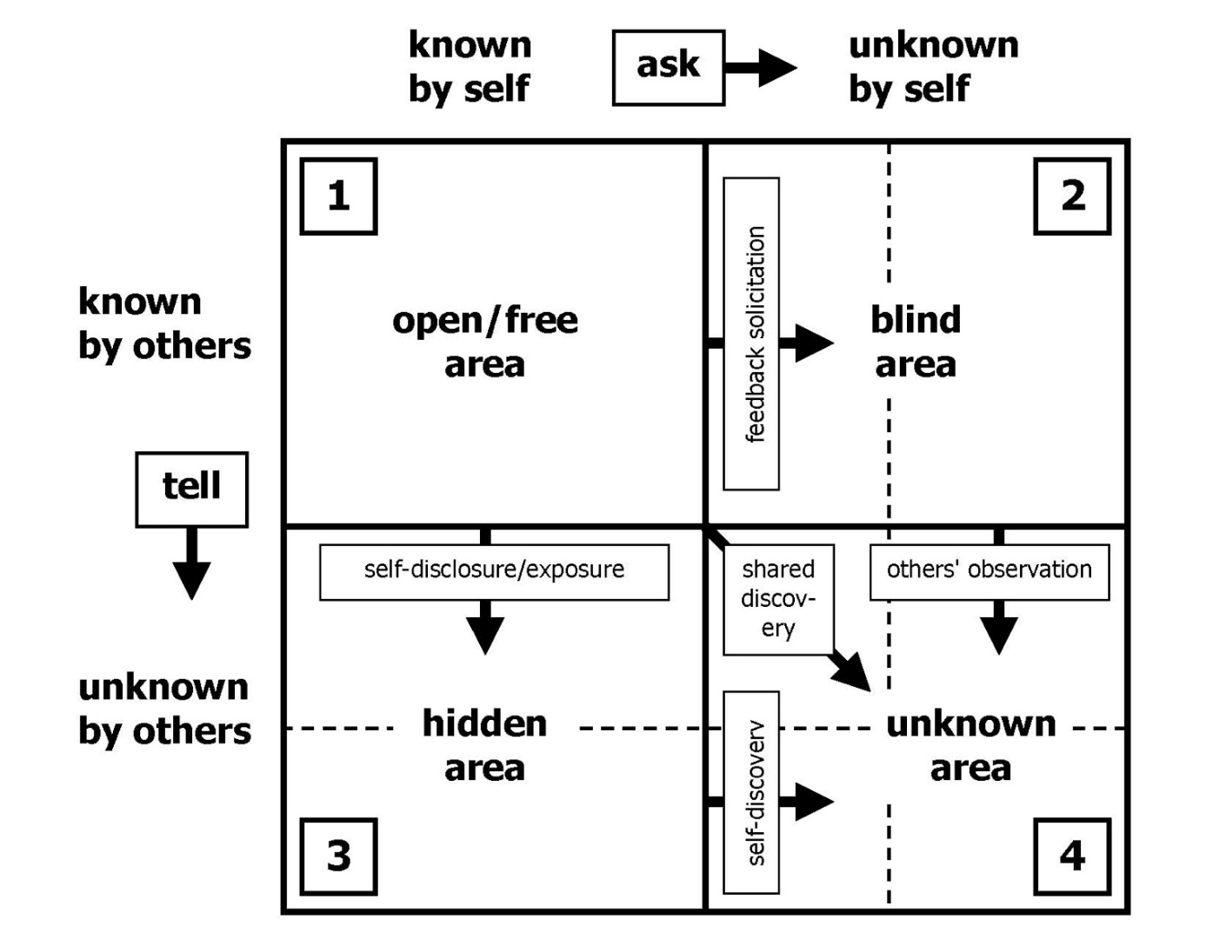
Johari Window

Slide 5
Levels of Personal Development
4
Wants to develop further to impact issue
3
Sees self as part of issue and solution
Level of awareness of self & others
2
Sees problem from own & others’ perspective
1
Sees problem from own perspective
Level of appropriate sense of personal responsibility in problem solving

Slide 6
Set Working Aims
Smaller space to work deeper to explore your leadership and what matters to you
Space to assimilate and process new information (programme, speakers, experience)
Compassionate support and challenge

Slide 7
Helpful Pointers
Contracting – confidentiality
Support : challenge
Resource : time
Open questioning, never telling

Slide 8
Coaching Question Examples
Who owns this issue/problem?
What have you already tried?
In an ideal world, what would be happening around this issue?
In an ideal world, how would you know it had been resolved?
What’s standing in the way of the ideal outcome?
What’s going right here? Even a little bit …
Imagine that you’re at your most resourceful, what do you say to yourself about this issue?
What are the options for action here?
What critieria will you use to judge the options?
What option seems the best one against your criteria?
So what’s the first/next step?
When will you take it?

Slide 9
ALS Process
Time | Activity
8 minutes | Coachee sets out problem without interruption
2 minutes | Coach(s) summarise without evaluation
2 minutes | Coach(s) describe their initial emotion/feeling response without conversation
5 minutes | Coach(s) ask clarifying questions to check basic facts
15 minutes | Coach(s) ask open questions to deepen client’s understanding of what’s going on
5 minutes | Coachee turns back. Coach(s) speak about their understanding of what’s going on. Coachee journals whilst listening.
5 minutes | Coachee summarises both their understanding and ACTIONS
5 minutes | Group reviews, led by observers, without going back into content.
Notes:
8 The client sets out the problem without interruptions. When they have finished one of the consultants summarises what they have heard without evaluation.
2 The consultants describe their initial emotional/feeling response to the client’s situation - without entering into conversation.
5 The consultants ask clarifying questions to check the basic facts of the situation have been understood.
15 The consultants ask open questions (see appendix 1) that deepen the client’s description of what is going on.
5 The consultants develop their explanations of what is going on and ideas about behaving differently. The client moves their chair away from the consultants and listens trying to notice how they are responding in terms of their thoughts and feelings. (The client might want to use their journal)
5 The client summarises how they are thinking and feeling about their issue. And, if possible, say something about how they might now behave.
5 The groups shifts into review mode, led by the observers. It is important not to go back into the content of the consultation.

