Slide 1
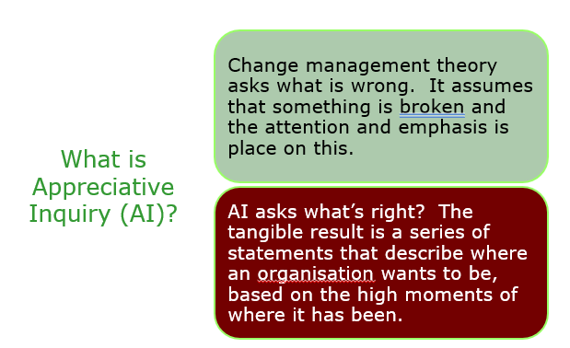
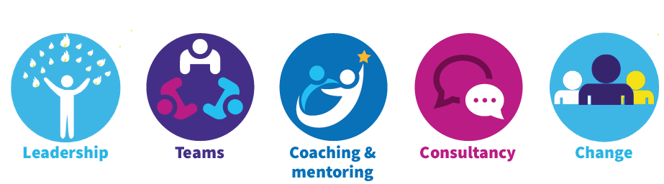
Appreciative Inquiry

Slide 2
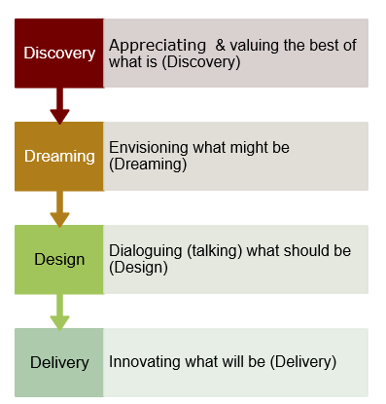
4 Stages of Appreciative Inquiry

Slide 3
Stage 1 - Discovery
  Think about all the teams you have been in. In pairs:
  tell the story of the team that you would say is characterised by an environment of TRUST
  How was trust established?
  How did you know trust was present?
  What were the benefits of trust to:
    team members
    service users/patients
  Take brief notes so that you can retell your partner’s story
Notes:
All teamwork requires trust among team members – trust that you can depend on one another, that all members will pitch in and do their share of the work, that resources will be fairly distributed, and that everyone will be included and kept informed through open, honest communication. In successful teams, an environment of trust is consciously established and maintained. It becomes a felt presence, an accepted norm and a foundation for all that the team does.

Slide 4
Stage 2 – Dreaming
Retell your partner’s story to a wider group (3 mins)
One nominated person to create sticky notes on the wall with the key content
Once completed each group member will use the stickers provided to put a (up to 3) stickers against the sticky notes that resonate the most with them.

Slide 5
Stage 3 – Design
Discuss what the final themes mean to you as a group.
Taking the key themes, create a list of statements that represent how the team would be if an environment of trust was fully visible and evident
Eg., Our team will/wont …
Be prepared to present and explain to everyone.

