Slide 1




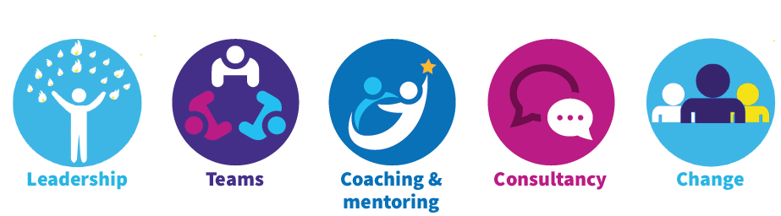
What is our shared Vision?
In small groups discuss and reflect on what the purpose/vision/mission of CIMHS is
Why do we do what we do?
What is our vision?
How do we add value?
What are our aspirations?
Capture your thoughts on the flip chart paper

Slide 2

Narrowing it down
Following on from the previous discussions try to highlight / capture relevant words or phrase.
Write the words/phrases on post it notes and come and stick them on the flip chart

Slide 3
Our Mission Statement
In pairs, Look at all the different words on the wall try to come up with a Mission Statement for the team.
“A mission statement is a short statement of why an organisation or team exists, and describes it’s overall goals, objectives and values.”
Share with the wider group

Slide 4

How can we achieve our Shared Vision?
We’ve just done the “what” now it’s time to think about the “how”. In your groups discuss how you might achieve the shared vision. Think about:
What actions do we need to take? Are there any quick wins?
What behaviours do we need to see? How can we model these?
What support do we need?

