Slide 1
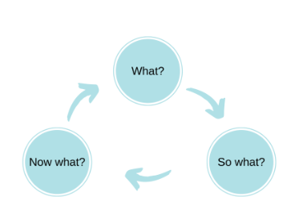
Driscoll’s What Reflection Model
Driscoll based his model of the 3 What's on the key questions asked by Terry Borton in the 1970s:
  What? Firstly we should describe what the situation or experience was to set it in context. This gives us a clear idea of what we are dealing with.
  So what? We should then reflect on the experience by asking 'so what?' - what did we learn as a result of the experience?
  Now what? The final stage asks us to think about the action we will take as a result of this reflection. Will we change a behavior, try something new or carry on as we are?
It is important to remember that there may be no changes as the result of reflection and that we feel that we are doing everything as we should. This is equally valid as an outcome and you should not worry if you can't think of something to change.
Notes:
Another simple model was developed by Driscoll in the mid-1990s. Driscoll based his model of the 3 What's on the key questions asked by Terry Borton in the 1970s:
What?
So what?
Now what?
By asking ourselves these three simple questions we can begin to analyse and learn from our experiences. Firstly we should describe what the situation or experience was to set it in context. This gives us a clear idea of what we are dealing with. We should then reflect on the experience by asking 'so what?' - what did we learn as a result of the experience? The final stage asks us to think about the action we will take as a result of this reflection. Will we change a behavior, try something new or carry on as we are? It is important to remember that there may be no changes as the result of reflection and that we feel that we are doing everything as we should. This is equally valid as an outcome and you should not worry if you can't think of something to change.

