Slide 1
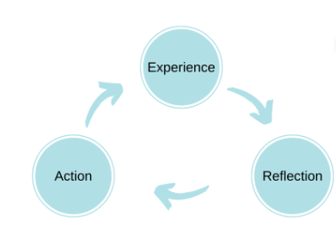
ERA Reflection Model (Jasper, 2013)
One of the simplest methods of reflection
We start with an experience (positive or negative).
We reflect on this (think through the experience, examine our feelings and decide on next steps)
Action – what we do as a result of the experience depends on us all as individual.
This action will result in another experience and the cycle will continue
Notes:
The ERA cycle (Jasper, 2013) is one of the most simple models of reflection and contains only three stages:
Experience
Reflection
Action
The cycle shows that we will start with an experience, either something we have been through before or something completely new to us. This experience can be positive or negative and may be related to our work or something else. Once something has been experienced we will start to reflect on what happened. This will allow us to think through the experience, examine our feelings about what happened and decide on the next steps. This leads to the final element of the cycle - taking an action. What we do as a result of an experience will be different depending on the individual. This action will result in another experience and the cycle will continue.
Jasper, M. (2013). Beginning Reflective Practice. Andover: Cengage Learning.

