Slide 1

Group Dynamics Workshop
To understand groups a bit better
To understand ourselves a bit better
To think about behaviour in groups:
  By thinking about my place in a group
  Understanding concepts of perception, preference and inference
  Providing some models about how groups work

Slide 2

What is Group Dynamics?
A group can be defined as several individuals who come together to accomplish a particular task or goal.
Group dynamics refers to the attitudinal and behavioural characteristics of a group.
Group dynamics concern how groups form, their structure and process, and how they function.

Slide 3
What is Group Dynamics?
Group dynamics is a more complex process than just summing up the individual characteristics of each group member.
It is best understood by combining the characteristics of each group member, how each group member's actions affect the group, and how these group interactions affect each group member.
This creates a circular feedback loop which simultaneously impacts all group members and all group members' relationships.

Slide 4
What do positive team dynamics look like?
Some signs that your team is showing positive team dynamics include:
Respectful debates, even when people heavily disagree.
Meetings feel productive, team members leave feeling invigorated and have a list of clear goals and takeaways.
Team members show awareness of how their behaviours impact others.
Team members understand that each role is an important cog in the project machine.

Slide 5
What can adverse group dynamics look like?
Conversely, poor or negative team dynamics can derail a project before it ever gets off the ground.
Some warning signs of poor team dynamics include:
Poor communication, especially during disagreements.
Team members walk out of meetings unsure of what was accomplished.
Lack of accountability for personal performance and how that affects the team.
Lack of respect toward other roles and the value they bring to the team.

Slide 6

Warm up Exercise
Creativity
Team work
Collaboration
Communication
Notes:
Ask the whole group to line up on one line (stick the long line of white solid tape on the floor).
Then ask them to line up in the order of their birth dates (date and month).
The group are not allowed to talk or move from the line.
Give 30 seconds for them to line up.
Discuss how well that went and what lessons can be learned in terms of:
Team work
Collaboration
Creativity
Communication

Slide 7
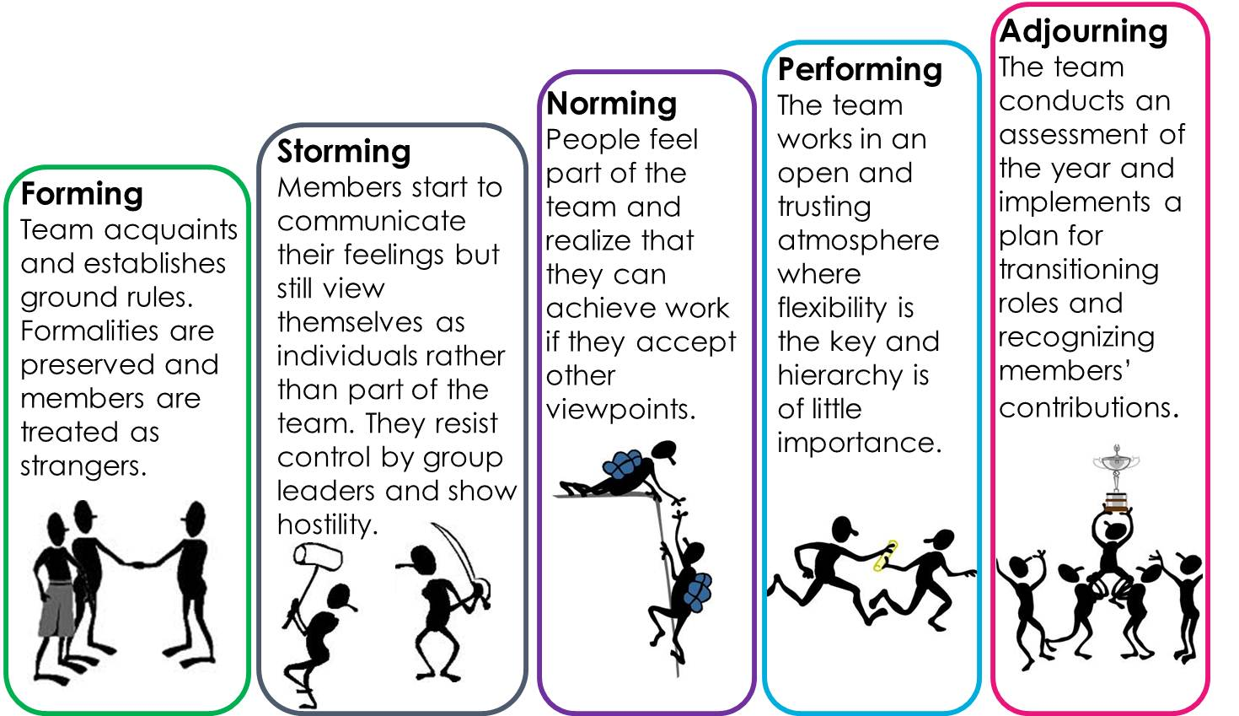
Tuckman’s Stages of Group Development
Notes:
Explain the slide – ask the group to reflect on their own experiences of groups and feedback any experiences that reflect these stages of development.

Slide 8

Discussion
What stage are we at as a team?
Why?

Slide 9
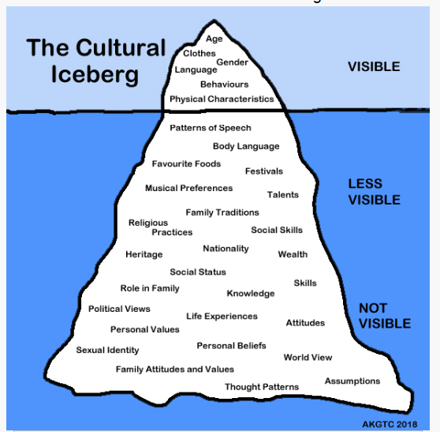
ICEBERG
Notes:
Iceberg metaphor helpful for understanding groups – whilst what we see above the surface there is a lot going on under the surface with groups and group dynamics.
What do we see ?
Age, clothes, our gender, language, physical characteristics
What is less visible?
List some of the above i.e. social skills, nationaility, heritage, wealth, patterns of speech.
What is invisible to us?
World view, family attitudes, personal values, personal beliefs, our world view etc.
An iceberg is the perfect relation with culture. You cannot see everything just with a look. It is important to analyse the whole background.

Slide 10
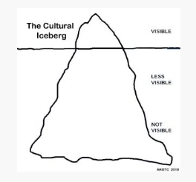
Your Individual Iceberg
Notes:
Ask each person to draw the above diagram on a blank piece of paper.
Ask them to draw a picture of their physical appearance above the water line on the culture diagram.
Below the water line, ask each person to write words or draw pictures to show some of the hidden elements of their lives as described in the previous slide.
Then ask them to circle 5 items on their own Cultural Iceberg below the water line which they would be comfortable with the team knowing about them.
In pairs, share their diagrams. Ask them to try to discover 5 things they didn’t know about the other person before, or 5 things they found interesting to learn and discover.

Slide 11
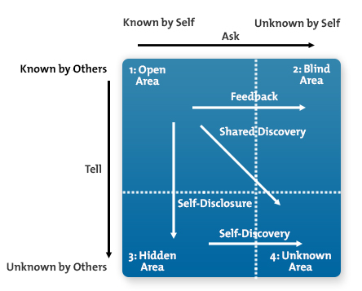
Trust - The Johari Window
Notes:
The Johari window was created by two American psychologists, Joseph Luft (1916–2014) and Harrington Ingham (1914–1995) in 1955 and is a technique used to help people better understand their relationship with themselves as well as others.
1. Open/self-area or arena – Here the information about the persons attitudes, behaviour, emotions, feelings, skills and views will be known by the person as well as by others. This is mainly the area where all the communications occur and the larger the arena becomes the more effectual and dynamic the relationship will be. ‘Feedback solicitation’ is a process which occurs by understanding and listening to the feedback from another person. Through this way the open area can be increased horizontally decreasing the blind spot. The size of the arena can also be increased downwards and thus by reducing the hidden and unknown areas through revealing one’s feelings to other person.
2. Blind self or blind spot – Information about yourselves that others know in a group but you will be unaware of it. Others may interpret yourselves differently than you expect. The blind spot is reduced for an efficient communication through seeking feedback from others.
3. Hidden area or façade – Information that is known to you but will be kept unknown from others. This can be any personal information which you feel reluctant to reveal. This includes feelings, past experiences, fears, secrets etc. we keep some of our feelings and information as private as it affects the relationships and thus the hidden area must be reduced by moving the information to the open areas.
4. Unknown area – The Information which are unaware to yourselves as well as others. This includes the information, feelings, capabilities, talents etc. This can be due to traumatic past experiences or events which can be unknown for a lifetime. The person will be unaware till he discovers his hidden qualities and capabilities or through observation of others. Open communication is also an effective way to decrease the unknown area and thus to communicate effectively.
“There are known knowns. These are things we know that we know. There are known unknowns. That is to say, there are things that we know we don't know. But there are also unknown unknowns. There are things we don't know we don't know”. Donald Rumsfeld
Building trust:
Lead by example
Communicate openly
Know each other personally
Don’t place blame
Discourage cliques
Discuss trust issues
Be honest, useful, curious
Etc. – discuss what other actions/processes can lead to building trust in groups

Slide 12
Your Individual Iceberg
Anyone brave enough to share?
Reflect on what you have learned about yourselves and other people.
How did it feel to have others show some form of appreciation for your unique qualities, and your personal culture?
Notes:
Spend time reflecting on the above as a wider group

Slide 13

Inclusion, Affection and Control
Notes:
On an A4 piece of paper write down inclusion and place it in the middle of the room, ask the group to form a circle around the room around.
Ask the group to think about themselves as a cohort of nurses that have been learning together for a while now. Explain that you will read some statements and while you are reading the statements you would like them to move closer to or farther away from the ‘centre’ depending on how true the statement is in regards to them. So if they really agree they should move as close as possible, if they do not agree they should step back. Read through a few questions and let them show their position in the ‘system’.
Everyone’s ideas are heard and included – step towards the centre if you agree, away if you don’t
I feel included in this group – again step towards or away
Everyone talks to each other in this group – again step towards or away
My successes are noticed and celebrated in this group – again step towards or away
I feel supported by others in this group
Once the shape has revealed itself – facilitate a conversation around were you surprised by this shape? Let them talk to each other a bit. Where are the similarities and differences? What is it like to work with each other (in same group) and those furthest away.
As a next step you could ask them to form groups of no more than 3 and write down what they think would be the most important issue to improve. Then chose one or two that they want to work on as a group.

