Slide 1
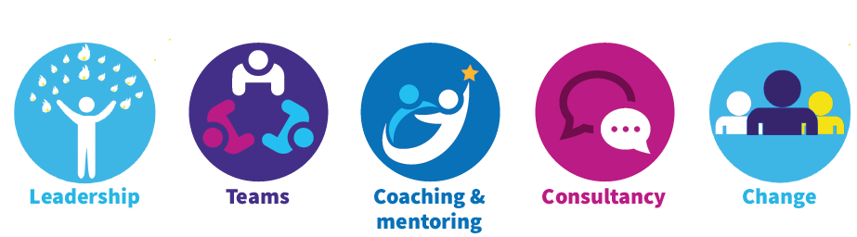
Reflection using ‘Metaphorical Mirrors’
REFLECTION – buffers against the negative aspect of working lives
RESILIENCE – being able to adapt in face of (severe) difficulty (Masten & Powell, 2003)
REBUILDING RESILIENCE
Competence (feeling successful)
Belonging (feeling valued)
Usefulness (feeling needed)
Potency (feeling empowered)
Optimism (feeling encouraged & hopeful)
SUPPORT
CRITICAL THINKING
CRITICAL THINKING
COLLABORATION
by Bassot, Barbara (2016). The Reflective Journal. 2nd Edition
(p.6). London: Palgrave
Notes:
Introduce the link between reflection and resilience. Saying that building resilience is about the flower model underpinned by support, critical thinking and collaboration.
Invite them to think about this session as opportunity for reflection as a collaborative team exercise.
Theory behind link between reflection and resilience:
Reflection has a role to buffer against negative sides of change and resilience, particularly when burdened by work related stress, our resilience is reduced, and we feel that we struggle to cope.
Resilience is defined as being able to adapt in the face of, often severe, difficulty (see Masten and Powell, 2003). It is a dynamic developmental process and is studied by looking at how competence develops in the face of adversity. When people’s adaptive abilities are in good working order, they can withstand hardship, but when they are stressed or overloaded this becomes more difficult.

Slide 2

Our Rear-View Mirror
The rear-view mirror is a vital tool that people use every time they get into the driver’s seat. By using it we can see what is behind us and assess whether it is safe to move ahead.
What are you looking back at? How does this make you feel?

Slide 3

Our Wing Mirrors
Wing mirrors also help us see behind us when we are driving. Most wing mirrors are convex, which helps us to see what is just over our should or in a blind spot.
What is in the blind spot?

Slide 4

Our Shop Window
Not a true mirror but we can see our reflection as we walk past.
What are the reflections that others might see in us?

Slide 5
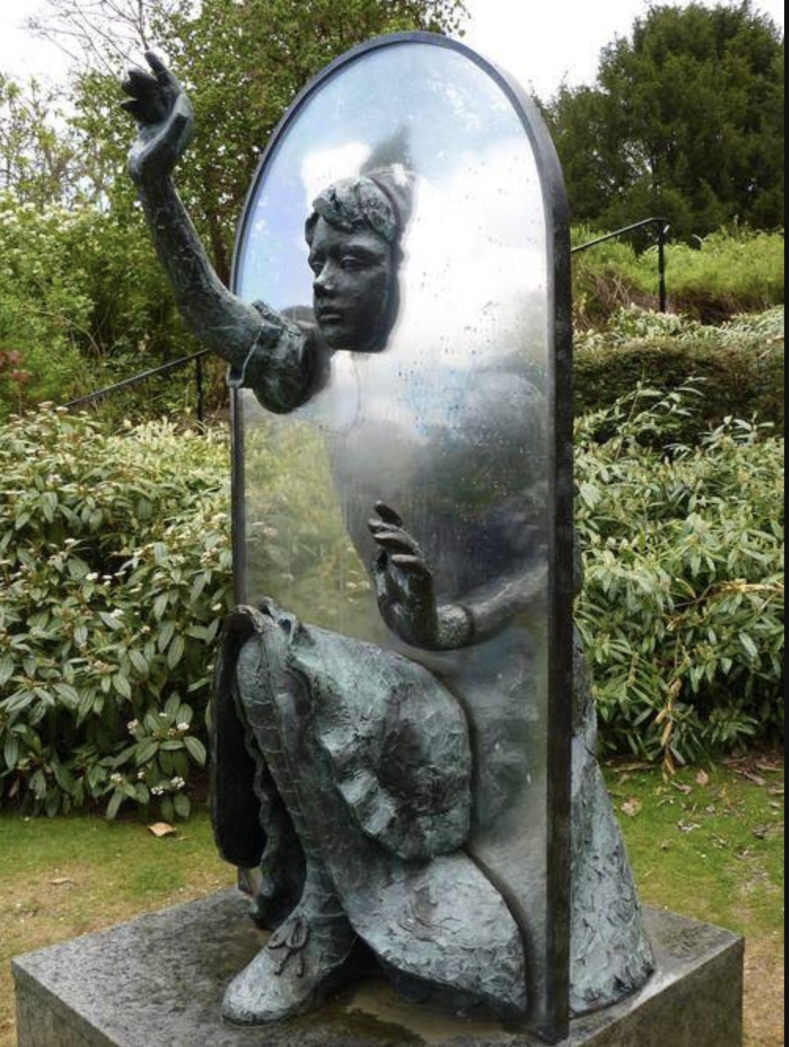
Looking Glass
Not a true mirror but stories, myths and legends use the looking glass to see into the future.
What are you looking forward to in the future?

Slide 6

Metaphorical Mirrors Activity
Get into 4 groups…
Each group, please visit a different mirror flipchart
Spend approx. 10 mins at each mirror and write your reflections on stickies
The instructions for the mirrors are metaphors – you need to think about you as part of this wider team when answering
Rotate until each group has visited all 4 flipchart mirrors

Slide 7

Metaphorical Mirrors Activity Cont’d
Once each group has contributed to all 4 flipchart mirrors…
Please go back to your original flipchart (where you started)
Reflect on what you now see on the fully completed flip chart
Any reflections?
What do you notice?
What does this mean for us?
This Photo by Unknown Author is licensed under CC BY-SA-NC

Slide 8
How can reflection help to maintain or to rebuild resilience?
Resilience has been shown to be made up of five areas:
Competency (feeling successful)
Belonging (feeling valued)
Usefulness (feeling needed)
Potency (feeling empowered)
Optimism (feeling encouraged and hopeful)
In healthcare it is easy to feel that our successes are rare, there is little or no value to what we do and that we have little or no power and these feelings can result in feeling discouraged and hopeless.

Slide 9
How can reflection help to maintain or to rebuild resilience?
However, using reflection can address three of the elements required for resilience:
Support – essential for resilience development. We all need to feel that we are not alone, are valued & appreciated
Critical thinking - can help to clarify the way through unclear and complex situations
Collaboration - Working in teams and with other people helps to mitigate against some of the feelings of hopelessness
Notes:
Support is an essential component of resilience development. We all need to feel that we are not alone, that we are valued, and our work appreciated. Taking time to talk to a peer or a friend can help to clarify feelings of worthlessness and impotence. The support mechanism of another person listening and asking how you felt, what you would have liked to have done and what your underlying values were, can mean that we feel supported a little more.
Being able to think critically as the participants in West’s (2001) research, can help to clarify the way through unclear and complex situations. “David” found it difficult to separate work issues and personal life issues but found that being asked some thought-provoking questions enabled that level of criticality to move the mists of confusion and to see things more clearly. Use some of the questions in this module to provide a starting point.
Resilient professionals are very often highly collaborative. Working in teams and with other people helps to mitigate against some of the feelings of hopelessness. Using reflective practices to identify ways to collaborate further and how to maximise those collective endeavours, can lead to a higher sense of value and contribution.

