Slide 1
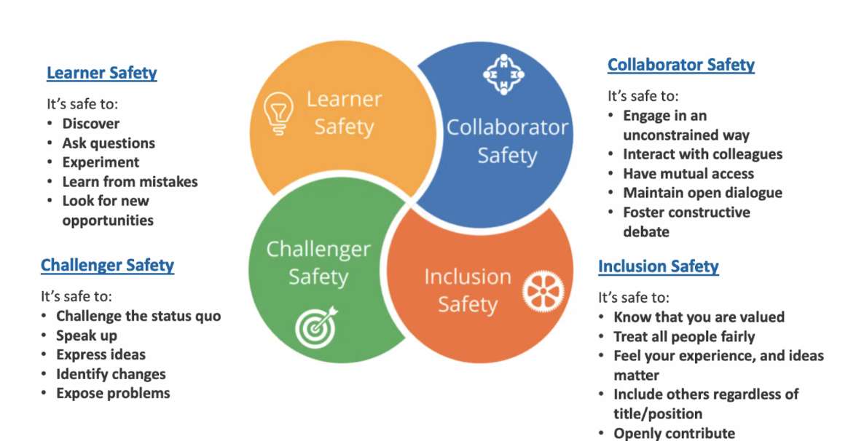
4 Quadrants of Psychological Safety
Notes:
Psychological safety is a shared belief that the team is safe for interpersonal risk-taking. In psychologically safe groups, team members feel accepted and respected — safety increases when the four quadrants above thrive.

Slide 2
4 Quadrants of Psychological Safety – Strengths/Gaps
In small groups, think about our current team. Please discuss the following and make some notes on the following questions:
Where are our strengths in these 4 quadrants?
Where are our gaps/areas of concern in these 4 quadrants?
What causes these gaps/concerns? What are our obstacles/gets in the way?
Notes:
20 mins group discussion. Feedback from each group

Slide 3
4 Quadrants of Psychological Safety Action Planning
In small groups, let’s work on creating a psychological safety action plan to address the gaps identified in the previous exercise.
To create this plan, For each quadrant, consider two actions that will be impactful. One of these actions is to start a new behaviour, and the other activity is to stop a behaviour.
Learner Safety (Stop & Start)
Collaborator Safety (Stop & Start)
Challenger Safety (Stop & Start)
Inclusion Safety (Stop & Start)
Notes:
20 mins discussion and then each group to feedback. Identify which actions will be implemented

