Slide 1

Psychological Safety
a belief that one will not be punished or humiliated for speaking up with ideas, questions, concerns or mistakes and that the team is safe for inter-personal risk-taking
    Absence of psychological safety looks like:
      Not asking questions
      Not admitting weaknesses or asking for help
      Not offering ideas
      Not critiquing the status quo
    Resulting in:
      Missed opportunities to learn
      Lack of innovation
      Managing impressions taking priority over creating a better organisation
Notes:
If you change the nature and quality of the conversations in your team, your outcomes will improve exponentially.
Psychological safety is the core component to unlock this
Defined by Amy Edmondson - a researcher and scholar of leadership, teaming and organisational learning and professor of learning at Harvard Business School
Fear of looking – ignorant, incompetent, intrusive, or negative ---- 'impression management'
An increase in psychological safety at work can create a more positive, creative and collaborative environment

Slide 2
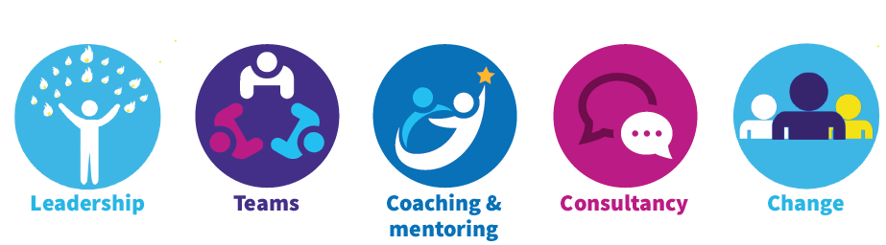
Psychological Safety
An increase in psychological safety at work can create a more positive and creative environment
There are a set of specific questions to help teams measure how psychologically safe they feel within their team
These questions were developed by organizational behavioural scientist Amy Edmondson,
Psychological safety refers to “a shared belief held by members of a team that the team is safe for interpersonal risk taking.”

Slide 3

Creating Psychological Safety
Make a logical case for speaking up, frame why candour is important, align with service goals, purpose and vision. In the face of uncertainty, when leading change in a complex system, frame the work as an opportunity to grow and learn.
Invite participation and build collaboration. This is where authenticity and humility come in: 'I don't have all the answers, we need your voices and ideas to innovate and achieve our goals'.
Model curiosity. Ask questions, with the intention to learn. This creates a necessity for voice.

