Slide 1
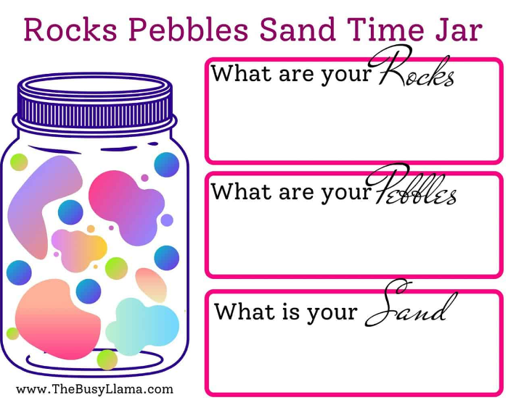
Time Management Model
What are your Rocks?
Super important things you prioritize over everything else and always get done. This may be time with your significant other, your day job, a child’s activities.
What are your Pebbles?
These are slightly smaller things you need to do each day, and these are still important activities but take up less of your time. Pebbles tend to fit in around your rocks, and they aren’t necessarily less important but take up less time. Ensure you haven’t over-allocated your jar. The jar can only hold so much, and if you have 1,000 pebbles that never make it into the pot, you are only hurting yourself.
What is your sand?
By now, your jar is almost full (little spaces between the rocks and pebbles, and those spaces get filled in with sand). The daily tasks take us just a few moments but need to get done. Are you constantly running from Rock to Pebble to Rock that you don’t have time for your sand activities? These aren’t any less important than the Pebbles or Rocks, and they are just smaller in scope. They might be reading to your kids, making dinner, or other things. Make time for those small moments. They become the most important.
Notes:
The Rocks Pebbles Sand method can be used as an analogy for time management. In this system, rocks represent the important things in your life, pebbles are less important but still need to be done, and sand is everything else that can be put off or eliminated. To summarize, you receive a jar each day to represent all of the time you have to get things done. The Rocks are the items that consume most of your time and are often non-negotiable activities.
Next, smaller pebbles are placed around the bigger ones. Still essential duties that must be completed, but not as crucial as boulders (rocks).
We finish the jar with sand to the top. You can accomplish these little tasks while spending time with your family or doing something else enjoyable.

Slide 2
Time Jar Exercise
What are your rocks, pebbles, and sand?
Which of these take up most of your time in a typical week?
How could you organise your activities differently to fit in what you want?
What could you say no to?
Notes:
The Rocks Pebbles Sand method can be used as an analogy for time management. In this system, rocks represent the important things in your life, pebbles are less important but still need to be done, and sand is everything else that can be put off or eliminated. To summarize, you receive a jar each day to represent all of the time you have to get things done. The Rocks are the items that consume most of your time and are often non-negotiable activities.
Next, smaller pebbles are placed around the bigger ones. Still essential duties that must be completed, but not as crucial as boulders (rocks).
We finish the jar with sand to the top. You can accomplish these little tasks while spending time with your family or doing something else enjoyable.

