Slide 1
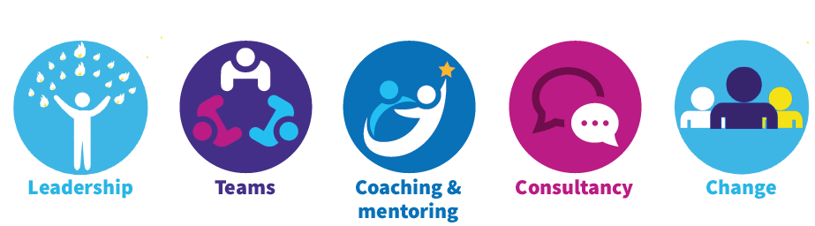
Our Roles and Responsibilities
Defining roles and responsibilities can help you to better understand each other’s role, and learn who is responsible for what.
Defining clear responsibilities prevents confusion and promotes better collaboration.
The following exercise should help give you all a clearer picture of each others roles and responsibilities…

Slide 2
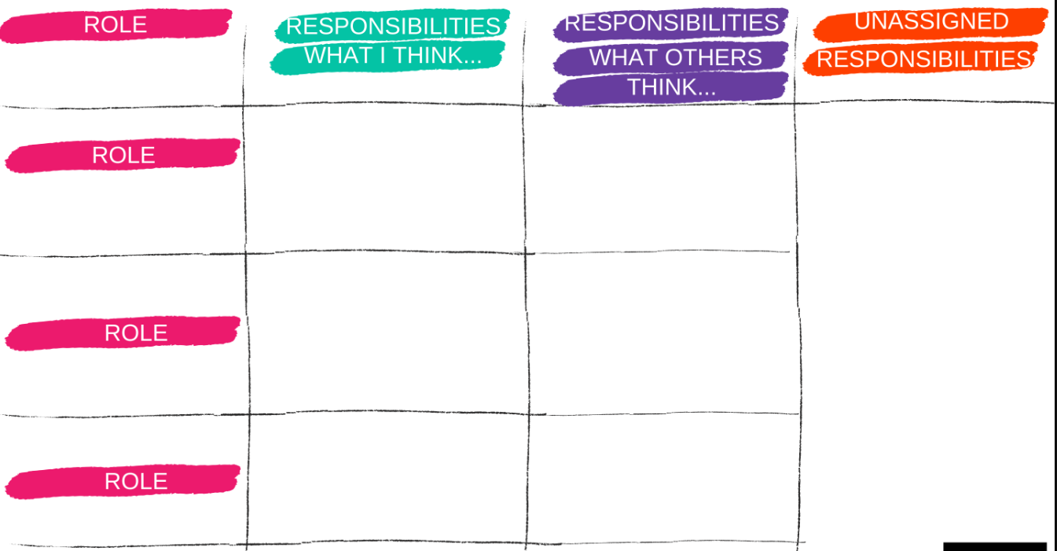
Our Roles and Responsibilities Exercise
I will draw this grid:
Tell me what the different roles are in the team. I will plot them on the grid
If you do the same role, sit next to each other
Clarify your own responsibilities (10 min) - identify the top 3 - 5 things your role is responsible for. Write each responsibility on a sticky note, then rank them in order of priority.

Slide 3
Our Roles and Responsibilities Exercise
The next step is your Team mate's responsibilities (5 min)
For each of the other roles identified, write 1-2 responsibilities you believe are their top priorities.
As you are brainstorming, you may think of responsibilities that don't have a clear owner, write those down and park them for now.

Slide 4
Our Roles and Responsibilities Exercise
The next step is to discuss each role (25 min)
For each role, have the role owner(s) describe what they believe their role is and place their sticky notes in the "what I think" column in priority order. Then go around the room to find out what others think the role is all about, and have them place their sticky notes in the "what others think" column.
Next, the role owner either "accepts" or "politely declines" the responsibilities identified by others. If they decline, they must suggest which role ought to own it.
If we uncover responsibilities with no established owner, let’s put these in the "unassigned responsibilities" section of the grid
Notes:
Where responsibilities overlap, be sure to define who is the primary owner (vs. who is a contributor or a back-up).

Slide 5
Our Roles and Responsibilities Exercise
Lets look at our final grid
Are we in agreement with this?
What are our next steps and actions?
What do we need to do with the unassigned responsibilities?

