Slide 1
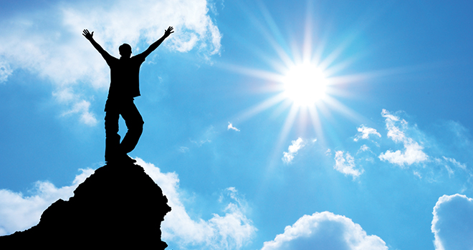
Shared aspirations for the future
Get into small groups.
Working together (mix of different teams), collectively draw/craft/build a shared model capturing your hopes for the future team life of all your teams working collaboratively together…
  Think about connections, the purpose of your team, the rich diversity of skills and strengths you possess, your aspirations for the future
  Spend 15 mins, then we will share our aspirations with the wider group
Notes:
Group to move to shared model building table (without chairs)
3 tables of 4 . - each group explains their models
On centre of the table, place a large base plate. The shared model will be built on this.
Invite participants to build a shared model using the individual models as the source of ideas and bricks or a complete reset if they prefer
Ask there to be one conversation or people will lose the meaning of the part they are not involved in.

Slide 2
Let’s share...
Share your aspirations with the wider group:
There are no wrong answers!
Only share what you want to
Ask questions of the other groups, not the person directly
Don’t give your interpretation of others’ work
Notes:
15 mins total feedback -
Each group to share/describe their models.
Katharine to write down key words to take away

