Slide 1

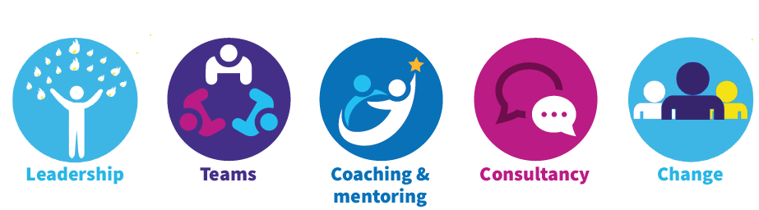
Looking Back…
Looking back - what went well?
What are we proud of having achieved over the past 12-18 months?
What are we really good at? What are our strengths?
What is working well?

Slide 2

Looking Back – Even Better…
Looking back – even better if…
What things have gone less well over the past 12 months?
What things frustrate us and get in the way of progress?
What do we want to improve over the next 12-18 months?

Slide 3
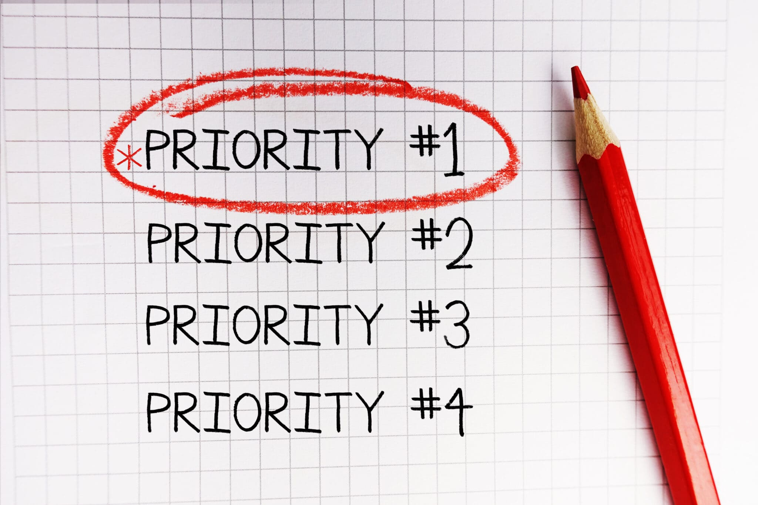
Looking forward – creating our future…
What opportunities do we have to improve and develop our future?
How do we look after each other?
What are our key priorities in the next 12 months?

