Slide 1
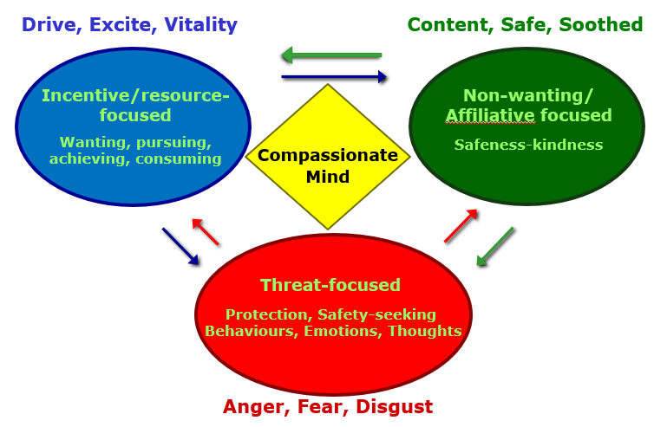
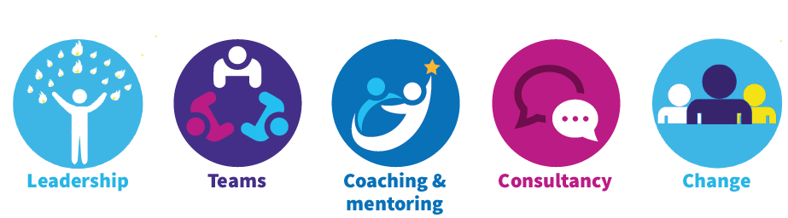
Three Emotional Systems Model (Three Circles)
Notes:
In order for us to navigate the different activities that we as humans engage in we have systems in our brain that make us interested and excited about achieving particular goals.
We also have systems in our brains that may us wary and warn us when things maybe harmful or things could go wrong.
Research in neuroscience tells us that there are at least 3 different types of emotion regulation system – areas that work together to control and maintain our emotions.
Threat System
Keep us safe, fast acting, better safe than sorry approach, focused – don’t want to be distracted by the lovely view whilst we are running from the Lion. 3 main emotions linked to Threat – Anger, Fear, Disgust – and a number of different behaviors fight, flight, freeze, has particular physiological changes
Better safe than sorry – set up to over estimate threat – we don’t want to miss the threat – fast acting
Over ruling the positive One Negative comment in a sea of positives, which one holds your attention – room full of friendly faces, one scowling
Rumination – things that have happened and worry – things to come/may happen
Can have a conflict of emotions – angry and fearful – at the same time or a time lag. Pulled in different directions
Drive
To survive and reproduce animals have to do more than just avoid danger – food, shelter, mates – need to be motivated to do these things, take pleasure in doing, achieving, acquiring
Linked to dopamine – feel a “buzz” when we achieve something – sometimes it’s a very big buzz – imagine winning the lottery, you might find it difficult to sleep, running through your options.
This is helpful but we can get stuck in this system, constantly seek that buzz, sense of achievement, recognition from others, do more and more
Soothing System
When feeing safe and content, free from threat having achieved what they need to. Linked to the attachment and affiliation system in humans, connection with care giver, sense of warmth – when a child is distressed – threat system is activated – mother soothes to calm it down, thus we learn how to begin to self soothe. If we are in caring contact with others it can help us feel less stressed.
Return to the colleague who has made an error.

Slide 2
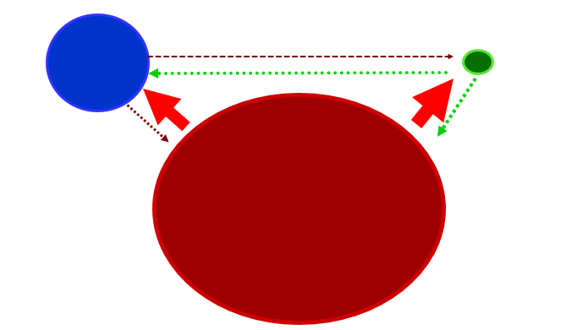
How are the three systems balanced?

Slide 3
Making sense of stress with CFT’s 3 circles Video
Theresa Dahm - Making sense of stress with CFT’s 3 circles
https://www.youtube.com/watch?v=6TTtnw7Zizs

Slide 4
Exercise in Pairs…
Take some time and some paper for this exercise. Thinking about how you feel now and how you have felt generally in the past week or two:
Map out your own three circles, what is in each one? How big are they in relation to ach other?
Is there balance? What needs to change? Where do we start?
Notes:
Give the group some time to do this exercise individually and then talk to each other if that feels ok. Emphasise talking a out the exercise rather than explicitly what is in each circle. Need to be careful not to expose the group too much.

Slide 5
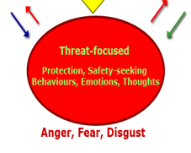
Threat Exercise in Pairs…
How do you process threat?
What happens to you as an individual?
What happens then as a team?
What happens then as a service?
Notes:
Give the group some time to do this exercise individually and then talk to each other if that feels ok. Emphasise talking a out the exercise rather than explicitly what is in each circle. Need to be careful not to expose the group too much.

Slide 6
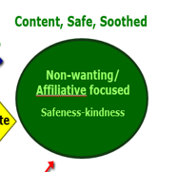
How can we soothe this threat?
In pairs, discuss and think if ideas as to how we can soothe these threats in the team and workplace…
Come and place your ideas up

